Slide 1
PG MANAGEMENT SYSTEM
CHRIST DEEMED TO BE UNIVERSITY
RDBMS PROJECT
PRESENTED BY:
KRISHI AGARWAL 2141119
Aaryaki Pandey 2141143
Riya Mary Cleetus 2141158

Slide 2
PG MANAGEMENT SYSTEM!
TWO QUESTIONS.
WHAT?
WHY?

Slide 3
SO WHAT IS PG MANAGEMENT SYSTEM
THIS IS A WEBSITE THAT AIMS TO GIVE A COMPLETE PACKAGE TO A PG(PAYING GUEST), WHICH WILL LEAD TO THE COMPLETE DIGITALIZATION OF THE PG. BE IT ATTENDANCE OF THE STUDENT TO RENT OF THE ROOM TO ORDERING THE INGREDIENTS REQUIRED IN PG.

Slide 4
WHY PG MANAGEMENT SYSTEM?
A ANSWER TO THE QUESTION, “WHY DO WE USE TECHNOLOGY?” THIS WILL BE A DIRECT ANSWER TO THIS.
Pg management system will ease the work of the owner, manager, warden and, give a sense of security to the parents and help the students to keep track of their activities in pg and their attendance and a handy solution to all their grievances as complaining will be possible through their cellphones it self.

Slide 5
HOW IS PG MANAGEMENT SYSTEM IS DIFFERENT FROM OTHER WEBSITES?
We barely know any website which has done what we are doing.
We agree there might be some websites for attendance or rent or some of the modules of our website.
BUT TO BRING IT IN, HIGHLIGHT
“WE ARE CLUBBING ALL THE FEATURES OF THOSE
WHICH ARE PRESENT IN THE MARKET AND, ALONG WITH
IT, MANY EXCLUSIVE FEATURES”

Slide 6
MAIN MODULES:

Slide 7
USERS:

Slide 8
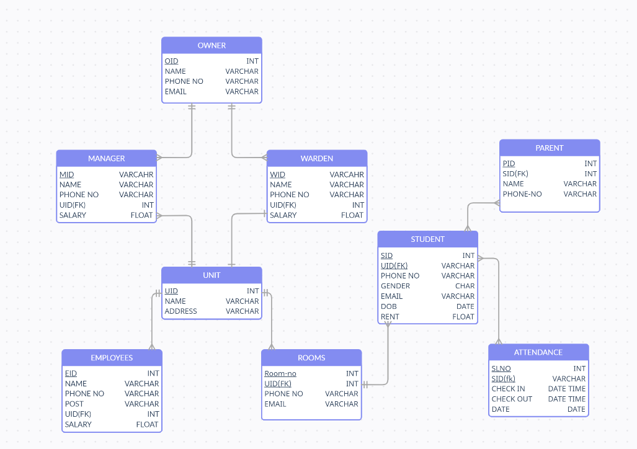
ER DIAGRAM:

