Slide 1

FINOVA - CREDIT RISK SCORING – LOAN DEFAULT/RISK PREDICTION
Final Project Review | Department of Computer Science and Engineering | KLH University
TEAM MEMBERS
2420030209 – Bhanu Prakash
2420030443 – Krishita Myneni
2420030002 – Laasya Priya
Guide: Dr N SUNANDA| Academic Year: 2026–27
Notes:
Title slide. Replace all bracketed text. Use the full project title, list every team member with registration number, and name your guide. Insert the institution logo in the dashed box.

Slide 2

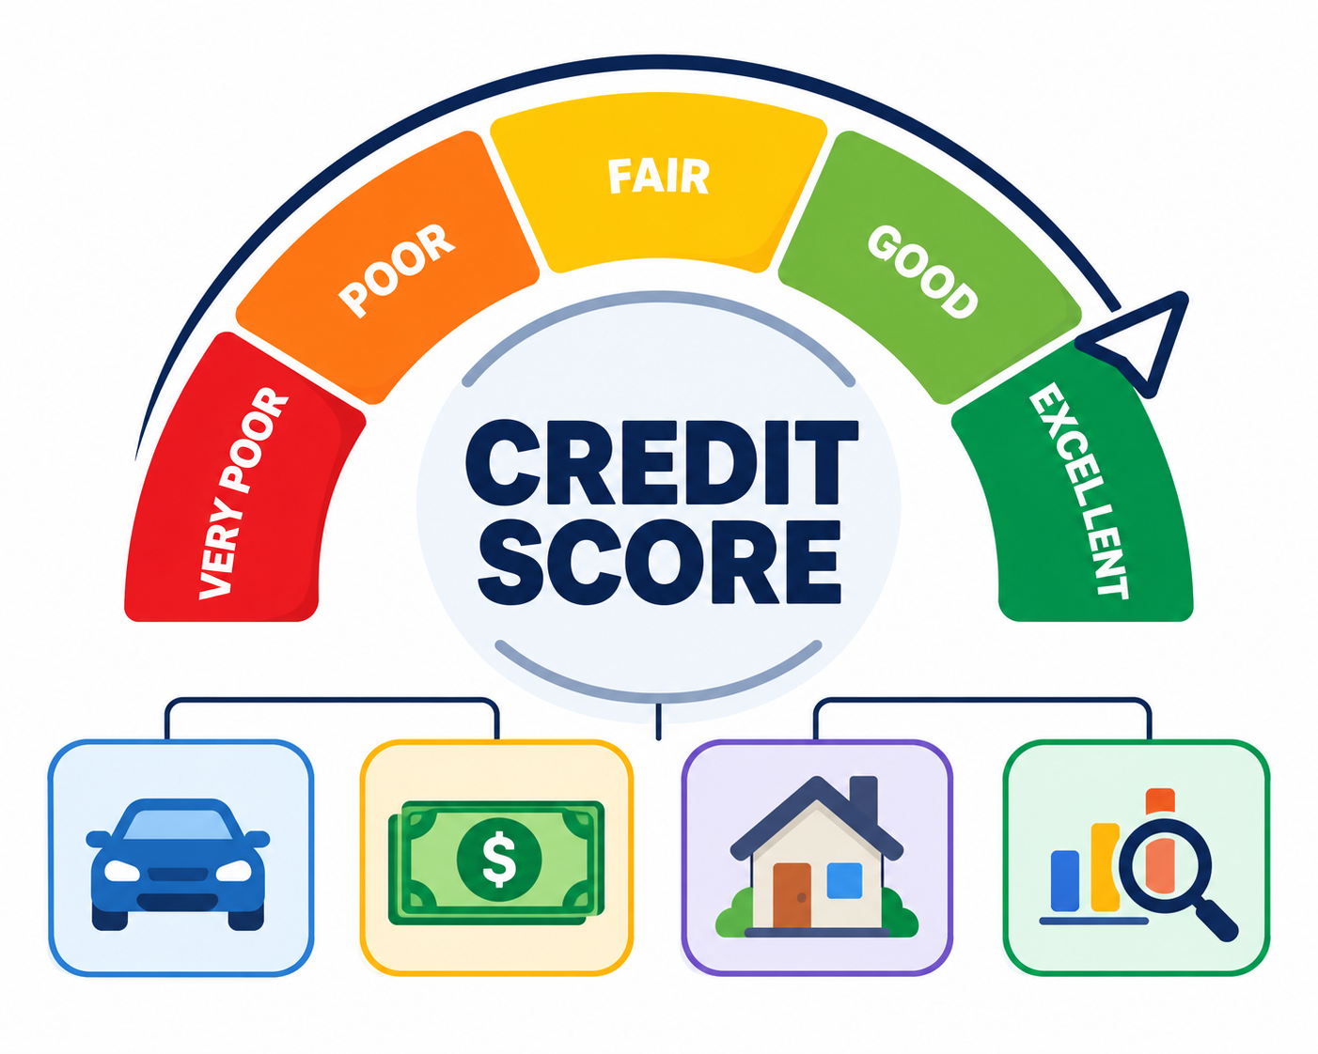


Introduction & Problem Statement
Background
Credit risk scoring helps lenders estimate the likelihood of loan default. Machine learning uses borrower finances and credit history to support consistent, data-driven assessment.
Problem Statement
Manual evaluation and noisy loan records make risk assessment slow and inconsistent. We develop a leak-free ML pipeline that predicts default probability and classifies borrower risk.
Motivation / Need
Lenders need faster, transparent decisions; applicants benefit from consistent assessments. The system combines calibrated predictions, explainable risk factors and a web dashboard.
Notes:
State the domain, the exact problem and why it matters. Keep it to about 2 minutes. Add one real-world statistic if you can, with a citation.

Slide 3


Objectives & Scope
Objectives
1
To Clean and standardize loan records, remove leakage and improve data quality.
2
To Train and compare six ML approaches using chronological validation.
3
To Predict calibrated default probability and assign low, medium or high risk.
4
To Build an interactive underwriting dashboard with explainable risk insights.
Notes:
Objectives should be measurable and start with action verbs. The scope slide tells the panel what you did and did not attempt.

Slide 4
Literature Survey
S.No | Author(s) & Year | Method / Technique | Key Findings | Limitation / Gap
1 | Altman (1968) | Financial Ratios, Discriminant Analysis | Introduced financial ratio-based bankruptcy prediction. | Assumes largely linear relationships.
2 | Altman & Saunders (1997) | Credit Risk Measurement | Reviewed developments in credit risk assessment. | Limited coverage of modern ML.
3 | Hand & Henley (1997) | Statistical Classification | Reviewed traditional consumer credit scoring methods. | Limited nonlinear modeling.
4 | Provost & Fawcett (1997) | ROC Analysis, Classifier Evaluation | Analyzed classifier performance under uncertain class distributions. | Does not directly address credit scoring.
5 | Thomas, Edelman & Crook (2002) | Credit Scoring Models | Explained credit scoring techniques and applications. | Primarily traditional approaches.
6 | Schreiner (2002) | Microfinance Credit Scoring | Examined the usefulness of credit scoring in microfinance. | Focused on microfinance institutions.
7 | Huang et al. (2003) | Naive Bayes, Decision Trees, SVM | Compared classification models using AUC and accuracy. | Not specific to credit risk.
8 | Niculescu-Mizil & Caruana (2005) | Probability Calibration | Studied reliable probability prediction using supervised learning. | Not credit-risk-specific.
9 | Basel Committee (2006) | Basel II Risk Framework | Established regulatory standards for credit risk and capital adequacy. | Regulatory framework, not a predictive ML model.
Notes:
Summarise four to six relevant papers or existing systems. End with the research gap, because that gap justifies your project.

Slide 5





Proposed System & Methodology
STEP 1
STEP 2
STEP 3
STEP 4
STEP 5
Define Problem
Ingest Loan Data
Prepare & Engineer
Train & Deploy
Validate & Explain
Predict default likelihood and support transparent lending decisions.
Use 100,000 Lending Club loan records with borrower and repayment details.
Clean records, remove leakage and engineer financial indicators.
Compare six models; integrate XGBoost with a FastAPI web console.
Measure ROC-AUC, KS, recall, calibration and risk-driver explanations.
Key Novelty / Contribution
Leakage-free chronological validation, calibrated risk scores and an auditable web underwriting console in one workflow.
Notes:
Walk through the five steps left to right. Rename the steps to match your project (for example, Requirement Analysis, Design, Coding, Testing, Deployment). End with your novelty.

Slide 6
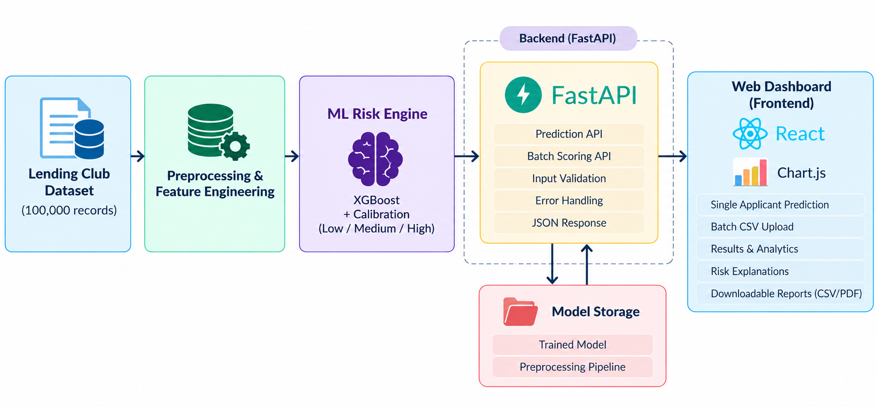
System Architecture
Components
1
Data Ingestion
Lending Club records, financial inputs
2
Data Engineering
Clean, standardize and engineer features
3
ML Risk Engine
XGBoost, calibration and risk tiers
4
Web Console
Scores, analytics and explanations
Notes:
Insert a clear block diagram: input, processing, storage, output. Number each block and explain them on the right. Redraw the figure yourself rather than copying it.

Slide 7


Hardware & Software Requirements
Hardware
Software & Tools
Libraries / Frameworks
Windows 11 development laptop
Multi-core processor and RAM
Local SSD for data and model files
Internet for datasets and packages
Windows 11
Python 3.x
VS Code / terminal
Git and GitHub
pandas, NumPy, scikit-learn
XGBoost, LightGBM, CatBoost
FastAPI, Chart.js
Matplotlib / model artifacts
Deployment / Platform: Local Python pipeline and FastAPI web-based underwriting console.
Notes:
List only what you actually used, with versions. For a pure software project, shorten the hardware list and add cloud or deployment resources.

Slide 8
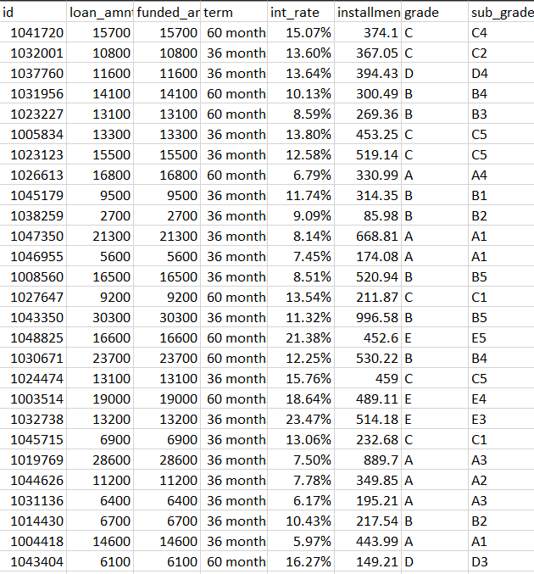
Dataset / Data Understanding
1,00,000
87,334
Raw loan records
Clean resolved loans
50,401
2
Values imputed
Target classes
Source: Lending Club historical loan portfolio (100,000 records).
Features: income, loan amount, interest rate, DTI, credit history and loan grade.
Quality: 558 duplicates removed; 40 leakage fields dropped; missing values imputed.
Notes:
Explain where the data came from and what it contains. Show a screenshot of the first rows or the info summary. For non-data projects, replace this slide with “Requirement Analysis” or “Input Specification”.

Slide 9
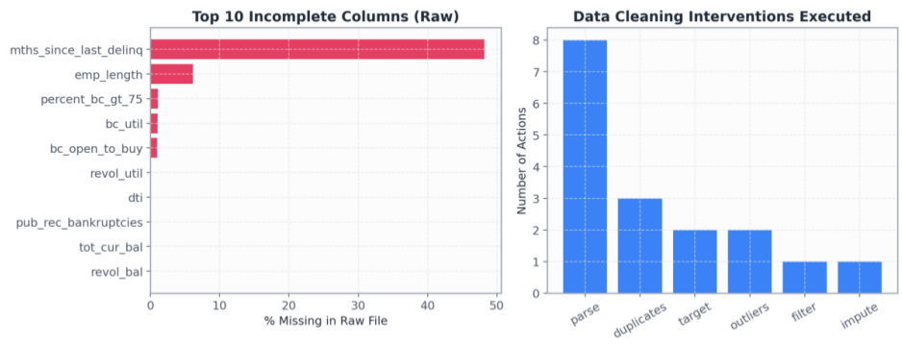
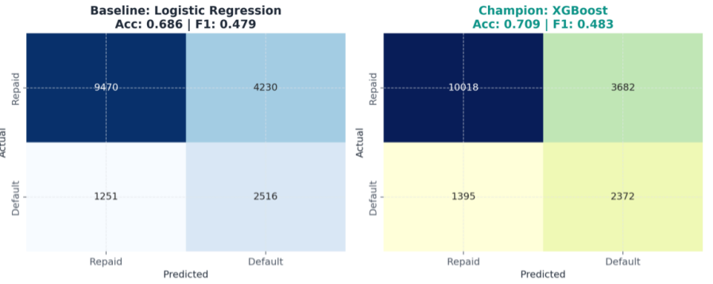



Data Preprocessing & Exploratory Analysis
Cleaning
Transformation
Feature Selection
Median imputation (50,401 values); remove 558 duplicates; clip extreme values at 0.5th/99.5th percentiles.
Parse percentage and term fields; encode categorical variables; standardize borrower attributes.
Drop 40 post-origination leakage columns; engineer DTI, installment-to-income and credit signals.
Notes:
Show two or three plots that tell a story: distributions, correlations, outliers. Explain what each plot told you and what you did about it.

Slide 10
Module-wise Description
1
Data Engineering
2
Feature Engineering
Purpose: Clean and validate loan records.
Input → Output: Raw loans → 87,334 usable loans.
Developed by: Project team.
Purpose: Build predictive borrower signals.
Input → Output: Clean records → model features.
Developed by: Project team.
3
Model Training
4
Underwriting Dashboard
Purpose: Benchmark and select models.
Input → Output: Features → calibrated XGBoost.
Developed by: Project team.
Purpose: Score and explain applicants.
Input → Output: Borrower inputs → risk decision.
Developed by: Project team.
Notes:
Divide the project into three to five modules. For each, state its purpose, inputs, outputs and who built it. Duplicate a card if you have more modules.

Slide 11

Algorithms & Technologies Used
Logistic Regression
Random Forest
XGBoost
Why chosen
Interpretable linear baseline for credit risk.
Key settings
Classification baseline and calibrated comparison.
Why chosen
Nonlinear ensemble handling feature interactions.
Key settings
Tree-based classification benchmark.
Why chosen
Strong discrimination on tabular loan data.
Key settings
Boosted trees; isotonic probability calibration.
Selection criteria: Chronological out-of-time ROC-AUC, KS, PR-AUC, recall and calibration; XGBoost selected.
Notes:
Name each model, algorithm or technology, say why you chose it, and list the key settings. Then explain how you picked the final one.

Slide 12
Implementation / Model Building
Feature Selection
Code snippet / pseudocode
Borrower finances, interest rate, DTI, credit grade, history and engineered ratios; post-loan leakage excluded.
from sklearn.model_selection import train_test_split
from sklearn.pipeline import Pipeline
from xgboost import XGBClassifier
X_train, X_test, y_train, y_test = train_test_split(
X, y, test_size=0.2, random_state=42
)
pipeline = Pipeline([
("preprocess", preprocessor),
("model", XGBClassifier(random_state=42))
])
pipeline.fit(X_train, y_train)
1. Load and clean Lending Club records
2. Remove leakage and engineer features
3. Split chronologically into train/test
4. Train and benchmark six classifiers
5. Calibrate XGBoost probabilities
6. Score applicants and explain risk
Preprocessing Pipeline
Parse → filter resolved loans → deduplicate → impute → clip outliers → encode → engineer features.
Data Splitting
Chronological out-of-time train/test split, preserving future-loan evaluation (not random shuffle).
Configuration
Six models benchmarked; XGBoost champion; isotonic calibration; risk policy: ≤10% approve, 10–20% review, >20% decline.
Notes:
Describe the build in the order you did it. Paste only the most important code or pseudocode, not entire files. For hardware projects, show the circuit or wiring summary instead.

Slide 13
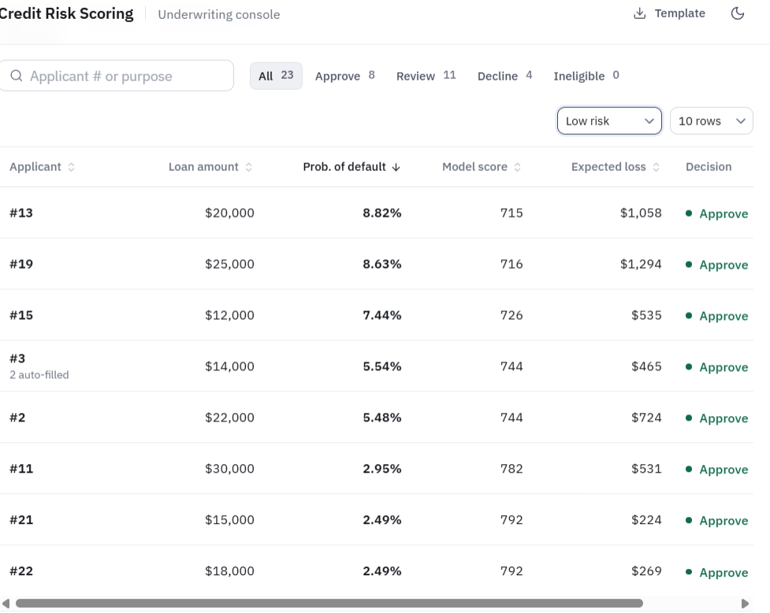
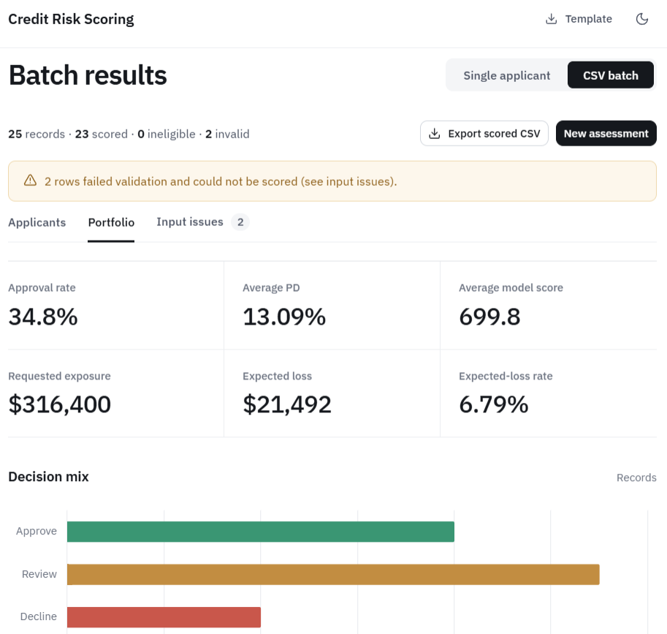
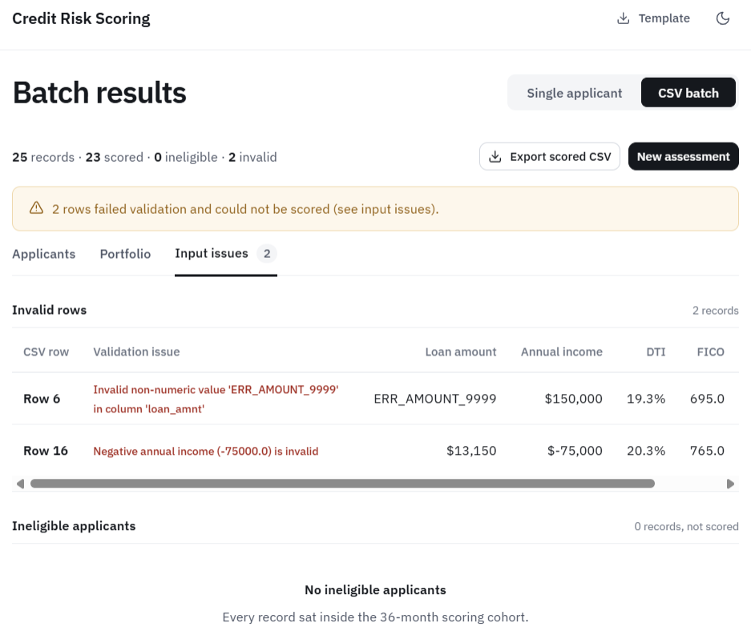
Working Prototype / Output Screens
Batch dashboard showing loan approvals, default risk, expected losses, and decision distribution.
Input validation dashboard highlighting invalid loan records and errors before risk scoring.
Applicant dashboard displaying default probabilities, model scores, expected losses, and loan approval decisions.
Notes:
Show real screenshots, photos of the hardware or a short demo video link. Caption each one with what the viewer should notice.

Slide 14
Results & Performance Comparison
Metric | Champion XGBoost | Model B | Model C
ROC-AUC | 0.7488 | 0.00 | 0.00
Accuracy | 70.93% | 0.00 | 0.00
Defaulter Recall | 65.44% | 0.00 | 0.00
KS Statistic | 0.3640 | 0.00 | 0.00
ROC-AUC | 0.00 | 0.00 | 0.00
Best: XGBoost – ROC-AUC 0.7488
Out-of-time benchmark on Lending Club data; metrics from the project training report.
Notes:
Right-click the chart and choose Edit Data to enter your real numbers. Replace the metrics with the ones that fit your project (accuracy, latency, power, throughput, user rating). State clearly which option performed best.

Slide 15
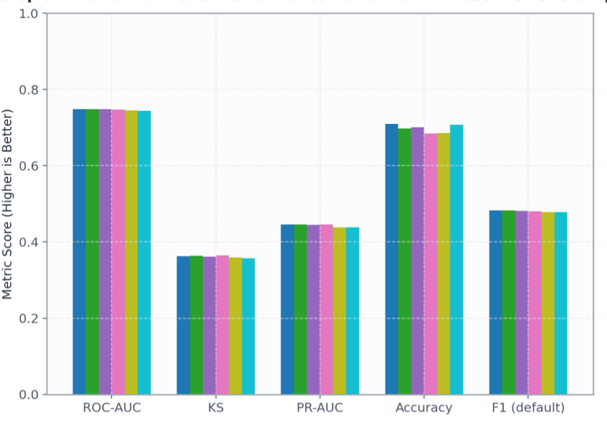
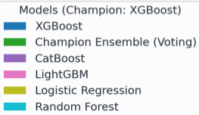
Analysis & Key Findings
0.7488
Best ROC-AUC achieved by XGBoost
Interpretation: The model ranks defaulters above non-defaulters with useful discrimination.
Error analysis: Overlapping risk profiles limit perfect classification.
Key drivers: Interest rate, loan grade, DTI and credit attributes.
Notes:
Explain what the numbers mean. Use a confusion matrix, ROC curve, feature-importance chart or output comparison. Be honest about weak results; panels value that.

Slide 16

Testing & Validation
Test ID | Test Description | Expected Result | Actual Result | Status
TC-01 | Batch CSV scoring | 294 scored, 6 ineligible | 294 scored, 6 ineligible | Pass
TC-02 | Invalid CSV rows | 18 scored , 2 invalid rows | 18 scored , 2 invalid rows | Pass
TC-03 | Single applicant prediction | Correct Approve/Decline decisions | Correct Approve/Decline decisions | Pass
TC-04 | Input and file validation | Reject invalid files | Reject invalid files | Pass
Functional Testing
Validation Method
Performance Testing
Data parsing, missing-value handling, duplicate checks, policy gating, invalid-row quarantine and dashboard scoring workflow.
Chronological out-of-time evaluation; ROC-AUC, KS, PR-AUC, accuracy, recall and isotonic calibration.
Sub-45 ms inference per applicant (reported); 3.2× top-decile lift; stability checks and auditable imputation flags.
Notes:
List representative test cases with expected and actual outcomes. Name the validation methods you used. Delete rows you do not need.

Slide 17


Challenges & Limitations
Challenges Faced
Limitations
Leakage-prone columns → removed 40 post-loan fields.
Incomplete and noisy data → imputation, clipping and deduplication.
Risk probability reliability → isotonic calibration.
Historical Lending Club data may not reflect every lending population.
Model predictions are probabilistic, not guarantees.
Real-world lending requires monitoring, fairness review and governance.
Notes:
Be candid. Pair every challenge with how you solved it, and list limitations that the panel would otherwise spot themselves.

Slide 18

Conclusion
Built an end-to-end credit risk pipeline using 100,000 historical Lending Club loan records and a web underwriting console.
1
Final Outcome
XGBoost achieved 0.7488 ROC-AUC, 70.93% accuracy, 65.44% defaulter recall and 3.2× top-decile lift.
70.93%
2
Classification accuracy
Objectives achieved: 4 of 4
The solution combines cleaning, prediction, risk categorization and explainability to support informed lending decisions.
3
Notes:
Revisit each objective and say whether you met it. Quote your headline result with numbers. Do not introduce new material here.

Slide 19



Future Scope & Applications
Improve Performance
Tune thresholds and evaluate more robust models on fresh data.
Applications
Bank credit underwriting
Loan portfolio risk monitoring
Fintech lending decision support
Credit analysts and risk managers
Expand Data / Features
Add newer borrower cohorts and richer verified credit attributes.
Deploy & Enhance Interface
Extend the existing FastAPI dashboard with monitoring and access control.
Scale & Secure
Add drift alerts, fairness checks, secure audit logs and scalable hosting.
Notes:
Give concrete next steps, ideally tied to the limitations. Then name two or three real-world uses.

Slide 20
Team Contribution
Member | Registration No. | Contribution
Bhanu Prakash | 2420030209 | Backend API development, risk prediction integration, and frontend dashboard
Krishita Myneni | 2420030443 | Model training, hyperparameter tuning, and performance evaluation
Laasya Priya | 2420030002 | Data preprocessing, feature engineering, and data quality validation
Notes:
Show that work was planned and shared. Every member should be able to explain their own module.

Slide 21

References
[1] Chang, V., Xu, Q. A., Akinloye, S. H., Benson, V., & Hall, K. (2024). Prediction of bank credit worthiness through credit risk analysis: An explainable machine learning study. Annals of Operations Research. https://doi.org/10.1007/s10479-024-06134-x
[2] Nguyen, N., & Ngo, D. (2025). Comparative analysis of boosting algorithms for predicting personal default. Cogent Economics & Finance, 13(1), Article 2465971. https://doi.org/10.1080/23322039.2025.2465971
[3] Kang, Z. Z., Teh, S. Y., Tan, S. Y. G., & Ng, W. C. (2025). Loan default prediction using machine learning algorithms. Journal of Informatics and Web Engineering, 4(3), 232–244. https://doi.org/10.33093/jiwe.2025.4.3.14
[4] Xie, S., & Shingadia, T. (2025). Explainable machine learning framework for predicting auto loan defaults. Risks, 13(9), Article 172. https://doi.org/10.3390/risks13090172
Project Links
GitHub: Project repository :https://github.com/KrishitaMyneni/KLH-CSE-2026-27-TEAM-7-Finova-loan-risk-prediction
Dataset: Lending Club historical loans
Demo : https://credit-risk-scoring-i1im.onrender.com/
Notes:
Use IEEE style, numbered in order of first citation in the deck. Include datasets, documentation and code repositories.

Slide 22
THANK YOU
Questions & Discussion
Team 7 – Data Science
Department of Computer Science and Engineering
KLH University
Guide: Dr N SUNANDA
Notes:
Leave this slide up during questions. Make sure every team member can answer questions about their own module.

