Slide 1

Orion: AI Assisted Microservices-Based Online Recruitment Portal
25 August 2026
 | Under the Guidance of Venkateshwari Ketineni Assistant Professor, Department of Computer Science and Engineering, KLH CSE Bowrampet Campus
Team Members Bhanu Prakash - 2420030209 Krishita - 2420030443 Laasya Priya - 2420030002

Slide 2
Outline of Project Work
Focus
Introduction
Literature Survey
Problem Statement
Research Objectives
Research Gap
Innovation, Creativity, and Novelty
Feasibility and Project Plan

Slide 3

PROBLEM STATEMENT
Increasing Job Opportunities
The growing number of jobs and internships makes it difficult for candidates to identify the opportunities that best match their skills and experience.
Keyword-Based Recruitment
Traditional platforms mainly depend on keyword-based search, which may miss relevant matches when candidates and recruiters use different terms for similar skills.
Manual Recruiter Screening
Recruiters have to manually review a large number of applications, making the screening process time-consuming and inefficient.
How can AI make recruitment more relevant, efficient, and understandable for both candidates and recruiters?
Lack of Transparency
Candidates often have limited information about why they are suitable for a job and which skills they are lacking.

Slide 4
OBJECTIVES
AI-Based Matching & Recommendations To develop an AI-assisted system to match candidates with relevant jobs and internships and provide personalized recommendations.
Skill-Gap Analysis & Explainability To identify missing skills and provide understandable explanations for candidate–job matching results.
Automated Recruiter Screening To rank applicants based on relevance and assist recruiters in efficiently screening candidates.
To do
Scalable Recruitment Platform
To implement an end-to-end recruitment platform using microservices, with application tracking and notifications.

Slide 5
Literature Survey
Study | Year / Main Focus | Methodology | Inferences | Limitation / Future Work
LinkedIn Talent Search & Recommendation | 2018 Candidate retrieval, ranking & recommendation | Candidate retrieval, ranking and recommendation mechanisms. | Retrieves and ranks relevant candidates for job openings and supports recommendations. | No explicit skill-gap analysis.
Jobindex Human-in-the-Loop Recommendation | 2026 AI-based candidate recommendation with recruiter involvement and feedback | AI-based candidate recommendation using recruiter feedback and human-in-the-loop interaction to improve candidate ranking and screening. | Demonstrates that AI-based candidate recommendation can improve recruitment relevance and screening efficiency, while recruiter feedback can help refine the recommendation process. | Does not provide a complete combination of skill-gap analysis and explainable recruitment
Indeed Job Recommender | 2019 Offline evaluation & online recommendation | Offline evaluation combined with online recommendation. | Supports personalized job recommendations based on candidate/job relevance. | Focuses on job recommendation, not candidate matching.

Slide 6
Problem Gap Identification
01
Systems retrieve and rank relevant candidates for job openings.
Candidate Search
& Ranking
02
AI/ML is used to recommend suitable jobs or candidates.
Job & Candidate Recommendations
03
Recruiter interactions and human feedback are used to improve recommendations and screening.
Recruiter Feedback & Screening
04
Existing systems focus on individual recruitment functions rather than an integrated end-to-end workflow.
Limited End-to-End Support

Slide 7
INNOVATION & NOVELTY
01
Semantic AI Matching
Matches candidates and opportunities based on relevance rather than relying only on exact keywords.
02
Skill-Gap Analysis
Identifies skills required by a job that are missing from the candidate profile.
03
Explainable Recruitment
Helps candidates and recruiters understand matching results.
04
Automated Applicant Ranking
Prioritizes relevant candidates to reduce recruiter screening effort.
05
Integrated Microservices
Combines recruitment and AI functions into independently deployable services.

Slide 8
FEASIBILITY STUDY
Technical Feasibility
Operational Feasibility
Scalability Feasibility
Economic Feasibility
Microservices and REST APIs support modular development.
AI functions can be implemented as independent services.
Simplifies job discovery for candidates.
Reduces manual screening effort for recruiters.
Individual services can be independently scaled.
New AI features can be added without redesigning the entire system.
Can be developed using commonly available development tools and frameworks.
Modular design avoids unnecessary resource usage.
PROJECT TIMELINE
01
02
03
04
05
06
Research & Planning
Literature Survey
Requirement Analysis
System Design
Architecture Design
Database Design
Core Development
Authentication
Profiles & Resumes
Jobs & Internships
AI Development
Matching
Recommendations
Skill-Gap Analysis
Explainability
Recruitment Workflow
Applicant Ranking
Screening
Application Tracking
Notifications
Integration & Testing
Service Integration
Testing
Deployment
Documentation

Slide 9
DATASET & FEATURES USED
SOA Dataset (JTH) • https://github.com/Aunsiels/JTH
MATCHING / OUTCOME INFORMATION
AI SKILL-GAP COMPONENT
• Candidate ID
• Job ID
• Application status
• Match score / relevance score
• Whether candidate was shortlisted
• Whether candidate was hired
• Relevance label (0/1, Low/Medium/High)
• Candidate skills / profile
• Job required skills
• Job preferred skills
• Candidate experience / projects
• Skill gap / missing skills, if available
• Hiring outcome / suitability label
Candidate
Job Requirements
Matching
Skill Gap
Outcome
Supports semantic matching, applicant ranking, recommendations, and explainable skill-gap analysis.

Slide 10
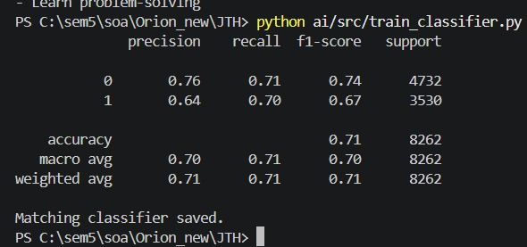
IMPLEMENTATION PROGRESS — AI MODEL
SEMANTIC MATCHING MODEL
• Embedding: BAAI/bge-small-en-v1.5
• Embedding size: 384
• Hardware: NVIDIA RTX 4050 6GB
• CUDA enabled
• Candidate embeddings: 37,554 × 384
• Job embeddings: 6,011 × 384
MATCHING CLASSIFIER
• Logistic Regression
• Training pairs: 41,308
• Positive: 17,649 | Negative: 23,659
• Test samples: 8,262
• Accuracy: 71% | F1-score: 0.70
EXAMPLE MATCH
74.39%
JTH → Preprocessing → BGE Embeddings → Logistic Regression → Match Score

Slide 11
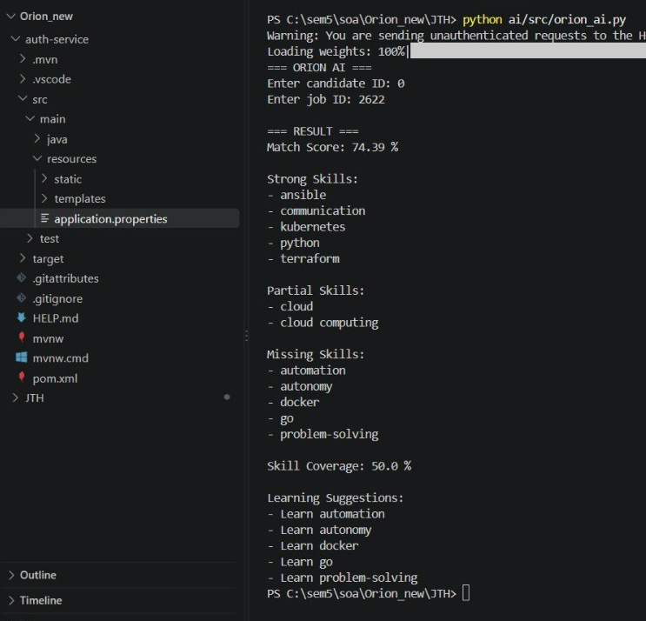
MODEL OUTPUT
Input
Candidate ID: 0
Job ID: 2622
Matching Result
Match Score: 74.39%
Skill Coverage: 50%
Skill Analysis
Strong: Ansible, Communication, Kubernetes, Python, Terraform
Partial: Cloud, Cloud Computing
Missing: Automation, Autonomy, Docker, Go, Problem-Solving
Personalized Recommendations
Identifies skills that need improvement
Generates learning suggestions for missing skills
🔄 Overall Flow
Candidate + Job → Match Score → Skill Analysis → Skill Gap → Learning Suggestions

Slide 12
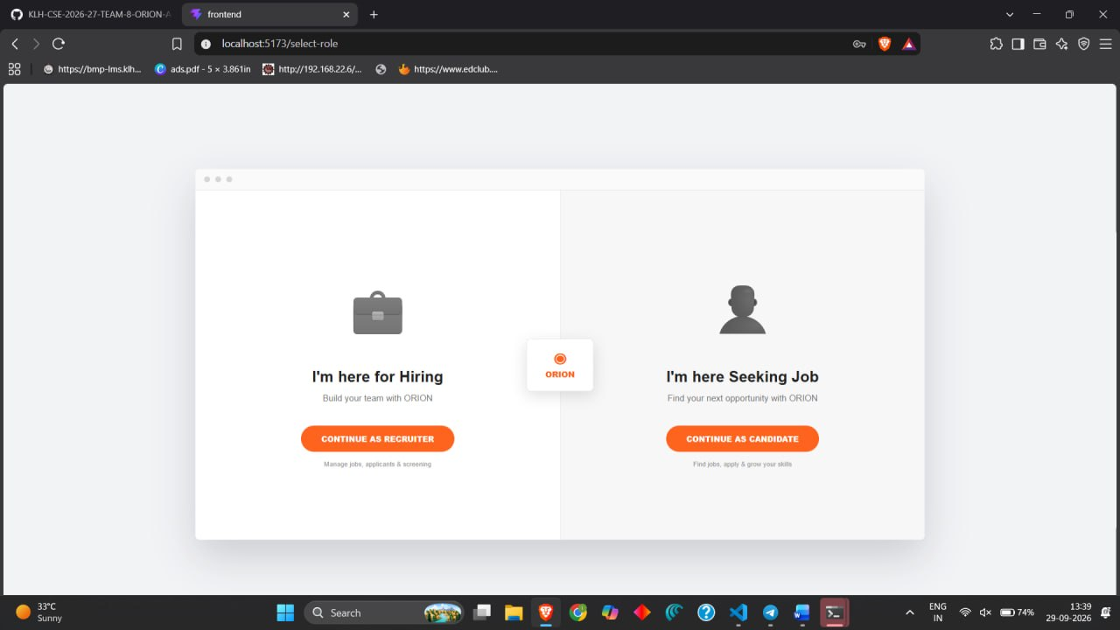
FRONTEND IMPLEMENTATION

Slide 13
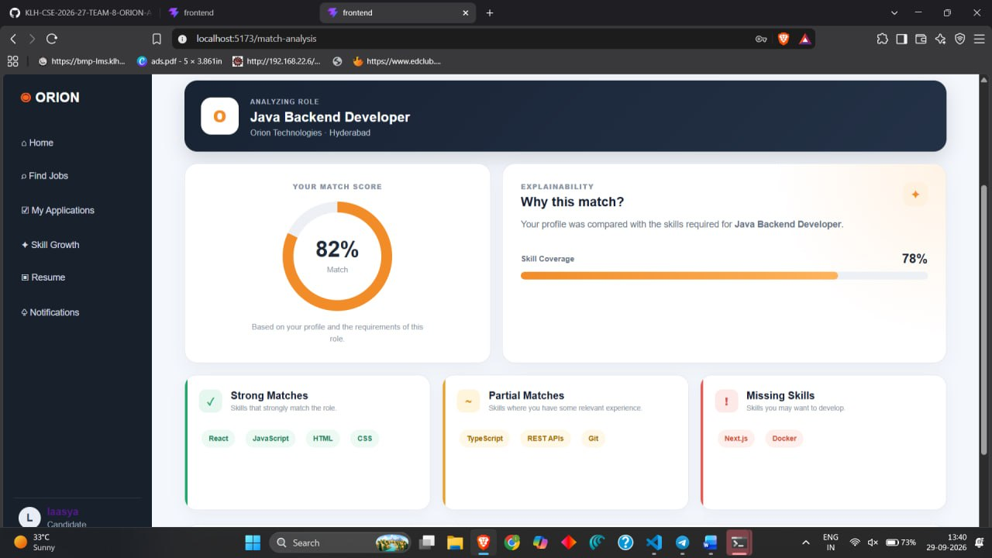
FRONTEND IMPLEMENTATION

Slide 14
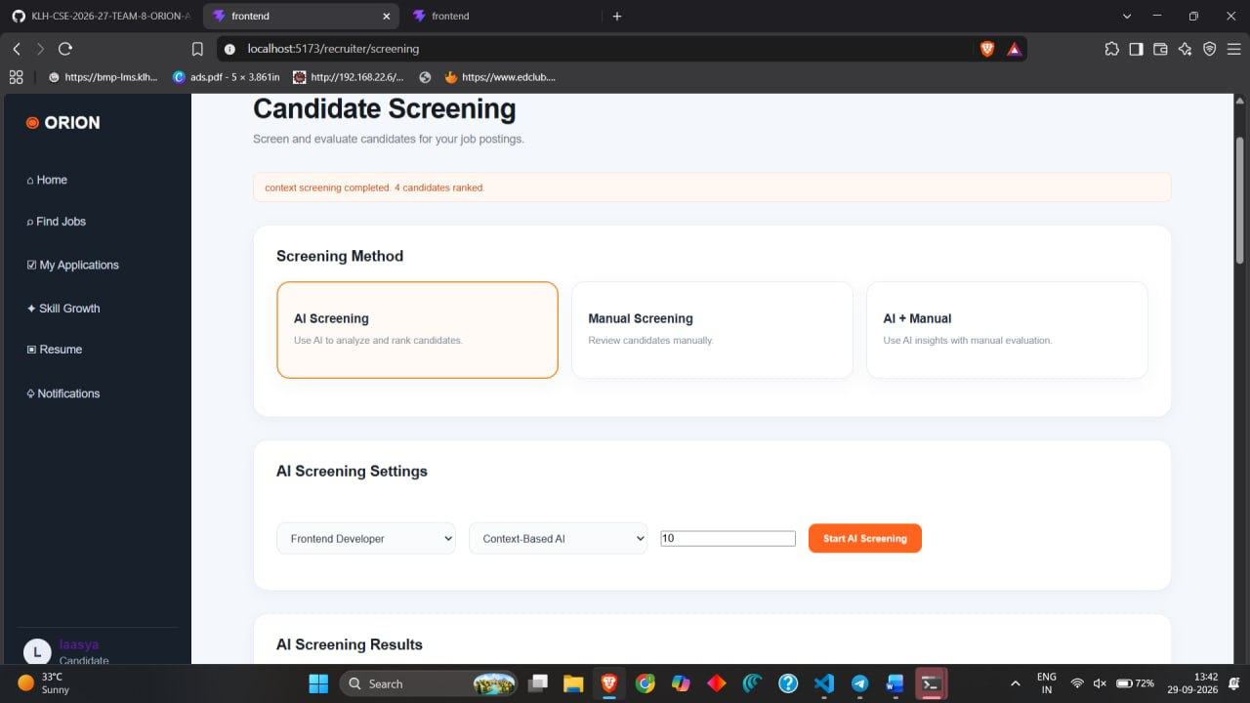
FRONTEND IMPLEMENTATION

Slide 15
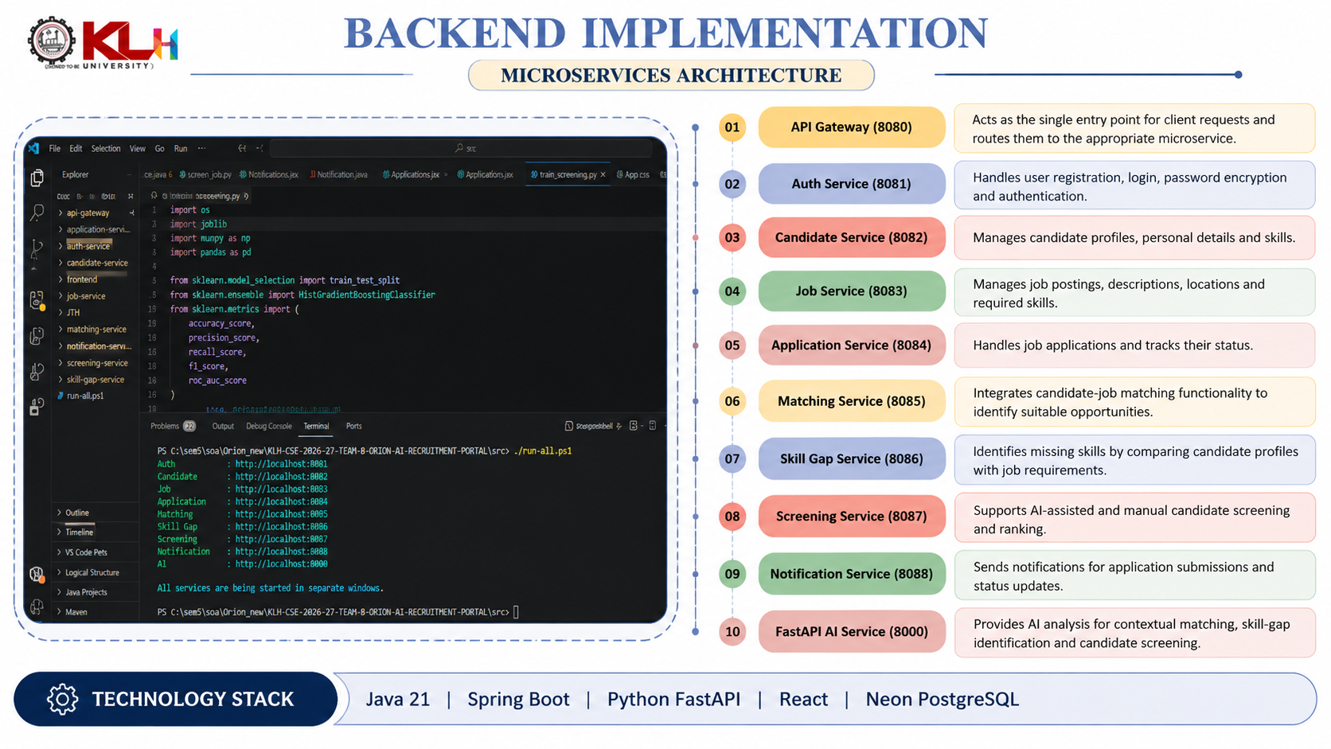
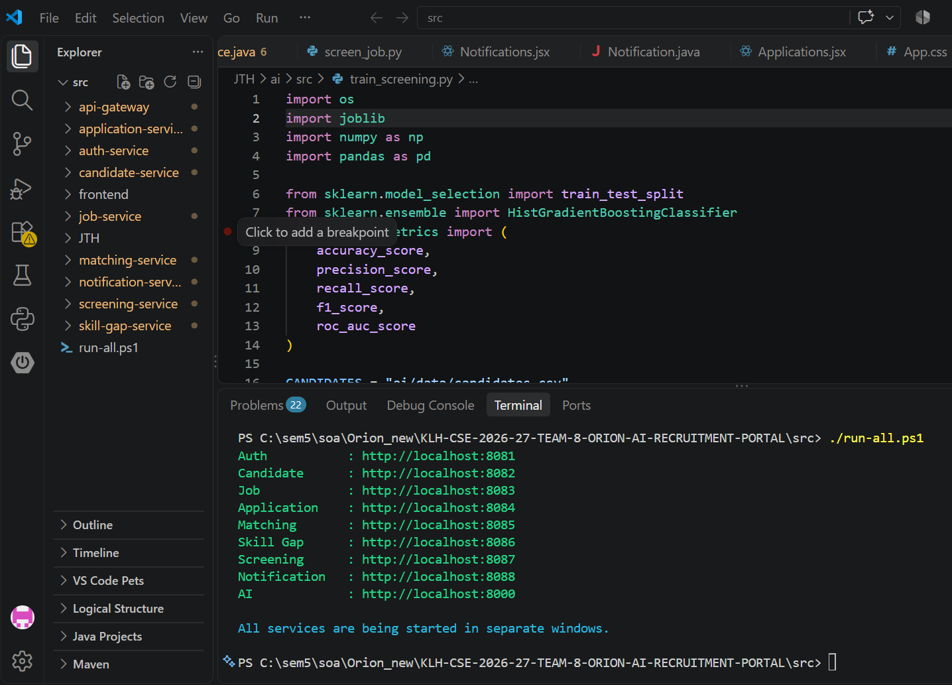
BACKEND IMPLEMENTATION

Slide 16
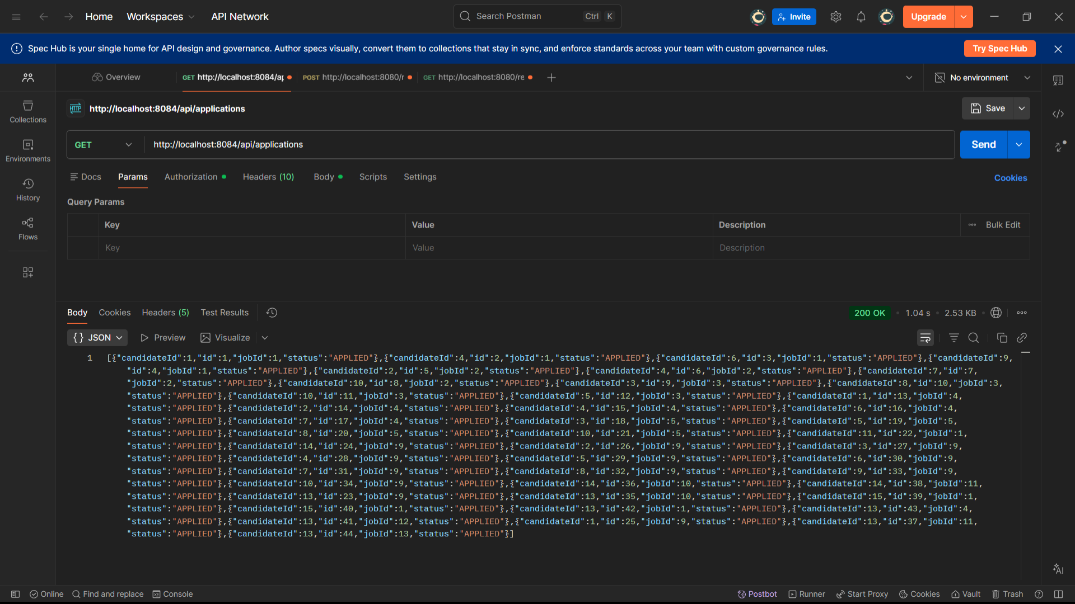

BACKEND IMPLEMENTATION
Candidate and Application APIs
Postman was used to test the Candidate and Application REST APIs. The Application Service retrieves application records, while the Candidate Service returns candidate profile information, including personal details and skills. Successful HTTP responses confirm that the tested endpoints can retrieve data from the backend.

Slide 17
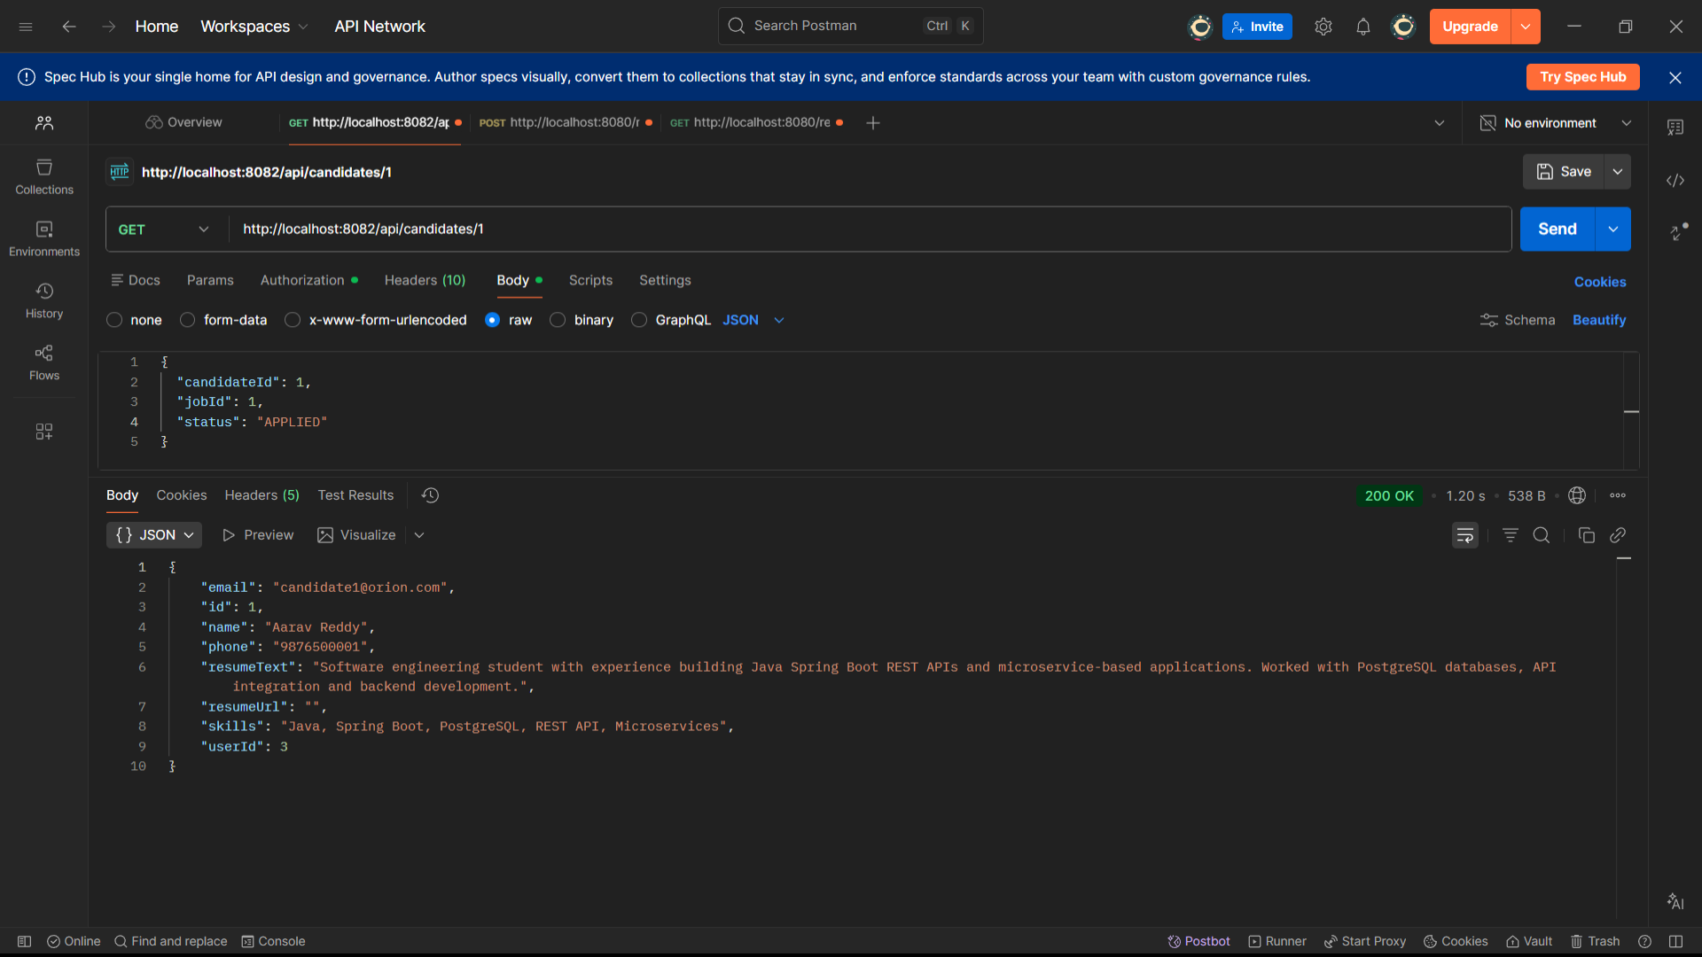
BACKEND IMPLEMENTATION
Candidate Service
The Candidate Service API was tested using Postman by sending a GET request to retrieve a candidate profile using their ID. The API returned a successful 200 OK response containing the candidate’s details, including name, email, phone number, and skills, demonstrating successful retrieval of candidate data from the backend.

Slide 18
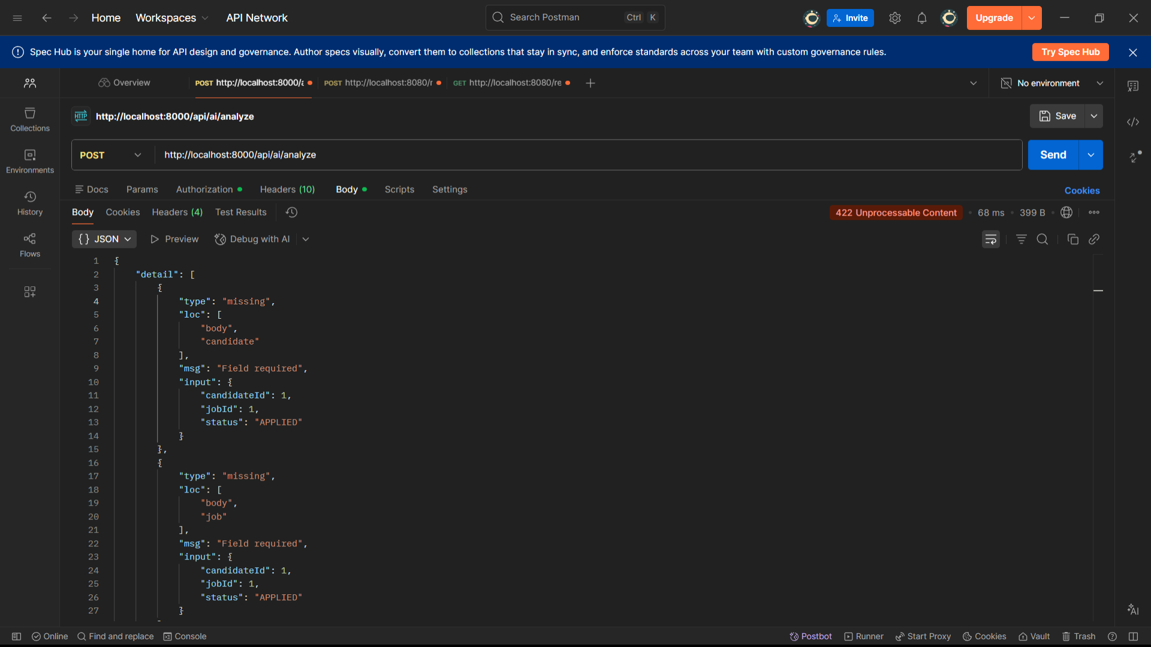
BACKEND IMPLEMENTATION
AI Service
The FastAPI AI endpoint was tested using Postman by sending a POST request to /api/ai/analyze. The request returned a 422 Unprocessable Content response because the required candidate and job objects were missing from the request body. This highlights the importance of providing input data in the expected JSON format for AI-based candidate–job analysis.

Slide 19
THANK YOU

