Slide 1
Events Finder -Application
A Web Application Built with Angular

Slide 2
Features
User Authentication
Event Listing & Filtering
Adding New Events
Viewing Event Details (Restricted Access)

Slide 3
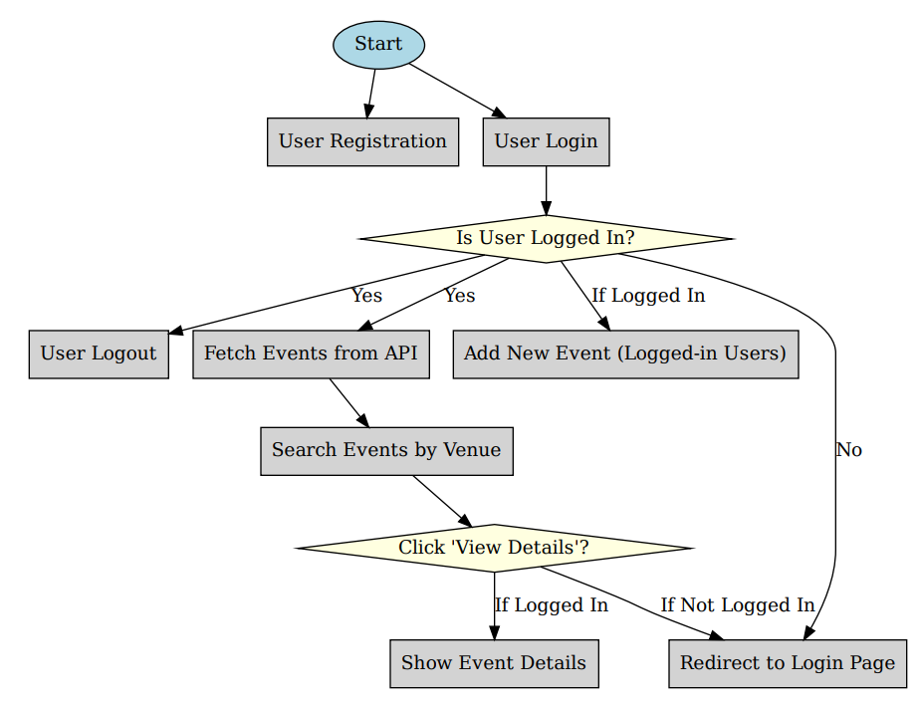
Workflow

Slide 4
User Authentication
Login & Logout
Uses Angular Services & Local Storage
Conditional Rendering in Navbar
Protecting Routes with Guards

Slide 5
Event Listing & Filtering
Fetching events via HTTP Requests (EventService)
Using Pipes for Filtering by Venue
Displaying events with *ngFor in Components

Slide 6
Adding New Events
Implemented using Angular Reactive Forms
Uses Form Validation & Binding
Stores new events in API (Local JSON Storage)

Slide 7
Viewing Event Details (Restricted Access)
Button works only if logged in
Uses Angular Route Guards
Redirects to Login Page if not authenticated

Slide 8
Conclusion
This project demonstrates the use of Angular concepts including:
Components & Routing
Services & Dependency Injection
Forms & Validation
Local Storage & Route Guards
Pipes & Filtering

