Slide 1
Deepfake Detection
ResNet-50 + Threshold Calibration on FaceForensics++
Hybrid ResNet-50 + BiLSTM · FaceForensics++

Slide 2
Problem statement
• Deepfakes are AI-generated face manipulations that are increasingly indistinguishable from real video.
• Manual detection is unreliable; automated, frame-accurate detection is needed for moderation, journalism, and forensics.
• Goal: classify a short uploaded video as REAL or FAKE with calibrated confidence.
• Constraint: this implementation runs on a low-end laptop CPU (Intel i5-7200U, 8 GB RAM, no GPU).

Slide 3
Dataset — FaceForensics++ subset
Split | Real | Fake | Total
train | 140 | 560 | 700
val | 30 | 120 | 150
test | 30 | 120 | 150
TOTAL | 200 | 800 | 1 000

Slide 4
Data preprocessing
• Per video: extract 32 evenly-spaced frames using OpenCV (cv2.CAP_PROP_POS_FRAMES seek).
• Per frame: detect the most prominent face with facenet-pytorch MTCNN (margin 20 px).
• Crop and resize to 224 × 224, save as JPEG. ImageNet mean/std normalisation at load time.
• Split CSVs (train/val/test) generated by src/preprocessing/create_splits.py with stratified ratios.
Output: 32 000 face crops at 224×224 (~1 GB on disk).

Slide 5
Inference pipeline
Upload
.mp4 / .avi / .mov
Extract Frames
(OpenCV, 32 evenly-spaced)
MTCNN Face Detect
(224×224 + 20-px margin)
ResNet-50 CNN
(per-frame fake prob)
Mean Pool + Threshold
(0.75)
Output: REAL / FAKE label + confidence (0–100 %) + per-frame diagnostics

Slide 6
Iteration 1 — frozen ImageNet features
• Cached frozen ImageNet ResNet-50 features per video (no GPU required).
• Trained BiLSTM head on cached tensors with WeightedRandomSampler.
• Result: test ROC-AUC = 0.44 — the head learned features that anti-correlate with truth on test.
• Even logistic regression on mean-pooled features hit only ROC-AUC 0.51 — the features themselves were the problem.
• Diagnosis: ImageNet features capture object semantics, not deepfake-specific artefacts.
Failure was informative — it isolated the feature representation as the binding constraint.

Slide 7
Iteration 3 — fine-tuned CNN as backbone (deployed)
• Replaced the frozen ImageNet backbone with the trained CNN baseline (its layer4 was fine-tuned on this dataset).
• Re-cached features → fed cached tensors to a small BiLSTM head (hidden=128, 1 layer, dropout 0.5).
• Same training pipeline (WeightedRandomSampler, macro-F1 early stop) — only the features changed.
• Result: test ROC-AUC jumped 0.44 → 0.87, accuracy 66 % → 82 %, real-recall 27 % → 73 %.
• Lesson: feature representation matters more than head architecture. Fine-tuning the right thing is decisive.

Slide 8
Training procedure
• Loss: BCEWithLogitsLoss; Optimiser: Adam (lr=1e-3, weight_decay=1e-3) for the head.
• Class imbalance handled via WeightedRandomSampler (4:1 fake:real → uniform per batch).
• Early stopping on val MACRO-F1 (not accuracy) so a 'predict-everything-fake' collapse cannot win.
• ReduceLROnPlateau scheduler halves LR after 3 epochs without improvement.
• Threshold calibration: sweep 0.05 → 0.95 on val, pick threshold maximising macro-F1.
• Best val macro-F1 achieved: 0.774 at threshold 0.575 (epoch 12 of 40).

Slide 9
Final results — Hybrid v3 (deployed) vs CNN baseline
Metric | Hybrid v3 | CNN baseline
Test accuracy | 80.00 % | 77.58 %
ROC-AUC | 0.8703 | 0.7657
Macro F1 | 0.7309 | 0.6433
F1 real | 0.5946 | 0.4258
Recall real | 0.7333 | 0.4156
Decision threshold | 0.575 | 0.750
Test set | 150 videos (video-level) | 4 800 frames

Slide 10
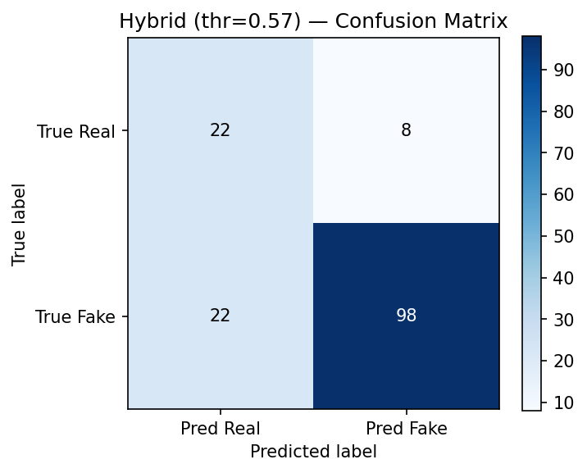
Confusion matrix — Hybrid v3
Test set, threshold 0.575 — see outputs/hybrid_evaluation.txt for the full report.

Slide 11
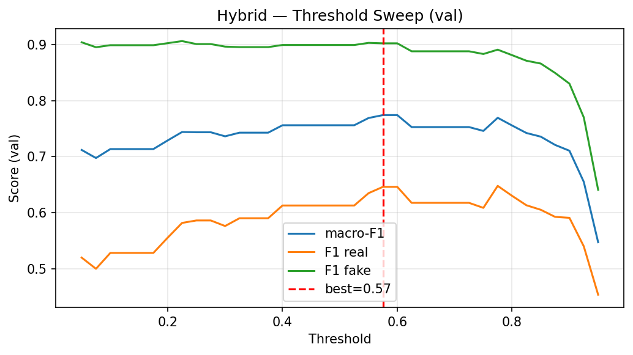
Threshold sweep on validation
Picking the macro-F1 maximiser balances real-recall vs fake-recall.

Slide 12
Web demo — upload page
[ screenshot placeholder — paste the file at F:\ml_project\deepfake-detection\presentation\screenshots\app_index.png ]
Drag-and-drop upload, AJAX submit, in-place result rendering. See DEMO_RECORDING_SCRIPT.md.

Slide 13
Web demo — prediction result
[ screenshot placeholder — paste the file at F:\ml_project\deepfake-detection\presentation\screenshots\app_result.png ]
Confidence bar, per-frame diagnostics, processing time. Inference: ~15 s per video on this CPU.

Slide 14
Challenges & solutions
• Class imbalance (4:1 fake:real) → WeightedRandomSampler + threshold calibration.
• No GPU → cache features once, train only small heads on cached tensors (~10 min vs ~50 hr/epoch end-to-end).
• Small training set (700 videos) → heavy regularisation (dropout 0.5, weight_decay 1e-3, early stopping on macro-F1).
• First hybrid attempt failed (frozen ImageNet features) → swapped backbone to the fine-tuned CNN baseline; ROC-AUC jumped 0.44 → 0.87.
• Mid-prediction crashes on bad uploads → typed PreprocessingError / PredictionError in the Flask layer.

Slide 15
Limitations
• Real-class recall ≈ 42 % — a meaningful fraction of authentic videos are mislabeled FAKE.
• Trained on a 700-video subset of FaceForensics++; published results in the 90 %+ range fine-tune the backbone end-to-end on a GPU.
• Bounded by 224 × 224 face crops × 32 frames; no body cues, no audio, no compression-domain features.
• Research demo only — not a forensic-grade detector.

Slide 16
Future work
• GPU end-to-end fine-tuning of ResNet-50 (Colab T4 free tier) — projected accuracy 88-93 %.
• Backbone swap: XceptionNet pretrained on FaceForensics++ (purpose-built features for deepfake artefacts).
• Larger training set + augmentation (compression, blur, brightness) for robustness.
• Multi-modal: include audio analysis and lip-sync consistency as additional signals.
• Real-time inference: ONNX export + quantisation for video-stream-rate prediction.

Slide 17
Questions?
Code, docs, and full diagnostics on the project repo.

