Slide 1


KGiSL Institute of Technology
(Approved by AICTE, New Delhi; Affiliated to Anna University, Chennai)
Recognized by UGC, Accredited by NBA (IT)
365, KGiSL Campus, Thudiyalur Road, Saravanampatti, Coimbatore – 641035.
Department of Computer Science and Engineering
Name of the Faculty : Ms.Suriya.A
Subject Name & Code : APP DEVELOPMENT & CCS332
Branch & Department : Computer Science and Engineering
Year & Semester : III / V
Academic Year :2024-25

Slide 2
Prerequisites
Basic programming skills and knowledge of web technologies (HTML, CSS, JavaScript).
Familiarity with mobile platforms (Android/iOS) and object-oriented programming concepts.

Slide 3
Syllabus
UNIT I - FUNDAMENTALS OF MOBILE & WEB APPLICATION DEVELOPMENT
Basics of Web and Mobile application development, Native App, Hybrid App, Cross-platform App, What is Progressive Web App, Responsive Web design.

Slide 4
Course Outcome
CO1: Explain the fundamentals for developing web and mobile applications using native and cross platform Apps-K2

Slide 5
TOPIC
Basics of Web and Mobile application development

Slide 6
Basics of Web Development
Basics of Web Development
Web development refers to the creating, building, and maintaining of websites.
It includes aspects such as web design, web publishing, web programming, and database management.
It is the creation of an application that works over the internet i.e. websites.

Slide 7
Basics of Web Development
Two Types
Web Development can be classified into two ways:
Frontend Development
Backend Development

Slide 8
Basics of Web Development - Frontend Development
The Face of the Web.
The part of a website where the user interacts directly is termed as front end.
This involves designing the structure, layout, and behavior of the website.
It is also referred to as the ‘client side’ of the application.

Slide 9
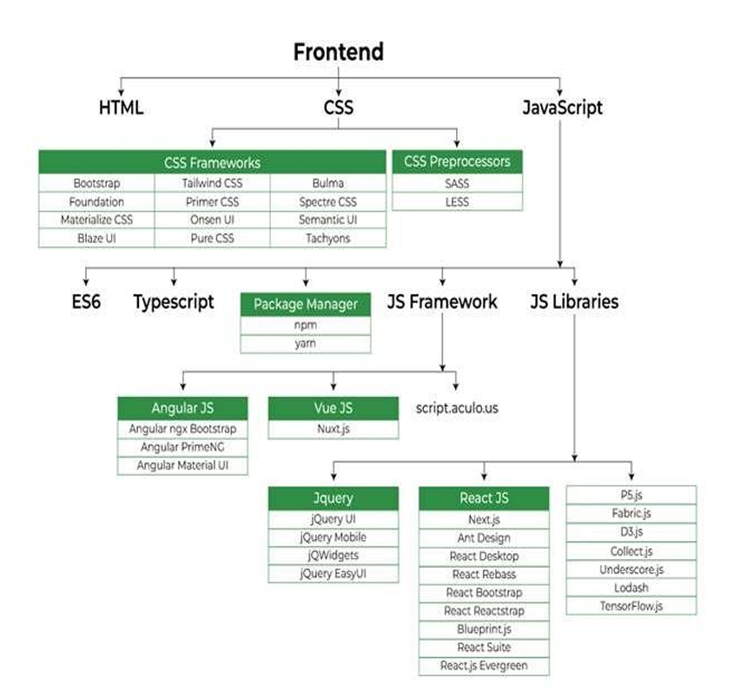
Basics of Web Development - Frontend Development

Slide 10
Basics of Web Development - Frontend Development
Frontend Technologies:
HTML: HTML stands for HyperText Markup Language. It is used to design the front-end portion of web pages using markup language. It acts as a skeleton for a website since it is used to make the structure of a website.
CSS: Cascading Style Sheets fondly referred to as CSS is a simply designed language intended to simplify the process of making web pages presentable. It is used to style our website.

Slide 11
Basics of Web Development - Frontend Development
Frontend Technologies:
JavaScript: JavaScript is a scripting language used to provide a dynamic behavior to our website.
Bootstrap: Bootstrap is a free and open-source tool collection for creating responsive websites and web applications. It is the most popular CSS framework for developing responsive, mobile-first websites. Nowadays, the websites are perfect for all browsers (IE, Firefox, and Chrome) and for all sizes of screens (Desktop, Tablets, Phablets, and Phones).
Bootstrap 4
Bootstrap 5

Slide 12
Basics of Web Development - Frontend Development
Frontend Frameworks/Libraries
React.js : A popular JavaScript library for building dynamic, component-based user interfaces.
Angular : A full-fledged framework for building single-page applications (SPAs), with features like two-way data binding and dependency injection.
Vue.js : A progressive JavaScript framework that is flexible and can be used for building both simple and complex user interfaces.

Slide 13
Basics of Web Development – Backend Development
The Backbone of the Web.
Backend is the server side of a website.
It is part of the website that users cannot see and interact with.
It is the portion of software that does not come in direct contact with the users.
It is used to store and arrange data.

Slide 14
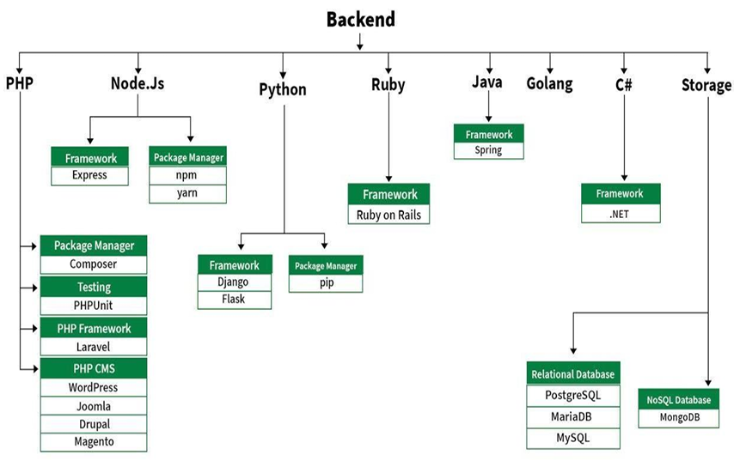
Basics of Web Development – Backend Development

Slide 15
Basics of Web Development – Backend Development
Server-side Programming Languages and Frameworks
PHP: PHP is a server-side scripting language designed specifically for web development.
Java: Java is one of the most popular and widely used programming languages. It is highly scalable.
Python: Python is a programming language that lets you work quickly and integrate systems more efficiently.

Slide 16
Basics of Web Development – Backend Development
Server-side Programming Languages and Frameworks
Node.js: Node.js is an open source and cross-platform runtime environment for executing JavaScript code outside a browser.
Ruby: Ruby is a dynamic, reflective, object-oriented, general-purpose programming language.
C# : C# is a high-level, general-purpose programming language developed by Microsoft.

Slide 17
Basics of Mobile Development
Mobile apps are majorly developed for 3 Operating System.
1. Android
2. IOS
3. Windows

Slide 18
Basics of Mobile Development
There are 3 different ways to develop Mobile apps:
1. 1st Party Native App development
2. Progressive web Application
3. Cross-Platform Application

Slide 19
Basics of Mobile Development
1st Party Native App development: These types of apps normally run in the native devices, that is, it runs only in the OS that it is specifically designed for it. These apps cannot be used on different devices using a different OS. The apps that are developed for android are normally coded using Java or Kotlin languages. The IDE normally used for android app development is Android Studio which provides all features and the apps that are developed for IOS are generally coded in Swift language or Objective-C. The IDE suggested for IOS App Development is XCode.

Slide 20
Basics of Mobile Development
Example - Here’s an example of a 1st party native app:
A retail company wants to improve the in-store shopping experience for its customers.
They develop a 1st party native app that allows customers to:
• Browse the store’s inventory and product information
• Create a shopping list
• Scan barcodes to view product information and reviews

Slide 21
Basics of Mobile Development
Locate items in the store using an interactive map
• Pay for items directly through the app, without having to wait in line at the register
• The app is only available to the company’s customers and can only be used in their physical stores. The app is designed to integrate with the company’s existing systems, such as inventory management and point-of-sale systems.

Slide 22
Basics of Mobile Development
This app is developed by the retail company for their own use, to improve the in-store customer experience, increase sales and gain insights from the customer’s behavior.
In this example, the retail company is the 1st party, and the app is a native app, because it is developed for the specific platform (iOS or Android) and can take full advantage of the device’s capabilities and features.

Slide 23
Basics of Mobile Development
2. Progressive web Application:
Progressive web apps are essentially a website which runs locally on your device. The technologies used are Microsoft Blazor, React, Angular JS, Native Script, Iconic. These technologies normally used for web development propose. The apps’ UI is developed the same way as they are developed while developing the website. This category has many ups and downs let’s start with the advantages of Progressive web apps.

Slide 24
Basics of Mobile Development
Example - Here’s an example of a Progressive Web App:
A news website wants to provide its users with a better mobile experience. They develop a Progressive Web App that:
• Allows users to access the website offline by storing content on the user’s device
• Sends push notifications to users to alert them of breaking news
• Can be installed on the user’s home screen like a native app

Slide 25
Basics of Mobile Development
Provides a fast and smooth browsing experience
• Has a responsive design that adapts to different screen sizes
• Users can access the PWA by visiting the website on their mobile browser. They are prompted to install the PWA on their home screen, which allows them to access the website offline and receive push notifications.

Slide 26
Basics of Mobile Development
In this example, the news website is the 1st party and the app is a Progressive web app, because it can be accessed through a web browser and can be installed on the user’s device like a native app. It also allows users to access the content offline and have a fast and smooth experience.

Slide 27
Basics of Mobile Development
3. Cross-Platform Application:
These are frameworks that allow developing total native applications which have access to all the native features of IOS and Android but with the same code base. These apps run on both Android and IOS. So normally the development speeds of these apps are very fast and the maintenance cost is low. The performance speed is comparatively low to 1st party native apps but faster than PWA.

Slide 28
Basics of Mobile Development
Example - Here’s an example of a cross-platform application:
A project management company wants to create a project management tool that can be
used by teams on different platforms. They develop a cross-platform application that:
• Can be used on Windows, Mac, iOS, and Android devices
• Allows users to create and assign tasks, set deadlines, and track progress
• Integrates with popular tools such as Google Calendar and Trello

Slide 29
Basics of Mobile Development
Has a user-friendly interface that works seamlessly across all platforms
• The application can be downloaded from the company’s website or from different app stores such as App Store, Google Play Store, Microsoft Store, and Mac App Store, depending on the platform.

Slide 30
Basics of Mobile Development
This example illustrates how the company developed a project management tool that can be used by teams on different platforms, Windows, Mac, iOS and Android, which is a cross-platform application. It allows teams to collaborate and manage their projects seamlessly, regardless of the platform they use.

