Slide 1

Machine Learning-Based Rainfall Prediction: Unveiling Insights and Forecasting for Improved Preparedness
Guide:
Dr. Venkatesan R
Assistant Professor III
SoC
Reg No./Students: 126158027 – KRISHLAYA KUMAR

Slide 2
MODELS
Naive Bayes (NB)
Decision Tree
Support vector Machine (SVM)
Random Forest
Logistic Regression(LR)
Artificial Neural Network(ANN)
Long-short-term Memory(LSTM)

Slide 3

NAÏVE BAYES
Load Dataset → Read the preprocessed dataset.
Encode Categorical Features → Convert "Yes/No" to 0 and 1.
Feature Selection → Separate independent (X) and dependent (y) variables.
Standardization → Normalize numerical features.
Train-Test Split → 80% training, 20% testing.
Train Model → Fit Naïve Bayes classifier (GaussianNB()).
Make Predictions → Predict RainTomorrow for test data.
Evaluate Performance → Check Accuracy, Precision, Recall, and F1-score.
Visualize Results
Bayes Theorem:
P(A|B)= [P(A)*P(B|A)]/P(B)

Slide 4
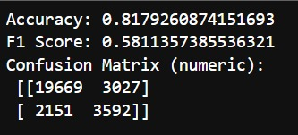
NAIVE BAYES

Slide 5
Metric | Output | Paper Result
Accuracy | 0.81 | 0.81
Precision | 0.89 | 0.79
Recall | 0.82 | 0.81
F1-Score | 0.85 | 0.80
G-Mean | 0.72 | 0.77
ROC AUC | 0.82 | 0.77

Slide 6
Decision Tree
Load Dataset → Read the preprocessed weather dataset
Encode Categorical Features → Convert values like "Yes/No" or "Rainy/Sunny" to numeric values using Label Encoding or One-Hot Encoding.
Feature Selection →
Independent variables (X): All predictor features (e.g., Temperature, Humidity, etc.)
Dependent variable (y): Target feature (RainTomorrow)
Handle Missing Values → Replace or drop missing entries if any.
Standardization (optional) → While not required for Decision Tree, it may help when used with other models or hybrid approaches.
Train-Test Split → Split the dataset (e.g., 80% training, 20% testing).
Train Model → Fit a DecisionTreeClassifier() from sklearn.tree on the training data.
Make Predictions → Predict RainTomorrow using the test data.
Evaluate Performance → Use metrics such as Accuracy, Precision, Recall, F1-Score, ROC AUC, and G-Mean.
Visualize Tree → Plot the Decision Tree using plot_tree() or export as a graph for better understanding.

Slide 7
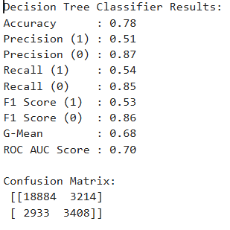
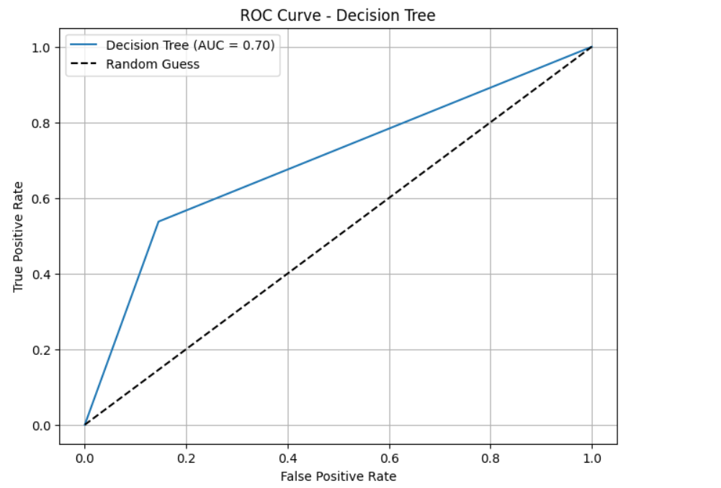
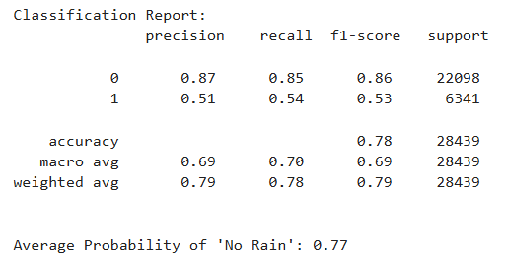

Slide 8
Metric | Output | Paper output
Accuracy | 0.78 | 0.81
Precision | 0.87 | 0.80
Recall | 0.85 | 0.81
F1 Score | 0.86 | 0.79
G-Mean | 0.68 | 0.68
ROC AUC | 0.70 | 0.68

Slide 9
Support Vector Machine (SVM)
Load Dataset → Read the preprocessed dataset.
Drop Unnecessary Column → Remove RISK_MM to avoid data leakage.
Feature Selection → Separate independent variables (X) and target variable (y).
Train-Test Split → Divide data into 80% training and 20% testing.
Train Model → Fit the Support Vector Machine with RBF kernel (SVC(kernel='rbf')).
Make Predictions → Predict RainTomorrow on test data.
Evaluate Performance → Compute Accuracy, Precision, Recall, F1-Score, G-Mean, and ROC-AUC.
Visualize Results → Plot ROC Curve.

Slide 10
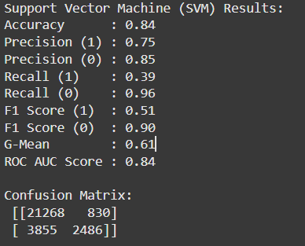
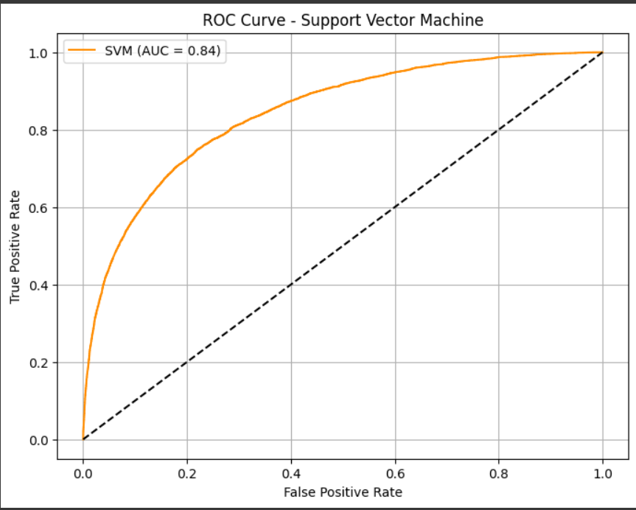
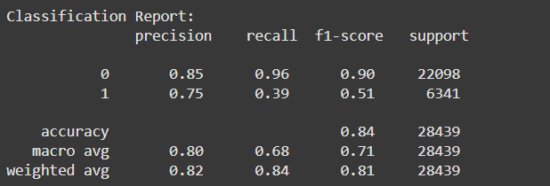

Slide 11
Metric | Output | Paper Output
Accuracy | 0.84 | 0.84
Precision | 0.85 | 0.82
Recall | 0.96 | 0.79
F1 Score | 0.90 | 0.76
G-Mean | 0.61 | 0.72
ROC AUC | 0.84 | 0.73

Slide 12
Logistic Regression
1. Load Dataset
→ Read the preprocessed dataset using pd.read_csv().
2. Drop Unnecessary Column
→ Remove RISK_MM to avoid data leakage.
3. Feature Selection
→ Separate independent variables (X) and target variable (y).
4. Train-Test Split
→ Divide the dataset into 80% training and 20% testing using train_test_split().
5. Train Model
→ Fit the Logistic Regression model using LogisticRegression() from sklearn.linear_model.
6. Make Predictions
→ Predict RainTomorrow values on the test dataset.
7. Evaluate Performance
→ Compute evaluation metrics: Accuracy, Precision, Recall, F1-Score, G-Mean, and ROC-AUC.
8. Visualize Results
→ Plot the ROC Curve using sklearn.metrics.roc_curve and matplotlib.

Slide 13
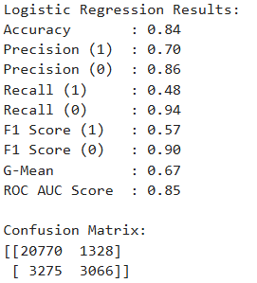
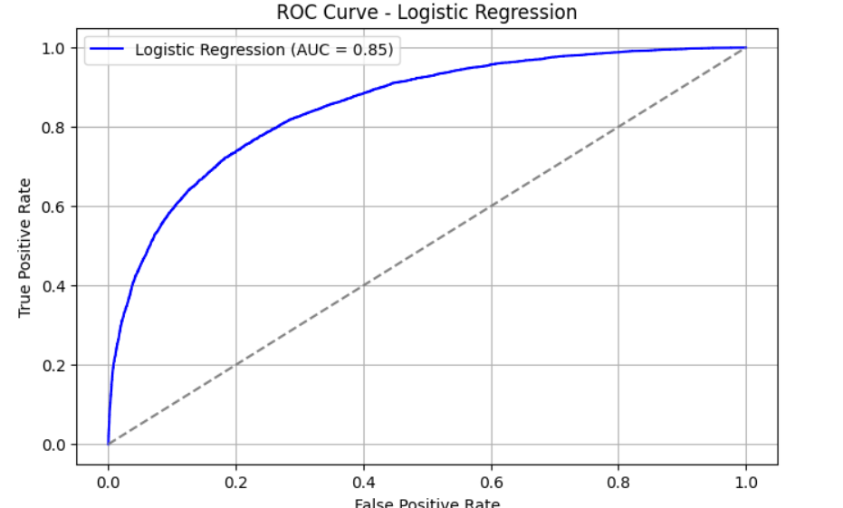
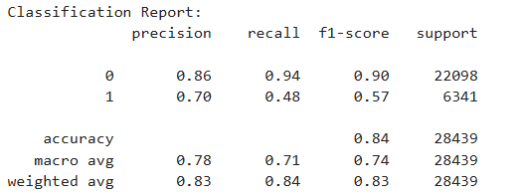

Slide 14
Metric | Output | Paper Output
Accuracy | 0.84 | 0.83
Precision | 0.86 | 0.82
Recall | 0.94 | 0.74
F1 Score | 0.90 | 0.65
G-Mean | 0.67 | 0.77
ROC AUC | 0.85 | 0.67

Slide 15
LSTM (Long Short-Term Memory)
Load Dataset→ Read the preprocessed CSV file using pandas.
Drop Unnecessary Column→ Remove the RISK_MM column to avoid prediction leakage.
Feature Selection→ Separate independent variables (X) and the target variable (y = RainTomorrow).
Normalize Features→ Use MinMaxScaler() to scale features to a 0–1 range.
Reshape Data for LSTM→ Convert feature matrix to 3D shape: (samples, timesteps=1, features) using .reshape().
Train-Test Split→ Split the data into 80% training and 20% testing using train_test_split().
Build LSTM Model→ Use Sequential() with:
LSTM() layer for sequence learning
Dropout() for regularization
Dense() for classification
sigmoid activation in the output for binary classification
Compile the Model → binary_crossentropy as the loss function ,Adam as the optimizer ,accuracy as a metric
Train the Mode → Train using .fit() with validation split, batch size, and epochs.
Make Predictions→ Use .predict() on the test set → Apply threshold (0.5) to convert probabilities to binary predictions
Evaluate Performance

Slide 16
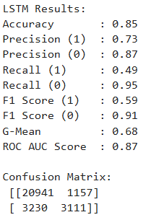
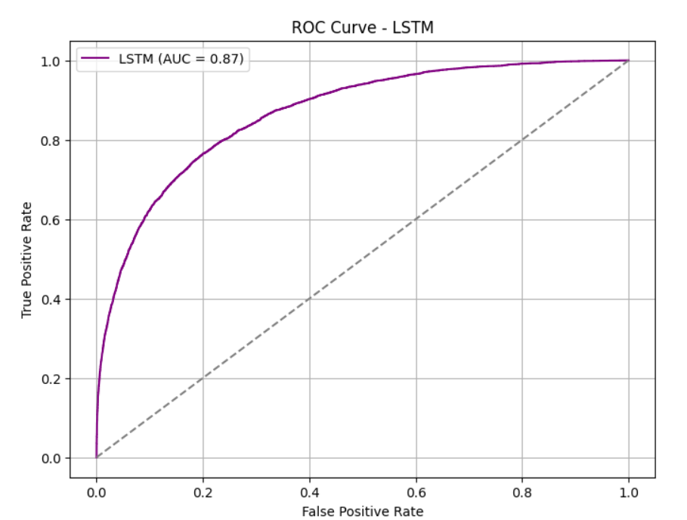
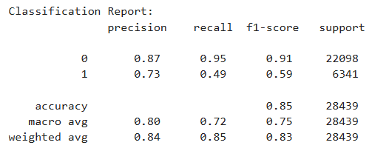

Slide 17
Metric | Output | Paper Output
Accuracy | 0.85 | 0.83
Precision | 0.87 | 0.78
Recall | 0.95 | 0.78
F1 Score | 0.91 | 0.81
G-Mean | 0.68 | 0.85
ROC AUC | 0.87 | 0.72

Slide 18
Artificial Neural Network
Data Collection – Gather the required dataset for the problem.
Data Preprocessing – Clean the data, handle missing values, and normalize features.
Data Splitting – Divide the dataset into training and testing sets.
Model Building –
Define the number of layers and neurons.
Choose activation functions for each layer.
Model Compilation –
Select a loss function to measure error.
Choose an optimizer to reduce the error.
Set performance metrics such as accuracy.
Model Training –
Train the model on the training data.
Set number of epochs and batch size.
Model Evaluation –
Test the model using the testing set.
Measure performance using selected metrics.
Prediction – Use the trained model to make predictions on new or unseen data.
Model Tuning – Adjust model parameters if performance is not satisfactory.

Slide 19
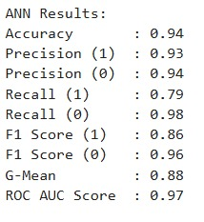
Artificial Neural Network

Slide 20
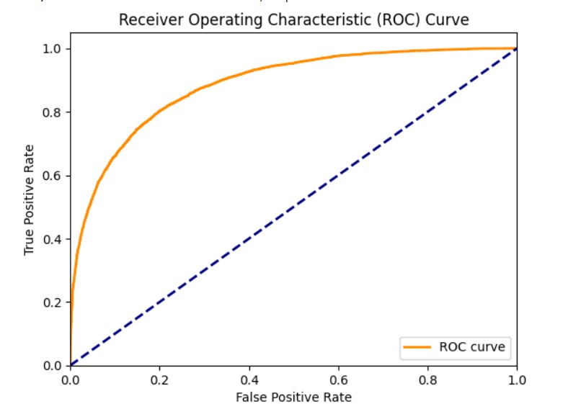
Artificial Neural Network

Slide 21
Accuracy Comparison
ALGORITHM | BASE PAPER VALUE | ACTUAL VALUE
Naive Bayes | 81 | 81
Decision Tree | 81 | 78
SVM | 84 | 84
LSTM | 85 | 83
Logistic regression | 84 | 84
Artificial Neural Network | 90 | 94

