Slide 1
AquaSense
Smart Water Monitoring System
Team Members: Krish Mahajan, Shreyash Chougule, Pranav Chougule, Varad Dake
D.K.T.E. Society’s Textile and Engineering Institute, Ichalkaranji

Slide 2
Problem Statement
• Significant water wastage in shared environments.
• Lack of real-time water consumption monitoring.
• Absence of section-wise or area-wise tracking.
• Frequent tank overflows and unexpected shortages.

Slide 3
Aim of the Project
• To develop an IoT-based smart water monitoring and management system.
• Provide real-time, multi-area water intelligence to prevent wastage.
• Facilitate sustainable water management practices.

Slide 4
Objectives
• Deploy flow sensors to monitor area-wise consumption independently.
• Analyze real-time flow and tank level data.
• Regulate distribution using servo-controlled valves.
• Provide actionable insights through a live dashboard.

Slide 5
Scope and Limitations
Scope:
• Hostels, apartments, institutions, and agriculture.
Limitations:
• Dependent on continuous power and Wi-Fi connectivity.
• Hardware maintenance required periodically.

Slide 6
Existing System vs Proposed System
Existing System:
• Manual monitoring, no section-wise data.
• Delayed overflow detection.
Proposed System (AquaSense):
• Automated IoT monitoring.
• Area-wise analytics and instant anomaly alerts.

Slide 7
Proposed Solution (AquaSense Overview)
• Integrated system using ESP32/ESP8266 microcontroller.
• Collects data from flow and tank sensors.
• Processes and displays data on web/mobile dashboard.
• Includes manual and Auto Mode valve regulation.
• Cloud integration for persistent storage and remote access.

Slide 8
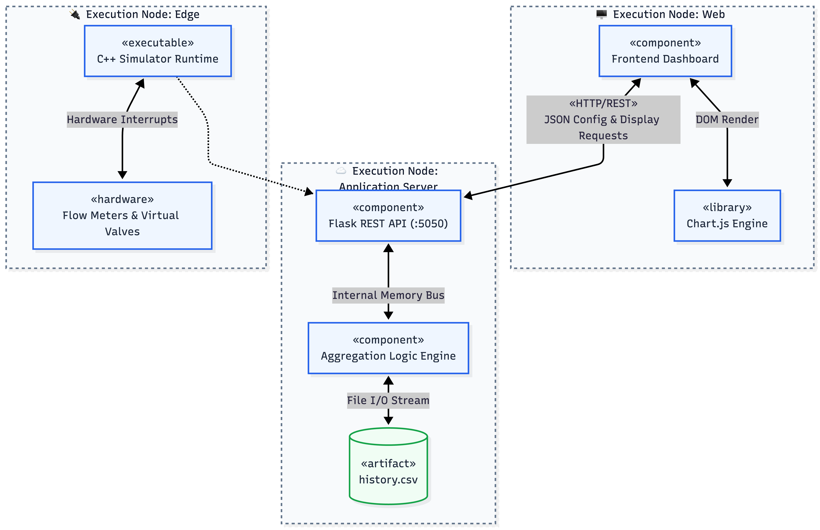
System Architecture Diagram

Slide 9
Working Flow
• Step 1: Sensors detect flow and tank levels.
• Step 2: Microcontroller processes signals.
• Step 3: Data transmitted to backend via Wi-Fi.
• Step 4: System analyzes consumption and detects anomalies.
• Step 5: Dashboard updates & Telegram alerts sent.

Slide 10
Modules Explanation
• Sensor Simulation: Simulates realistic flow data.
• Backend Processing: Handles data aggregation and logic.
• Adaptive Aeration Logic: Optimizes water flow.
• Anomaly Detection: Identifies leaks and overflows.
• Dashboard: Real-time user interface for monitoring.
• Telegram Integration: Instant notifications and control.

Slide 11
Algorithm Logic
1. Initialize sensors and connect to network.
2. Read data continuously.
3. If usage exceeds threshold, trigger anomaly.
4. If tank full/empty, actuate valve.
5. Log data and notify user.

Slide 12
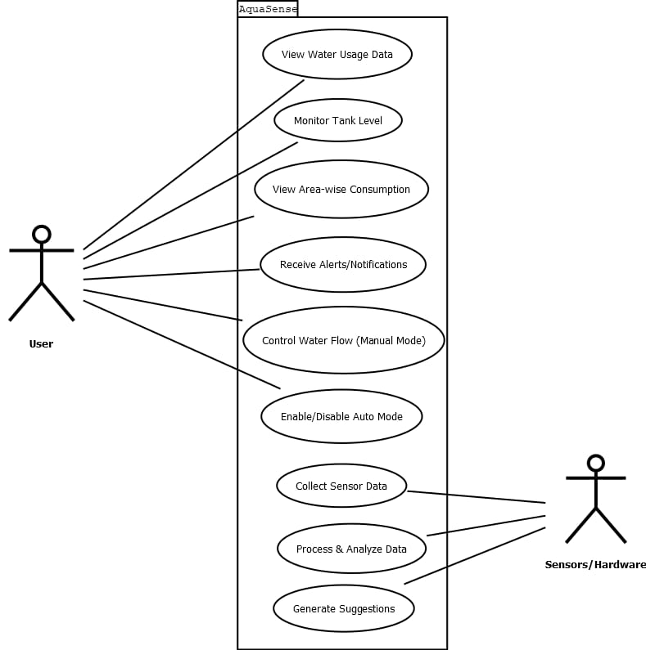
Use Case Diagram

Slide 13
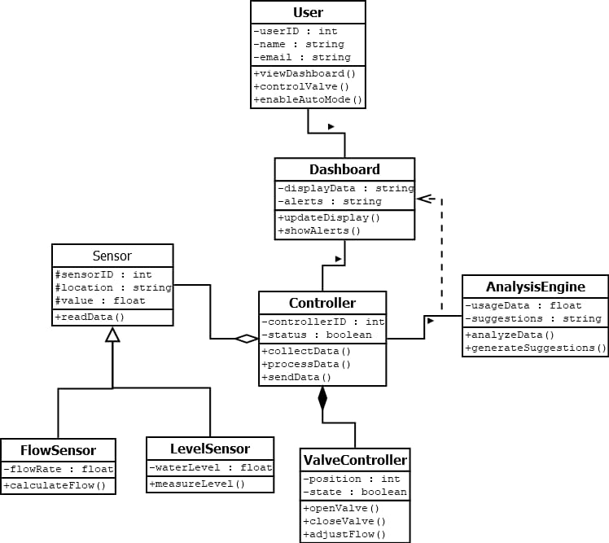
Class Diagram

Slide 14
Sequence Diagram

Slide 15
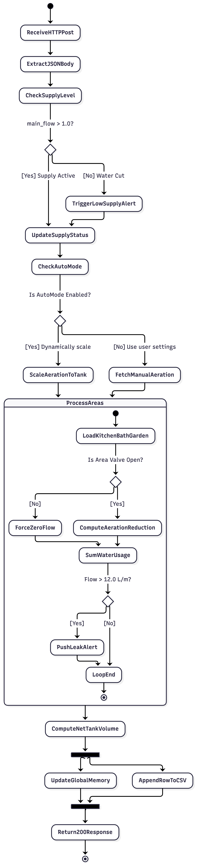
Activity Diagram

Slide 16
Implementation Details (Tools & Technologies)
• Hardware: ESP32/ESP8266, Flow Sensors, Servo Valves.
• Software: Python, Flask backend, Web/Mobile Dashboard.
• Cloud Storage: Firebase / Firestore.
• Communication: Wi-Fi, Telegram Bot API.

Slide 17
Results & Performance
• Achieved 22–35% water saving.
• Fast 1.5 sec anomaly detection.
• Accurate area-wise consumption tracking.
• Reliable automated valve control.

Slide 18
Outputs / Screens
• Dashboard: Real-time metrics overview.
• Analytics: Historical consumption graphs.
• Control Panel: Manual valve override.
• Telegram: Alerts on leakages or low tank levels.

Slide 19
Testing
• Integration Testing: Seamless hardware-software communication.
• System Testing: Validated end-to-end functionality under stress.
• Robustness verified for continuous 24/7 operation.

Slide 20
Future Scope
• Integration with AI for predictive maintenance.
• Solar-powered sensor nodes for sustainability.
• Expansion to smart city infrastructure.
• App-based notifications for granular user control.

Slide 21
Applications
• Residential complexes and hostels.
• Educational institutions and hospitals.
• Precision agriculture and plantation.
• Industrial water management systems.

Slide 22
Conclusion
• AquaSense provides an effective, low-cost solution for water management.
• Real-time tracking and automated controls significantly reduce wastage.
• Simple, user-friendly interface enhances system usability.

Slide 23
Thank You
Any Questions?

