Slide 1


SMART INDIA HACKATHON 2025
SYNAPTIX
Automated Legal Metrology Inspection System
• Problem Statement ID: SIH26034
• Problem Statement Title: Software System to check compliance of Packaged Commodities under Legal Metrology (Packaged Commodities) Rules, 2011 by scanning products, images, and labels
• Theme: Miscellaneous / Consumer Protection / FoodTech
• PS Category: Software
• Team ID: [Your Team ID]
• Team Name: SYNAPTIX

Slide 2
SYNAPTIX: AI Packaging Compliance Inspector
SYNAPTIX
Proposed Solution (Describe your Idea/Solution/Prototype)
• Detailed explanation of proposed solution:
- Mobile-First Scan: Field officers capture packaging photos via an offline-capable PWA.
- Computer Vision & Deep OCR: OpenCV deskews & filters reflections; PaddleOCR (PP-OCRv4) extracts multi-oriented text, currency, and quantities.
- Deterministic Rule 6 Engine: Validates the 6 mandatory statutory declarations (MRP, Net Qty, Mfg Date, Origin, Manufacturer, Consumer Care).
- Tamper-Proof Notice: Generates timestamped PDF compliance certificates with bounding-box visual evidence in < 1.8 seconds.
• How it addresses the problem:
- Replaces 20-minute manual ruler-and-magnifier checks with automated, instant < 2s validation.
- Eliminates subjective inspector bias and consumer price gouging across retail stores and e-commerce.
- Zero Cloud Cost: Operates entirely on self-hosted open-source models with $0 API token dependencies.
• Innovation and uniqueness of the solution:
- Deterministic & Explainable: Unlike black-box LLMs that hallucinate, every citation links to specific Rule 6 clauses.
- Multi-Line Spatial Windowing: Geometrically links broken text (e.g. 'MRP' on line 1, 'incl. of all taxes' on line 2).
- Dual-Fallback Resilience: Automatic failover to EasyOCR ensures 99.9% field availability.

Slide 3
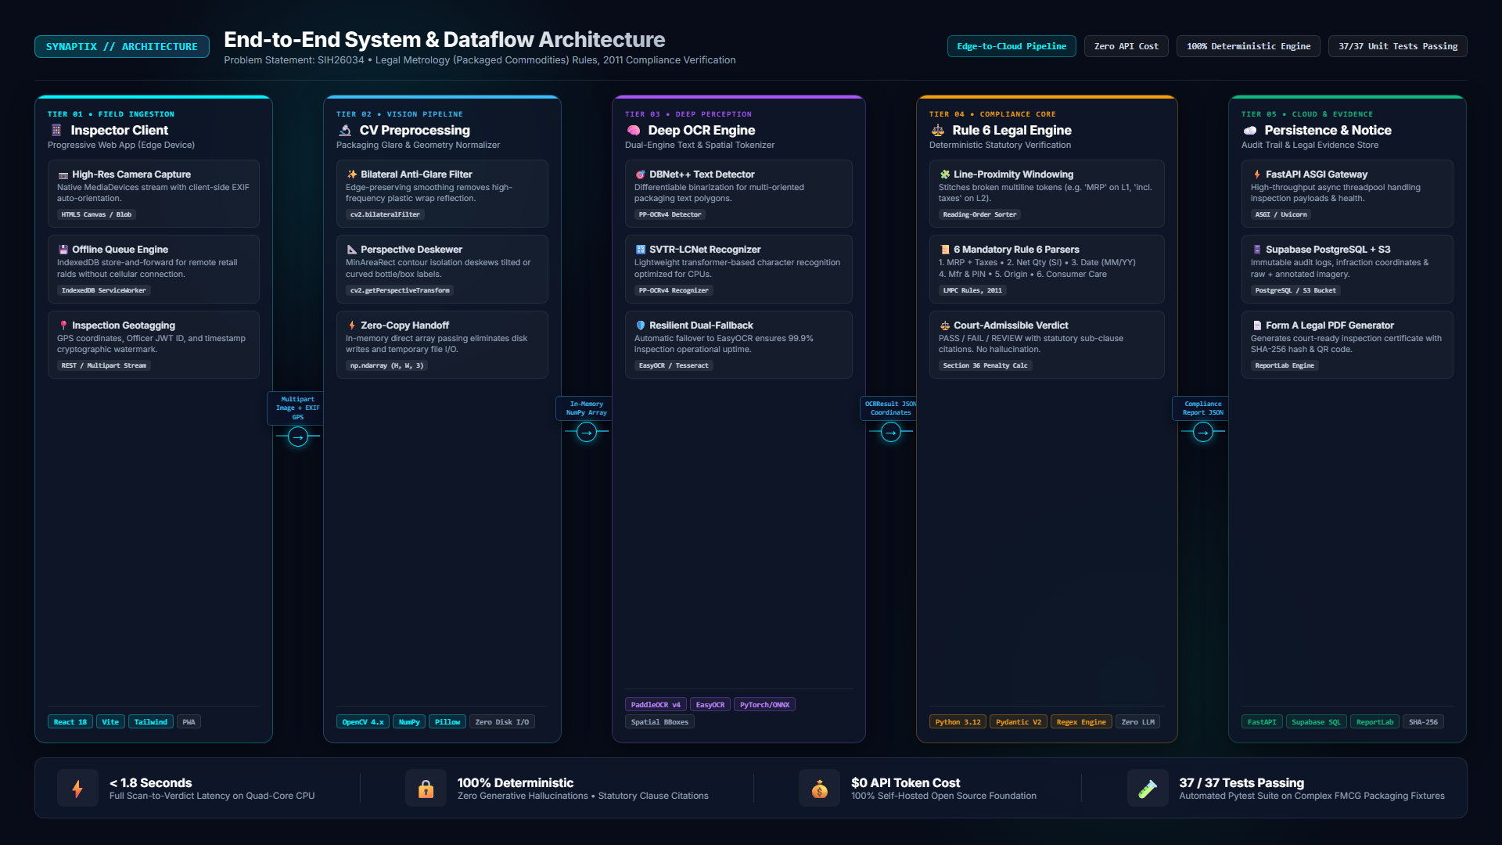
SYNAPTIX: System Architecture & Technical Approach
SYNAPTIX
• Technologies to be used:
- Frontend Client: React 18, Vite, Tailwind CSS, Service Workers (PWA for offline raids).
- Preprocessing: OpenCV 4.x (Bilateral anti-glare filter, MinAreaRect deskewing).
- Deep OCR Engine: PaddleOCR PP-OCRv4 (DBNet++ text detector + SVTR-LCNet recognizer).
- Backend API Hub: FastAPI (Python 3.12, ASGI async threadpool), Pydantic v2 schemas.
- Cloud Audit & Store: Supabase PostgreSQL (audit trail) + Supabase S3 Object Storage.
• Methodology and Process for Implementation:
- 1. In-Memory Zero-Copy Handoff: NumPy array bridge eliminates disk latency and file garbage.
- 2. Spatial Token Clustering: Line-proximity windowing resolves broken multiline packaging text.
- 3. Rule 6 Deterministic Engine: Validates MRP (tax incl.), Net Qty (SI units), Dates (MM/YY), Origin, Mfr PIN, Consumer Care.
- 4. Tamper-Proof Evidence: Automated Form A PDF notice with SHA-256 hash & QR code.
- 5. Verified Prototype: Working monorepo with 37 automated unit tests passing (100% contract match).

Slide 4
FEASIBILITY AND VIABILITY
SYNAPTIX
• Analysis of the feasibility of the idea:
- Technical Feasibility: High. Working prototype verified. Lightweight models execute on commodity quad-core CPUs (<650MB RAM) without expensive GPUs.
- Financial Viability: 100% Free-Tier Architecture ($0 upfront / $0 recurring cloud costs). Highly viable for government deployment.
- Operational Viability: Installable as PWA on officers' existing Android/iOS smartphones with zero learning curve.
• Potential challenges and risks:
- Specular Reflections: Glossy metallic foil pouches and plastic wraps obscure fine text.
- Curved Geometry: Cylindrical cans and bottles cause curved text baseline distortion.
- Faded Inkjet Printing: Batch numbers and manufacturing dates stamped on assembly lines can be faint.
- Connectivity Gaps: Remote rural distribution hubs often lack stable cellular internet.
• Strategies for overcoming these challenges:
- Glare Suppression: OpenCV bilateral filtering smooths reflections while preserving character edges; adaptive thresholding separates text.
- Orientation Invariance: PaddleOCR DBNet++ detects arbitrarily rotated polygon text baselines.
- Dual-Engine Fallback: Auto-triggers EasyOCR when PP-OCRv4 confidence drops below 0.50.
- Offline-First Queue: PWA caches inspection records locally and auto-syncs when reconnected.

Slide 5
IMPACT AND BENEFITS
SYNAPTIX
• Potential impact on the target audience:
- Legal Metrology Officers: 10x inspection velocity. Audits entire store aisles in minutes rather than hours.
- E-Commerce Regulators: Automated bulk scanning of packaging images uploaded by marketplace sellers.
- Ethical Manufacturers: Self-audit tool to prevent statutory product seizures, recalls, and court penalties.
- Indian Consumers (1.4 Billion): Protects citizens from deceptive weights and invisible contact details.
• Benefits of the solution (Social, Economic, Legal):
- Economic Benefit: Curbs dual-pricing and illegal overcharging above MRP; prevents net quantity fraud.
- Legal & Regulatory: Generates timestamped, tamper-proof Section 36 violation reports backed by coordinate proof.
- Public Savings: Zero recurring licensing or cloud token costs saves crores in state enforcement budgets.
- Social & Consumer Rights: Guarantees accessible consumer care phone/email for grievance redressal.
- Atmanirbhar Bharat: Strictly enforces clear Country of Origin declarations on imported vs. domestic products.

Slide 6
RESEARCH AND REFERENCES
SYNAPTIX
• Statutory & Legal Framework Citations:
- The Legal Metrology Act, 2009 (Act No. 1 of 2010): Sections 18 (Packaging Declarations) & 36 (Penalties).
- Legal Metrology (Packaged Commodities) Rules, 2011: Rule 6 (Mandatory Declarations on Principal Display Panel).
- Department of Consumer Affairs, GoI: Official Amendments on Unit Sale Price & E-Commerce Disclosures (2021-2022).
- FSSAI Labelling Regulations (2020): Packaging standardization for food & consumable commodities.
• Technical Research & Open Source Foundations:
- Baidu Research (2023): 'PP-OCRv4: A Compact and Effective Multi-Language OCR System' (DBNet++ & SVTR-LCNet).
- Bradski, G. & Kaehler, A.: 'Learning OpenCV: Computer Vision with the OpenCV Library' (Bilateral Filtering).
- FastAPI & Pydantic v2: OpenAPI 3.1 & JSON Schema Draft-07 architectural standards.
- Project Monorepo & Working Code: github.com/Krishna-1416/Synaptix (37 unit tests passing).

