Slide 1
SAR Narrative Generator with Audit Trail
COLLEGE OF ENGINEERING GUINDY
PROJECT NAME: CHRONOGUARD
TEAM MEMBERS: 1.TAMILMATHI M 2.NILA PR 3.KRISHNA SHREE B 4.RUBASHREE A
5.RAJAN S

Slide 2
PROBLEM STATEMENT & OBJECTIVE
PROBLEM STATEMENT:
Financial institutions are required to file Suspicious Activity Reports (SARs) whenever potentially fraudulent transactions are detected. However, the current SAR preparation process is highly manual, time-consuming, and error-prone.
OBJECTIVES:
To design and develop an AI-assisted SAR Narrative Generation System that automates suspicious activity analysis and report drafting while ensuring explainability, auditability, and human-in-the-loop control.
Unique Selling Proposition:
Key Features:
Explainable AI Risk Scoring
End-to-End SAR Automation
Human-in-the-Loop Governance
Transparent Audit Trail
Fraud Pattern Intelligence Engine
Structured Narrative Generation
Regulatory-Aligned Architecture
Scalable Microservices Architecture
Secure Role-Based Access Control
Continuous Learning Feedback System
Automated Suspicious Activity Detection
Multi-Source Data Ingestion
AI-Based Risk Scoring Engine
Fraud Pattern Matching System
Transaction Timeline Summarization
AI-Generated SAR Drafting
Human Analyst Review Dashboard
Transparent Audit Logging
Secure Role-Based Access Control
Scalable Microservices Deployment

Slide 3
ABSTRACT
Preparing Suspicious Activity Reports (SARs) is one of the most time-consuming tasks in financial compliance. When a suspicious transaction is flagged, analysts must manually review KYC records, scan through transaction histories, compare patterns with past fraud cases, and write a detailed report from scratch. This process takes hours, increases workload, and can lead to inconsistent reporting.
ChronoGuard is designed to simplify this process. The system automatically gathers relevant data, analyzes risk based on known fraud patterns, and generates a structured draft SAR highlighting key red flags and important transaction details. Instead of replacing analysts, it acts as a smart assistant that reduces repetitive work.
A built-in review dashboard allows analysts to verify the data sources, edit the generated narrative, and approve the final report. Every action is logged, creating a transparent audit trail for compliance purposes.
By combining automation with human oversight, ChronoGuard helps financial institutions prepare accurate SARs faster, while ensuring accountability and regulatory integrity.

Slide 4
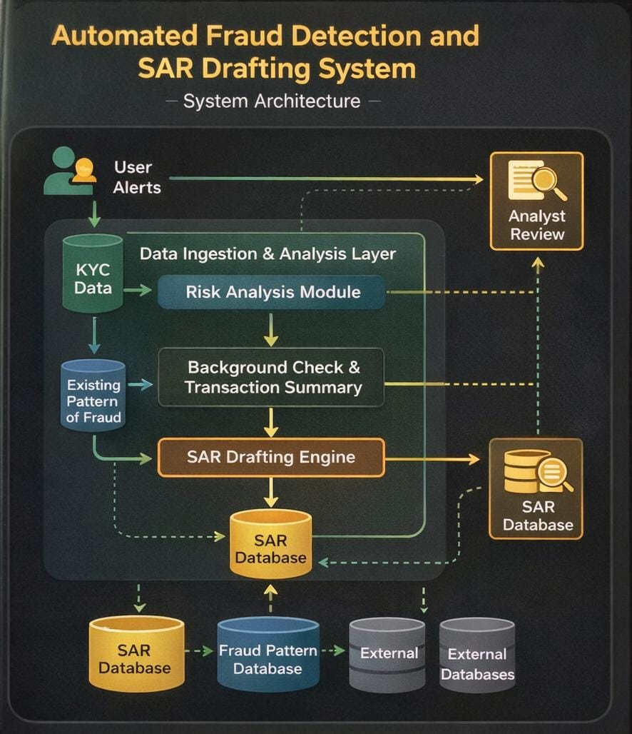
SYSTEM ARCHITECTURE

Slide 5



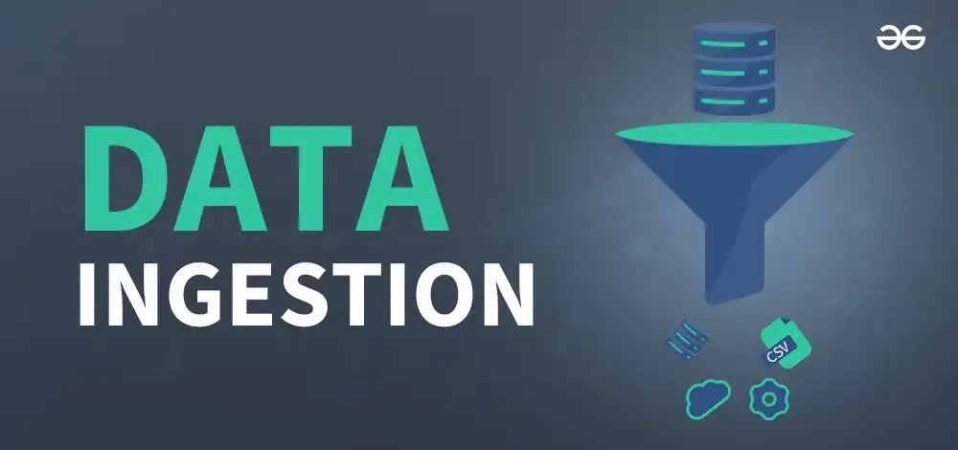
SYSTEM ARCHITECTURE
EXPALANATION:
1 . User Alerts / Event Trigger What it is: Source of initial alert such as: Suspicious transaction
New KYC update
Rule-based trigger
External system flag
Role:
Initiates the entire workflow
Sends data to:
➡ Data Ingestion & Analysis Layer
3. Risk Analysis Module
What it does:
Applies rules / ML models
Compares alert with fraud patterns
Calculates risk score
Assigns risk level (Low / Medium / High)
Output:
Risk attributes + confidence score
Sends to:
➡ Background Check & Transaction Summary
➡ SAR Drafting Engine
4. Analyst Review
Who:
Human compliance analyst
What they do:
Review auto-drafted SAR
Edit / add observations
Approve or reject
Outcome:
Approved SAR
Sends to:
➡ SAR Database
2. Data Ingestion & Analysis Layer
What it does:
Central processing layer that:
Collects data from all sources Cleans & normalizes dataRoutes to appropriate modules
Contains:
✔ Risk Analysis Module
✔ Background Check &
Transaction Summary

Slide 6


SYSTEM ARCHITECTURE
7. SAR Drafting Engine
What it does:
Auto-generates SAR draft using:
Risk results
Transaction summary
KYC data
Fraud pattern references
Features:
Template-based generation
NLP summarization
Highlights key red flags
Sends to:
➡ SAR Database
➡ Analyst Review
10. Fraud Pattern Database
Stores:
New confirmed fraud cases
SAR insights
Emerging typologies
Updated by:
Approved SARs
Used by:
Risk Analysis Module

Slide 7

METHODOLOGY
1. Finding Suspicious Activities
The system automatically collects and cleans transaction data from multiple sources. Using pattern matching, it identifies potentially suspicious activities and assigns them a risk level (Low, Medium, High) so analysts can focus on the most important cases.
4. Secure and Scalable System
Built on microservices architecture, the system can handle large transaction volumes reliably. It also uses encryption and role-based access control to protect sensitive financial data.
Big Picture
The system supports financial institutions by automating repetitive tasks, allowing analysts to focus on investigation, judgment, and preventing financial crime.
2. Automating Investigation Work
The system reduces manual effort by acting as a digital assistant. It summarizes a customer’s transaction history and prepares a draft Suspicious Activity Report (SAR) highlighting major red flags. This saves analysts significant time.
3. Human-in-the-Loop Decision Making
The AI does not make final decisions. Analysts review, edit, and approve reports. Their feedback helps the system improve its accuracy over time.

Slide 8
TECH STACK
Frontend:
react.js/angular dashboard for analyst
Backend:
python/flask/node.js
Database:
PostgreSQL
Integration:
APIs for KYC providers, transaction monitoring systems
Deployment:
cloud/docker
AI:
->LLM API (OpenAI / Azure OpenAI)
->Prompt engineering with structured template

Slide 9
FUTURE SCOPE
Integration with AI-powered NLP for narrative generation in SARs
Expansion to cross-border fraud detection using federated learning.
Real-time collaboration tools for analysts.
Automated regulator submission pipelines.
Continuous learning from analyst feedback to improve fraud detection accuracy.
Integration with live transaction monitoring systems.
Real-time fraud pattern learning using ML.
Multi-language SAR generation.
Regulatory format customization.
Integration with national reporting authorities

Slide 10
REFERENCE & ANALYSIS
Technical References
Microservices architecture best practices
AML risk scoring methodologies
LLM-based document generation research
Regulatory References
FATF AML guidelines
FinCEN SAR filing framework
Global AML compliance standards
Competitive Analysis
Traditional SAR Systems
Manual drafting
Limited automation
No explainable AI
ChronoGuard Advantages
Automated SAR drafting
Transparent audit trail
Human-in-the-loop governance
Continuous pattern learning system

Slide 11
CONCLUSION
Suspicious Activity Report preparation is a critical but resource-intensive process in financial compliance. Manual investigation and narrative drafting not only consume valuable analyst time but also introduce risks of inconsistency and delay.
ChronoGuard addresses this challenge by combining structured risk analysis, automated narrative generation, and a transparent audit trail within a secure, scalable architecture. The system streamlines alert evaluation, reduces repetitive workload, and ensures that every SAR draft is supported by traceable data and explainable logic.
By maintaining a human-in-the-loop approval process, ChronoGuard balances automation with accountability, ensuring regulatory integrity while improving operational efficiency.
This project demonstrates how AI can enhance compliance workflows — not by replacing human judgment, but by strengthening it.

