Slide 1
Financial Transaction
Fraud Analytics Dashboard
Interactive fraud insights across transactions, customers, and risk
49K
4.87%
11
243K
Transactions
Fraud Rate
Cities
Total Amount
Prepared by: Krishna SR | Power BI | Data Analytics
Power BI
DAX
Power Query
Kaggle

Slide 2
Introduction
What is Financial Fraud?
Why This Dashboard?
Financial fraud involves unauthorized or deceptive transactions causing monetary loss to individuals or organizations.
🔍
📊
📈
Detect
Analyze
Visualize
Identify fraudulent transactions using key risk indicators
Deep-dive into fraud patterns by location, time & type
Present complex data through intuitive Power BI dashboards
It includes credit card fraud, identity theft, account takeover, and unauthorized transfers.
Fraudsters use phishing, identity theft, and investment scams to steal funds.
🛡️
💡
Protect
Decide
Early detection is critical to minimizing losses and protecting customers.
Reduce fraud losses and protect customers effectively
Enable data-driven decisions with actionable insights

Slide 3
Dataset Description
📦 FraudShield Banking Dataset | Source: Kaggle | 48,635 Rows × 25 Columns
49K
25
11
Transactions
Columns
Cities
Key Columns
Transaction_ID
Customer_ID
Transaction_Amount_M
Unique transaction identifier
Unique customer identifier
Transaction value in millions
Transaction_Date
Transaction_Type
Merchant_Category
Date of each transaction
ATM / Online / POS
Restaurant, Fuel, Grocery, etc.
Transaction_Location
Fraud_Label
Card_Type
City of the transaction
Normal or Fraud classification
Credit or Debit card
Previous_Fraud_Count
Failed_Transaction_Count
Account_Balance_M
History of previous frauds
Number of failed attempts
Customer account balance

Slide 4
Tools & Technologies Used
01
Power BI Desktop
02
DAX (Data Analysis Expressions)
Primary Dashboard Tool
Calculation Language
Built all 8 interactive pages with visuals, slicers, and navigation buttons
Created 10+ measures: Fraud Rate %, Total Fraud Cases, High Risk Transactions, and more
03
Power Query Editor
04
Kaggle
Data Transformation
Data Source
Cleaned raw CSV — removed duplicates, fixed data types, added date/time columns
FraudShield Banking Dataset — 48K+ transactions, 25 columns
⚡ DAX Measures: Total Transactions | Total Fraud Cases | Fraud Rate % | Fraud Amount | Legitimate Amount | High Risk Transactions | Total Customers | Total Locations

Slide 5
Charts & Visualizations Used
🃏
📉
🍩
📊
📋
KPI Cards
Line Chart
Donut Chart
Clustered Bar
Matrix Table
All Pages
Executive Summary, Fraud Analysis
Executive Summary, Fraud Analysis, Risk
Transaction Overview, Fraud Analysis
Transaction Overview
Key metrics: Total Transactions, Fraud Rate %, High Risk Transactions
Monthly transaction trends and fraud patterns
Fraud vs Normal split (4.87%), Credit vs Debit distribution
Transaction counts by type (ATM/Online/POS) and merchant category
Cross-tabulation of total transactions and amounts by type
🌳
💧
🗺️
📦
📐
Treemap
Waterfall Chart
Map Visual
Clustered Column
Stacked Bar
Transaction Overview, Financial Impact
Financial Impact
Customer Analysis, Geographic Analysis
Transaction Overview, Customer Analysis
Risk Dashboard
Visual representation of amounts by merchant category
Monthly cumulative amounts showing increase/decrease trends
Bubble map showing distribution across 11 global cities
Transaction volume by merchant category and customers by card type
Failed vs successful transaction proportion by type

Slide 6
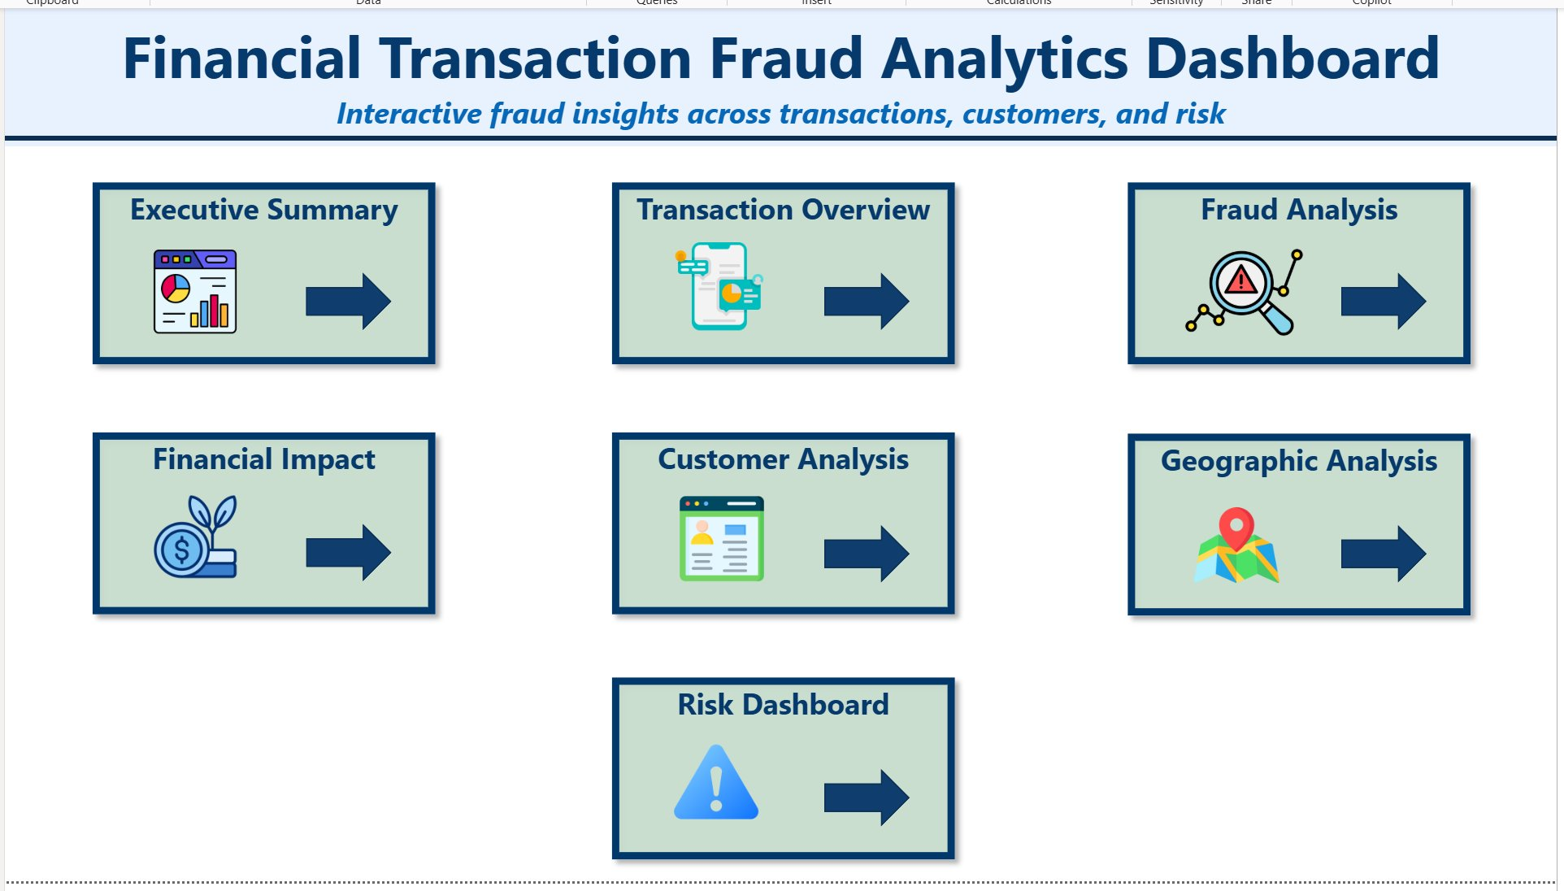
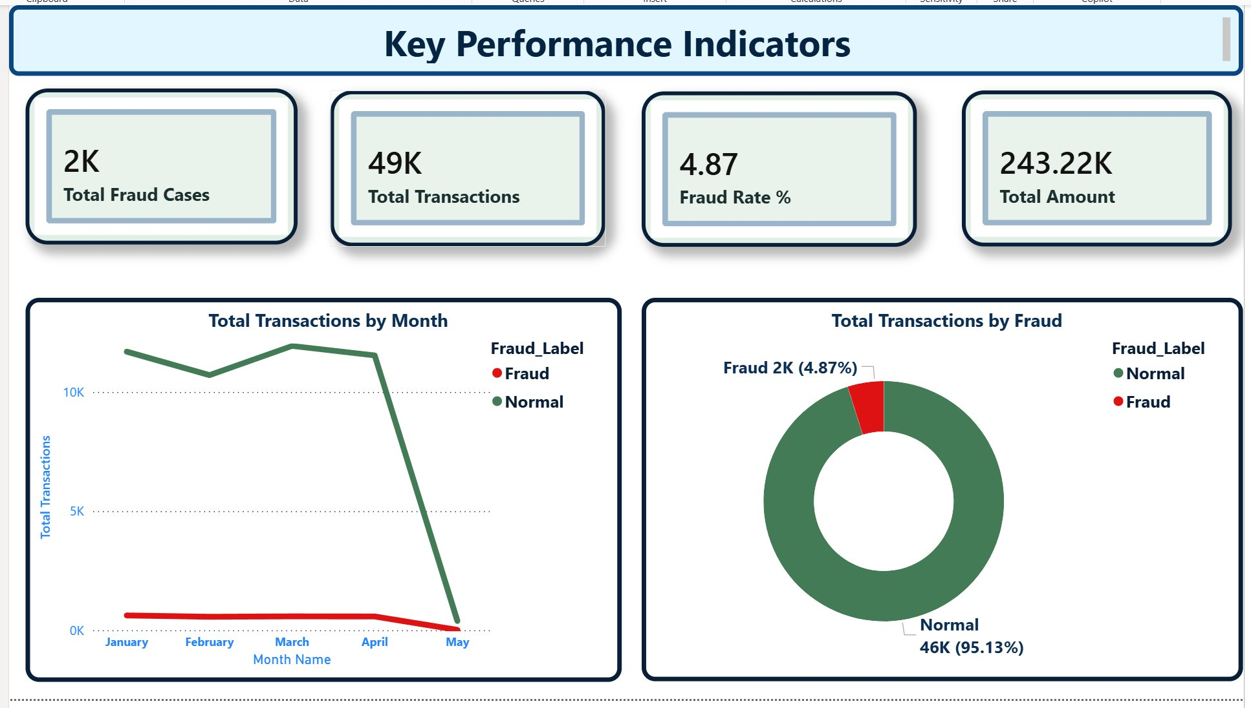
💡 7 interactive dashboard pages navigable via button links — covering fraud, financials, geography, and risk in one place.
💡 4.87% fraud rate across 49K transactions. 2K confirmed fraud cases carry a financial exposure of 11.82K out of 243K total.
Slide 6 of 11

Slide 7
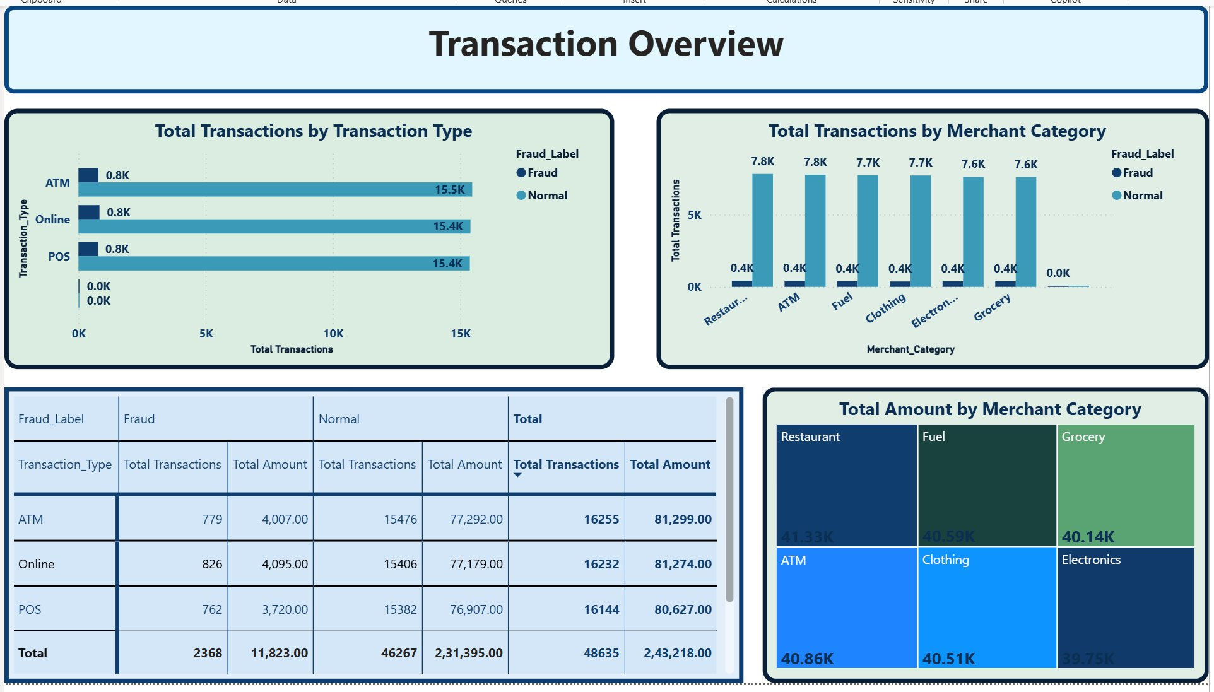
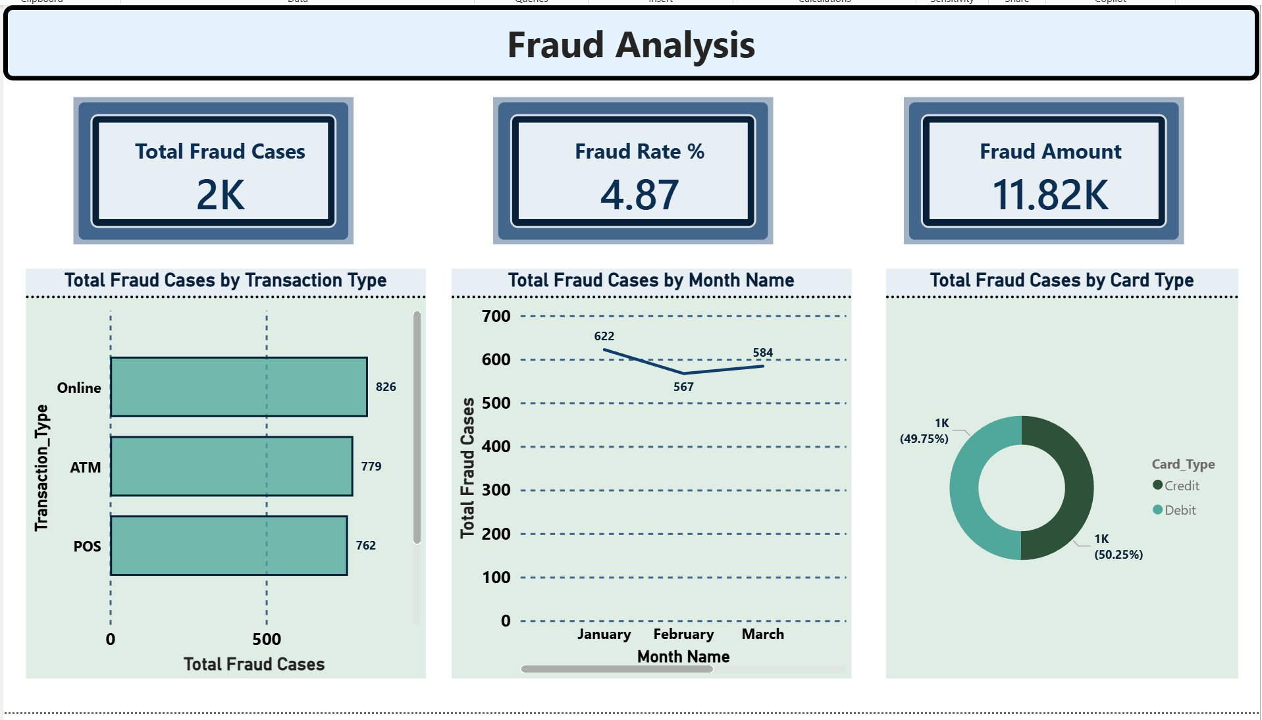
💡 Online, ATM, and POS channels each carry ~15.5K transactions with fraud nearly equal across all three at 0.8K each.
💡 Online leads fraud with 826 cases. Credit and debit cards are equally affected — 49.75% vs 50.25%.
Slide 7 of 11

Slide 8
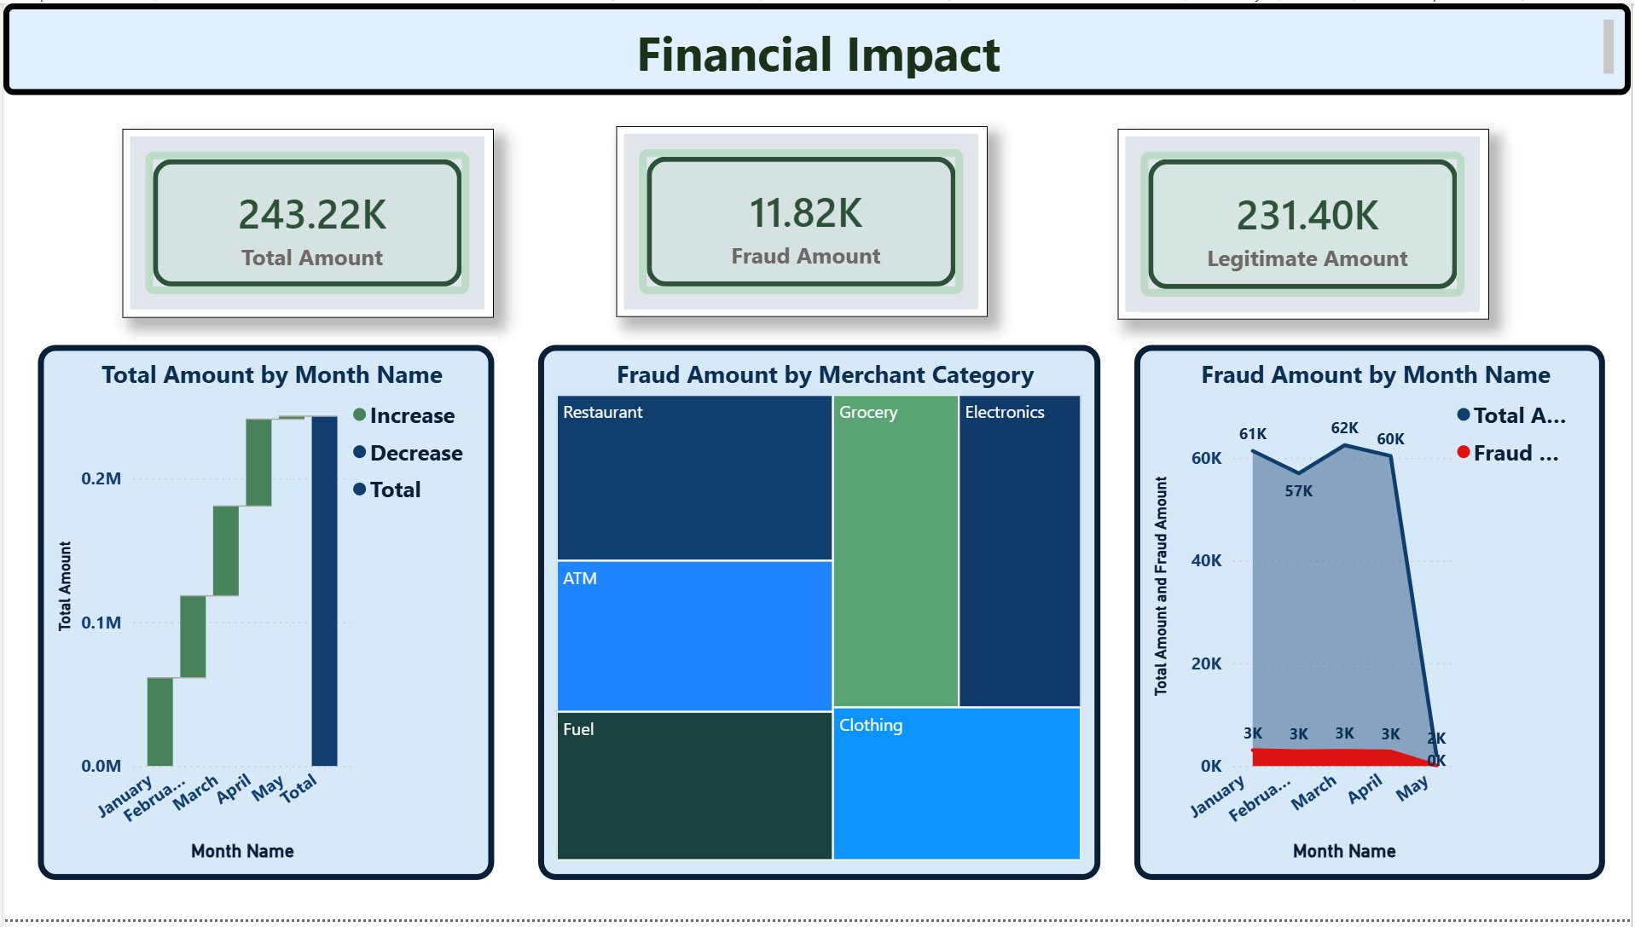
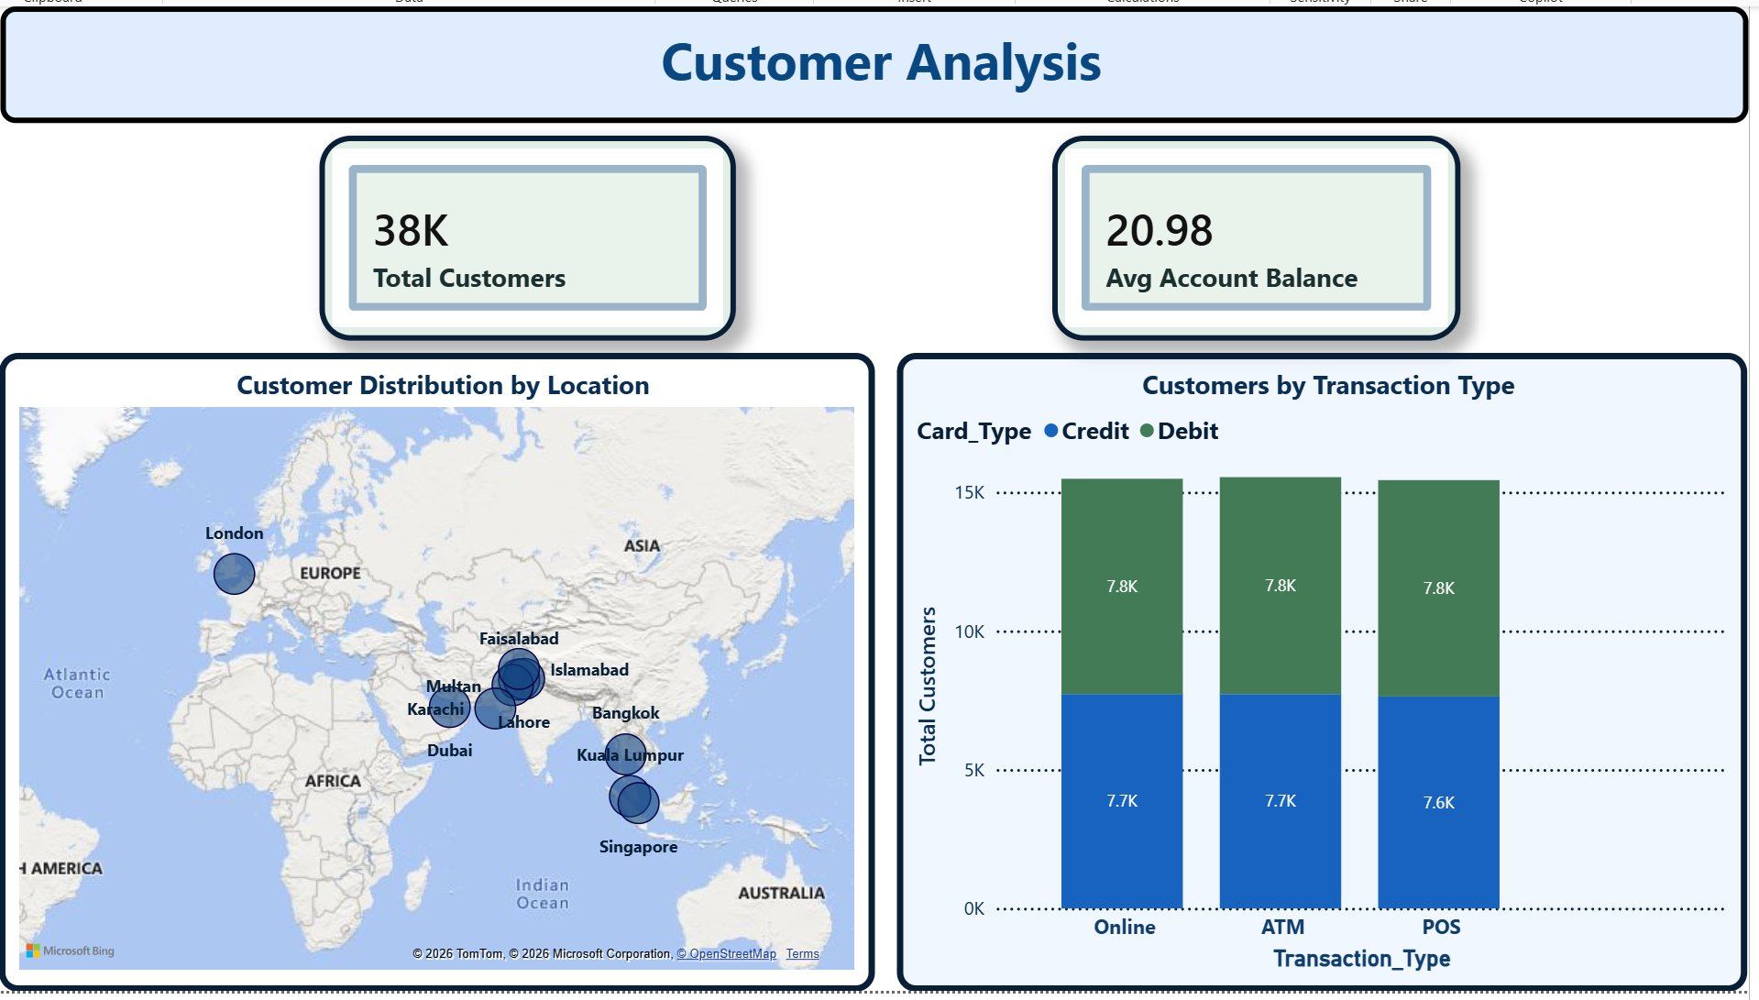
💡 Total amount grew steadily Jan–May reaching 243K. Fraud amount held flat at ~3K/month — fraud did not scale with volume.
💡 38K customers distributed evenly across 11 cities. Credit and debit card usage is nearly identical across all transaction types.
Slide 8 of 11

Slide 9
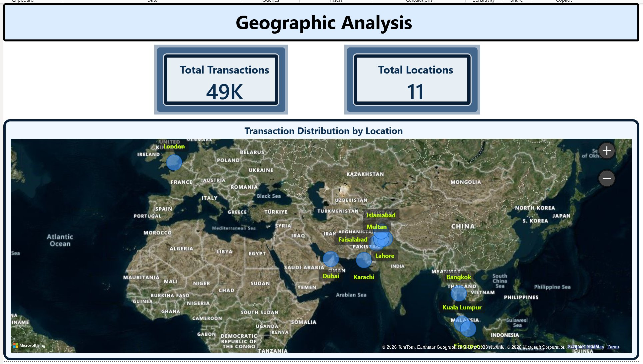
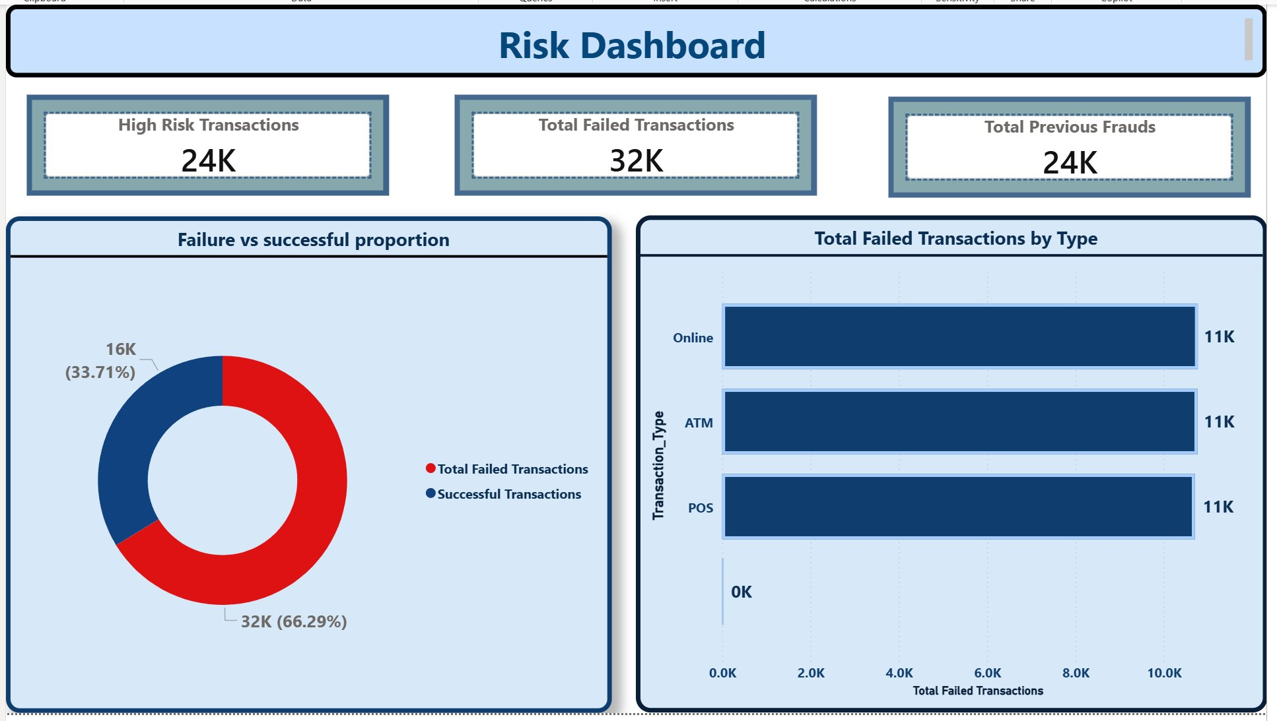
💡 49K transactions span 11 cities across 3 regions — London, Dubai, Bangkok, Kuala Lumpur, Singapore, and 6 Pakistani cities.
💡 32K failed attempts and 24K high-risk transactions out of 49K signal elevated fraud-attempt activity requiring monitoring.
Slide 9 of 11

Slide 10
Key Insights & Findings
📉 4.87%
💻 Online #1
💰 11.82K
Overall Fraud Rate
Fraud by Channel
Financial Exposure
Out of 49K total transactions, 2,368 were fraudulent — a significant rate requiring immediate attention.
Online transactions recorded the highest fraud (826 cases), followed by ATM (779) and POS (762).
Fraud amount totals 11.82K against 231.40K legitimate — directly quantifying the monetary risk in the dataset.
⚠️ 24K Flagged
🚫 32K Failed
💳 50 / 50
High Risk Transactions
Failed Transaction Attempts
Credit vs Debit Fraud
24,000 transactions were flagged as high risk out of 49K — nearly 49% of the dataset carries elevated risk signals.
32,000 failed attempts across 49K transactions indicate active fraud-probing behaviour in the dataset.
Fraud is equally split — Credit (49.75%) vs Debit (50.25%) — no card-type preference detected among fraudsters.

Slide 11
Conclusion
✅ This Power BI dashboard successfully transforms raw banking transaction data into actionable fraud intelligence.
📊 The 8-page interactive dashboard covers all aspects — executive KPIs, transaction analysis, financials, geography, and risk.
🚨 Key finding: 4.87% fraud rate with Online being the highest risk channel; 24K high-risk and 32K failed transactions detected.
💰 Financial exposure quantified at 11.82K fraud amount — enabling prioritization of fraud prevention investment.
🚀 Future enhancements: real-time data streaming integration and machine learning fraud prediction models.
Thank You! | Prepared by Krishna SR | Data Analytics | Power BI

