Slide 1

SAMSUNG PRISM
Generative AI
Hackathon
3rd Edition 2026 – 27
Theme ID - 01
Team Name - Agentic Code Intelligence
College Name – VIT VELLORE
Member Name & Email 1- Krishna & krishna.2024@vitstudent.ac.in
Submission Github link - https://github.com/Krishna-24-24/PRISM_GENAI_HACKATHON_Y2026

Slide 2
Theme
Theme 01: Agentic Code Intelligence
Problem
Modern software repositories contain thousands of files, functions and code snippets, making it difficult for developers to locate the exact code relevant to a natural-language query.
Traditional code search often struggles with:
Semantic understanding of developer queries
Exact identifiers and API names
Structural relationships between functions/files
Long and evolving codebases
Balancing retrieval accuracy with CPU-friendly latency
Objective
Build an agentic code retrieval and ranking system that:
Understands the query → searches using multiple signals → inspects candidates → refines retrieval → ranks the most relevant code.
Target
High-quality Top-K code retrieval using NDCG@10 and MRR, while remaining practical for CPU-based execution.

Slide 3
Existing Solutions & Gaps
Approach | Strength | Limitation
Keyword / grep search | Exact matches | Weak semantic understanding
BM25 | Strong lexical retrieval | Misses semantic similarity
Dense embeddings | Semantic matching | Can miss exact identifiers/structure
Vector-only search | Scales semantic search | Weak for code-specific relationships
Static code search | Fast | Limited query adaptation
Single-pass retrieval | Simple | Cannot recover from poor initial candidates
Key Gap- No single retrieval signal is sufficient for diverse developer queries.
A query such as:
“Where is Bluetooth-settings deeplink used?”
may require:
lexical matching
semantic similarity
identifier matching
structural context
TRACEIQ Approach
Hybrid + Adaptive + Agentic Retrieval
Instead of relying on one search method, TRACEIQ dynamically combines multiple retrieval signals and iteratively improves the candidate set.

Slide 4
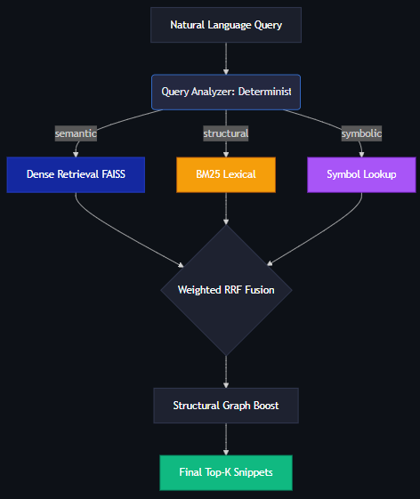
Architecture Diagram

Slide 5
Demo & Product Walkthrough
TRACEIQ Developer Search
1. Enter Query
Natural-language code search
2. Query Understanding
Classifies query intent and selects retrieval strategies
3. Multi-Channel Retrieval
BM25 + Dense + Identifier + Structural search
4. Agentic Refinement
Analyze → Search → Inspect → Refine
5. Ranked Results
File • Function • Lines • Score • Relevant Code
Demo Queries
How is input preprocessed before main?
Where is Bluetooth-settings deeplink used?
Which files call XYZ before ABC?

Slide 6
Tools and tech stack used
Backend
Python
FastAPI
REST APIs
Modular retrieval pipeline
Code Intelligence
JavaScript AST parsing
Tree-sitter / equivalent parser
Symbol extraction
Function/class metadata
Structural relationships
Retrieval
BM25 — lexical retrieval
Dense embeddings — semantic retrieval
Identifier retrieval
AST / structural signals
Hybrid candidate fusion
Reranking
Vector / Search Infrastructure
FAISS / equivalent vector index
In-memory / persistent indexes
Incremental indexing
Frontend
React
TypeScript
Developer-tool oriented UI
Syntax-highlighted code viewer
Engineering
Git / GitHub
Docker
MTEB / CoIR evaluation
CPU-oriented execution

Slide 7
Impact & Use case
1. Developer Productivity
Reduce the time required to locate relevant code in large repositories.
2. Codebase Understanding
Help developers navigate unfamiliar projects through natural-language queries.
3. Debugging & Maintenance
Locate related implementations, usages and structural dependencies.
4. Legacy Code Navigation
Retrieve relevant functionality even when developers don't know exact filenames or identifiers.
5. Version-Aware Code Search
Maintain useful retrieval across evolving repository versions without rebuilding everything from scratch.
Target Users
Software developers
Code reviewers
QA / debugging teams
Engineering teams maintaining large repositories
Developers onboarding onto unfamiliar codebases

Slide 8
Innovation highlights, results and limitations
Innovation Highlights
Adaptive Retrieval — Strategy changes based on query type
Hybrid Search — Lexical + Semantic + Structural signals
Agentic Loop — Search → Inspect → Refine → Search
Version-Aware — Efficient retrieval across code versions
CPU-Oriented — Designed for practical, low-resource execution
Results
Best measured configuration: Dense Only (BGE-small)
NDCG@10: 0.0498
MRR: 0.0422
P50 Latency: 222 ms
P95 Latency: 283 ms
Index Size: 13.2 MB
Key Finding:
Dense retrieval achieved the strongest measured accuracy–latency trade-off in this ablation.
Limitations
Agentic refinement can increase latency
Large repositories increase indexing cost
Retrieval depends on code parsing/chunking quality

Slide 9
What’s next
Phase 1 — Retrieval Quality
Improve query classification
Tune hybrid retrieval weights
Improve code chunking
Optimize reranking
Phase 2 — Repository Evolution
Incremental indexing
Cross-version retrieval
Changed-function detection
Historical retrieval
Phase 3 — Evolutionary Retrieval
Learn from repository evolution:
Version N
↓
Code Changes
↓
Retrieve Related Historical Code
↓
Understand Evolution
↓
Improve Current Retrieval
Phase 4 — Productionization
Larger repository support
Distributed indexing
Persistent indexes
Enterprise authentication
IDE integration
Future Interface
VS Code / IDE plugin
Search your repository directly from the developer workflow.

Slide 10
Brownie points slide( differentiation)
Conventional Code Search
Query
↓
Single Search Method
↓
Results
TRACEIQ
Query
↓
Understand
↓
Classify
↓
Select Retrieval Strategy
↓
Search Multiple Channels
↓
Inspect Candidates
↓
Refine Query
↓
Fuse
↓
Rerank
↓
Top-K
Differentiators
Adaptive
Retrieval strategy changes according to query intent.
Hybrid
Combines lexical, semantic, identifier and structural evidence.
Agentic
Can iteratively inspect and refine retrieval rather than stopping after one search.
Version-Aware
Designed to handle evolving repositories efficiently.
CPU-Oriented
Designed around practical retrieval rather than GPU-heavy generation.
Evaluation-Driven
Every major retrieval component is validated using MRR, NDCG@10 and latency.

Slide 11
Checklist- Updated on Public GitHub
Working prototype code — public or shared GitHub repo (Y/N) - Yes
README with reproducible setup instructions (Y/N) - Yes
Demo video, max 5 minutes (YouTube or Drive link) - Yes
Presentation file (PPT or PDF) (Y/N) - Yes

Slide 12
Thank you
Organised by the Language AI Team and the PRISM Team, Samsung R&D Institute India

