Slide 1




AMERICAN EXPRESS CODESTREET 2026 · IIT MADRAS
ZKD Concierge
Autonomous Travel-Disruption Concierge for Indian Domestic & International Aviation
WHAT WE BUILT
Autonomous Detection
Hold-First Rebooking
Consent-First Booking
Detects issues instantly
Nothing committed until you say go
Confirms before booking
Trained on 7.89M real flights · 4 independent detection channels · 10-factor ranking model · 0.804 ROC-AUC
ZKD Concierge · Team ZKD, IIT Madras · Amex Codestreet 2026
01

Slide 2
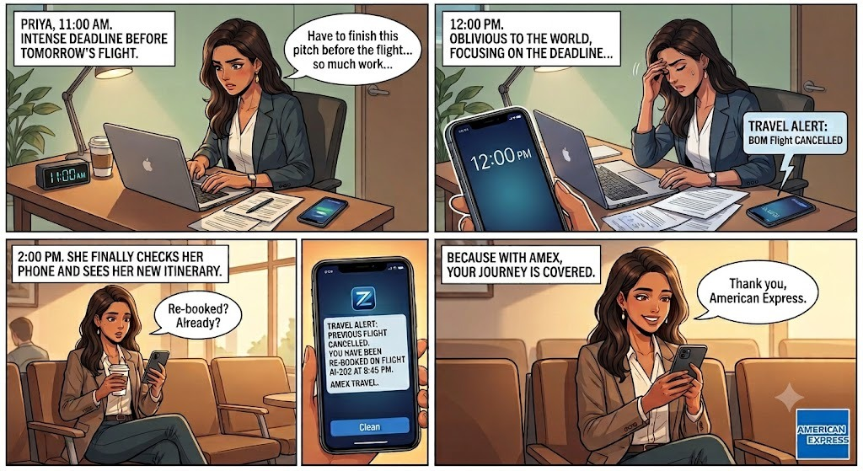

THE MEMBER EXPERIENCE
Priya's Flight Was Cancelled. She Never Had To Deal With It.
One real recovery, from the member's side of the screen — not the ops dashboard.
11:00 AM
Deep in a pitch deadline. Phone face-down.
12:00 PM
Her BOM flight is cancelled. She has no idea yet — the system already does.
2:00 PM
She finally checks her phone: already rebooked, AI-202, 8:45 PM.
At the gate
Boards without one call, one hold, or one scramble.
0 calls made · 3 hrs elapsed unnoticed · 1 new boarding pass, already waiting
ZKD Concierge · Team ZKD, IIT Madras · Amex Codestreet 2026
02

Slide 3









SYSTEM OVERVIEW
How Recovery Happens, End to End
Four coordinated stages carry every disruption from the first signal to a booked, confirmed recovery — and every outcome makes the next decision smarter.
1 · Detection, Corroboration & Notification
2 · Risk & Environmental Scoring
Push webhook, 5-min poll sweep & corroborated member reports converge on one confirmed signal, then a 4-rung consent ladder notifies everyone.
A model trained on 7.89M real flights (ROC-AUC 0.804) blends live weather, airspace & news to predict risk before it is confirmed.
3 · Rebooking & Planning
4 · Smart Ranking & Continuous Learning
A 7-step hold-first pipeline ranks flight, hotel & ground with a 10-factor learned model — nothing booked or spent yet.
A discrete-choice model retrains every 30 minutes from real outcomes, only promoted if it measurably beats what is live.
WHY IT MATTERS — THE PROBLEM AT SCALE
9.5B
1.4%
457 vs 16 min
global air passenger trips in 2024 — 104% of 2019 volume (ACI World / ICAO)
of all US flights cancelled in 2024 — still tens of millions of disrupted itineraries a year (US DOT)
average delay for a disrupted passenger vs. an on-time one — the entire cost sits in that tail (US GAO)
ZKD Concierge · Team ZKD, IIT Madras · Amex Codestreet 2026
03

Slide 4



STAGE 01
NO HUMAN IN THE CRITICAL PATH
Detection, Corroboration & Notification
Three lanes race to one confirmed signal; a member claim is corroborated before it moves the whole flight; a four-rung ladder verifies awareness before any spend.
DETECT — 3 lanes racing
Push / Webhook
Poll Sweep (backstop)
Member Report
Fastest lane; per-flight subscription. Marked unhealthy after 6 hrs of silence — silence is treated as a fault, not good news.
Runs every 5 minutes over the active window. Catches a push the webhook silently dropped — recovers what a change-feed cannot.
A claim, not an event: corroborated by 3 reports, an ops mark, or a stored cancel flag — else one live provider poll settles it.
CONFIRMED detectDisruption(flightId) — idempotent, autonomous: first lane to report wins, every later report is a no-op.
Corroboration settles cheapest-evidence-first: an ops mark, 3 member reports, or a stored cancel flag — all free and instant; otherwise one live provider poll decides. No approval required.
NOTIFY — fan-out to every passenger on the flight, 4-rung consent ladder
Rung 1 · Risk Crossed
Rung 2 · Cancelled
Rung 3 · Pending Spend
Rung 4 · Booked
Alerted as risk crosses a warning band
Immediate confirmed-cancellation notice
Exact amount + countdown to cancel
Final itinerary & ticket confirmation
Delivery-verified safety net
Waits for confirmed delivery of the pending-spend alert, retries once. The system never books blind.
⚠ ESCALATE
Human handoff — only if delivery can’t be confirmed at all
4
5 min
3
Local-only
detection channels — push, poll, member report, manual override
poll-sweep cadence, the reconciliation backstop
independent reports = free corroboration threshold
Flutter push today — fires while app is open; FCM token path to the backend is not yet wired
ZKD Concierge · Team ZKD, IIT Madras · Amex Codestreet 2026
04

Slide 5


STAGE 02
Risk Prediction & Environmental Intelligence
A gradient-boosted model trained on 7.89M real historical flights blends with live weather, airspace & news signals to move ZKD from reactive to proactive.
7.89M
0.804
0.123
5.25x
real historical flights trained on — 7.08M US DOT/BTS + 0.81M Brazil ANAC rows. Zero synthetic rows in the training table.
ROC-AUC — discrimination, not accuracy: odds a random cancelled flight is scored riskier than one that flew.
PR-AUC — precision/recall at a ~1% real cancellation base rate, where AUC alone flatters a rare event. ~12x the base rate.
lift — flights in the riskiest 10% cancel 5.25x more often than the overall base rate.
LIVE ENVIRONMENTAL SIGNALS feeding the ranking of alternatives
Live Weather
Airspace Alerts
World Events
Real ceiling, visibility & wind by airport — live, keyless, no cost
Restriction/advisory feed — real integration, one-country coverage today
Global news scan for unrest/strikes near the relevant airports — live, keyless
HOW A SCORE IS BUILT
1
2
3
4
5
Assemble features in the flight’s own local time (a naive UTC read skews 5.5 hrs for India)
3-tier lookup per signal: real history → synthetic estimate → population average
Score + calibrate: gradient-boosted trees, in milliseconds — 8s/15s are abort ceilings
Adaptive thresholds: seat scarcity, time-to-departure & confidence move 3 action bands
Alert, log to audit, and pre-cache alternatives once risk-percentile is high enough
Critical · every 90s
at hold-gate/pre-authorise, or <3 hrs to departure
Standard · every 10 min
everything not critical or dormant
Dormant · every 30 min
quiet and >24 hrs from departure
Honest cold-start No Indian per-flight dataset exists publicly — training rows are 100% US + Brazil. Every Indian flight is a real inference with population-average, honestly cold-started inputs, never a fabricated number.
ZKD Concierge · Team ZKD, IIT Madras · Amex Codestreet 2026
05

Slide 6


STAGE 03
NO HUMAN IN THE CRITICAL PATH
Rebooking & Planning — Before Anything Is Booked
A hold-first engine ranks flight + hotel + ground with a real, self-learning discrete-choice model. Nothing is booked, held, or spent until the member says go.
INPUT
PROCESSING — LEARNS & RANKS
OUTPUT
Disruption signal — 4 detection channels (push, poll, member report, manual)
1
Search Live parallel search; builds its own connecting itineraries when direct is thin
One ranked, rule-compliant plan per passenger — parked and ready
2
Filter (hard rules) Disqualifies outright — blocked airline, missed deadline, split party, entitlement
Live flight, hotel & ground alternatives — searched fresh in parallel every time
3
Rank (10-factor model) Real discrete-choice model — never ranks cheaper/earlier worse than costlier/slower
Nothing booked, held, or spent yet at this stage
4
Overnight & Ground Hotel + ride added together, only if the gap genuinely spans overnight
Live weather, airspace advisory & news risk for the airports/carriers involved
5
Hold — nothing spent Plan is parked and kept fresh; nothing booked, held, or charged
Auto only if pre-approved, fully autonomous, or silence + confirmed alert delivery
6
Consent or Auto Pre-approved / full-autonomy proceeds; else a time-bound window opens
Member profile, preferences & per-flight overrides — read fresh, never duplicated
Real rollback: essential failure unwinds cleanly; non-essential degrades honestly
7
Execute + Rollback Pay → book → release old ticket last; essential failure unwinds cleanly
Never holds inventory a carrier cancels duplicate holds. The system re-verifies the parked plan instead, with one last check immediately before booking.
The one human step if a decision window lapses without confirmed delivery of the spend alert, the case hands to a human — every other step above runs with zero human involvement.
ZKD Concierge · Team ZKD, IIT Madras · Amex Codestreet 2026
06

Slide 7



STAGE 04
Smart Ranking & Continuous Learning
A conditional-logit discrete-choice model orders every option from 10 signed signals, with a hard safety guarantee and a closed, self-improving training loop.
10
4 tiers
30 min
Never worse
signed signals — arrival, cost, cabin, effort, loyalty, red-eye, seats, stability, weather, advisory
weight resolution: preset → profile warm-start → cross-member pattern → personal pattern
automatic retrain cadence — promotes only if it beats the live version on unseen data
hard guarantee: a cheaper/earlier/less-downgraded option is never ranked below a worse one
CONTINUOUS LEARNING LOOP
Log What’s Shown
Reconcile Outcomes
Retrain (safeguarded)
Promote if Better
Live, Zero Downtime
Every real ranking logged: full option set, signals, order & probabilities
Completed recoveries matched back to what was shown, entirely offline
Weights pulled toward the preset in proportion to real evidence; guarantee enforced every step
Adopted only if it out-predicts live, on data the fit never saw
Same running process reloads new weights instantly — no redeploy
BOOKABILITY — A FIXED PENALTY THE MODEL CAN NEVER LEARN AWAY
~97% a live, currently-valid offer
~72% a confirmed offer with no expiry
~45% anything else, refined as real bookings accumulate
Honest status today every ranking runs on preset + profile warm-start — real, personalized from message one, but not yet shaped by learned patterns. Learned layers auto-engage at ~100s of reconciled decisions/goal, or a few dozen per member.
ZKD Concierge · Team ZKD, IIT Madras · Amex Codestreet 2026
07

Slide 8




BUSINESS IMPACT · 01
Driving Deep Engagement & Loyalty
Proactive alerts and real, time-bound choices keep members engaged inside the Amex ecosystem — and every zero-surprise recovery compounds into lasting trust.
MEMBER TOUCHPOINTS
Proactive, Not Reactive
Rung-1 risk alerts reach members before a disruption is even confirmed
Push
SMS
WhatsApp
Interactive Decisions
Members see live rebooking bundles and make a real, time-bound choice
69.57%
Trust Compounds
modelled same-day recovery rate — up from 65.48%, now driven by the risk model’s own measured recall, not a hand-picked guess
A zero-blind-spend guarantee — members never get an unwelcome card surprise
One Seamless Bundle
Flight + hotel + ground handled as one recovery, not three separate headaches
Consent Every Time
A time-bound window puts control back in the member’s hands
Amex-Native Experience
Every recovery reinforces the card that takes care of you mid-journey
ZKD Concierge · Team ZKD, IIT Madras · Amex Codestreet 2026
08

Slide 9
BUSINESS IMPACT · 02
Experience, Metrics & Growth KPIs
What each model reports today, in its own numbers — and exactly what we'll watch next, in plain English, no internal codes.
RISK PREDICTION MODEL
RANKING MODEL
7.89M
real flights trained on
0.804
discrimination score, not accuracy
0.123
precision/recall at ~1% base rate
5.25x
riskiest decile vs. base rate
10
real factors weighed together
30 min
automatic retrain cadence
Auto-checked
only promoted if it beats what’s live
Never worse
cheaper/earlier option never ranked below a worse one
Feeding the model back into the business case the risk model’s own real recall at its production gate (70% of cancellations caught, replacing a hand-picked 55% guess) lifts modelled same-day recovery from 65.48% to 69.57%.
WHAT WE'LL MONITOR NEXT — IN PLAIN ENGLISH
WHAT WE TRACK
WHAT IT MEANS
STATUS
How Fast We Notice a Problem
Minutes between a disruption happening and our system actually knowing about it.
Not built yet
How Fast We Get a Plan Ready
From "we know" to a checked plan waiting for approval — on every real recovery.
Measured today
How Often a Human Had to Step In
Share of cases where a member took over instead of letting the system finish.
Measured today
Was Our Warning Actually Right?
Of the flights flagged as risky, how many really were — one logging step from live.
Blocked on one fix
Did the Member Leave Happy?
A direct rating captured right after a recovery closes — nothing collects this yet.
Not built yet
Biggest single unlock one engineering change — logging what actually happened to each flight — switches on the accuracy check and most of what comes after it.
ZKD Concierge · Team ZKD, IIT Madras · Amex Codestreet 2026
09

Slide 10

FUTURE ASPECTS · 01
System Design at a Glance
One continuous application process, a separate real risk-scoring service, and a consent ladder that shows the exact net amount — after the refund on the original ticket — before anything is charged.
Solid line
real, wired, running today
Dashed line
built & tested, not yet connected
Blue
core application logic
Violet
prediction & ranking intelligence
Amber
consent & member notifications
Red
irreversible, or the one human handoff
ONE APPLICATION PROCESS
A SEPARATE, REAL SERVICE
EXTERNAL SUPPLIERS
Detection webhook status poll + member report, 3 lanes
Duffel
flights — search + write, real cancel
wired
Risk-scoring service
Python · gradient-boosted trees, trained on 7.9M real US + Brazil flights. Runs locally, real & reachable today.
Risk Forecast Client assembles features, reads adaptive bands
Preference Intent free-text chat, live before booking
OAG
schedules — real, needs detection subscription
wired (search)
Lifecycle Engine deciding → waiting → choosing → acting
Policy Gate default-deny hard checks — built & tested
Travelport
flights — sandbox, non-live inventory
sandbox
Cloud deployment (dashed)
Weekly retrain, built & validated infra-as-code — never switched on. $140 credit reserved for demo week.
Ranking Engine learned discrete-choice model over the portfolio
LiteAPI
hotels — real, sandbox
Execution Saga reserve → flight → hotel → ground → dispose original
sandbox
Notification Dispatch four-rung consent ladder
Uber Sandbox
ground — real, cancel/rollback tested
sandbox
Escalation Classifier the ONE human handoff — fires only when consent/delivery can’t resolve
Contact: one network call. Either side can be down without crashing the other.
Critical path, ranked flight-status push feed → booking API with real cancel → single-use payment credential → push transport. Weather/history improve lead time, not correctness.
ZKD Concierge · Team ZKD, IIT Madras · Amex Codestreet 2026
10

Slide 11

FUTURE ASPECTS · 02
From Hackathon Build to Production-Ready
The core recovery engine already works end-to-end. Here's what we'd build next to take it into members' hands.
Real Airline & Hotel Partnerships
Automatic Reschedule
Wider Disruption Coverage
Learning at Scale
Move from sandbox test integrations to live, licensed booking partnerships
Let members reschedule their existing ticket directly, not just rebook a new one
Extend beyond cancellations to delays, missed connections & multi-city trips
Run the preference-learning loop across millions of members, improving every trip
ZKD Concierge · Team ZKD, IIT Madras · Amex Codestreet 2026
11

Slide 12
AMERICAN EXPRESS CODESTREET 2026 · IIT MADRAS
Thank You
Built end-to-end, run live, and honest about what still needs a human — for now.
69.57%
modelled same-day recovery
7.89M
real flights trained on
4
independent detection channels
0 humans
in the critical path, by default
TEAM ZKD
ZKD Concierge · Team ZKD, IIT Madras · Amex Codestreet 2026
12

