Slide 1
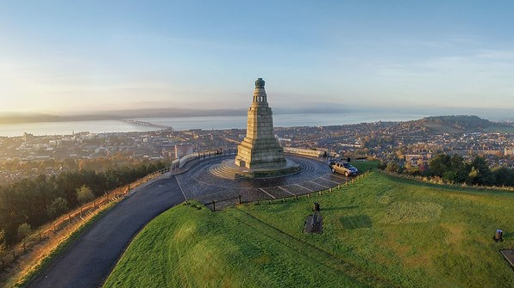


OpenStreetMap United Kingdom is excited to welcome the community to Scotland’s cultural centre for two days of exchanging results, ideas, projects, and more.
Take a look at the website for all the
latest information, early bird tickets, and travel/accommodation discounts.
https://2025.stateofthemap.eu
Image courtesy of: “One City, Many Discoveries”

