Slide 1
DATA VISUALIZATION CONCEPTS
DR. NANDKUMAR KHACHANE

Slide 2
DEFINITION OF DATA VISUALIZATION
Visualization is a cognitive process that allows to form a mental image to gain insights, discover, make decisions and explain. Data Visualization is the use of computer-supported, interactive visual representations of data to amplify cognition.

Slide 3
BASIS OF DATA VISUALIZATION
There are 3 main subfields of Data Viz :
Scientific visualization, whose role is to model real-world phenomena
Information visualization, whose role is to map a more abstract concept into 2D or 3D for decision making and analysis purposes
Visual analytics, which is the frontier of Data mining and Machine Learning
There are 3 main types of variables :
Qualitative (Nominal or ordinal)
Quantitative
Metadata which is descriptive information about the data

Slide 4
WHY USE DATA VISUALIZATION?
We use Data Viz to help people rapidly narrow in from a large space and find parts of the data to study more carefully. Visualization and visual contents have been chosen since among the human senses, the vision has the highest band with, with over 100Mb/s theoretically. Ears only allow the processing of 100 bytes/second on the other hand.
We use the viz for better decision making, better anomaly detection… Overall, we want the end-user to be better and more effective at his task. Computers allow simply to map a large volume of data and to update the visualization as often as needed.

Slide 5
DATA MAPPING
How do we map data to a *representation *?
We first define a space, usually using axis
Then we define the marks we’ll be using, which are the things that occur in the space (points, stars, dots…)
Then the graphical properties of marks (size, position, orientation, color, texture…)
Our aim should be to increase the use of space, encode data, and make the graph efficient. There are overall only 5 main categories of graphs :
Data tables, like Excel Sheets for example

Slide 6
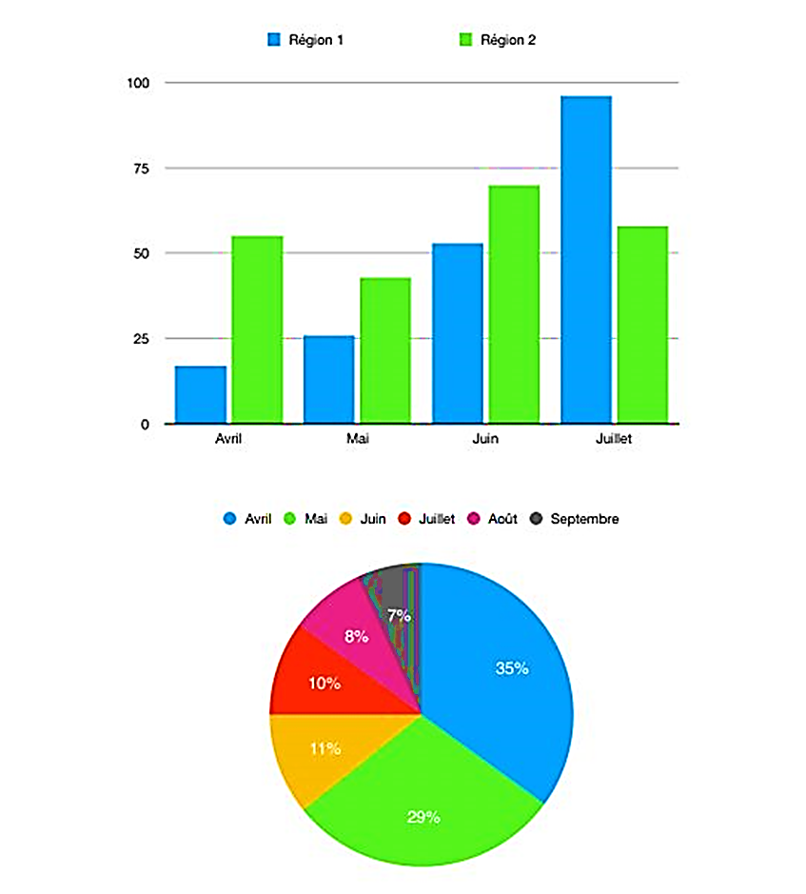
Graphs on rails or planes (visually, we can see a 1D plot as a single rail, a 2D plot as a combination of rails, a Pie chart as a single rail folded…)

Slide 7
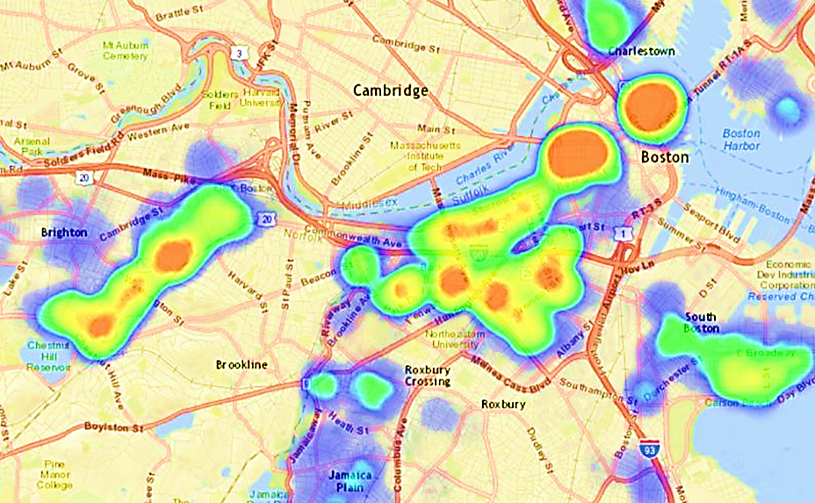
Geospatial maps, which is the mapping of the latitude and longitude on a 2D plane, in which we can add some information (features on a map, size of components…)

Slide 8
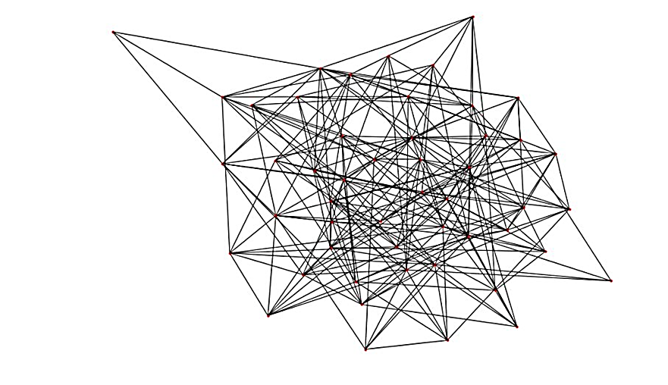
Network diagrams, whose role is to display the relation between items. In such diagrams
Symbols and conceptual images, which can be any logo whose aim is to present an information (e.g the PEGI 12 logo on a video game)

Slide 9

MARKS AND CHANNELS
These are the building blocks of a design space of visual encodings.
Marks are basic geometric elements that depict items or links (point, line, area)
and channels control their appearance, independently of the dimensionality go the geometric primitive. (position, color, shape, tilt (angle), size)

Slide 10
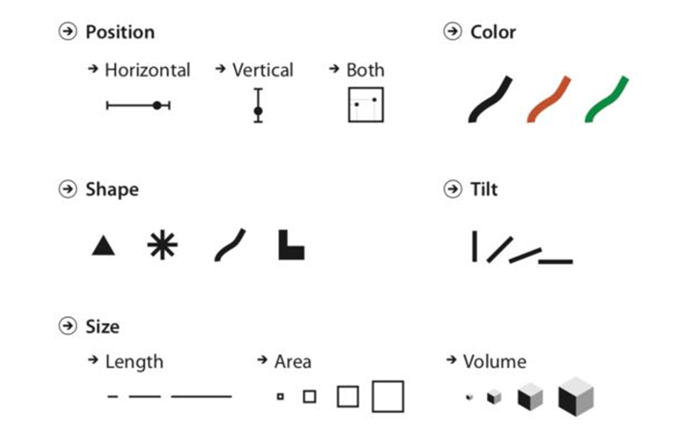

Slide 11
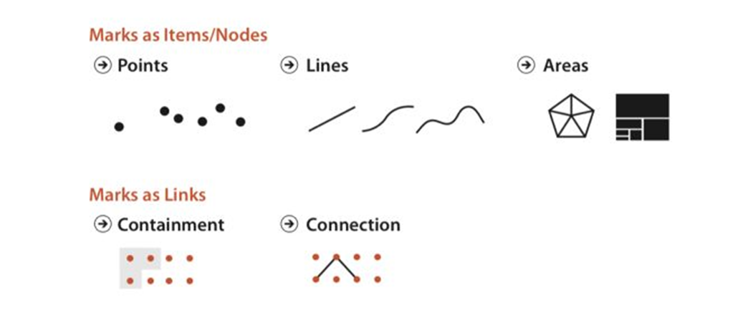
Usually, a mark represents an item. (In a table dataset for example). In a network dataset, a mark can represent an item (node), or a link between items. There are 2 types of link marks :
Connection mark shows a pairwise relationship between 2 items using a line
Containment marks show hierarchical relationships using areas, nested in each other at multiple levels

Slide 12
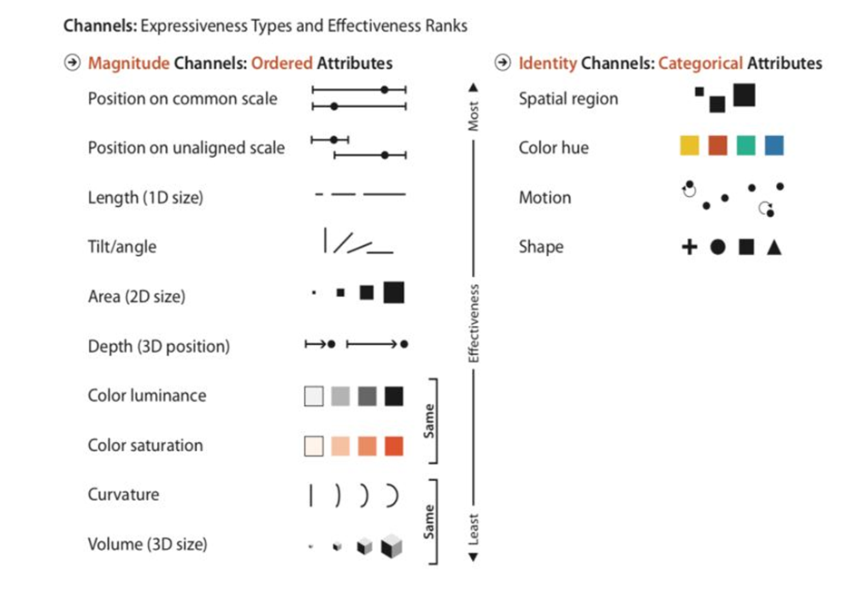

Slide 13
FAMOUS TOOLS
Along with matplotlib, pandas, seaborn…, there are some really good tools that are used for Data Visualization :
Tableau, for drag&drop UX, and great dashboards
Altair, for a programmatic tool similar to Tableau, in Python
D3.js for interactive JS graphs

