Slide 1

Credit Chronicles
Team 8
Tulasi Thotakura
Sai Krishna paila
Gourab mukherjee

Slide 2

INTRO
Credit cards offer convenience for making purchases, both in-store and online, without the need for carrying cash.
They provide financial flexibility, allowing individuals to spread the cost of purchases over time through monthly payments.
By delving into attributes such as customer age, income, credit card usage, and more, we'll be equipped to analyze the key relationships in the data.
It's crucial for all income levels to manage credit card debt carefully. High-interest rates on unpaid balances can lead to financial strain, and this is a concern for both higher and lower-income individuals.

Slide 3
DATA AND ITS ATTRIBUTES
We utilized a dataset containing detailed information on 10,127 clients and their financial interactions consisting of 23 attributes.
Demographics, finance, and transactions in this dataset provide a comprehensive view of customer well-being and engagement.
Categorical Variables | Numerical Variables | Numerical Variables
Attrition_Flag | Customer_Age | Avg_Utilization_Ratio
Gender | Dependent_Count | Months_on_book
Education_Level | Total_Relationship_Count | Months_Inactive_12_mon
Marital_Status | Contacts_Count_12_mon | Credit_Limit
Income_Category | Total_Revolving_Bal | Avg_Open_To_Buy
Card_Category | Total_Amt_Chng_Q4_Q1 | Total_Trans_Amt
 | Total_Trans_Ct | Total_Ct_Chng_Q4_Q1

Slide 4
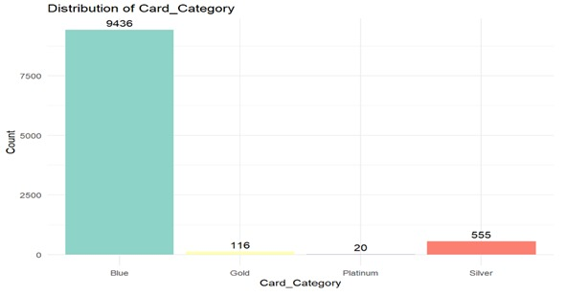
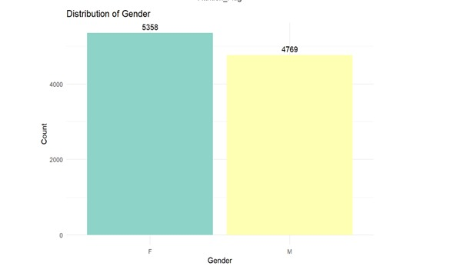
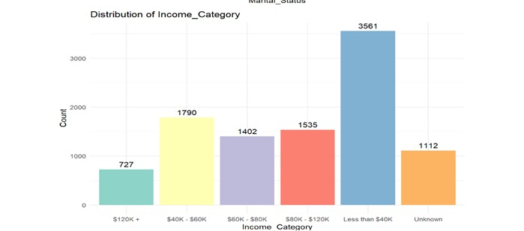
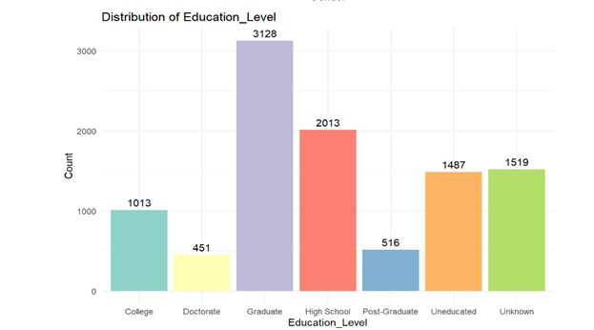
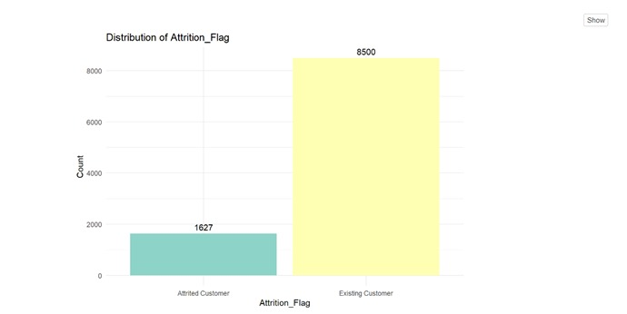
EDA- Categorical

Slide 5
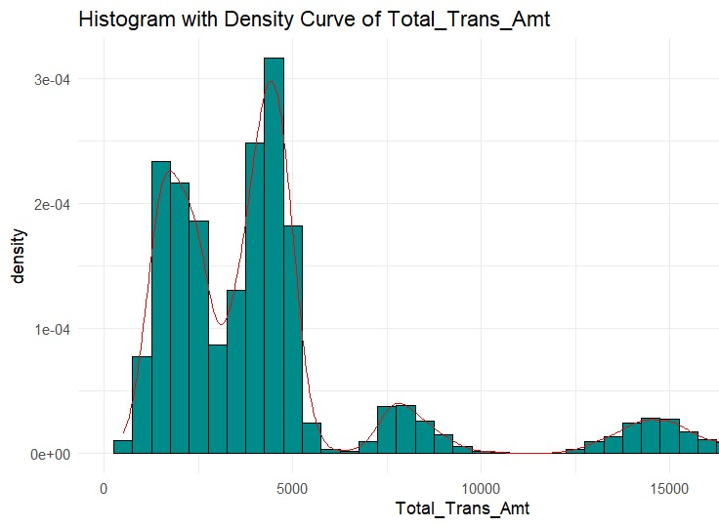
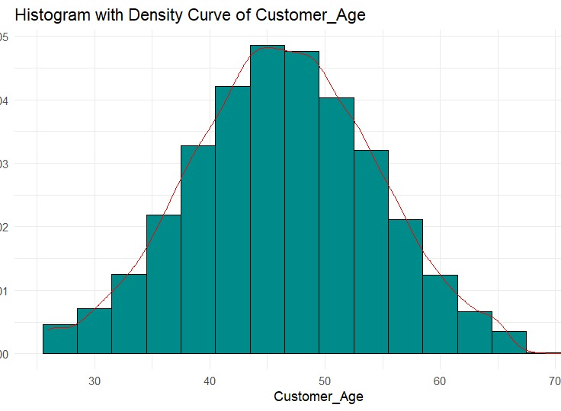
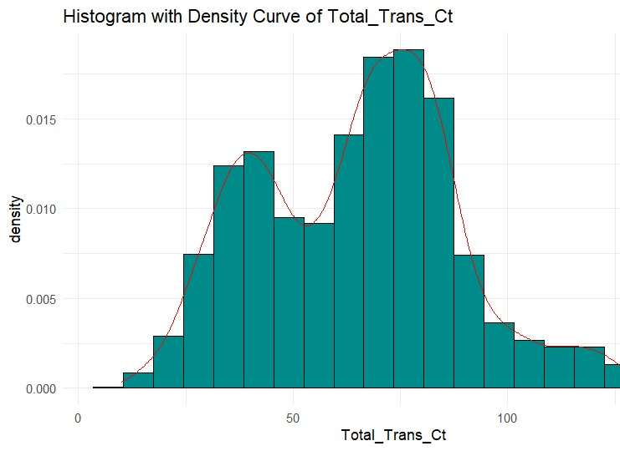
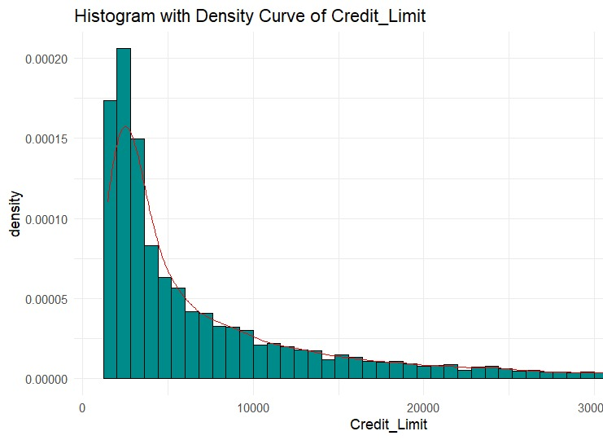
EDA-Numerical

Slide 6
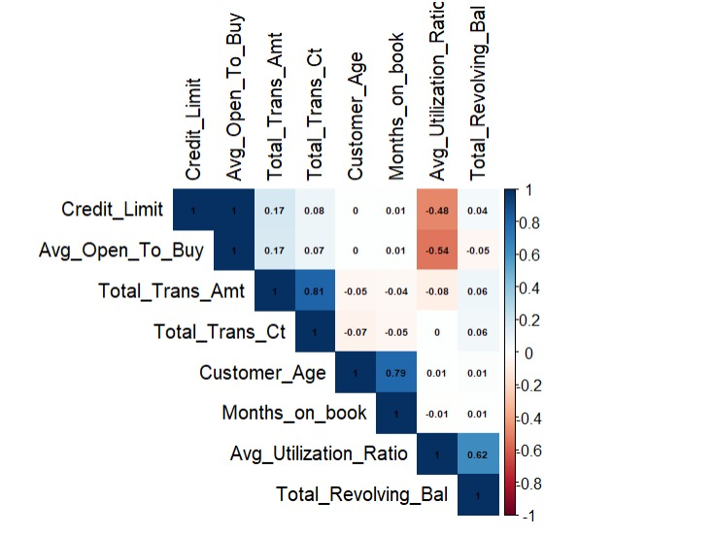
Correlation Analysis

Slide 7
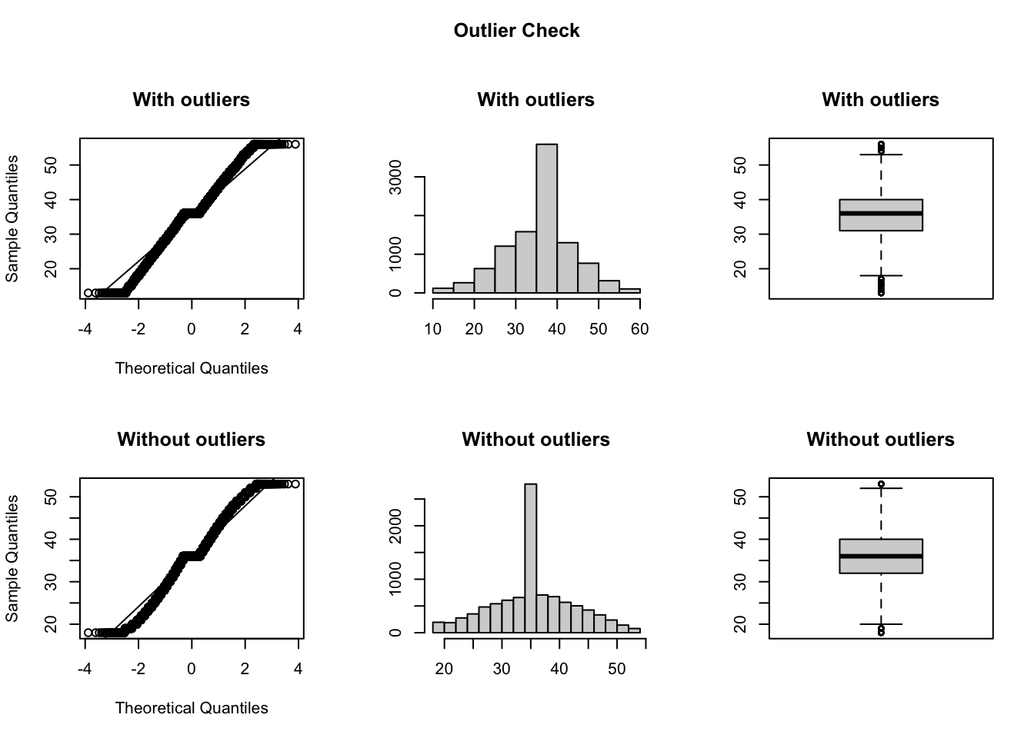
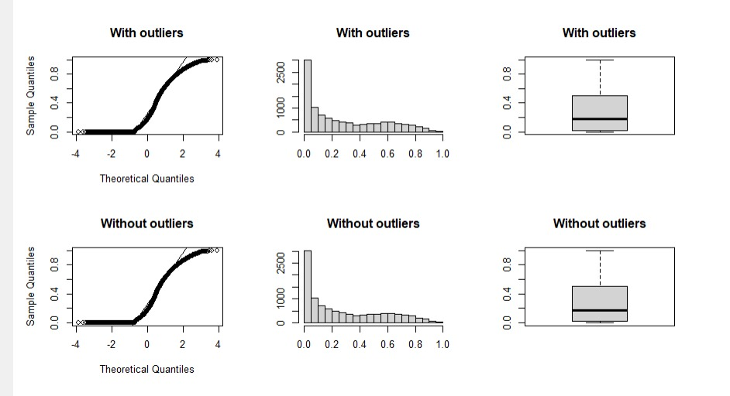
Outlier Detection and Removal
Credit Limit
Avg utilization Ratio

Slide 8
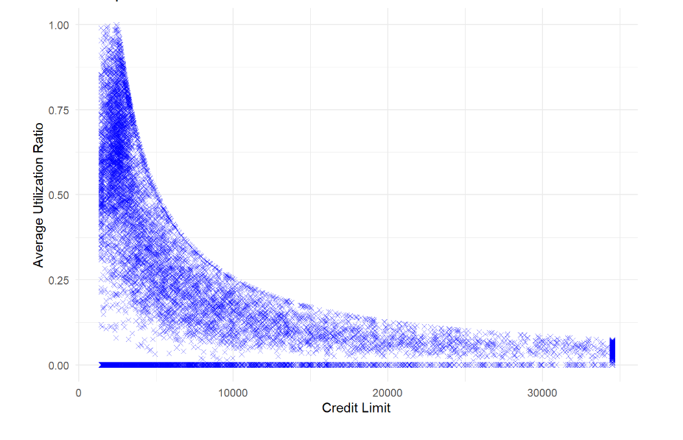
Credit Utilization Analysis
Credit Utilization Analysis: How does a client's average utilization ratio relate to their credit limit, and what can be done to encourage responsible credit utilization?
Responsible Credit utilization can be increased by
1.Financial Education
2.Clear and Transparent Information
3.Credit Limit Setting
4.Credit Monitoring and Alerts
5.Responsible Lending Practices

Slide 9
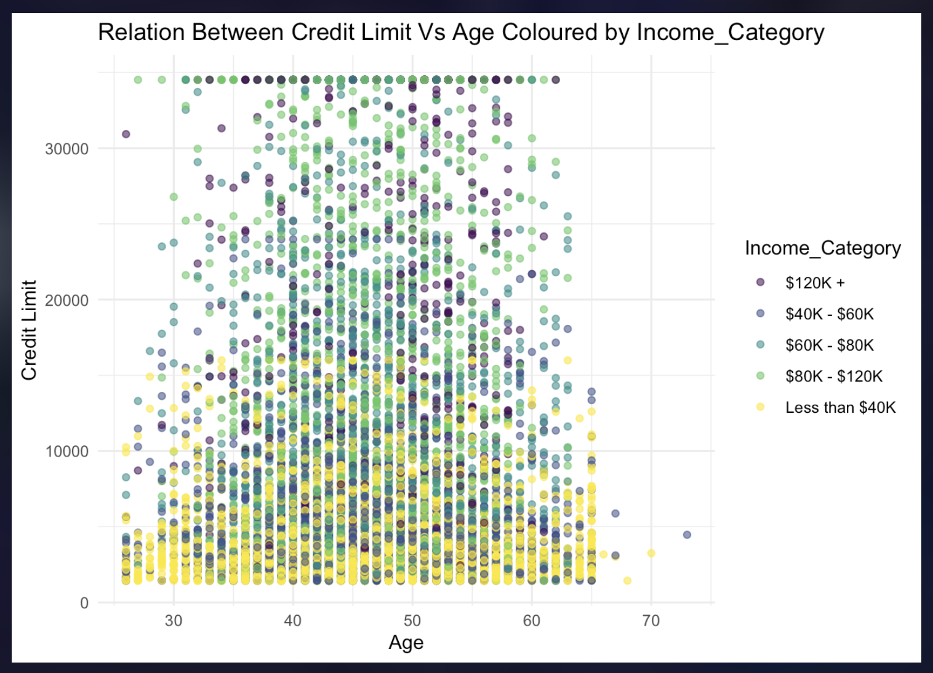
Relationship between Variables

Slide 10
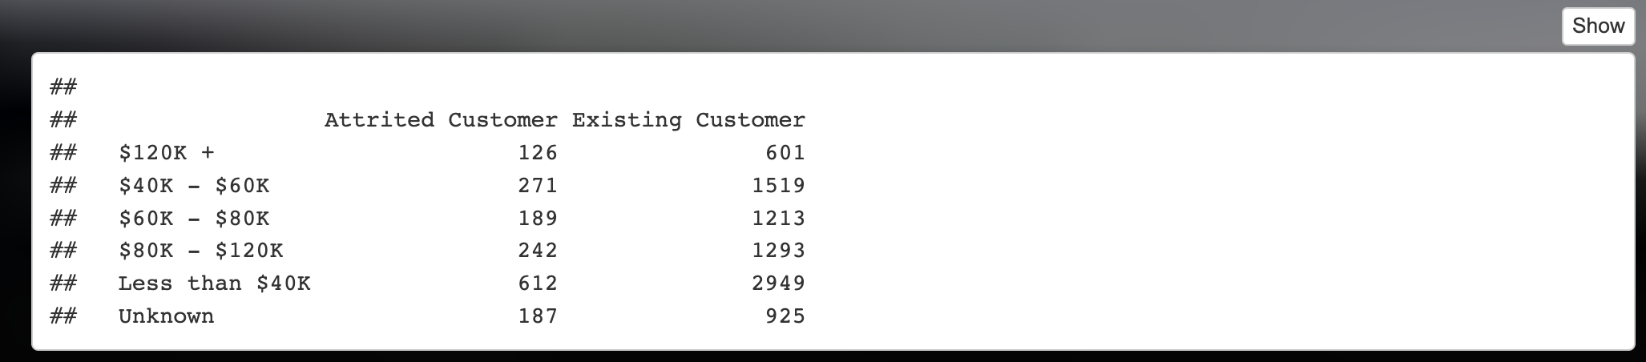

Income Category and Churn
Income Category and Churn: Do clients in higher income categories have a lower attrition rate.
NH: The attrition rate (churn rate) is the same across all Income categories.
AH: The attrition rate differs between at least two Income categories.
P-Value = 0.03

Slide 11
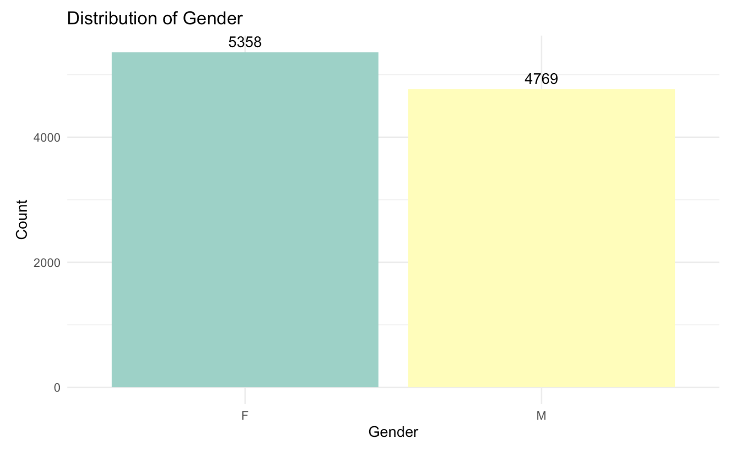
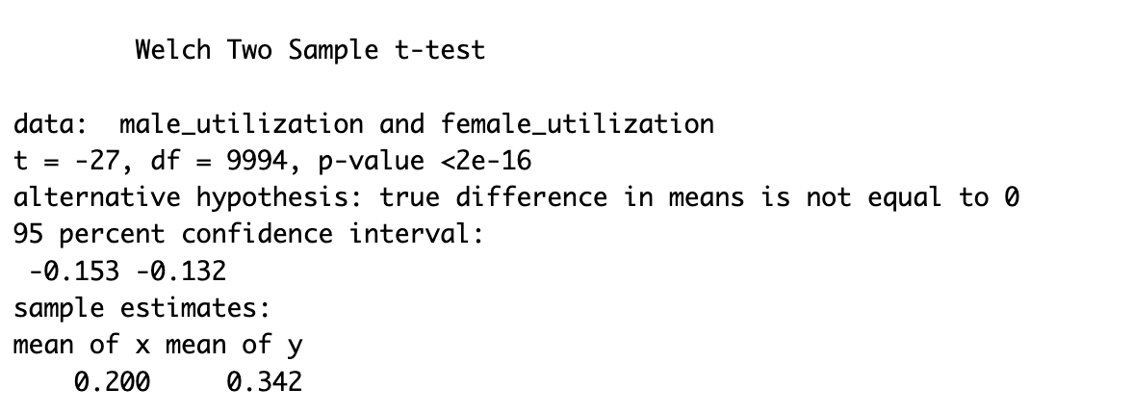
Credit Utilization Across Gender
Null hypo : The mean credit utilization ratio is the same for both genders.
Alternative : The mean credit utilization ratio is different for males and females

Slide 12

Thank You
PAY YOUR CREDIT CARD BILL ON TIME !!!!

