Slide 1

Credit Chronicles

Slide 2



Team Members
Sai Krishna
Tulasi
Gourab

Slide 3

Recap
Overview of Dataset
EDA- Categorical & Numerical
Correlation Analysis
Outlier Detection and Removal
Credit Utilization Analysis
Relationship between Variables
Churn (chi square) & Credit Utilization Across Gender (T-test)

Slide 4

Project Flow
Identification of Targeted Variable
Attrition Realtionships
Splitting the Dataset
Training and Testing
Modelling
ROC & AUC
Comparison of Model Accuracy

Slide 5
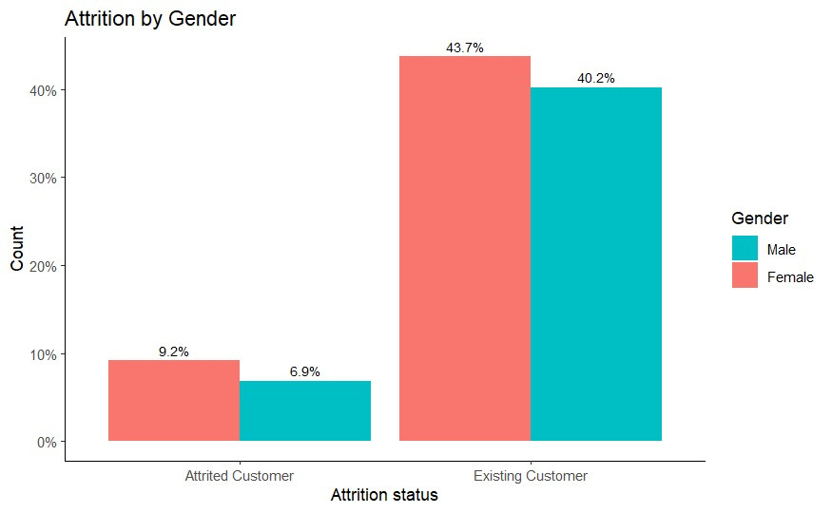
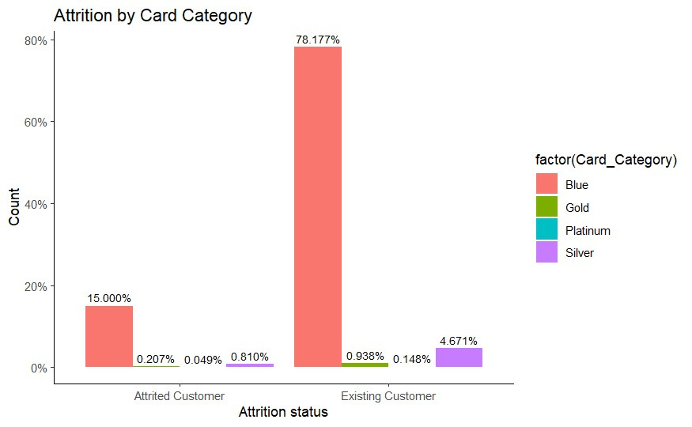
Analysis of Attrition Flag
Attrition by Gender
Attrition by Card Category

Slide 6
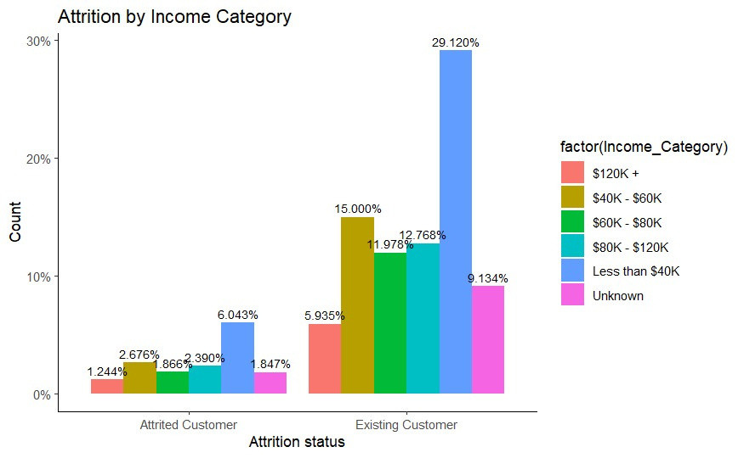
Attrition by Income Category

Slide 7

Testing & Training
We achieved to split the dataset in the ratio of 80:20 for modelling.

Slide 8

It's time to do Modelling
01 | Logistic Regression
 | Predicts the probability of a binary outcome by fitting data to a logistic curve.
02 | Decision Tree
 | Makes sequential decisions based on data features to predict outcomes by creating a tree-like structure.
03 | Random Forest
 | Uses multiple decision trees to make more accurate predictions in classification and regression tasks by aggregating their outputs.

Slide 9

Evaluating Metrics

Slide 10
 | Accuracy |  | Recall
 | Indicates the overall correctness of the model's predictions. |  | The ability to capture actual positive cases.
 | Precision |  | F1 score
 | The accuracy of the positive predictions. |  | A balance between precision and recall.
01
02
03
04

Slide 11
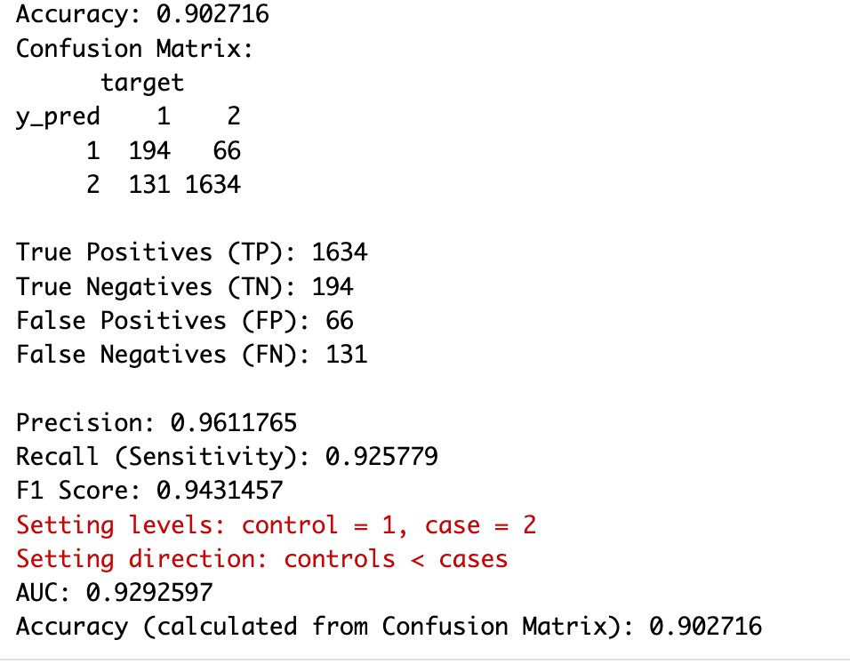
Logistic Regression
Confusion Matrix :
Model is effective in correctly predicting both positive (customer leaves) and negative (customer stays) cases.

Slide 12
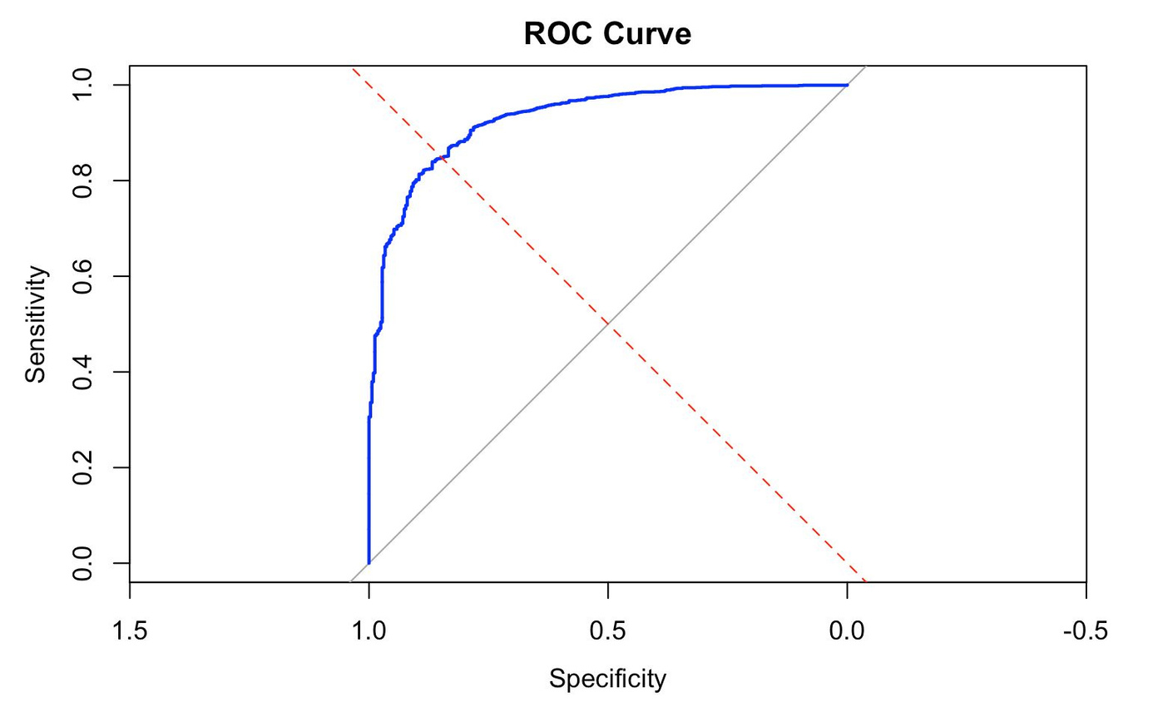
ROC Curve of LR
The ROC curve suggests a strong performance of the LR, with a high true positive rate and a low false positive rate. The curve indicates a significant area under the curve (AUC), demonstrating the model's good discriminative ability between the two classes.

Slide 13

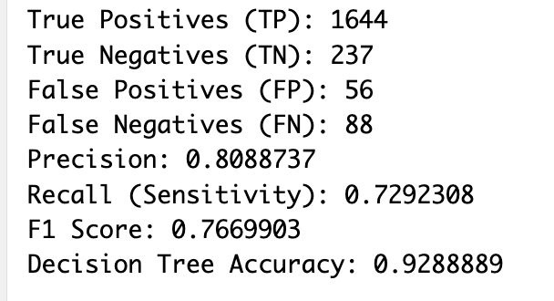
Decision Tree
They make decisions by recursively splitting the dataset into subsets based on the most significant attribute.

Slide 14

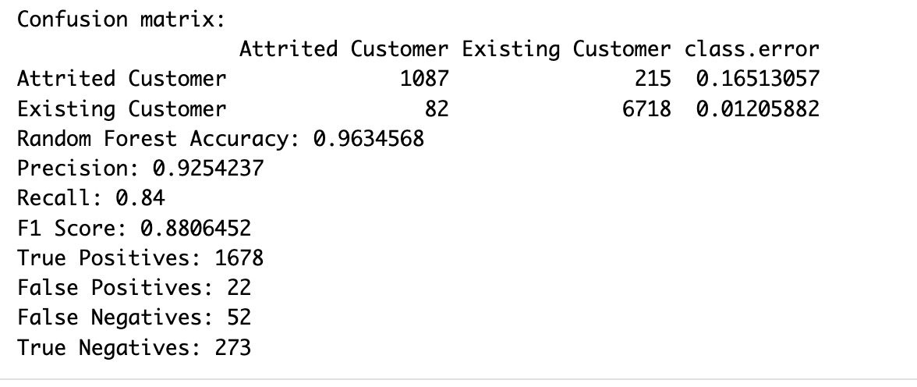
Random Forest
Random Forest is an ensemble learning method that builds multiple decision trees during training.

Slide 15
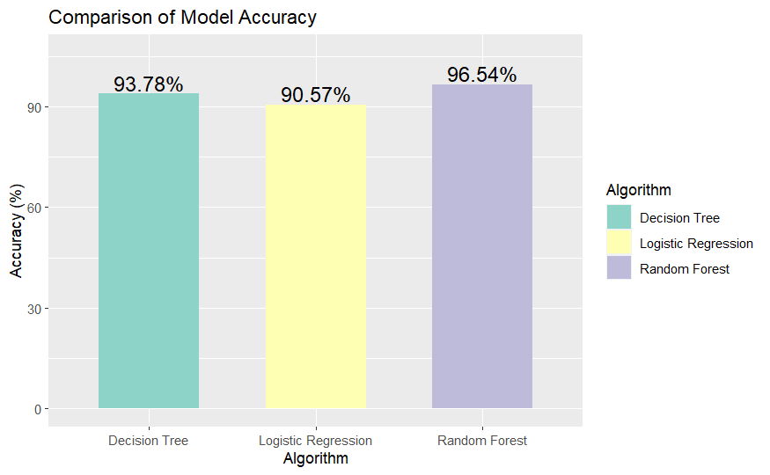
Comparative Analysis of Model Accuracies
Random Forest outperforms other models, exhibiting the highest overall accuracy

Slide 16


Logistic
Regression
Random
Forest
Decision
Tree

Slide 17

THANK YOU
QUESTIONS?

