Slide 1
IBM University Engagement Project Submission
“Exploring the Power of Agentic AI with IBM Granite and IBM Bob”

Slide 2
Project Tile –
Domain of Project – Education
Student Name | Recent Passport Photo | Email ID | Mobile number [WhatsApp]
Krishna Bakde |  | krishnabkd@gmail.com | 9131154307
Recommended font style and size: Font Style: Arial Font Size (Heading): 28
Font Size (Content): 20

Slide 3
Problem Statement – EduPath – AI Career Guidance Agent
The Challenge : Students often struggle to choose the right stream, course, and career path. Information about courses, skills, colleges, and job opportunities is scattered across different sources. Without personalized guidance, students may make uninformed academic and career decisions.
The Objective : Build an AI-powered Career Guidance Agent that provides personalized academic and career guidance for students. The solution should:
Career & Stream Guidance – Recommend suitable streams and courses based on interests and goals.
Learning Roadmaps – Provide year-wise study plans, skills, and certifications.
Career Information – Offer details on courses, colleges, entrance exams, and job opportunities.
Personalized Recommendations – Suggest projects, internships, and learning resources.
Multi-Agent System - Career Guidance Agent
Roadmap Agent
Skill Development Agent
Career Insights Agent
Student Dashboard – Display profile, roadmap, recommended skills, and career progress.

Slide 4
Proposed Solution - EduPath – AI Career Guidance Agent
The proposed solution is an AI-powered Career Guidance Agent built using IBM watsonx Orchestrate, IBM BOB, Python Flask, and Granite Models to provide personalized academic and career guidance.
The system consists of four key agents:
Career Guidance Agent – Recommends suitable streams and career paths.
Roadmap Agent – Generates year-wise learning plans, skills, and certifications.
Career Insights Agent – Provides information on courses, entrance exams, colleges, and job opportunities.
Skill Development Agent – Suggests projects, internships, and learning resources.
The application includes an AI chatbot, student profile, career dashboard, stream selection, and learning roadmap to help students make informed career decisions.
IBM BOB is used for application development, watsonx Orchestrate manages AI workflows, and Granite Models provide intelligent recommendations.
Overall, EduPath offers a smart, personalized platform that helps students confidently plan their education and future careers.

Slide 5
Technology Used
IBM BOB Platform – For developing the EduPath web application and integrating AI workflows.
IBM watsonx Orchestrate – For creating and managing the EduPath AI agent.
IBM Granite Models (e.g., granite-3-2-8b) – For career guidance, reasoning, roadmap generation, and personalized recommendations.
IBM Cloud – Provides a secure and scalable platform for deploying and managing the AI application.
Python Flask – Backend framework for handling APIs, routing, and application logic.
Bootstrap, HTML, CSS & JavaScript – For building a responsive and interactive user interface.
GitHub – For version control and project collaboration.

Slide 6
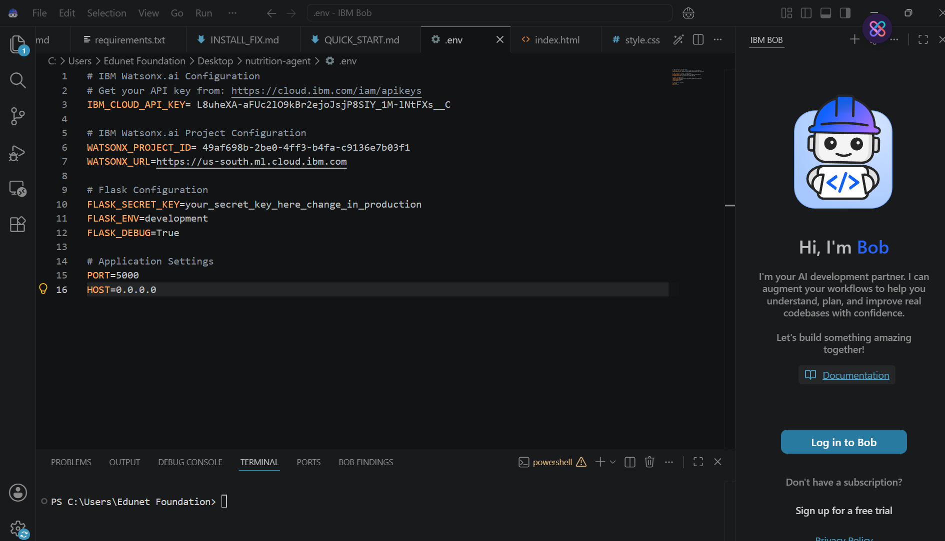
Required Files created using IBM bob -
App.py
Requirements.txt
Style.css
.env
Index.html

Slide 7
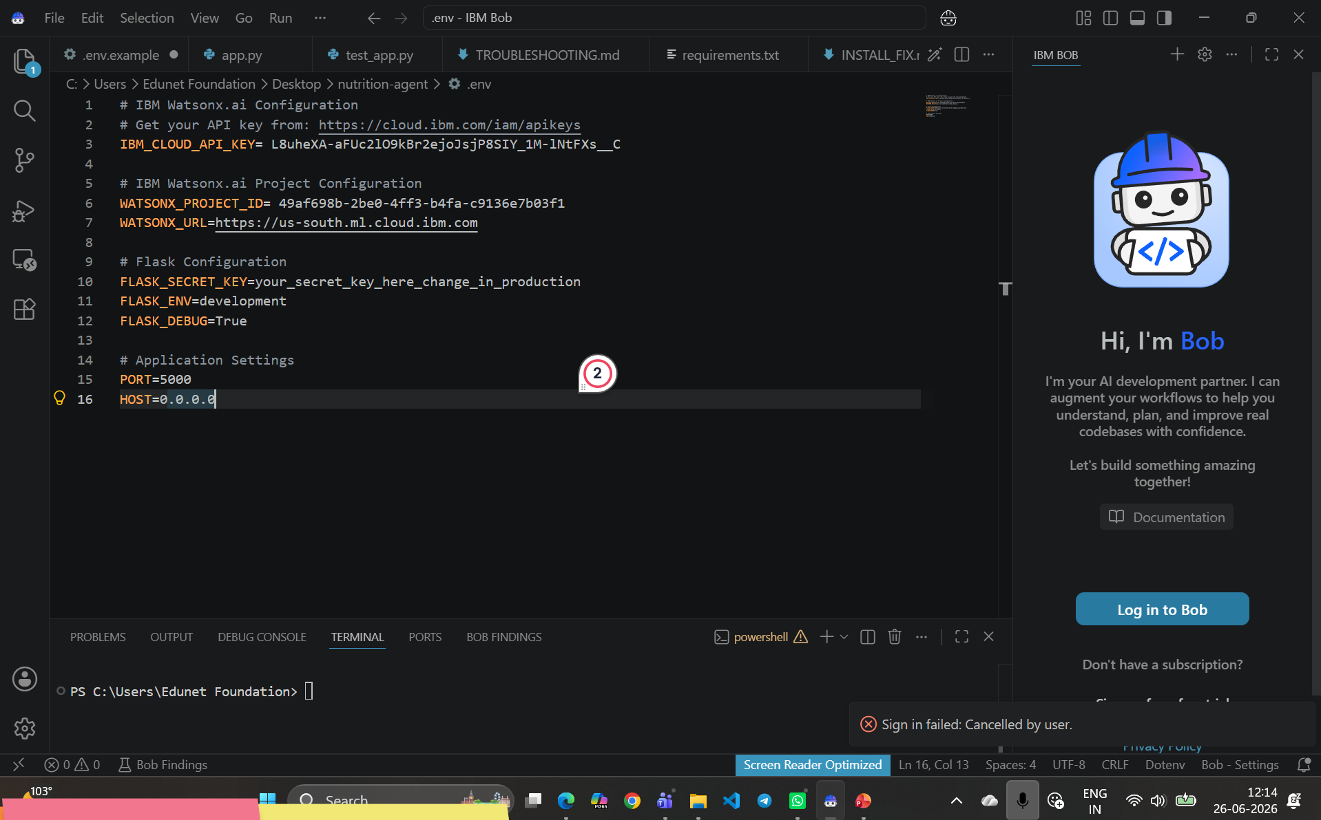
IBM Bob Screenshots:

Slide 8
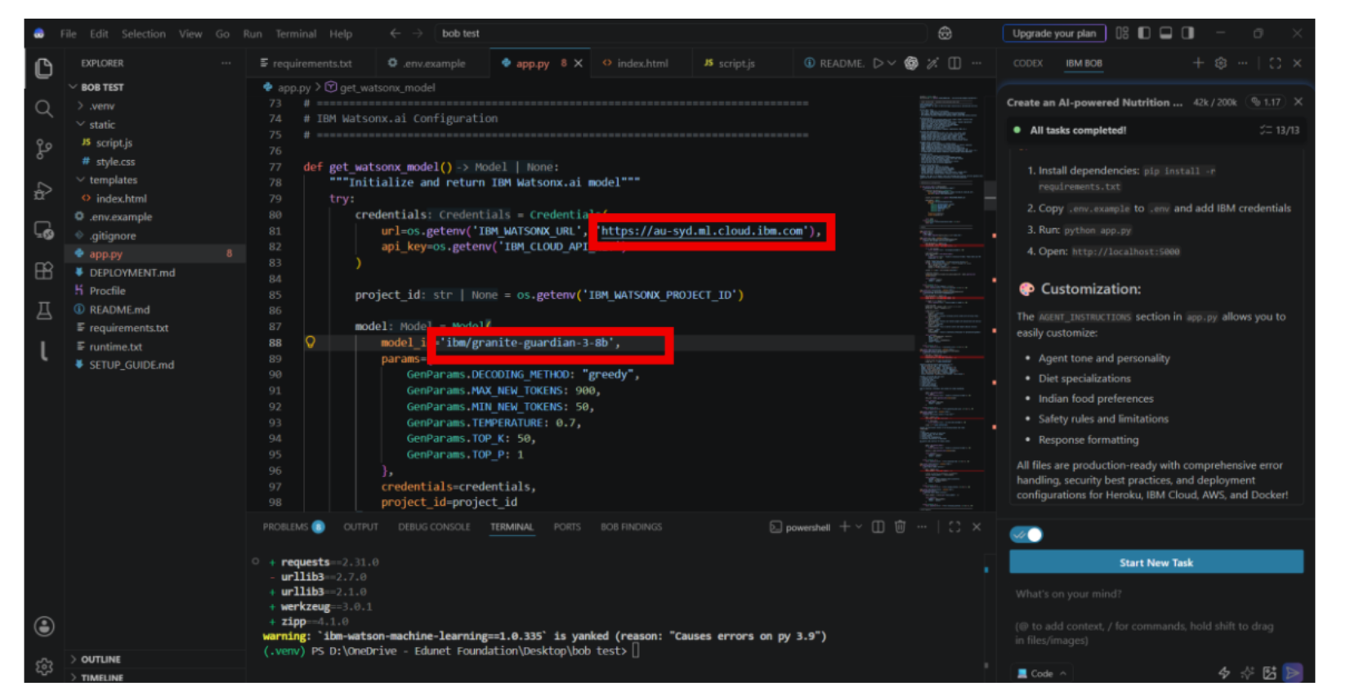

Slide 9

Architecture blueprint for IBM bob:

Slide 10

Role of Agentic AI in the solution for EduPath
Agentic AI enables EduPath to act as an intelligent career guidance system rather than a simple chatbot. Using IBM watsonx Orchestrate and Granite Models, it coordinates multiple specialized agents to provide personalized academic and career guidance.
Each agent performs a specific task, such as career guidance, roadmap generation, career insights, and skill development, while working together to deliver accurate recommendations.
Agentic AI understands a student's interests, strengths, academic background, and career goals to generate personalized suggestions. It also adapts recommendations based on user inputs and learning progress.
Overall, Agentic AI makes EduPath smart, personalized, and goal-oriented, helping students make informed decisions about their education and future careers.

Slide 11
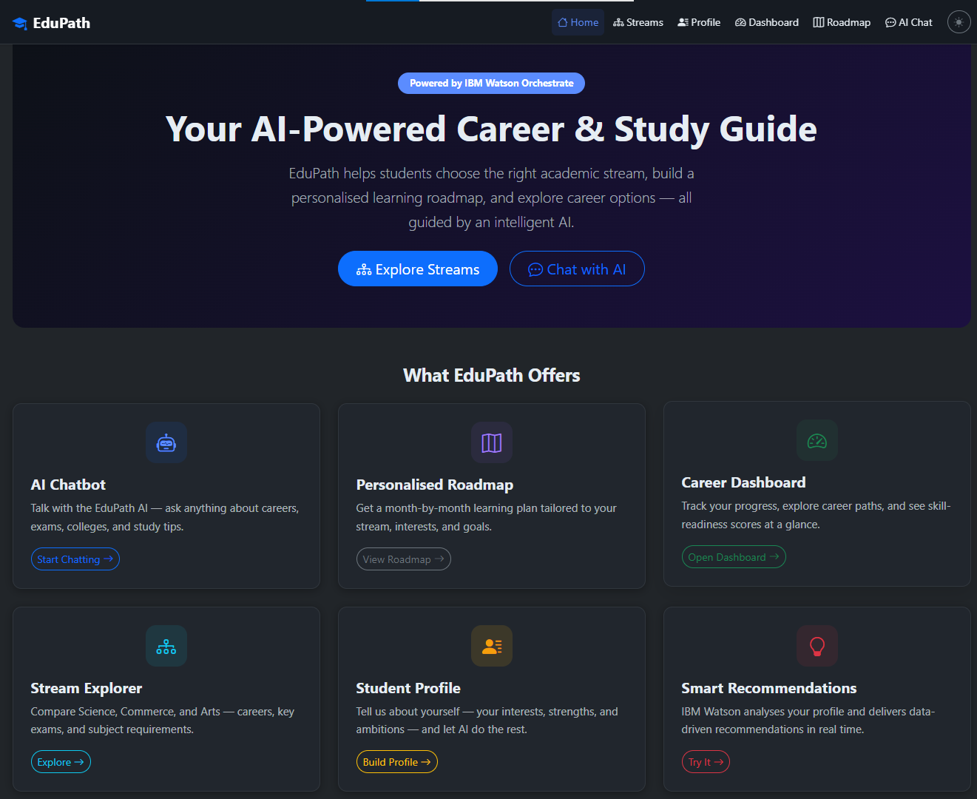
Project Output - Home Screen
·
·
·

Slide 12
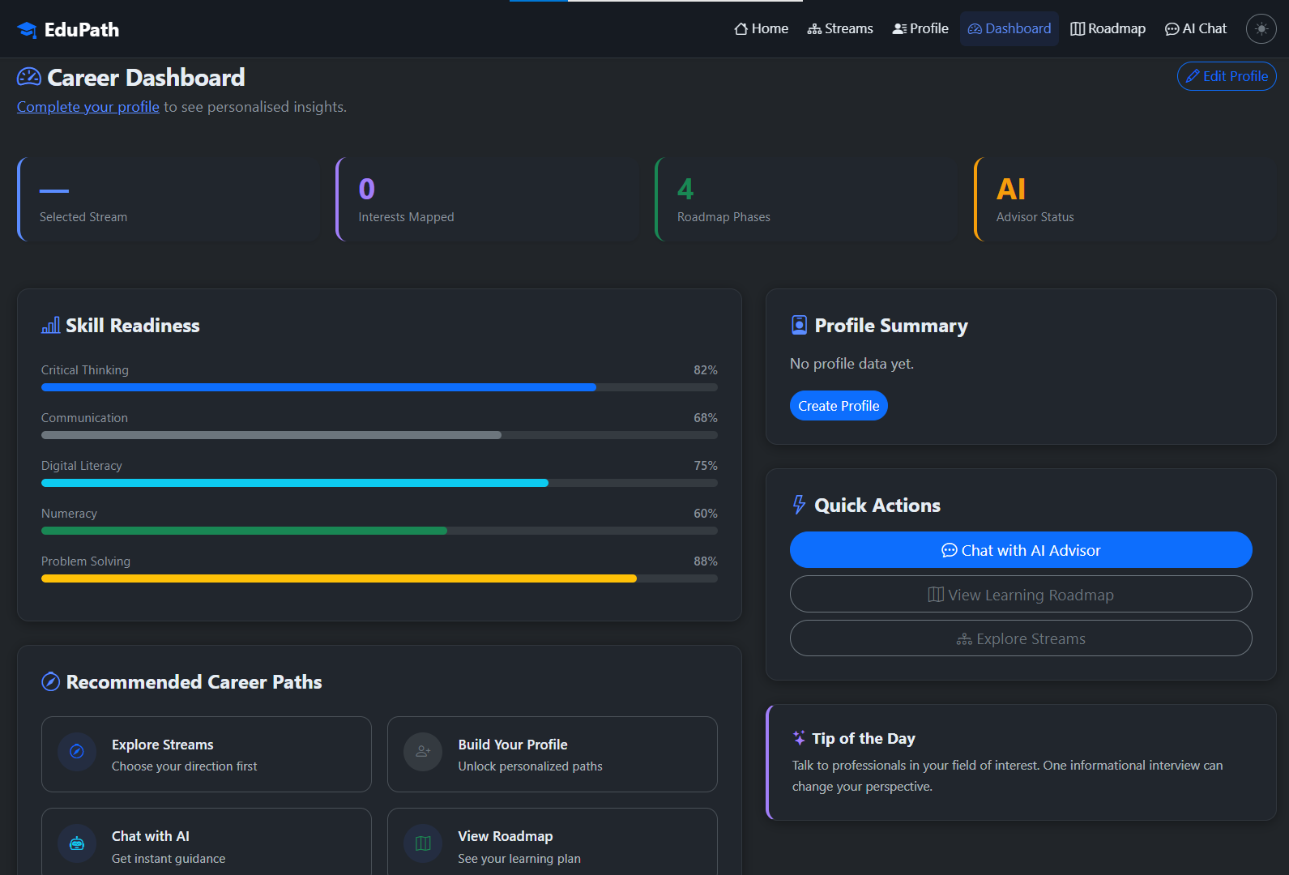
Project Output - Dashboard
·
·
·

Slide 13
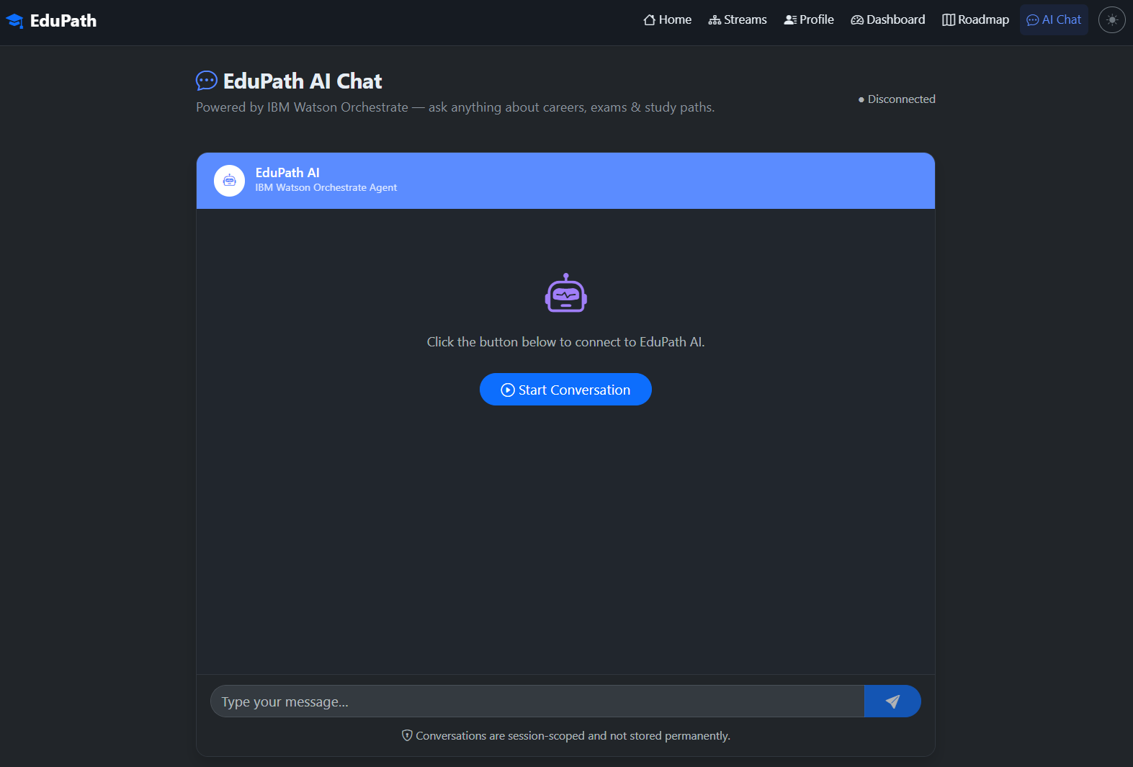
Project Output – AI Chat
·
·
·
I want to know about the streams after 12th for my career

Slide 14
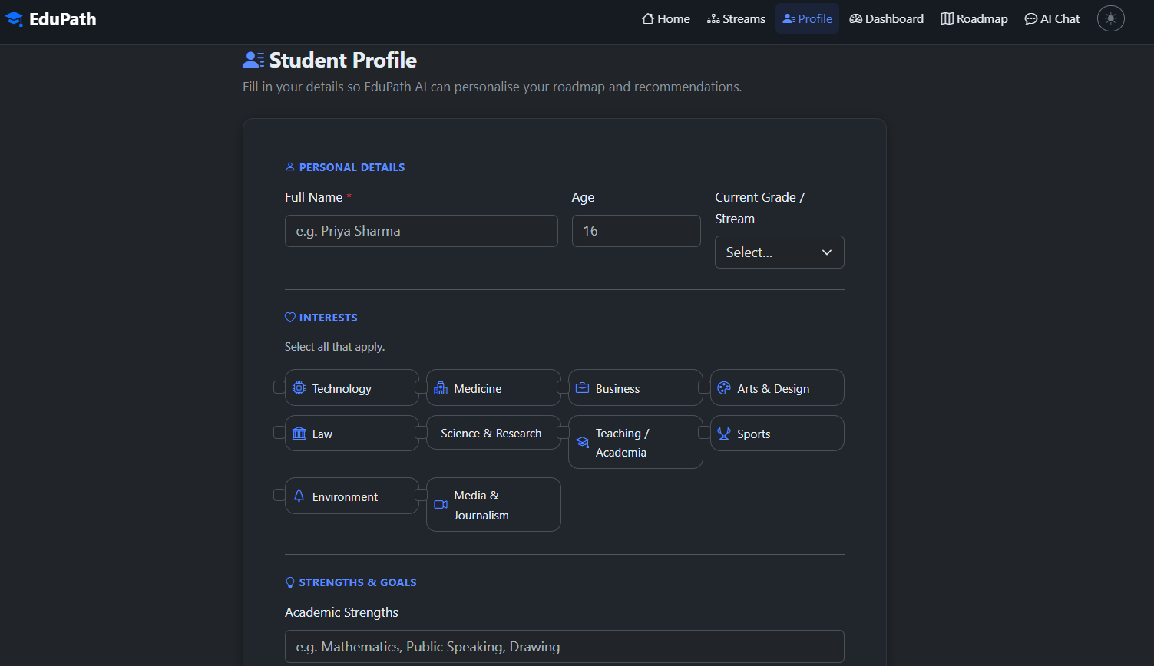
Project Output – Profile of Student
·
·
·

Slide 15
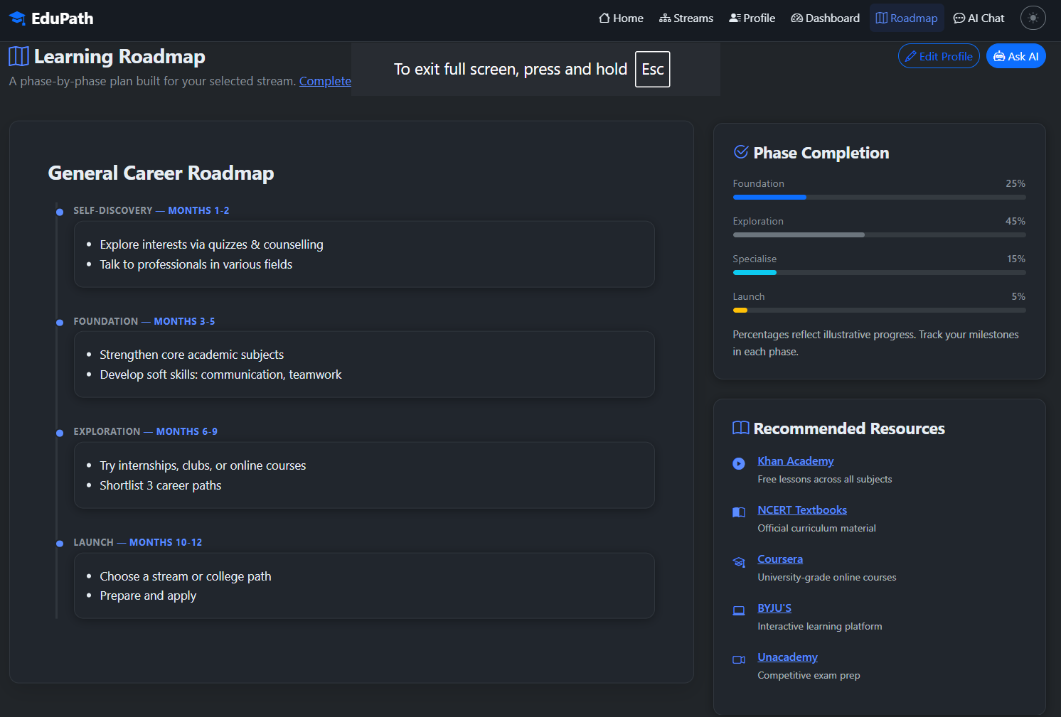
Project Output – Profile of Student
·
·
·

Slide 16
Novelty and Uniqueness
The proposed EduPath stands out by combining Agentic AI, personalized career guidance, and structured learning roadmaps into a single intelligent platform.
Multi-Agent Intelligence – Multiple specialized agents collaborate to provide accurate career and academic guidance.
Personalized Recommendations – Suggests streams, courses, and career paths based on students' interests, strengths, and goals.
Year-wise Learning Roadmaps – Provides structured study plans, skills, certifications, and project recommendations.
Interactive AI Guidance – Enables real-time conversations for career counseling and academic support.
Student-Centric Dashboard – Displays profiles, career progress, and personalized learning paths.
Scalable & Enterprise-Ready – Built using IBM watsonx Orchestrate, IBM BOB, and Granite Models for reliable AI-powered guidance.
This makes EduPath a smart, personalized, and goal-oriented career guidance platform rather than just a basic educational chatbot.

Slide 17
Git Hub Link
Github URL – https://github.com/Krishna-Kode/EduPath.git
·
·
·

Slide 18
Future Scope
1.Integration with Wearables & Health Devices –
The system can be integrated with smartwatches and fitness trackers to collect real-time data such as steps, calories burned, heart rate, and sleep patterns. This will enable the Nutrition Agent to provide more accurate and dynamic diet recommendations based on actual user activity and health metrics.
2.AI-Powered Voice Assistant & Multilingual Support –
Enhancing the system with a voice-enabled assistant and support for multiple languages will improve accessibility. Users can interact naturally in their preferred language, making the solution more inclusive and suitable for diverse populations, especially in regions with varied linguistic backgrounds.
·
·
·

Slide 19
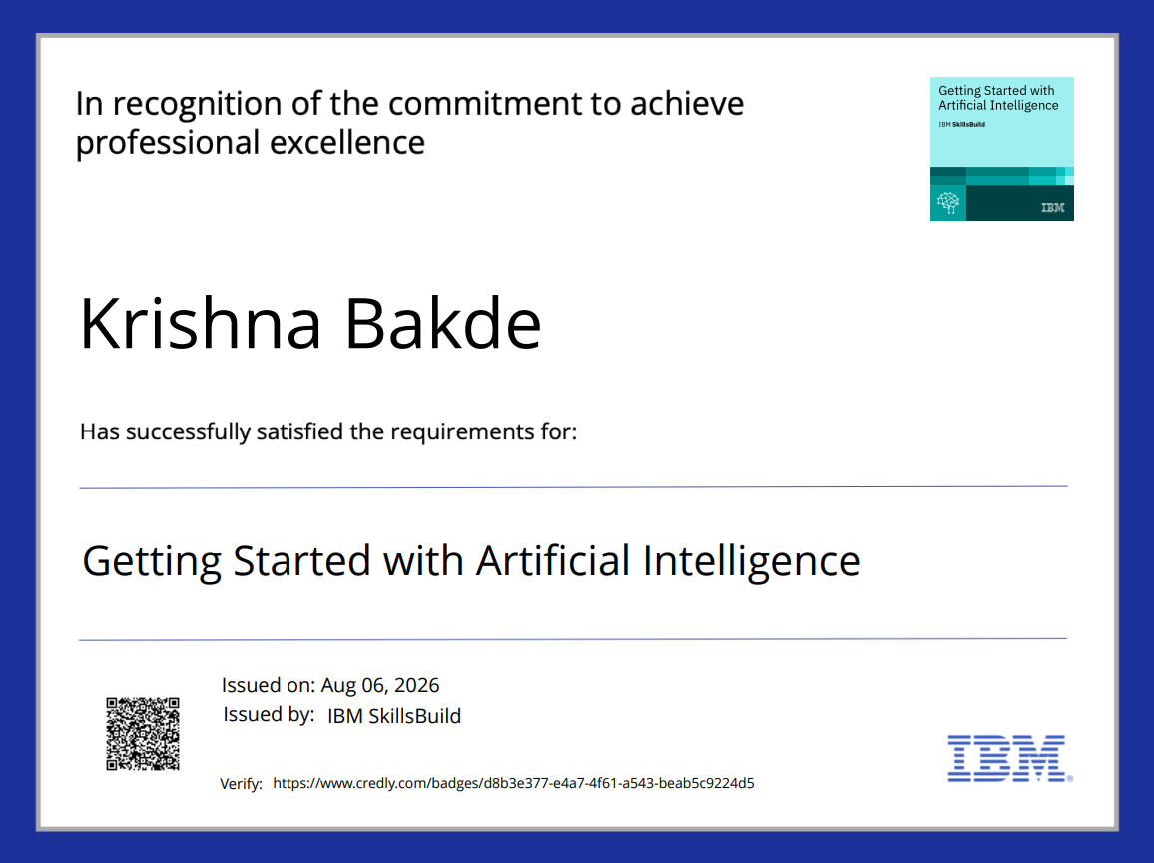
Certificates Earned : Getting Started with Artifical Intelligence

Slide 20
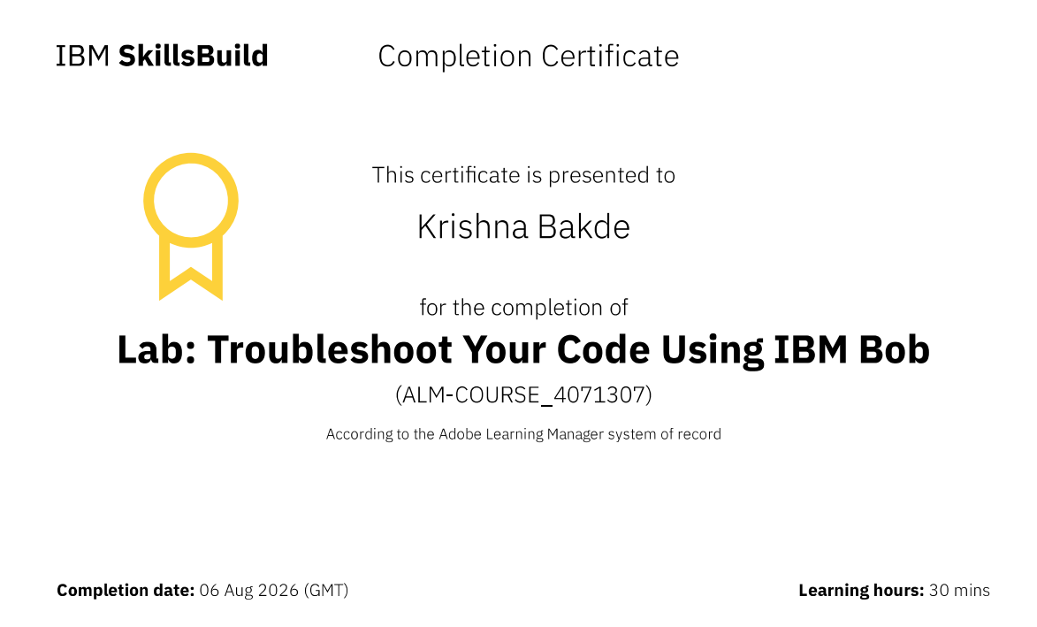
Certificates Earned : Troubleshoot Your Code Using IBM Bob​

Slide 21


