Slide 1

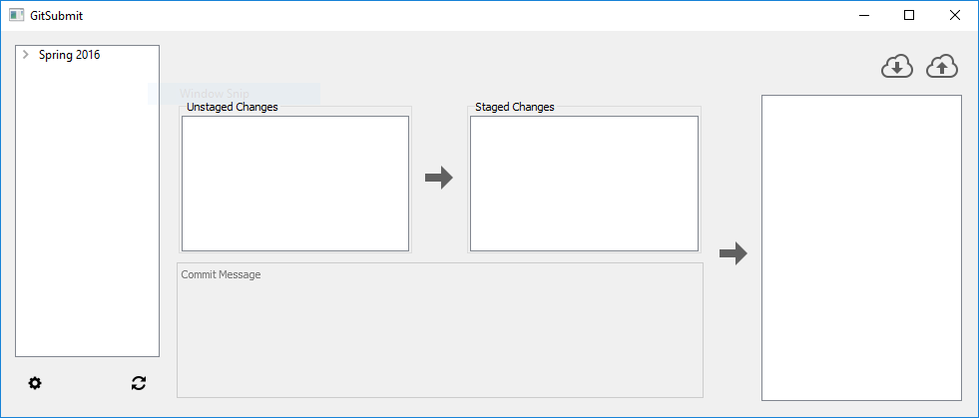
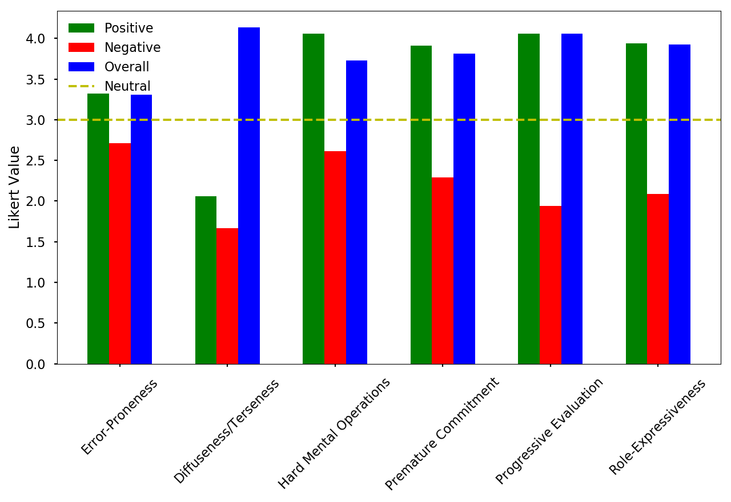

GitSubmit: Integrating VCS in Introductory CS Classes
Nathan Eloe
School of Computer Science and Information Systems, Northwest Missouri State University
GitSubmit
The UI
Conclusions
Written with Python and QT
Simplified Git client that integrates with GitLab
Organizes assignments by semester and class
Only provides necessary functionality to submit assignments (clone, add, commit, push, pull)
Evaluation of Cognitive Dimensions indicates GitSubmit performs well in its task
Strongest aspects: Diffuseness/Terseness, Progressive Evaluation
Weakest aspects: Error-Proneness
Implementation had some stability and network issues
Non-novice responses indicate that GitSubmit has neither too much or too little abstraction
Cognitive Dimensions
Results
Six Cognitive Dimensions Measured:
Diffuseness/Terseness
Error-Proneness
Hard Mental Operations
Premature Commitment
Progressive Evaluation
Role-Expressiveness
Evaluated with student responses to survey
Evaluate
Example Evaluation Statement:
The UI makes it easy to make a mistake in the submission process.
The UI makes it difficult to make a mistake in the submission process.
The UI is not expressive enough to complete a submission.
The UI is cluttered or complex.
Most dimensions had a positive and negative
Diffuseness/Terseness questions all had negative wording. This was adjusted for the overall score for this category.
Additional Resources
Acknowledgements
Poster Repository
https://git-scm.com/downloads/logos
T. R. Green. Cognitive dimensions of notations. People and Computers V, pages 443–460, 1989.
S. Chacon. Pro Git. Apress, Berkely, CA, USA, 2nd edition, 2014.
GitLab. Code, test, and deploy together with GitLab open source git repo management software, https://about.gitlab.com
Student feedback approved by the IRB committee at Northwest Missouri State University.
Feedback is from students enrolled in Data Structures and Operating Systems classes at Northwest.
nwmostate/csis-poster-templates

