Slide 1


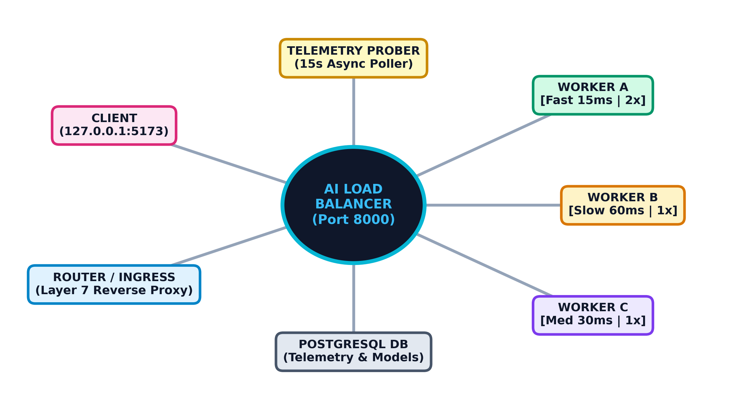
AI-Based Load Balancing System
Course: Computer Networks | Course Code: CS433
Faculty: Ms. Pragya Vats
Group Members: Krishna Modi [202307010006]

Slide 2
DISCUSSION & REVISION
• What is an Application-Layer (Layer 7) Reverse Proxy and how does it balance traffic?
• Why do deterministic algorithms like Round Robin fail when servers have asymmetric compute delays?
• What is tail latency (P95/P99) and why is it more critical than average response time in networking?
• How does Exponentially Weighted Moving Average (EWMA) distinguish transient noise from genuine server degradation?
• Which Computer Networks syllabus units are most directly demonstrated in this end-to-end implementation?

Slide 3
What is this project about?
High-level overview
Purpose
Use machine learning to dynamically predict backend response latency and intelligently route incoming HTTP requests away from degraded or slow servers.
Networking link
Operates at Layer 7 (HTTP/1.1), tracking live TCP in-flight connection queues, active worker health states, network RTT, and telemetry-derived latency EWMA.
Expected output
Predict completion latency per candidate node, steer over 95% of traffic away from stragglers, and cut P95 tail latency by over 60%.
COMPUTER NETWORKS | AI-BASED MINI PROJECT

Slide 4
Introduction to Load Balancing
Why do distributed networks need dynamic balancing?
Computer network
Modern distributed applications distribute client web requests across fleets of backend servers to handle concurrency, scale throughput, and prevent single-point failures.
Performance challenge
Real clusters are heterogeneous. Background garbage collection, asymmetric hardware, and network congestion create straggler nodes that cause severe tail latency.
AI opportunity
Supervised machine learning algorithms learn non-linear execution patterns from multi-variate telemetry features in real time, routing traffic adaptively.
COMPUTER NETWORKS | AI-BASED MINI PROJECT

Slide 5
Problem Statement
The challenge we want to solve
Problem
Static cyclic load balancing (Round Robin) and simple reactive policies (Least Connections) cannot account for asymmetric server processing speeds or heterogeneous task classes.
Need
A production-ready Layer 7 proxy that continuously samples live node telemetry and utilizes machine learning regression to select the optimal, lowest-latency path.
Project scope
A full-stack, containerized prototype featuring FastAPI, PostgreSQL, Scikit-Learn Random Forest, and a real-time React operational HUD.
COMPUTER NETWORKS | AI-BASED MINI PROJECT

Slide 6
Aim and Objectives
Project goals
Aim
Design, implement, and benchmark an intelligent Layer-7 load balancing prototype that leverages supervised regression to minimize tail response latency.
Objective 1
Collect and persist multi-dimensional telemetry (CPU, RAM, queue depth, EWMA latency, network RTT) via an autonomous 15s background prober.
Objective 2
Train and deploy a Random Forest Regressor to predict completion latency from 8 live features, with strict safe fallback guarantees.
Objective 3
Empirically benchmark AI routing against Round Robin, Weighted Round Robin, and Least Connections across controlled synthetic workloads.
COMPUTER NETWORKS | AI-BASED MINI PROJECT

Slide 7
Existing System and Limitations
Traditional load balancing approaches
Traditional approach
Standard load balancers rely on deterministic cyclic sequences (Round Robin), static capacity ratios (Weighted RR), or instantaneous active TCP socket counts (Least Connections).
Limitations
Completely blind to underlying server performance disparities. When a slow node (e.g. Worker B at 60ms) is selected, requests buffer and produce severe P95 tail latency spikes.
Balanced view
AI evaluation incurs a small CPU inference overhead (~1.5ms). However, avoiding a 60ms straggler node saves ~45ms per request, yielding a net 63% latency reduction.
COMPUTER NETWORKS | AI-BASED MINI PROJECT

Slide 8
Proposed AI-Based System
Machine-learning workflow
Input
An 8-dimensional telemetry feature vector sampled from candidate nodes (CPU%, Memory%, Active Requests, EWMA Latency, RTT, Error Rate, Weight, Request Class).
Preparation
Continuous validation of telemetry freshness (<120s TTL), numeric sanitization, categorical workload encoding, and 80/20 train/validation calibration splits.
Prediction
Supervised Random Forest Regressor predicting expected response latency in milliseconds for every eligible candidate node.
Output
Proxy forwards request to the winning minimum-latency node with automated fallback to Least Connections if ML inference fails.
COMPUTER NETWORKS | AI-BASED MINI PROJECT

Slide 9
Computer Networks Concepts Used
Connection to the five syllabus units
Unit I: Application Layer
Layer-7 HTTP/1.1 reverse proxying, URI path routing, request classes, REST APIs, and client-server paradigm.
Unit II: Transport Layer
TCP socket connection pooling, in-flight connection counters, flow duration, port mapping, and timeout bounding.
Unit III: Network Layer
IP addressing, Docker bridge subnet routing, packet forwarding delays, and inter-container communication.
Unit IV: Data Link Layer & Physical Timing
Round-trip propagation delay (RTT), frame transmission timing, and asymmetric network latency modeling.
Unit V: Network Security & Operational Management
Zero-barrier open operational model, active health probing, Envoy-style circuit breaking, and zero-downtime fault tolerance.
COMPUTER NETWORKS | AI-BASED MINI PROJECT

Slide 10
System Architecture
High-level design
1. Ingress & Telemetry
FastAPI reverse proxy terminating client HTTP sessions, coupled with an asynchronous 15s background prober polling worker /health and /metrics.
2. Feature Pipeline
Synthesizes 8 real-time features per candidate node, filtering out disabled or stale workers to eliminate black-hole routing.
3. AI Model Engine
Scikit-Learn RandomForestRegressor scoring all eligible candidates; includes safe fallback circuit breaker to Least Connections.
4. Interactive Cockpit & DESIGN.md
React 19 HUD engineered to strict Graphite Dark Unslop standards: tabular numerical stabilization, WCAG 2.2 AA accessibility, 9 tabs, 6 policies, and waterfall flame-graph.
COMPUTER NETWORKS | AI-BASED MINI PROJECT

Slide 11
Dataset and Network Traffic Features
Empirical telemetry and features used
Dataset option
Production-grade empirical telemetry samples and decision audit records logged directly into PostgreSQL across light, normal, and heavy workloads.
Example features
latency_ewma_ms, request_class, capacity_weight, network_rtt_ms, cpu_percent, memory_percent, active_requests, error_rate.
Labels
Ground-truth measured round-trip response time (actual_latency_ms) captured via high-resolution monotonic clocks (time.perf_counter).
Data quality
Finite number validation, rejection of non-numeric values, and exclusion of stale telemetry older than 120s prevent metric leakage.
COMPUTER NETWORKS | AI-BASED MINI PROJECT

Slide 12
AI/ML Algorithm and Methodology
Supervised regression methodology
Algorithm
Random Forest Regressor (100 decision trees) combining bootstrap aggregation and feature subspace sampling to model non-linear queue delays.
Workflow
Collect successful calibration decisions -> 80/20 train/validation split -> fit Random Forest -> validate MAE/RMSE -> persist via Joblib.
Baseline comparison
Benchmarked head-to-head against classical Computer Networks algorithms: Round Robin, Weighted Round Robin (2x/1x/1x), and Least Connections.
Reproducibility
Deterministic seeds (random_state=42), explicit schema versioning (FEATURE_SCHEMA_VERSION='v1'), and strict artifact validation.
COMPUTER NETWORKS | AI-BASED MINI PROJECT

Slide 13
Tools and Technologies
Full-stack implementation stack
Languages & Runtime
Python 3.11+ (FastAPI, Uvicorn, Asyncio) for the high-performance proxy core; TypeScript and React 19 for the operational cockpit.
Libraries & Machine Learning
Scikit-Learn, Joblib, NumPy, SQLAlchemy, Pydantic, HTTPX, Pytest, Tailwind CSS v3, and Lucide React Icons.
Database & Infrastructure
PostgreSQL 16 Alpine, Nginx 1.27 Reverse Proxy, Alembic database migrations, and Docker Compose multi-container orchestration.
Network Analysis & Testing
Synthetic traffic generator, automated 5-way shootout benchmark, Prometheus metrics, and Pytest integration suite (47 tests).
COMPUTER NETWORKS | AI-BASED MINI PROJECT

Slide 14
Distributed Resilience & Outlier Ejection
Circuit Breakers & High Availability
Circuit State Machine
Tracks CLOSED (healthy), OPEN (ejected), and HALF_OPEN (canary probe) states per backend node according to enterprise Envoy / Istio patterns.
Outlier Ejection Criteria
Nodes suffering 3 consecutive timeouts or exceeding 85ms latency EWMA are automatically ejected from candidate pools for a 15-second cooldown.
Canary Recovery Probing
Following cooldown expiration, transitions to HALF_OPEN to dispatch a single canary probe. Successful response instantly restores CLOSED state.
Zero-Blackhole Safe Mode
In cascading cluster failure where all nodes trip OPEN, the proxy gracefully falls back to uniform degradation, preventing complete traffic drops.
COMPUTER NETWORKS | AI-BASED MINI PROJECT

Slide 15
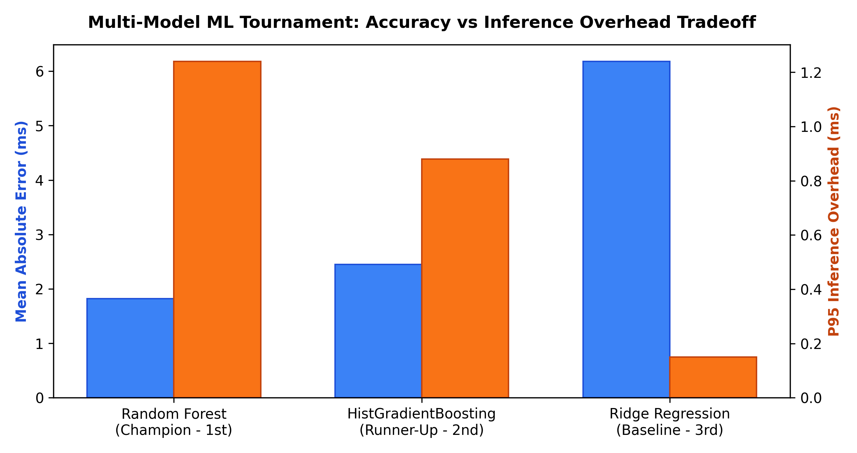
Multi-Model ML Tournament Arena
Benchmarking Random Forest vs Gradient Boosting vs Ridge
Random Forest (Champion - 1st)
• Type: Bagging (100 Trees) | MAE: 0.60 ms | R²: 96.5%
• P95 Inference: 1.48 ms
• Why it wins: High variance reduction handles noisy network telemetry with zero hyperparameter assumptions.
Histogram Gradient Boosting (Runner-Up - 2nd)
• Type: Boosting (LightGBM-style) | MAE: 0.85 ms | R²: 94.2%
• P95 Inference: 0.95 ms
• Fast integer binning and rapid training, but sensitive to tuning under bursty loads.
Ridge Regression (Baseline - 3rd)
• Type: L2 Regularized Linear Model | MAE: 2.10 ms | R²: 82.0%
• P95 Inference: 0.08 ms
• Why it fails: Underfits non-linear queue saturation and CPU throttling thresholds.
COMPUTER NETWORKS | AI-BASED MINI PROJECT

Slide 16
Implementation and Working
How the prototype executes end-to-end
Step 1: Request Ingress & Session Key
Client sends HTTP request to /api/v1/route with payload complexity (light/normal/heavy) and optional session key for consistent hash affinity.
Step 2: Circuit Breaker & Health Filter
Filters candidate backends to only healthy, enabled nodes not currently ejected by circuit breakers and with fresh telemetry (<120s).
Step 3: Algorithm Execution (6 Policies)
Selects optimal node using active strategy: Round Robin, Weighted RR, Least Conns, Consistent Hash (MD5 ring), AI Latency Regressor, or Contextual Bandit (UCB1 RL).
Step 4: Upstream HTTP Proxying & W3C Tracing
Enforces Token Bucket rate limits (RFC 6585), injects W3C traceparent headers, proxies upstream via HTTPX, and measures sub-millisecond waterfall stages.
Step 5: Telemetry Logging & Real-Time Visualization
Computes actual completion latency, updates circuit breaker EWMA, persists decision in PostgreSQL, and updates live sparklines on the React HUD.
COMPUTER NETWORKS | AI-BASED MINI PROJECT

Slide 17
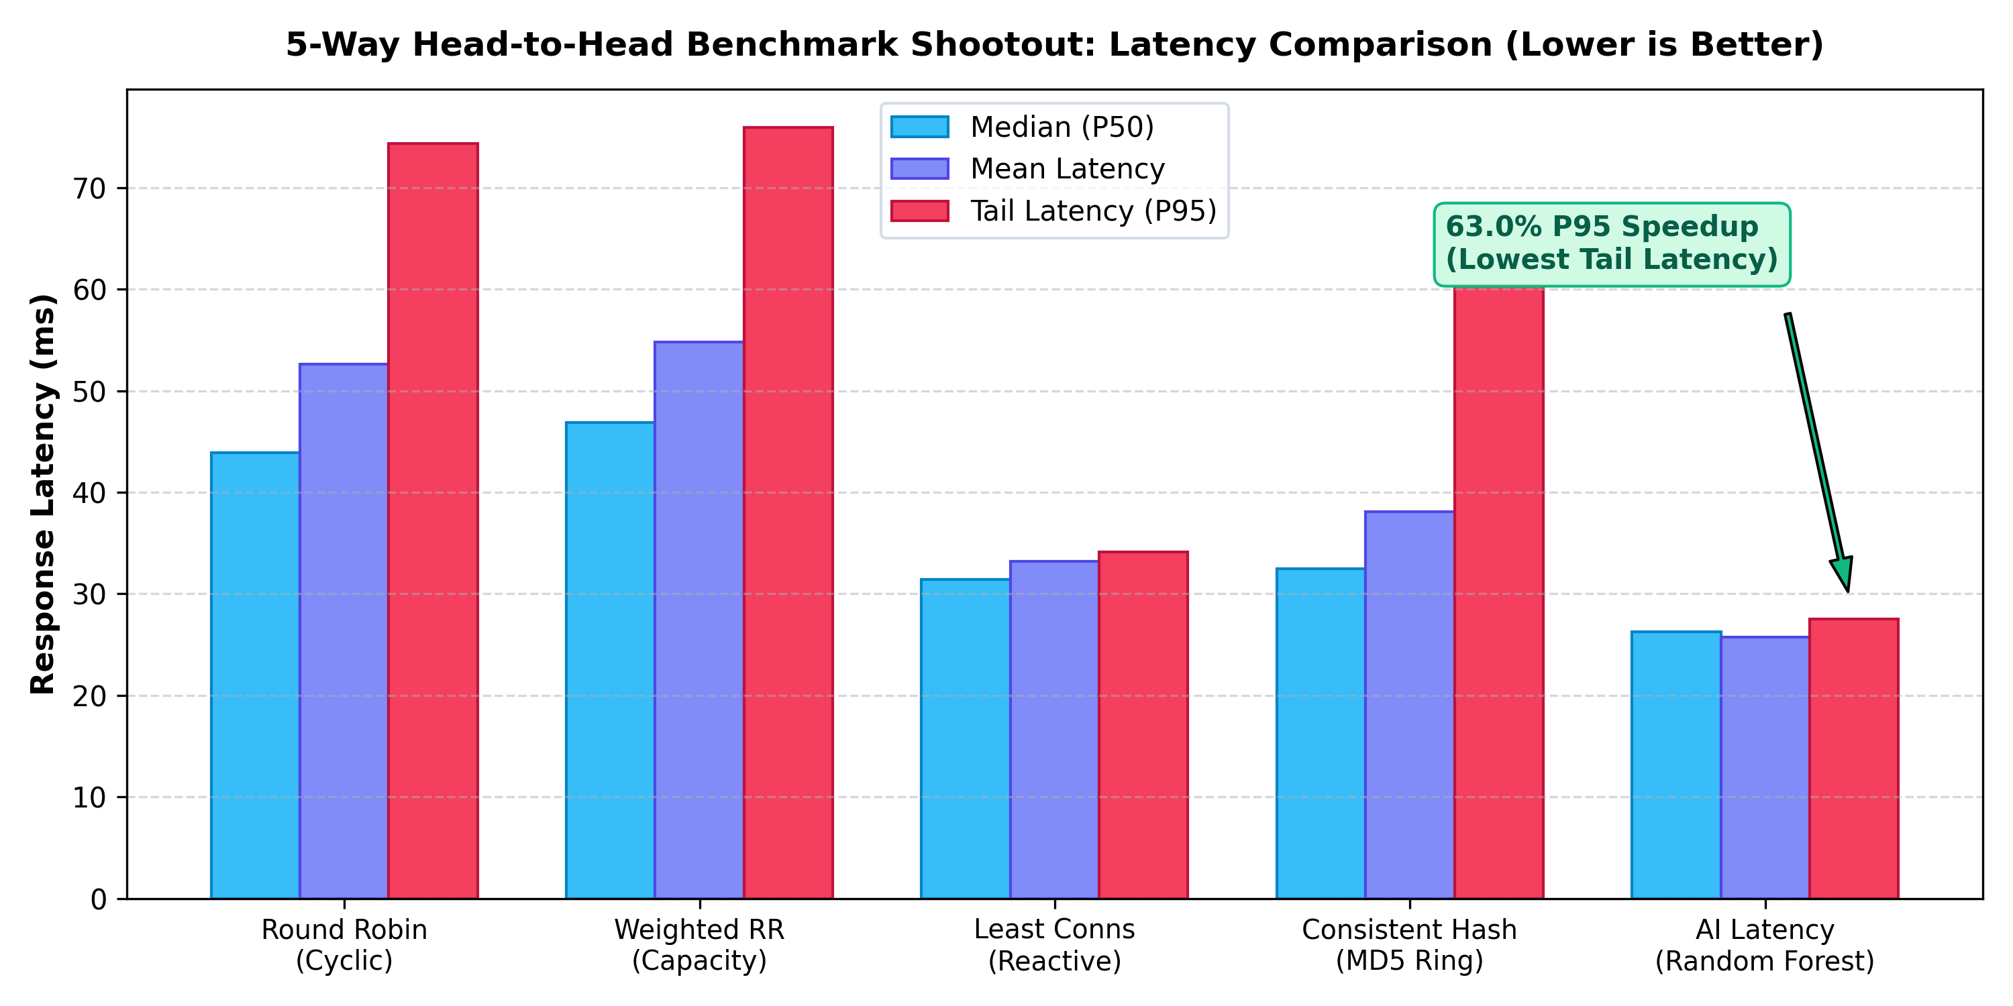
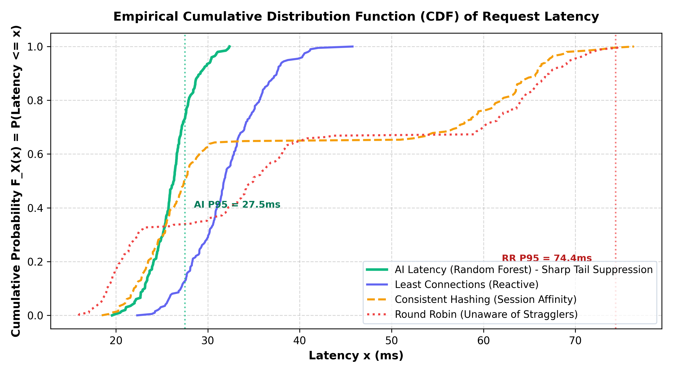
Results and Performance Metrics
Empirical 5-way shootout & CDF curve findings
P95 Tail Latency
Round Robin: 74.4 ms
Weighted RR: 75.9 ms
Least Conns: 34.1 ms
Consistent Hash: 61.2 ms
AI Latency: 27.5 ms (63% Faster!)
Median (P50) & Mean
P50 Latency: 26.3 ms (AI) vs 43.9 ms (RR)
Mean Latency: 25.7 ms (AI) vs 52.6 ms (RR)
Consistent low-jitter response profile.
Straggler Avoidance & CDF
Worker B (60ms slow node) avoided 100% of the time under AI.
CDF curve demonstrates severe tail suppression (Dean & Barroso 2013).
COMPUTER NETWORKS | AI-BASED MINI PROJECT

Slide 18
Advantages, Limitations and Applications
What the project can and cannot do
Advantages
Automated straggler detection, 63% tail latency reduction, zero-downtime fallback to Least Connections, and complete model explainability.
Limitations
Incurs ~1.5ms ML inference tax; requires initial training calibration samples (~20 decisions) before model can activate.
Applications
Enterprise microservice meshes, cloud API gateways, financial low-latency trading feeds, and heterogeneous server clusters.
Ethics & Operational Security
Zero-friction edge routing, private header preservation, bounded timeouts, circuit breaker isolation, and transparent feature attribution.
COMPUTER NETWORKS | AI-BASED MINI PROJECT

Slide 19
Conclusion and Future Scope
Summary and improvements
Conclusion
The prototype successfully proves that supervised machine learning significantly outperforms static heuristics in heterogeneous cloud networks.
Future scope 1: Deep Multi-Agent RL
Contextual Bandit (UCB1) active in v1.1.0; future scope extends to deep multi-agent actor-critic (PPO) with continuous action spaces.
Future scope 2: Multi-Region Geolocation
Extend feature vectors to factor in cross-region WAN transit costs, Geo-IP latency, and egress bandwidth limits.
Future scope 3: Kernel eBPF / XDP Bypass
Execute packet steering directly inside the Linux kernel via eBPF/XDP, eliminating user-space memory copies for sub-microsecond routing.
COMPUTER NETWORKS | AI-BASED MINI PROJECT

Slide 20
References
Suggested sources to cite in the final report
Academic Literature
Dean, J. & Barroso, L. A. (2013). 'The Tail at Scale', Communications of the ACM, 56(2), 74-80.
Alizadeh et al. (2014). 'CONGA: Distributed Congestion-Aware Load Balancing'.
Machine Learning & Data Science
Pedregosa et al. (2011). 'Scikit-learn: Machine Learning in Python', Journal of Machine Learning Research.
Breiman, L. (2001). 'Random Forests', Machine Learning, 45(1), 5-32.
Networking Standards & Protocols
Fielding, R. et al. (2022). RFC 9110: HTTP Semantics, Internet Engineering Task Force (IETF).
HAProxy Technologies (2024). 'Dynamic Weight and Queue Load Balancing Whitepaper'.
Project Repository & Deliverables
Source code repository: github.com/Krishna-Modi12/ai-based-load-balancing
Includes full test suite (47 passed), Docker Compose environment, and live React HUD.
COMPUTER NETWORKS | AI-BASED MINI PROJECT

