Slide 1
AI-Based Load Balancing in Computer Networks
Implementation and comparative performance evaluation
[Student] • [Institution] • [Academic year]

Slide 2
Problem and motivation
HTTP services need availability, low latency, and effective worker utilization.
Conventional routing is inexpensive; ML routing may adapt to telemetry but adds cost.
Research question: does prediction justify its overhead under controlled workloads?

Slide 3
Objectives and research questions
Implement a registered-backend Layer-7 reverse proxy.
Compare Round Robin, Least Connections, and AI latency routing.
Persist telemetry and experiments; evaluate performance and failure handling.
Do not assume AI superiority—measure it.

Slide 4
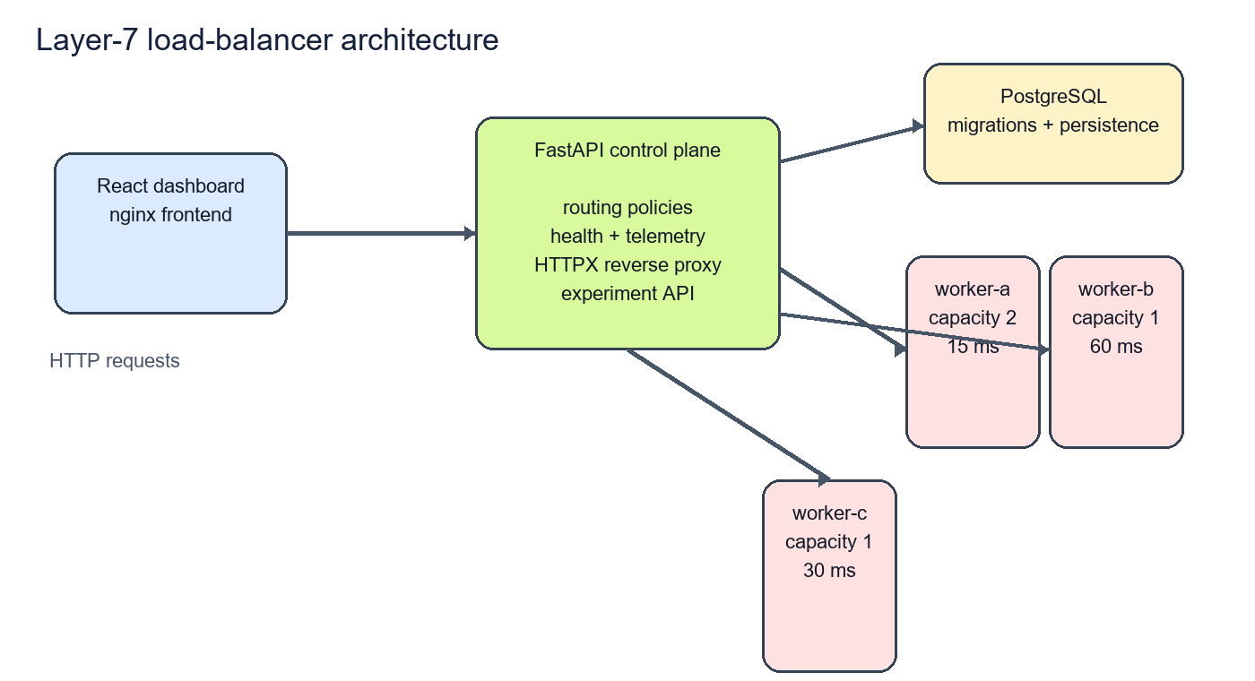
System architecture
Illustration derived from the implemented Docker Compose topology.

Slide 5
Technology stack
FastAPI + HTTPX reverse proxy
PostgreSQL + SQLAlchemy + Alembic
React + TypeScript + Vite + nginx
Docker Compose, pytest, Locust starter, scikit-learn

Slide 6
Routing policies
Round Robin: deterministic cursor across eligible workers.
Least Connections: choose lowest in-flight count with deterministic tie-break.
AI latency: predict each candidate's latency; choose the lowest valid prediction.
Health filtering and safe Least Connections fallback apply before service.

Slide 7
Machine-learning methodology
RandomForestRegressor with fixed feature schema.
Features: CPU, memory, active requests, EWMA, RTT, error rate, capacity, request class.
Chronological 80/20 split over persisted calibration decisions.
Evaluation outcomes were not used for tuning.

Slide 8
Implementation and dashboard
Dashboard displays backend health, routing decisions, active policy, model status, and persisted experiment comparisons.
Routing decisions include request ID, backend, prediction, actual latency, status, and fallback reason.
Exports provide raw CSV and JSON evidence.

Slide 9
Experimental design
3 policies × 4 workload profiles × 3 repetitions = 36 valid runs.
Profiles: uniform, heterogeneous, bursty, mixed.
5-second warm-up; 30-second measurement; concurrency 4.
P50/P95/P99, throughput, error rate, distribution, MAE/RMSE.

Slide 10
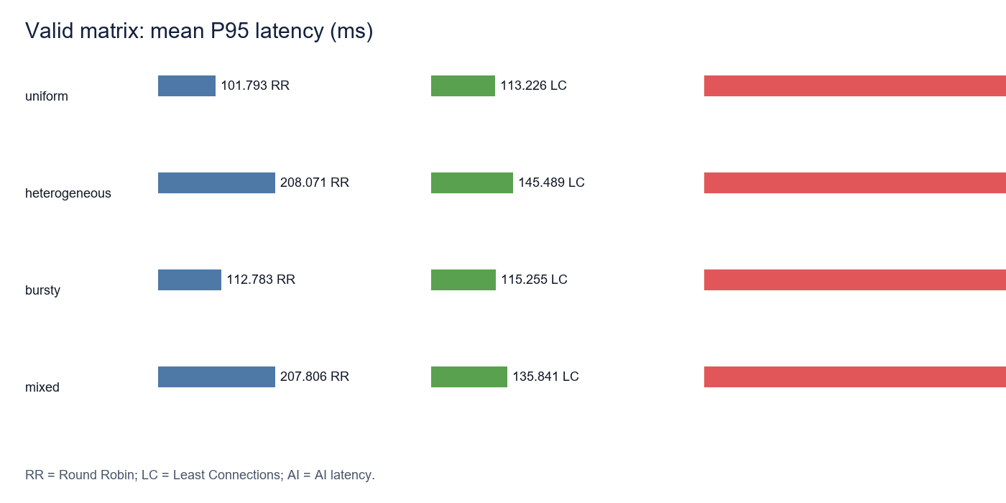
Measured results
AI was slower and lower-throughput than both baselines in all four profiles.

Slide 11
Why AI underperformed
Mean client latency: RR 75.498 ms; LC 68.545 ms; AI 359.527 ms.
AI inference p50: approximately 52.041 ms.
AI path also queries telemetry and loads/validates the predictor in the request path.
Prediction error and concentration on worker-a are plausible additional factors; causal contributions were not fully isolated.

Slide 12
Failure-mode evaluation
Backend disabled: remaining workers served requests and recovery passed.
Worker 503 and slow-worker timeout: API mapped upstream failures to 502.
Missing model: AI requests succeeded through Least Connections fallback.
Stale telemetry: no eligible backend produced 503; health refresh restored service.

Slide 13
Limitations and future work
Local Docker host and simulated worker delays.
One model artifact, one concurrency level, three repetitions, no significance claims.
Future: cache validated predictor, bound telemetry snapshots, add concurrency levels and drift tests.
Optional future network testbed: Mininet/SDN.

Slide 14
Conclusion and demonstration
The project demonstrates a reproducible, auditable load-balancing testbed.
The tested AI implementation did not outperform conventional baselines.
Demo order: Compose health → dashboard → three policies → fallback → failure/recovery → measured chart.
Honest negative results are part of the research contribution.

