Slide 1
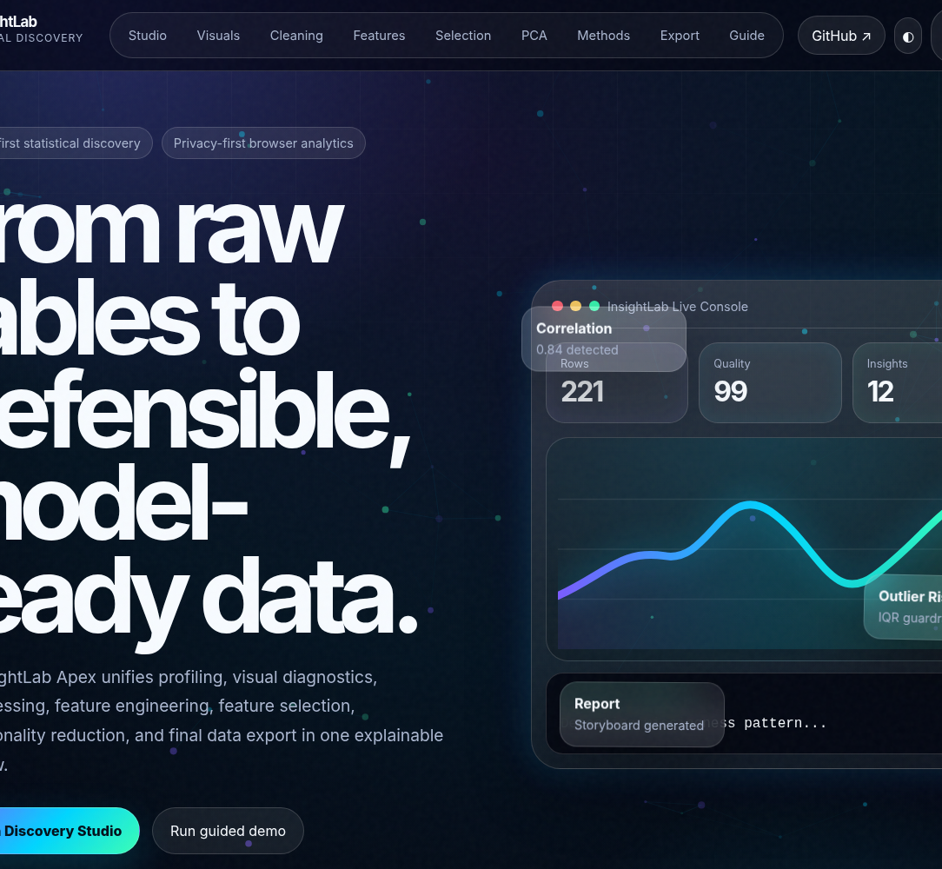
LOCAL-FIRST · EXPLAINABLE · EXPORTABLE
EDA InsightLab
Apex
From raw tables to defensible, model-ready data.
A statistical discovery product for profiling, visual diagnostics, preprocessing, feature engineering, target-aware selection, PCA, and final analytical export.
KRISS GOWDA
krishna-v-gowda.github.io/EDA-InsightLab-Apex/
AI · DATA SCIENCE · PRODUCT ENGINEERING
Notes:
Open with the problem, not the feature list. Say: “The hardest failures in data science often happen before modeling. I built EDA InsightLab Apex to make that entire reasoning path visible, explainable, and exportable.”

Slide 2
THE PROBLEM
The model is rarely the first failure point.
Most analytical risk enters earlier - through data quality, leakage, weak feature design, and opaque handoffs.
01
02
03
04
MESSY INPUT
TARGET LEAKAGE
WEAK SIGNALS
OPAQUE HANDOFF
Missing values, duplicate records, inconsistent types and extreme values distort the evidence.
Future or target-derived information can make a model look strong while making it useless in reality.
Raw columns often fail to express the domain relationships a model actually needs.
When transformations live across ad hoc scripts, stakeholders cannot trace what changed or why.
Raw data
Exploration
Preparation
Features
Validation
Decision
A better product must protect the entire path - not only display the final chart.
Notes:
Frame the project as a workflow problem. Emphasize that the product is designed to reduce pre-modeling risk and make analytical decisions inspectable.

Slide 3
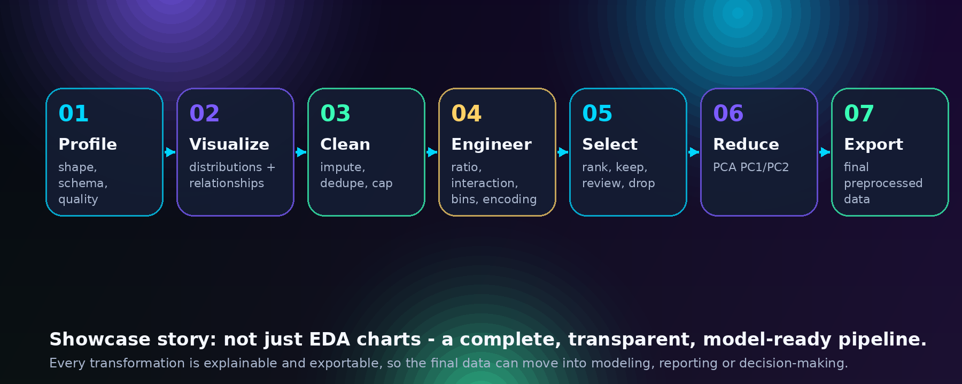
PRODUCT THESIS
One visible journey from raw CSV to analytical handoff.
Seven connected stages. Every transformation is explainable. Every major output is exportable.
Notes:
Walk left to right. The differentiator is not the number of charts; it is the continuity of the workflow and the visibility of every transformation.

Slide 4
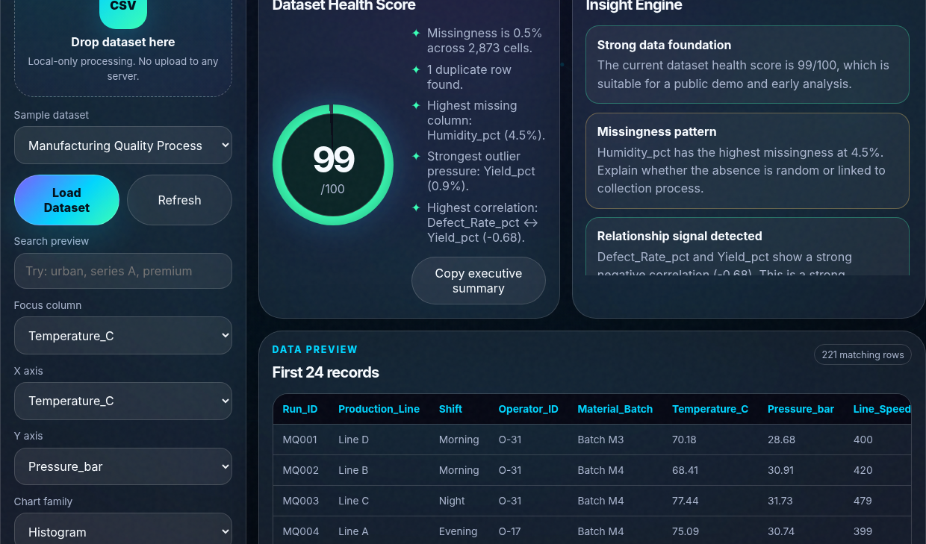
01 · PROFILE
A command center for understanding the data before changing it.
Automatic schema, quality signals, distributions, missingness, duplicates, outlier pressure, and a searchable preview.
1
Local-first intake
Built-in datasets or a user CSV. Rows are processed inside the browser.
2
Transparent health signals
Missingness, duplicates and IQR pressure are visible - not hidden inside a pipeline.
3
Narrative layer
The interface explains what the diagnostics mean and what should be reviewed next.
Heuristic score ≠ model accuracy
Notes:
Point out that the health score is a transparent prioritization heuristic. It is deliberately not described as a prediction of model performance.

Slide 5
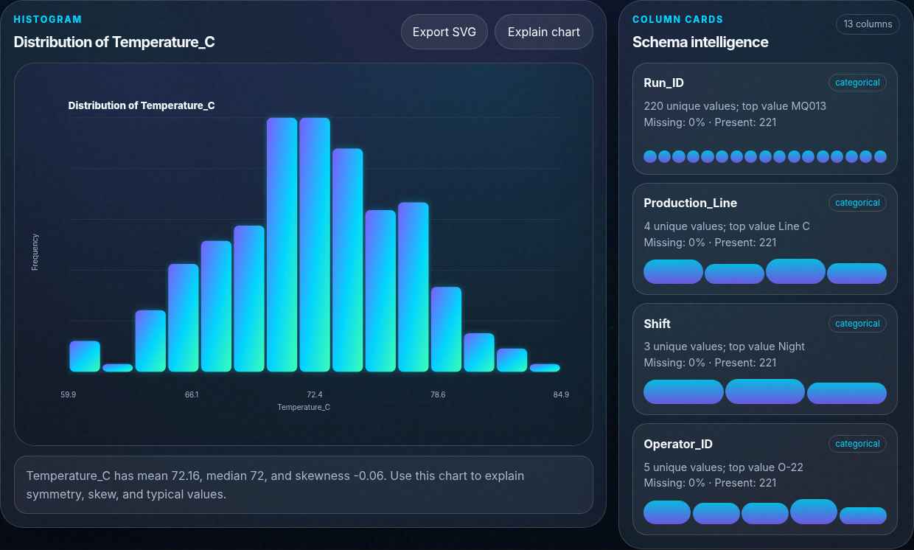
02 · VISUALIZE
Charts that teach, not just decorate.
Each visual connects the graphic to statistical interpretation, assumptions, and decision context.
Distribution
Histogram + summary statistics
Spread
Box plot + IQR diagnostics
Relationship
Scatter + Pearson correlation
Structure
Correlation heatmap
Data quality
Missingness map
Association is evidence - not causation.
Notes:
Demonstrate one histogram, one box plot, and one relationship view. Always interpret the evidence and state that correlation does not establish causality.

Slide 6
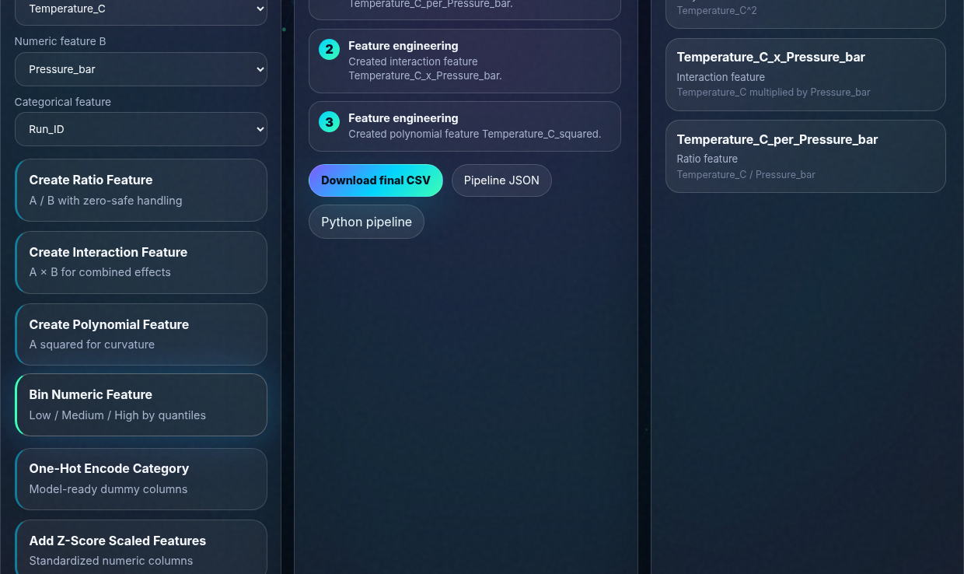
03–04 · PREPARE + ENGINEER
Transformations become a product workflow - not invisible notebook state.
Create domain-relevant signals, inspect the inventory, and preserve a reproducible history.
Ratio
Interaction
A / B with zero-safe handling
A × B for combined effects
Polynomial
Binning
A² for curvature
Quantile-based segments
Encoding
Scaling
Low-cardinality predictor dummies
Standardized predictor copies
Target protected during predictor transforms
Notes:
Create one ratio or interaction live. Explain that useful features must come from domain reasoning, not only mathematical possibility. Then show the inventory and history.

Slide 7
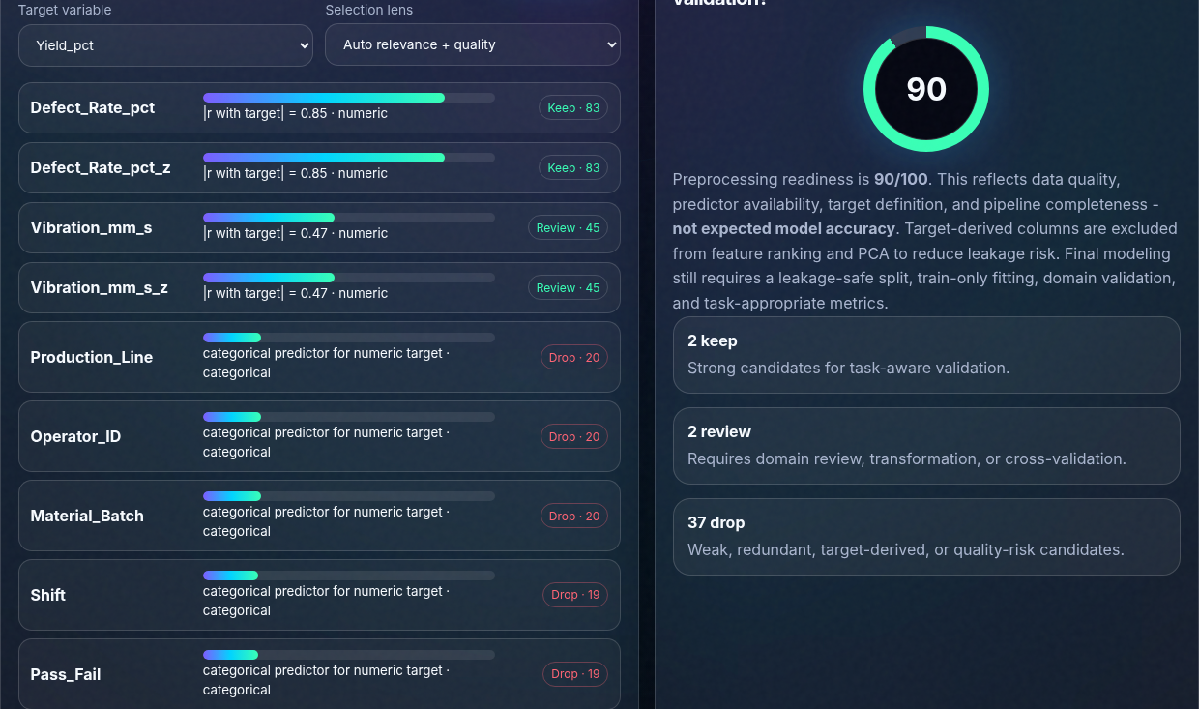
05 · SELECT
Target-aware screening with visible leakage guards.
Rank relevance, penalize quality risk, and explain why a feature should be kept, reviewed, or dropped.
1
Meaningful default target
Manufacturing opens with Yield_pct, not an arbitrary final column.
2
Association by data type
Pearson, eta-squared, and Cramer’s V support mixed tabular data.
3
Leakage protection
Target and target-derived columns are removed from predictor ranking and PCA.
Screening heuristic → domain review → cross-validation
Notes:
Explain that this is a transparent screening layer, not a claim of feature importance from a trained model. The target and target-derived variables are excluded to reduce leakage risk.

Slide 8
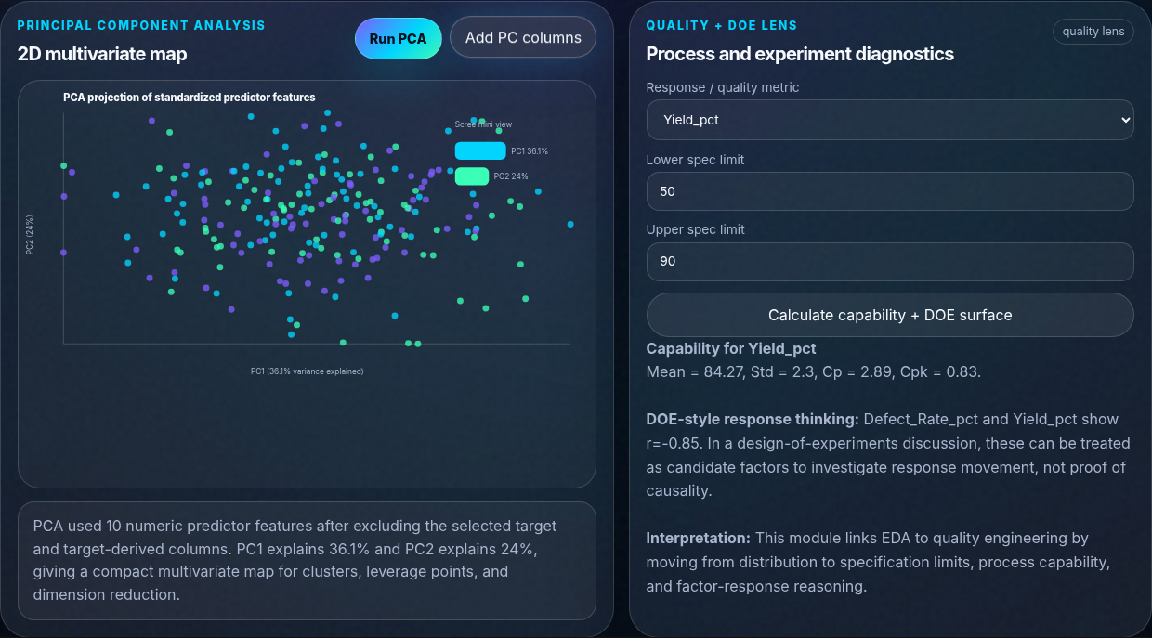
06 · REDUCE
Compress correlated numeric structure without hiding the method.
Standardize predictors, project onto PC1/PC2, display explained variance, and optionally export the components.
1
STANDARDIZE
Comparable feature scales
2
COVARIANCE
Capture joint variation
3
EIGENVECTORS
Approximate principal directions
4
PROJECT
Map rows into PC1/PC2
PCA supports compression and exploration - it does not identify causal drivers.
Notes:
Explain why standardization occurs first. Point out explained variance and the 2D projection. State clearly that PCA is exploratory and not causal.

Slide 9
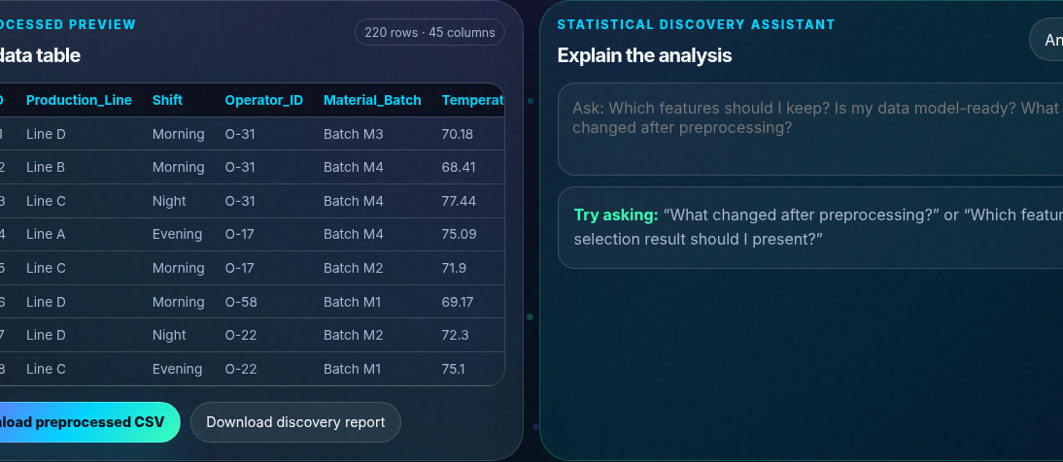
07 · EXPORT
The analytical handoff includes data, code, metadata, and narrative.
The final output is more than a chart: it is a reproducible package for downstream modeling or review.
CSV
JSON
Processed rows and engineered features
Ordered transformation metadata
PYTHON
REPORT
Leakage-aware pipeline template
Discovery summary and method caveats
Processed data is a strong analytical starting point - final modeling still requires a leakage-safe split, train-only fitting, and task-specific validation.
Notes:
Open the Data Vault and download the CSV. Then explain that exportability makes the workflow reproducible, but model readiness still depends on task-aware validation.

Slide 10
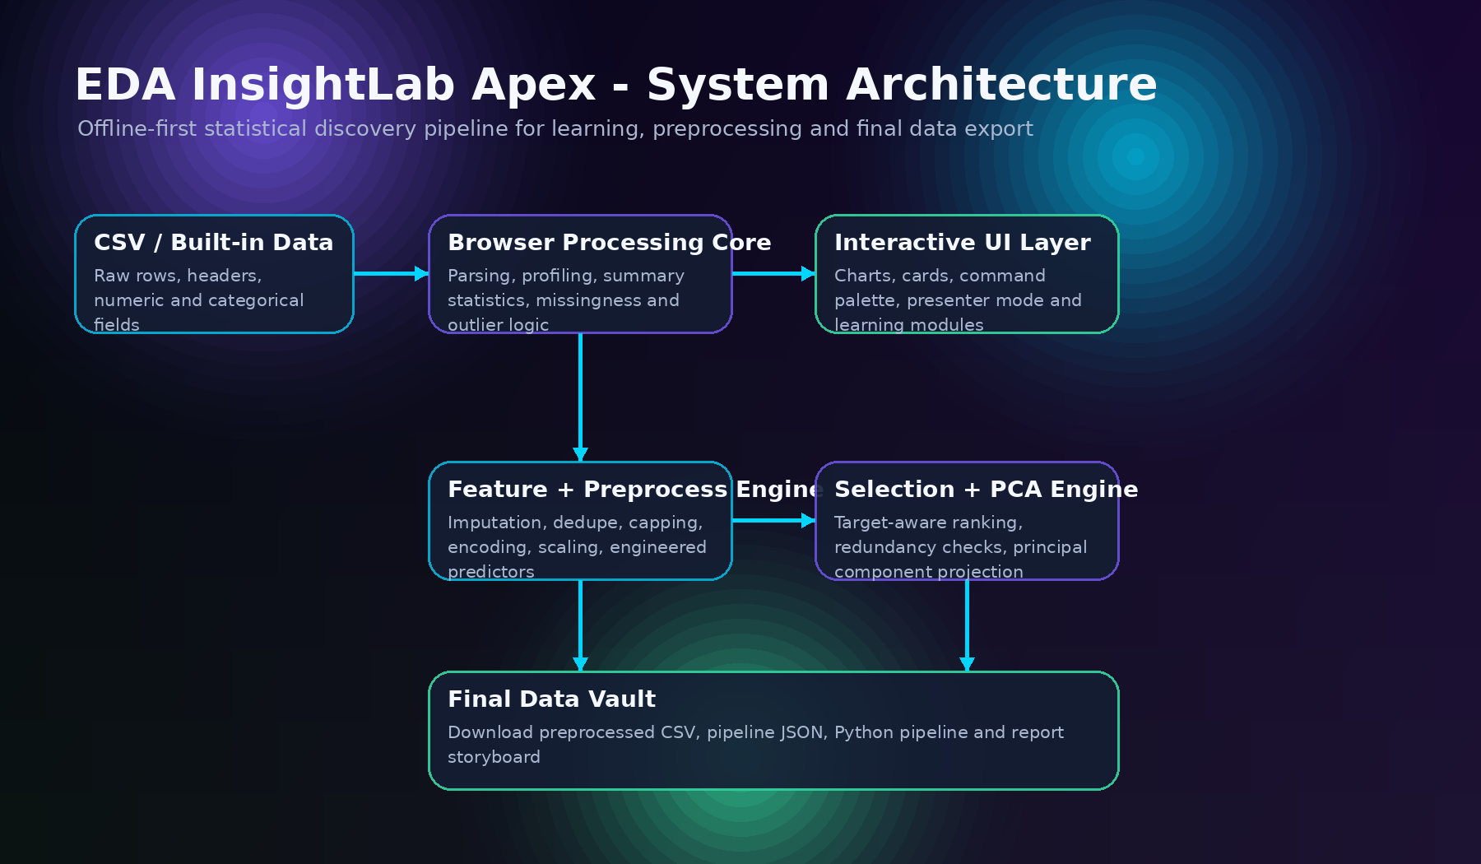
ARCHITECTURE + PRIVACY
Zero-backend by design. Production-ready evolution by roadmap.
The current product keeps uploaded CSV rows in the browser while preserving a clear path to scalable analytical services.
CURRENT RELEASE
• Static HTML, CSS, and JavaScript
• Browser-memory data state
• SVG chart rendering
• Client-side file exports
• No project-owned data API
PRODUCTION EVOLUTION
• Validated Python statistics service
• Larger datasets and job queues
• Authentication and data lineage
• Versioned runs and audit logs
• Governed AI explanations
Notes:
This is the right place to show maturity. The browser version is a deliberate demonstration architecture. Production requires validated libraries, secure storage, lineage, testing, and governance.

Slide 11
METHOD INTEGRITY
Trust comes from separating what works from what still needs validation.
The product is strongest when its claims are precise, testable, and honest.
VERIFIED WORKFLOW
VALIDATION BOUNDARIES
• CSV ingestion and schema inference
• Descriptive profiling and SVG visuals
• Tracked cleaning and engineered features
• Target protection and leakage guards
• Feature screening and PCA workflow
• CSV, JSON, Python, and report exports
• Responsive desktop and mobile layout
• Health and readiness scores are heuristics
• Selection is screening, not trained importance
• IQR flags are diagnostics, not deletion rules
• Correlation is not causation
• PCA needs reference-library comparison
• No production model is trained in v1.0
• Regulated decisions require stronger controls
EVIDENCE OVER HYPE
Notes:
This slide is a credibility amplifier. Do not apologize for boundaries. Show that you know the difference between a functioning prototype, an educational heuristic, and a production statistical system.

Slide 12
WHAT COMES NEXT
From flagship prototype to governed analytical platform.
A clear roadmap converts the current product into a serious foundation for AI, operations, quality, and decision intelligence.
NOW
NEXT
THEN
SCALE
INTELLIGENCE
v1.0
v1.1
v1.2
v2.0
v2.5
Local-first discovery, feature workflow, PCA, export
Reference-library tests, schema overrides, accessibility
Leakage-safe splits, baseline models, error analysis
Python service, versioning, auth, lineage, audit
Governed AI copilot grounded in computed evidence
BUILD WITH EVIDENCE. SHIP WITH INTENT.
Kriss Gowda · github.com/Krishna-V-Gowda · krishna-v-gowda.github.io/EDA-InsightLab-Apex/
Questions · feedback · collaboration
Notes:
Close with ownership. Say: “This is the first complete release. I now want to validate the methods against reference libraries and evolve it around real analytical decisions.” Then invite questions.

