Slide 1
Court Case Page Rank
Time-aware Bibliographic Ranking Algorithm for Court Cases based on Google PageRank Algorithm
Krishna Singh, 3rd year CS and Math major April 11, 2024
Mathematics Department, Northeastern University College of Science

Slide 2
Table of contents
Introduction
PageRank Algorithm
Small Example
Our Application and Modifications
Method and Results
Future Improvements
Conclusion
1

Slide 3
Introduction

Slide 4
Introduction
This research presents a novel approach to ranking court cases using a time-aware bibliographic PageRank algorithm, adapting Google’s famous algorithm to consider factors unique to legal documents.

Slide 5
Motivation
Traditional bibliographic measures do not account for the temporal aspect of court cases.
A need for a dynamic ranking system that reflects the evolving nature of legal precedents.
Enhance legal research efficiency by providing more relevant search and reference tools.

Slide 6
PageRank Algorithm

Slide 7
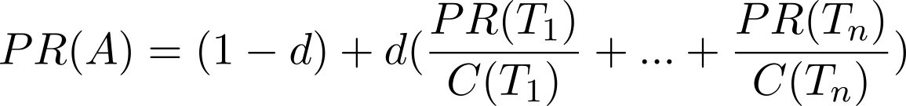
Google’s PageRank Algorithm
Developed by Larry Page and Sergey Brin in 1996.
Ranks web pages based on link structures.
Iteratively transfers rank through links, simulating a ”random surfer”.
where d is the damping factor
4

Slide 8
Small Example

Slide 9
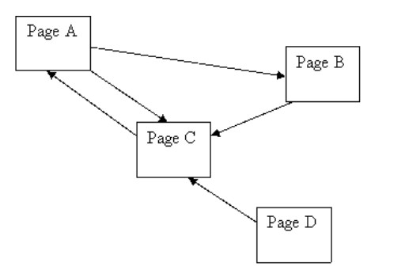
Simplified PageRank Calculation Example
Simple Network:
Two pages, A and B, each linking to the other.
Each page has one outgoing link, hence C(A) = 1 and C(B) = 1.

Slide 10
Simplified PageRank Calculation Example
Simple Network:
Two pages, A and B, each linking to the other.
Each page has one outgoing link, hence C(A) = 1 and C(B) = 1.
PageRank Formula:
( )
PR(Y)
C(Y)
PR(X) = (1 − d) + d
where d is the damping factor, typically set to 0.85.
Guess 1: Initial PR of 1.0 for both pages
PR(A) = PR(B) = 1 (No change, lucky guess!)

Slide 11
Simplified PageRank Calculation Example
Simple Network:
Two pages, A and B, each linking to the other.
Each page has one outgoing link, hence C(A) = 1 and C(B) = 1.
PageRank Formula:
( )
PR(Y)
C(Y)
PR(X) = (1 − d) + d
where d is the damping factor, typically set to 0.85.
Guess 2: Initial PR of 0 for both pages
Iteration 1: PR(A) = 0.15, PR(B) = 0.2775
Iteration 2: PR(A) = 0.385875, PR(B) = 0.47799375
Numbers keep increasing but never exceed 1.0 due to normalization.

Slide 12
Simplified PageRank Calculation Example
Simple Network:
Two pages, A and B, each linking to the other.
Each page has one outgoing link, hence C(A) = 1 and C(B) = 1.
PageRank Formula:
( )
PR(Y)
C(Y)
PR(X) = (1 − d) + d
where d is the damping factor, typically set to 0.85.
Guess 3: Initial PR of 40 for both pages
The PageRank values decrease each iteration and approach 1.0.

Slide 13
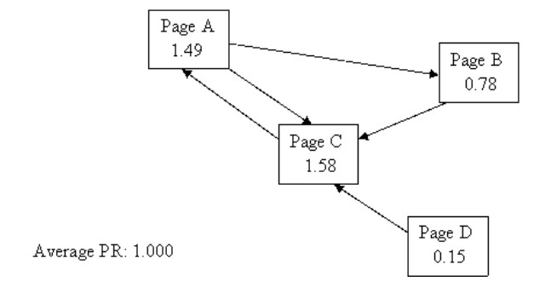
Simplified PageRank Calculation Example
Simple Network:
Two pages, A and B, each linking to the other.
Each page has one outgoing link, hence C(A) = 1 and C(B) = 1.
Guess 3 is correct!

Slide 14
Simplified PageRank Calculation Example
Simple Network:
Two pages, A and B, each linking to the other.
Each page has one outgoing link, hence C(A) = 1 and C(B) = 1.
PageRank Formula:
( )
PR(Y)
C(Y)
PR(X) = (1 − d) + d
where d is the damping factor, typically set to 0.85.
Principle:
The final PageRank values converge to a normalized distribution with an average of 1.0.
Efficiency:
The damping factor and the order of calculations can affect the speed of convergence.
A simple network may settle after around 20 iterations.
10

Slide 15
Our Application and Modifications

Slide 16
Adapting PageRank for Court Cases
Personalization vector adjusted by case date to prioritize newer information.
Transitions only from newer to older cases, reflecting citation flows.
Not accounting for geographic and citation relevance yet

Slide 17
Personalization Vector
A personalization vector is a way to introduce bias or preference into the calculation of PageRank scores, making the algorithm ”personalized” for specific needs.
The vector typically represents a probability distribution over all nodes in the graph, indicating where a ”random surfer” is more likely to begin or jump to when navigating the network.

Slide 18
Method and Results

Slide 19
How We Obtained the Data
Data was obtained by web scraping Google Scholar Case Law
Data ranges from 1940s to 2023
Visualization done on 500 cases

Slide 20
Web Scraping
The process involved Requests and Beautiful Soup in Python for data retrieval and automation.
After receiving the HTML content, we parsed it using Beautiful Soup to extract articles.
Each article’s title, authors, and URL were collected, along with citations through parsing the json file.
The script looped over multiple pages to accumulate comprehensive data.
This method allowed us to quickly aggregate structured academic data, significantly accelerating the research process.

Slide 21
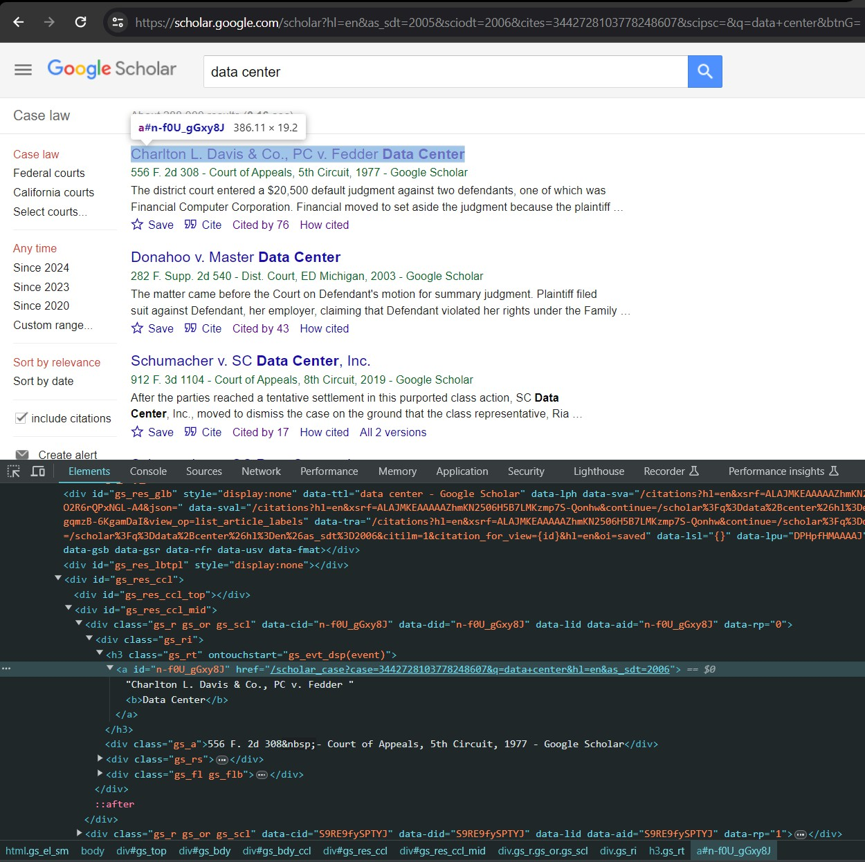
Web Scraping
Figure 1: Google Scholar with developer tools highlighting the structure of a search results page.
15

Slide 22

Graph Visualization of Dataset
Figure 2: Visualization of the dataset with 500 nodes.

Slide 23
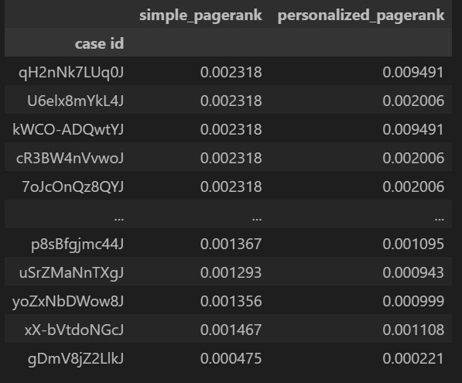
PageRank Comparison
Figure 3: Comparison of simple and personalized PageRank scores.
simple_pagerank: Scores from the standard PageRank algorithm, based solely on network structure.
personalized_pagerank: Scores adjusted by a personalization vector, which introduces bias towards certain nodes.

Slide 24
PageRank Comparison
Figure 4: Comparison of simple and personalized PageRank scores.
Key Observations:
Variability between simple and personalized PageRank scores indicates the influence of personalization.
Cases with higher personalized scores were likely prioritized in the personalization vector.
The analysis reveals the impact of personalization on the authority of cases in a legal citation network.
18

Slide 25
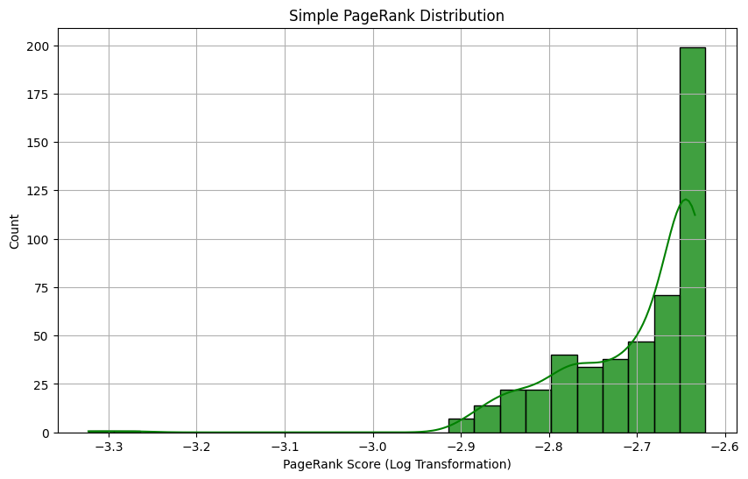
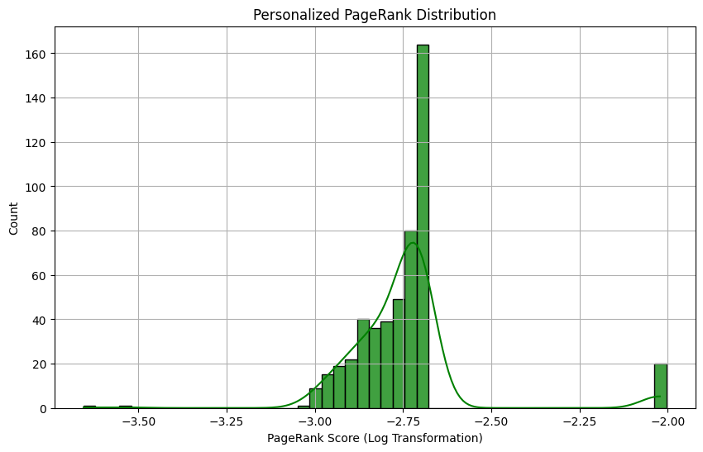
PageRank Log Distributions
Figure 5: Personalized PageRank Distribution
Figure 6: Simple PageRank Distribution
The Simple PageRank shows a concentration of cases around a specific score range.
The Personalized PageRank has a more uniform distribution across different scores, although there is still a peak
This suggests that personalization introduces a bias towards certain nodes within the graph.
19

Slide 26
Future Improvements

Slide 27
Future Improvements
Expanding the dataset to over 4.6 million cases.
Weighting the data using relevance of each citation to the case.
Refining geographical weighting and incorporating expert assessments in rankings.
20

Slide 28
Conclusion

Slide 29
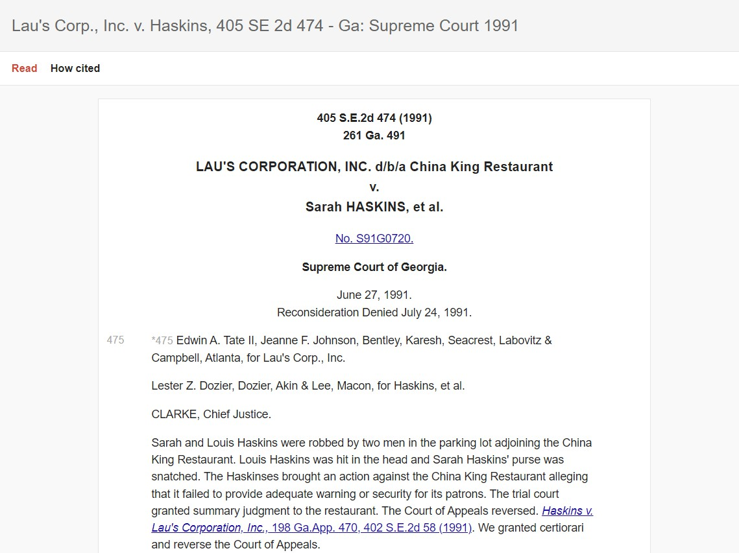
So What is the top case?!

Slide 30
So what is the top case?!
This case, being the most significant in our dataset, revolves around a negligence claim against China King Restaurant by Sarah and Louis Haskins following a robbery and assault in the restaurant’s parking lot. The legal question centered on the restaurant’s duty of care and whether they provided adequate security.
Note: This case is key for its insights into a proprietor’s duty of care and the limits of liability for unforeseen crimes, influencing the evaluation of similar cases.

Slide 31
Acknowledgements
I would like to express my deepest gratitude to those who have helped me throughout this project:
My mentor, Arturo, for his invaluable guidance and support.
The faculty and staff at Northeastern University for providing the necessary resources and for hosting the DRP

Slide 32
Questions?

Slide 33
References i
Wikipedia: PageRank
Tutorial on using Pagerank
Time-Aware Weighted PageRank for Paper Ranking in Academic Graphs
PageRank for bibliographic networks
Bibliometric Measures in Citation-Tracking Databases
Check out the code on github !

Slide 34
Thank You!

