Slide 1
ADVANCED DATA ANALYTICS · IIIT SRI CITY · APRIL 2026
Multi-Modal Analysis of
Delhi Air Quality
14.8M
38
2009 – 2025
Observations
Stations
16 yrs
7
Krishna Gupta
Kumarran Mahesh
Time Span
ML Models
github.com/Krishna-ctrl1/delhi-aq-analysis
Source Fingerprinting
Causal Discovery
Anomaly Detection
PM₂.₅ Forecasting

Slide 2
THE CRISIS
Why Delhi's Air Quality Demands Urgent Action
20×
30M+
>500
100%
Above WHO PM₂.₅ guideline (5 µg/m³)
Residents exposed to chronic health risks
µg/m³ PM₂.₅ during Diwali/crop episodes
Stations exceed WHO benzene carcinogen limit
PM₂.₅ Time Series — 6 Key Stations, Patparganj 2019
KEY PATTERN: Massive winter/post-monsoon pollution spikes. Clean monsoon season. Every station chronically breaches NAAQS (60 µg/m³). PM₂.₅ peaks > 800 µg/m³ during Diwali + crop-burning convergence.
Three episodic sources converge: Diwali fireworks, agricultural residue burning (Punjab/Haryana), and boundary layer temperature inversions
Superimposed on chronic vehicular, industrial, and construction dust emissions year-round
NAAQS (60 µg/m³) breached at virtually every station — the guideline is aspirational, not operational
Research Gap: Fragmented studies lack strict causal separation and naive forecasting baselines.

Slide 3
RESEARCH FRAMEWORK
Four Integrated Research Questions
VOC Source Fingerprinting
Causal Structure Discovery
RQ1
BTEX ratios + K-Means clustering to discriminate traffic vs. industrial vs. mixed monitoring stations — with seasonal variation analysis.
RQ2
Directed causal graph linking meteorology & co-pollutants to PM₂.₅ via PCMCI+ (confound-controlled) — first application to Delhi's CAAQM network.
Anomaly & Regime Detection
PM₂.₅ Forecasting Benchmark
RQ3
Isolation Forest + PELT at 3 scales to identify extreme pollution episodes and seasonal regime boundaries for GRAP activation.
RQ4
7-model comparison — Persistence, SARIMA, XGBoost, LightGBM, RF, LSTM, Ensemble — at 1-hour horizon with honest persistence baseline.
6-Stage Pipeline: Harmonisation → EDA → VOC Fingerprinting → Causal Discovery → Anomaly Detection → Forecasting

Slide 4
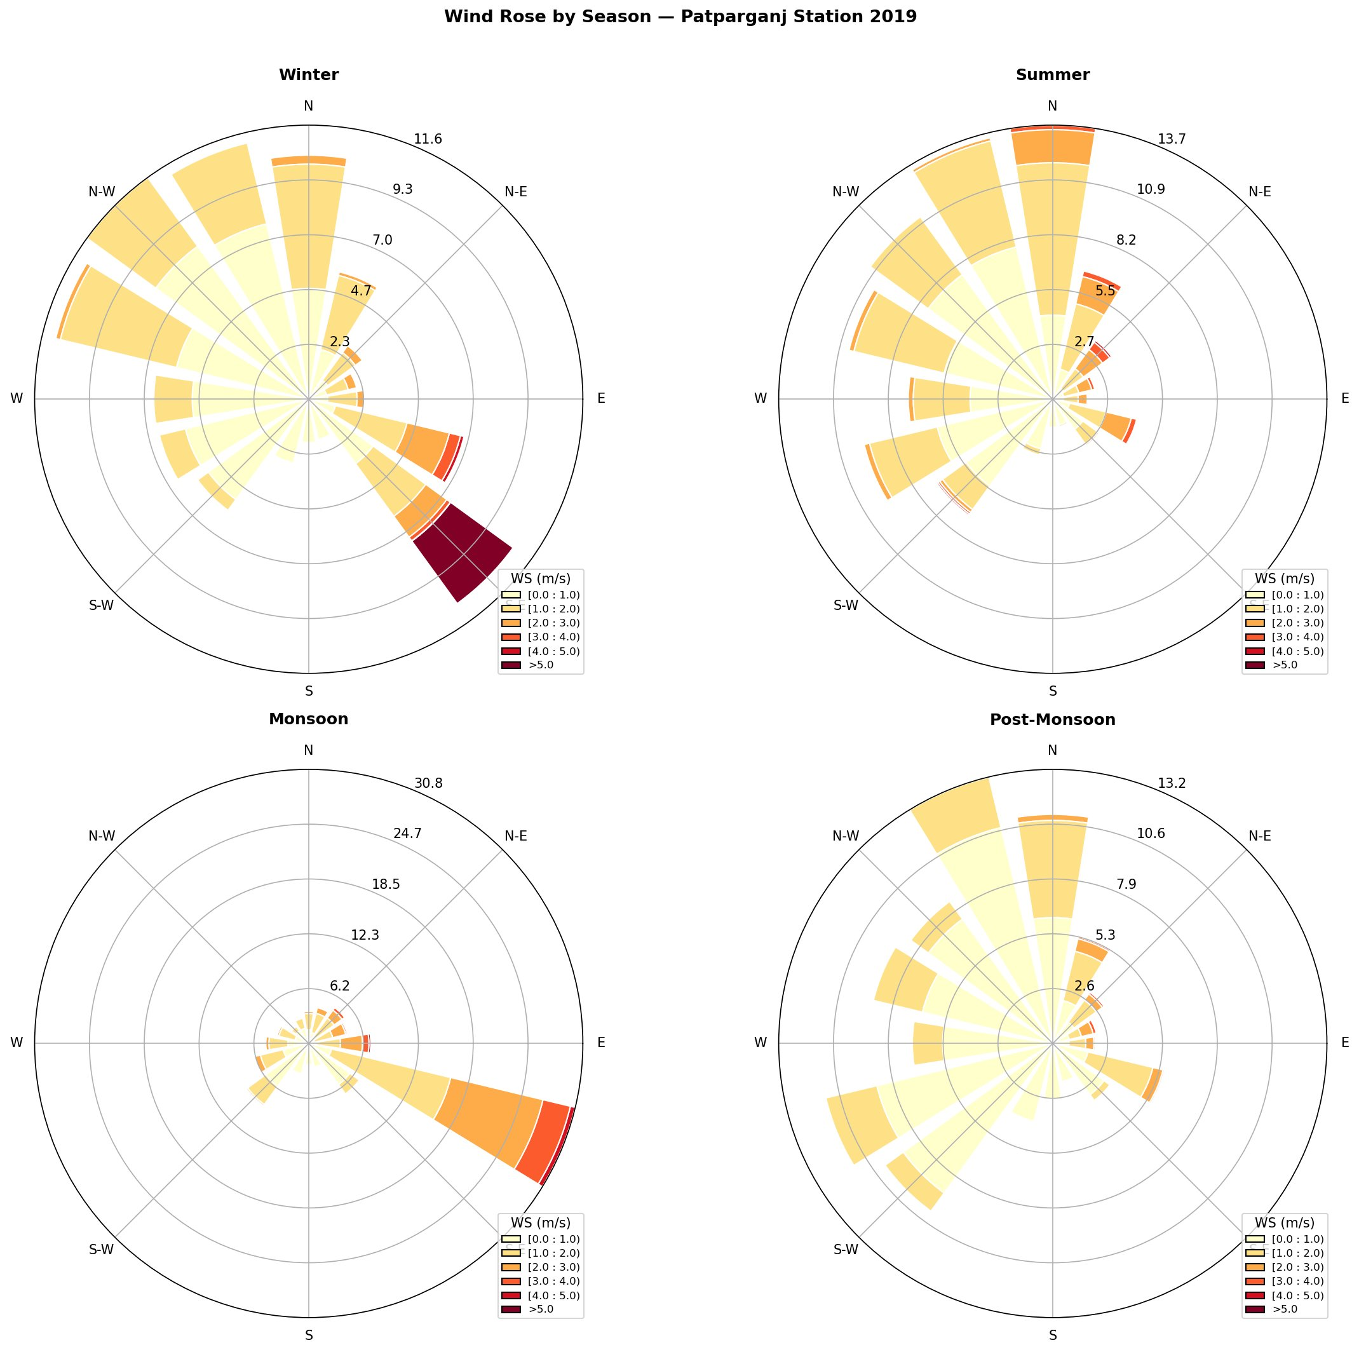
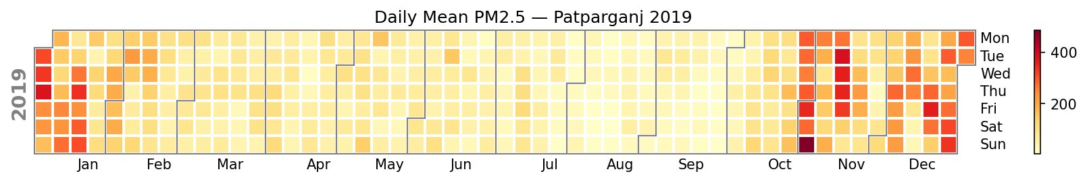
DATA & EXPLORATORY ANALYSIS
14.8M Observations — Wind Patterns & PM₂.₅ Calendar
14.8M
38
25
2009–25
Observations
(15-min)
CAAQM
Stations
Parameters
Pollutants+Met
Full
Time Span
Wind Rose by Season — Patparganj 2019
Daily Mean PM₂.₅ — Patparganj 2019 (Calendar Heatmap)
Key Meteorological & Seasonal Findings
Winter: NW winds dominate — transport from Punjab/Haryana stubble burning regions
Monsoon: SW winds, high speeds (peak 30.8%) — effective pollutant scavenging
Nov–Dec: Darkest cells in heatmap — PM₂.₅ peaks 400+ µg/m³ (Diwali + crops)
Summer–Monsoon transition: Calendar shows clean period (pale yellow cells Jun–Sep)
Post-Monsoon: NW return + inversion onset = rapid pollution buildup from Oct

Slide 5
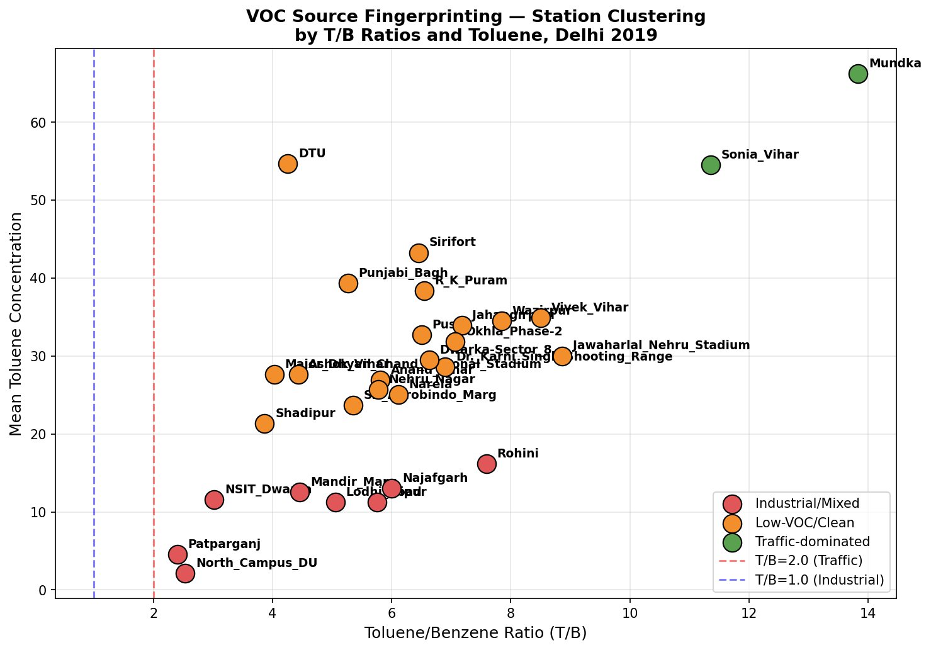
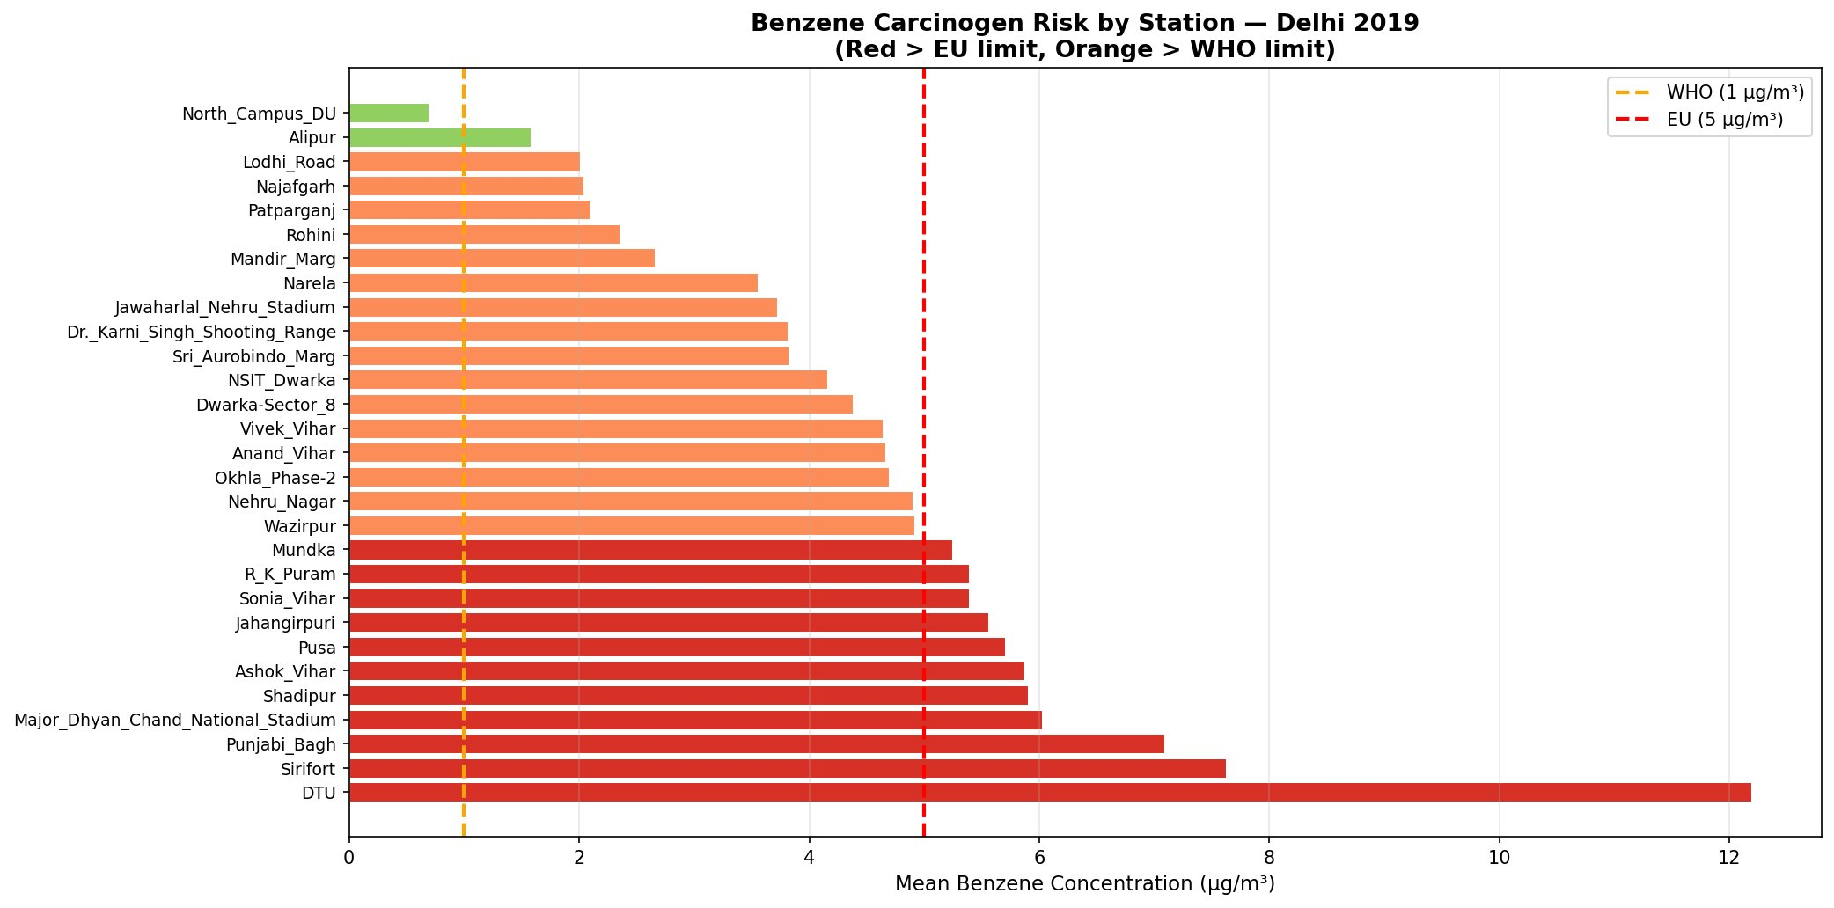
RQ1 RESULT
VOC Source Fingerprinting — 3-Cluster Station Classification
T/B > 2.0
1.0 – 2.0
T/B < 1.0
Traffic-Dominated
Mixed / Low-VOC
Industrial / Solvent
Mundka, Sonia Vihar
Most central stations
Patparganj, NSIT Dwarka
High toluene from vehicular exhaust — major arterial roads
Composite traffic + residential + construction sources
Industrial solvents, painting, manufacturing emissions
T/B peaks in winter (less photodegradation)
Stable ratio year-round
Higher summer toluene oxidation
⚠ BENZENE CARCINOGEN RISK: Nearly ALL stations exceed WHO (1 µg/m³) and EU (5 µg/m³) annual mean benzene limits — a carcinogenic health hazard ABSENT from India's NAQI framework.

Slide 6
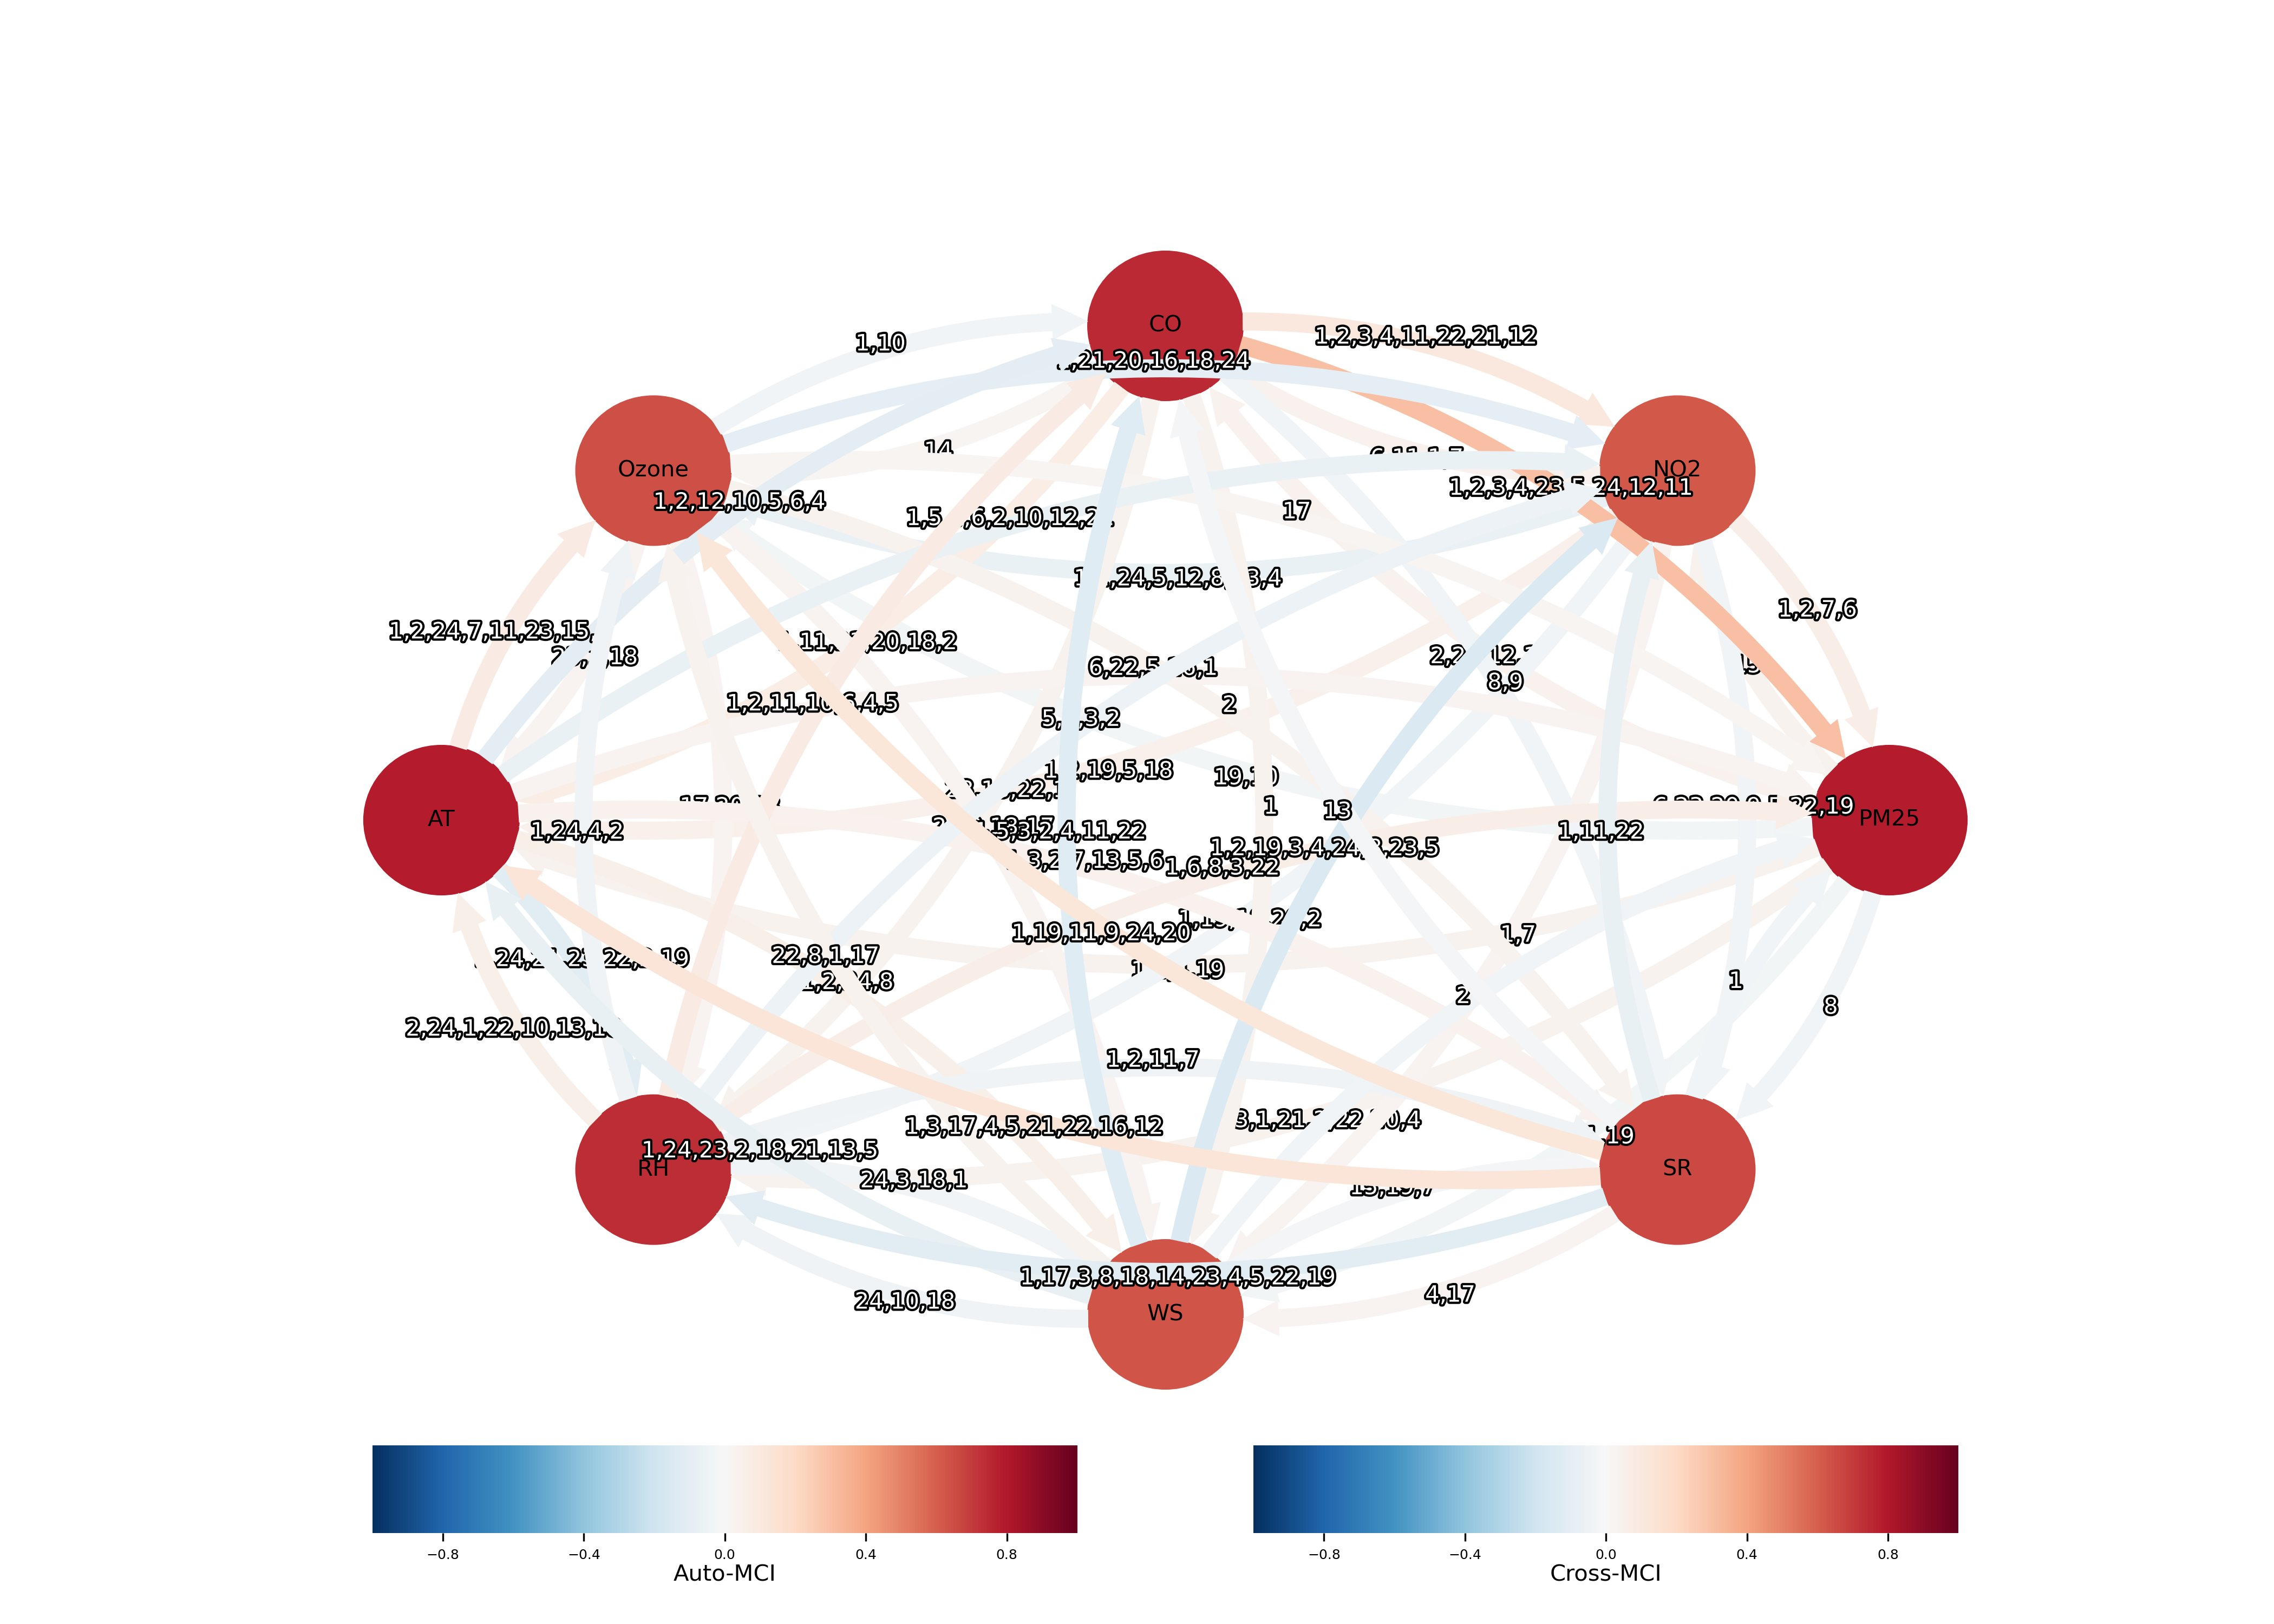
RQ2 RESULT
Causal Structure Discovery — PCMCI+ Directed Causal Graph
PCMCI+ Confirmed Causal Links (ParCorr, τmax=24h, α=0.05)
PM₂.₅ ← CO (lag 1–3h)
#1 causal driver — combustion co-emission signature
PM₂.₅ ← SR (lag 1h)
Immediate photolytic effect on secondary aerosol dynamics
PM₂.₅ ← PM₂.₅ (lag 1–24h)
Strong autoregressive memory — system inertia > 0.95
O₃ ↔ SR ↔ NO₂
Photochemical coupling correctly recovered as bidirectional
BP → PM₂.₅ ELIMINATED
Granger link was spurious — confounding by temperature
SEASONAL CAUSAL SHIFT (causal structure is NOT temporally invariant):
Winter → WS dominates (low boundary layer) · Summer → SR (photolysis) · Monsoon → RH (wet scavenging) · Post-Monsoon → AT + WS (inversion onset)
CRITICAL INSIGHT: PCMCI+ eliminates confounded Granger links (e.g. BP→PM₂.₅) by conditioning on all other variables. Pairwise Granger alone yields false positives — never use it without conditional independence testing.

Slide 7
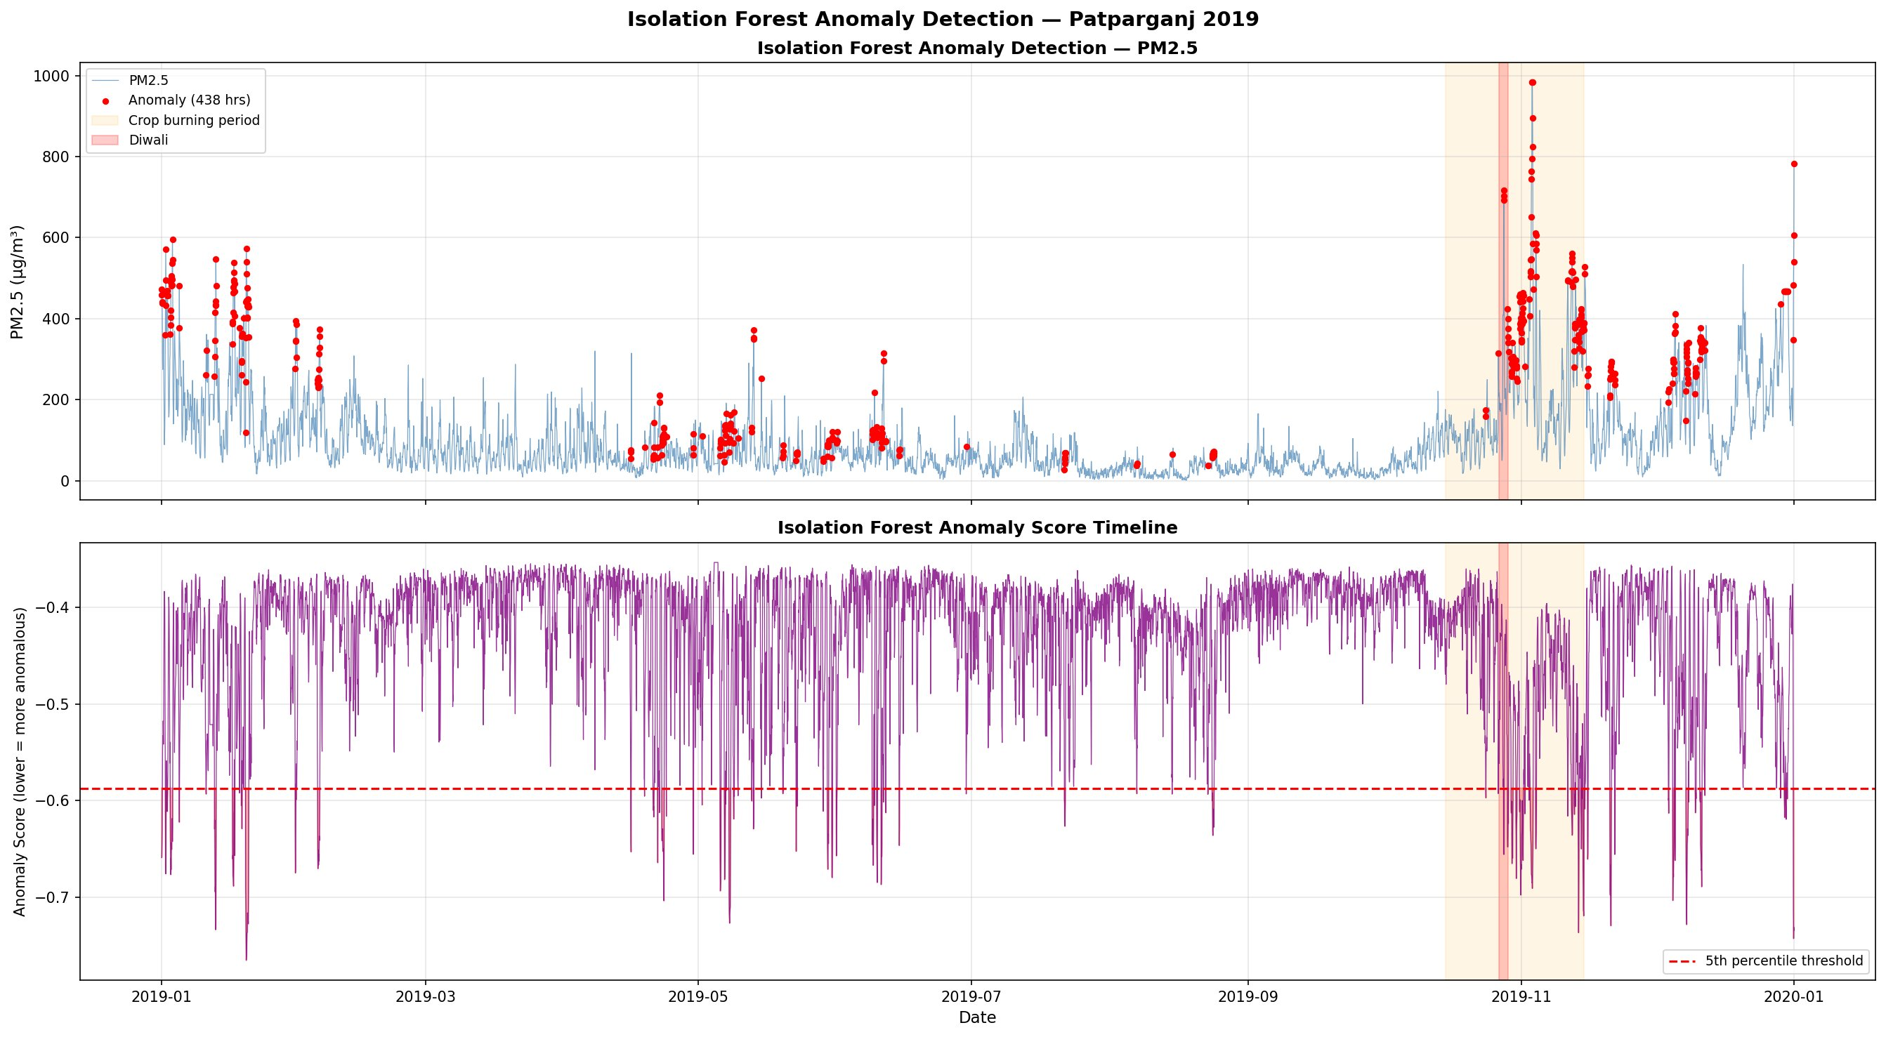
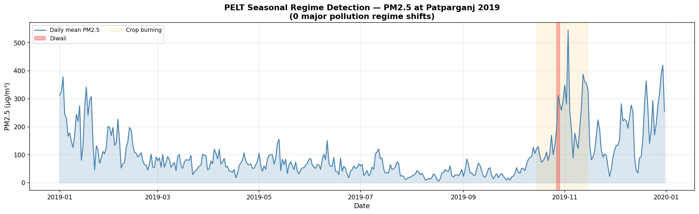
RQ3 RESULT
Anomaly Detection & Regime Analysis
Multi-Scale PELT Change-Point Detection
Scale | Penalty | Shifts | Interpretation
Fine | 80 | ~57 | Short-duration episodes
Macro | 500 | 6–8 | Major seasonal transitions
Seasonal | 3000 | 3–4 | Annual regime boundaries
438
anomalous hours flagged by Isolation Forest (5.0% of 2019)
KEY FINDING: Anomalous hours concentrate in Oct–Nov (Diwali + crop-burning convergence). PELT October change-point coincides PRECISELY with Diwali/stubble-burning onset — providing actionable GRAP activation dates.

Slide 8
RQ4 RESULT
PM₂.₅ Forecasting — The Persistence Ceiling
Test Set: Nov–Dec 2019 (Peak Pollution Period)
Model | RMSE (µg/m³) | R² | Skill Score
Persistence ★ BEST | 30.29 | 0.948 | 0.836
Random Forest | 44.44 | 0.889 | 0.760
LightGBM | 47.82 | 0.871 | 0.742
XGBoost | 52.26 | 0.846 | 0.718
LSTM | 54.36 | 0.832 | 0.701
Ensemble | 56.00 | 0.814 | 0.688
SARIMA ✗ FAIL | 233.69 | −2.08 | −0.262
30.3
0.948
µg/m³ RMSE
R²
Persistence Best
Persistence R²
44.4
−2.08
µg/m³ RMSE
R²
Random Forest 2nd
SARIMA catastrophic
WHY PERSISTENCE WINS: Lag-1 autocorrelation of PM₂.₅ exceeds 0.95 — the series barely moves hour-to-hour. Any trained model battles the raw inertia of the signal.
SARIMA FAILURE: Negative R² (= −2.08) — captures diurnal cycle but cannot model non-stationary Diwali/crop-burning extremes.
INVESTMENT PRIORITY: 1h horizon is dominated by autocorrelation. Operational value is at 6–24h where ML models are expected to outperform persistence.
Note: All models trained on Jan 8–Sep 30, validated Oct 2019, tested Nov–Dec 2019. Strict chronological split — no data leakage.

Slide 9
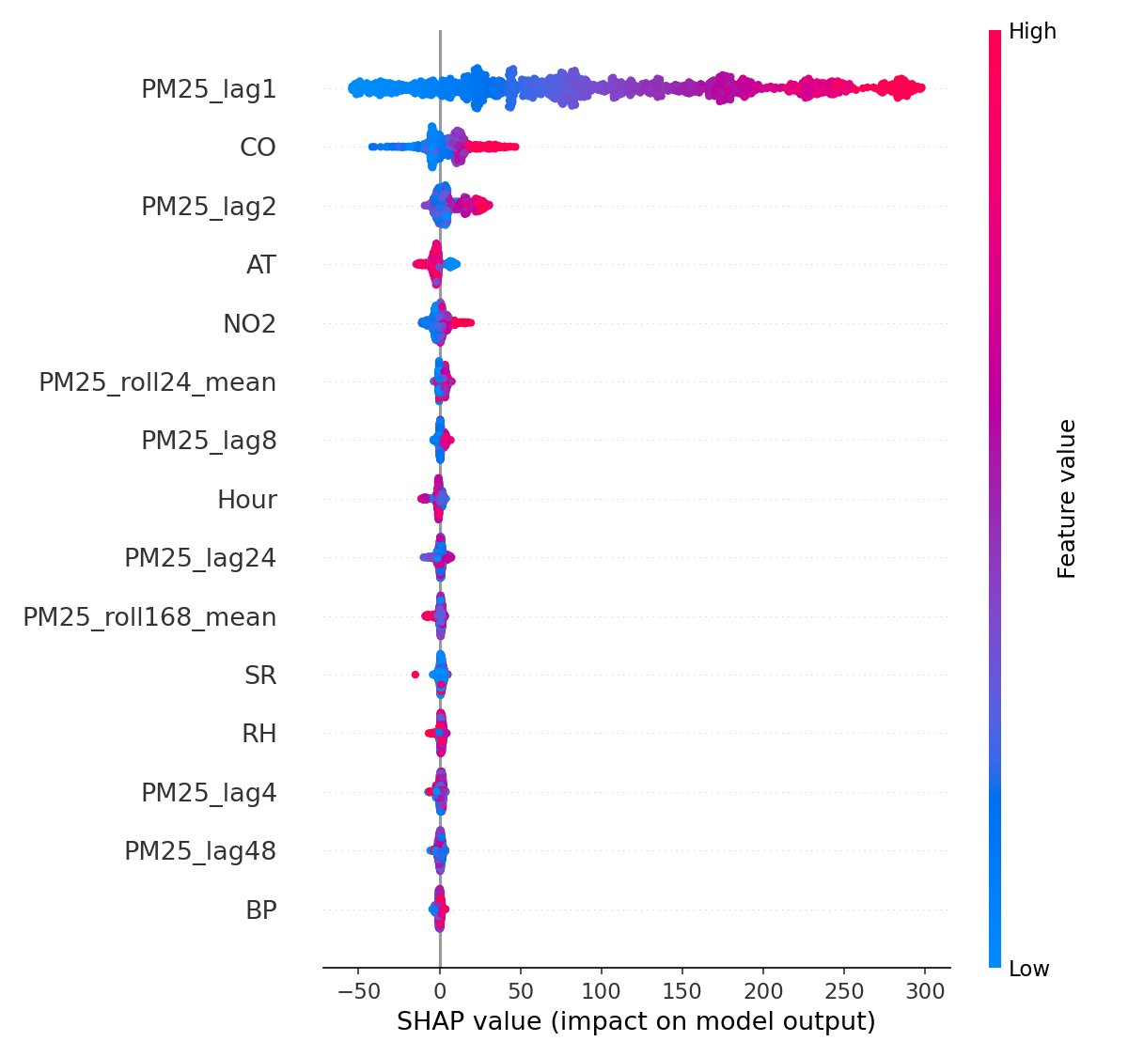
KEY INSIGHT
Prediction ≠ Causation — The SHAP vs PCMCI+ Divergence Matrix
SHAP (Predictive Importance) vs PCMCI+ (Causal Drivers)
Rank | SHAP — Best for Prediction | PCMCI+ — Causal Drivers
1 | PM₂.₅ lag-1 (autoregressive) | CO (combustion co-emission)
2 | PM₂.₅ lag-2 | SR (photolytic dispersion)
3 | PM₂.₅ lag-4 | PM₂.₅ lag-1 (autoregressive)
4 | PM₂.₅ 24h rolling mean | NO₂ (vehicular proxy)
5 | CO | AT (boundary layer)
POLICY IMPLICATION: Prior Delhi forecasting studies reported ML superiority WITHOUT a persistence baseline — likely making INFLATED claims. This study is first to benchmark all 7 models honestly, revealing the autoregressive ceiling at 1h horizons. Invest in 6–24h multi-step forecasting where ML genuinely outperforms.
SHAP XGBoost feature importance confirms: PM₂.₅_lag1 contributes more predictive power than ALL other features combined. CO appears only at rank 5 in SHAP despite being the #1 causal driver in PCMCI+.
This divergence is not a contradiction — it is informative. Prediction leverages inertia; causation identifies intervention points.

Slide 10
KEY CONTRIBUTIONS
5 Novel Contributions to Delhi AQ Research
First PCMCI+ on Delhi CAAQM Network
Persistence Ceiling Exposed
1
Winter → WS-driven dispersion measures. Summer → photolytic (SR-mediated controls). Monsoon → wet scavenging leverage. Post-Monsoon → prevent boundary layer inversions.
2
Honest 1h benchmarking shows naive persistence (RMSE=30.3) beats ALL trained ML/DL models. Prior studies made inflated claims by omitting this baseline.
Prediction–Causation Divergence Matrix
Multi-Scale PELT Analysis
3
First explicit SHAP vs PCMCI+ comparison — separating predictive importance from causal drivers for policymakers. Autoregressive lags ≠ intervention targets.
4
3 penalty scales simultaneously resolve episodic (p=80), transitional (p=500) & seasonal (p=3000) pollution regime structure with actionable GRAP trigger dates.
Benzene Carcinogen Risk Mapping
5
Nearly ALL stations exceed WHO (1 µg/m³) and EU (5 µg/m³) benzene limits — a public health risk substantially absent from India's NAQI framework.

Slide 11
POLICY RECOMMENDATIONS
Actionable Insights for Delhi AQ Governance
Season-Stratified Controls
CO as #1 Intervention
1
Confound-controlled directed causal graph with seasonal decomposition — first application to all 38 stations. Eliminates false-positive Granger links (e.g. BP→PM₂.₅).
2
PCMCI+ identifies CO as strongest causal driver (F=427.5). Tighter vehicular emission norms + open burning bans are highest-ROI. Direct path to PM₂.₅ reduction.
Benzene in NAQI Framework
Invest in 6–24h Forecasting
3
All stations exceed WHO/EU carcinogen limits. India's NAQI must urgently include benzene as an index pollutant. Current framework omits a major carcinogenic risk.
4
At 1h, persistence is unbeatable (autocorrelation > 0.95). Operational early-warning value only materialises at 6–24h horizons — fund multi-step model development.
GRAP Triggers from Episode Catalogue
5
PELT change-points + Isolation Forest episode dates provide precise, data-driven Graded Response Action Plan activation thresholds by season and episode type.

Slide 12
Thank You
Multi-Modal Characterisation, Causal Attribution,
and Predictive Modelling of Ambient Air Quality in Delhi, India (2009–2025)
Krishna Gupta · S20230010124
Kumarran Mahesh · S20230030387
IIIT Sri City — Advanced Data Analytics, April 2026
github.com/Krishna-ctrl1/delhi-aq-analysis
14.8M
PCMCI+
7 Models
CO + SR
Observations
Causal Discovery
Benchmarked
Causal Drivers

