Slide 1



Carbon Emission Prediction

Slide 2

Learning Objectives
Understand the causes and impact of carbon emissions
Explore and clean real-world carbon emission datasets
Apply machine learning models to predict emission levels
Analyze key factors influencing emission trends
Improve data handling and model evaluation skills
GOAL
Source :
www.freepik.com/

Slide 3
Tools and Technology
Python – For data preprocessing, analysis, and machine learning model building
Pandas & NumPy – To handle and manipulate large datasets efficiently
Scikit-learn – For training and evaluating ML models like Linear Regression, Random Forest
Matplotlib & Seaborn – To visualize emission trends and model performance
Jupyter Notebook / Google Colab – As the primary development environment for experimentation

Slide 4
Methodology
Data Collection: Acquired emission data from public sources
Preprocessing: Cleaned and prepared the data for analysis
EDA: Explored patterns and visualized key insights
Model Training: Applied ML algorithms for prediction
Evaluation: Tested model performance using accuracy metrics

Slide 5
Problem Statement:
Analysis of country-specific data and development of machine learning models in order to predict CO2 emissions from country parameters. The project uses the publicly available dataset Climate Change Data from the World Bank Group.

Slide 6
Solution:
Cleaned and processed climate and economic data from the World Bank (1990–2011).
Performed data analysis to identify key factors influencing CO₂ emissions.
Built and trained a Random Forest Regressor model to accurately predict emissions.

Slide 7
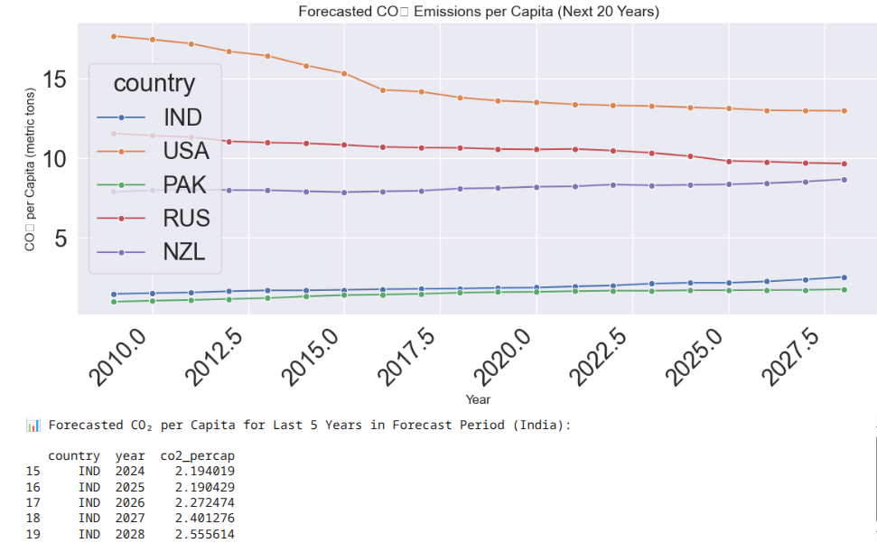
Screenshot of Output:

Slide 8
Conclusion:
CO₂ emissions per capita are projected to decrease in developed countries like the USA and Russia, reflecting efforts in sustainability, clean energy adoption, and stricter emission regulations.
India and Pakistan show a rising trend, indicating the environmental impact of rapid industrialization and economic growth.
The forecast highlights a convergence in global emission patterns, though countries are at different stages of development.
These insights emphasize the need for balanced growth, where emerging economies like India adopt greener technologies while sustaining development.

