Slide 1

Customer and Sales Data Analysis Report
BY- Krishna Rathore

Slide 2
Agenda
Objective Questions
Unique Customers Analysis
Product Analysis
Table Relationships
Data Handling and M-Query
Top Customers Identification
Revenue Growth Analysis
Revenue Breakdown
Product Returns Analysis
Impact of Product Ratings
Revenue Distribution by Location
Monthly Sales Analysis
Notes:
Agenda * Objective Questions * Customer Ages in Order Table * Data Cleaning in Power BI * Customer Table Attributes * Annual Unique Customers * Product Analysis * Average Delivery Time * Popular Products and Categories * Sales Increase Analysis * Unique Products Count * Customer ID Relationship * Data Handling and M-Query * Handling Null Values * Data Format Issues * Power Query M-Code * Composite Score Calculation (SQL) * Revenue Growth Analysis * Month-over-Month Growth Rate (SQL) * Rolling 3-Month Average Revenue (SQL) * Revenue Breakdown * Yearly Revenue Breakdown * Product Revenue Breakdown * Total Returned Orders (DAX) * Ratings vs Sales Analysis * Top Contributing Locations * Sales Trends by Month * High Price, Low Sales Products * Discount Implementation * Segmentation and Benefits * Total Sales Calculation (DAX) * Wait Times Across Product Categories * Delivery Type Analysis * Shipping Charges by Product Type * Factors Influencing Low Ratings * Monthly Sales Comparison (DAX) * Use Cases of Power BI Gateway * Data Understanding and Analysis

Slide 3

Customer Ages in Order Table
Joining Tables for Age Retrieval
Customer ID is the unique identifier in the customer table
Customer ID in the order table links to the customer table
Steps to Retrieve Ages
Perform a join operation between customer and order tables
Match customer IDs from both tables
Extract age information from the customer table
Notes:
To retrieve customer ages from the order tables, join the customer ID from the customer table with the customer ID in the order table. This allows you to extract age information from the customer table. Original Content: How will you get the “Customer’s” ages in the “Order” tables according to customer IDs? Ans To get customer ages in the order table we need to join customer id that is unique id of customer table to join customer id of order table.

Slide 4

Data Cleaning in Power BI
Importance of Data Cleaning
Address inconsistencies
Handle missing values
Specific Example: Orders Table
Reason column mostly empty
Removed reason column
Notes:
When analyzing datasets with Power BI, it's crucial to clean the data to fix inconsistencies and handle missing values. For example, in the orders table, the reason column was mostly empty, so it was removed. Original Content: In analyzing the dataset with Power BI, ensure data cleaning to address inconsistencies and missing values before further analysis. Ans In orders table most of the row reason column is empty so I removed reason column from order tables by following steps

Slide 5
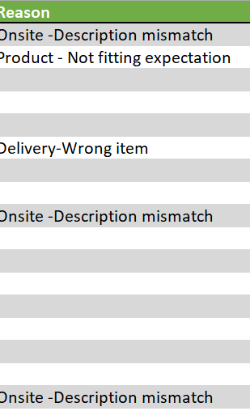
Handling Null Values
Notes:
To handle null values in the data, we join the customer ID from the customer table with the customer ID in the order table to get customer ages. Original Content: How have you handled the null values in the data? Ans To get customer ages in the order table we need to join customer id that is unique id of customer table to join customer id of order table.

Slide 6
Customer Table Attributes
Total Number of Attributes in Customer Table
Customer ID
Customer Age
Customer Gender
Calculating Total Revenue Generated by Sales
Method to calculate total revenue
Notes:
The customer table contains three attributes: customer ID, customer age, and customer gender. To calculate the total revenue generated by all sales, a specific method is required. Original Content: What is the total number of attributes in the customer table? Ans There are total 3 attributes in the customer table that is customer id, customer age and customer gender. How can we calculate the total revenue generated by all the sales?

Slide 7
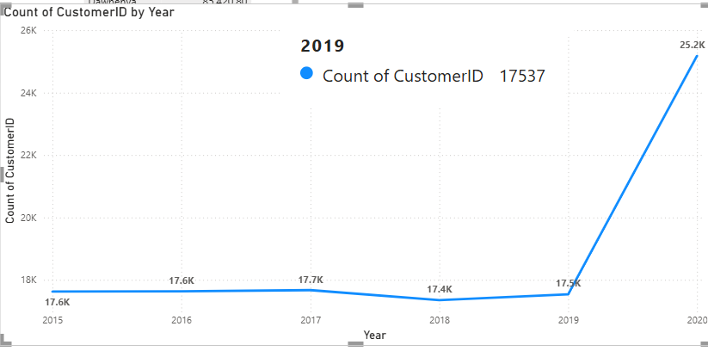
Unique Customers Analysis
Total number of unique customers
Yearly count of unique customers
Comparison of customer numbers over the years
Total number of attributes in customer table
Details of attributes in the customer table
Notes:
This slide presents an analysis of the total number of unique customers who made purchases each year, highlighting any increase over the years. Additionally, it covers the total number of attributes in the customer table. Original Content: What is the total number of unique customers who made purchases each year? Is there any increase in the number over the years? What is the total number of attributes in the customer table?

Slide 8

Average Delivery Time
Calculation Method
Difference between order date and delivery date
Total number of days for each order's delivery
Filter Applied
Included only delivered orders
Result
Average delivery time is 9 days
Notes:
The average delivery time for delivered orders is calculated by finding the difference between the order date and delivery date. After filtering for delivered orders, the average delivery time is found to be 9 days. Original Content: What is the average number of days it takes for products to be delivered, get the metric for only the delivered orders. Ans By calculating the difference between the order date and the delivery date, we obtained the total number of days for each order's delivery. After applying a filter to include only those orders that were delivered, we found that the average delivery time is 9 days.

Slide 9
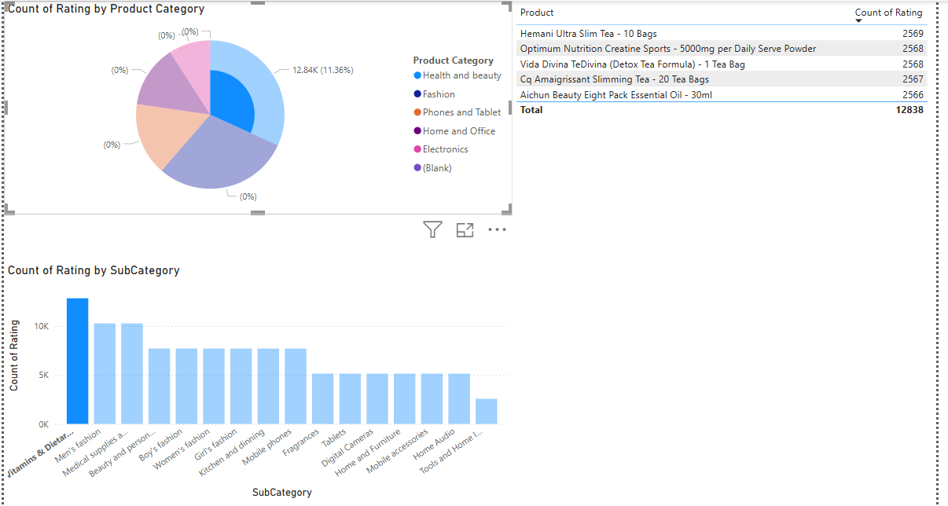
Popular Products and Categories
Customer Table Attributes
Customer ID
Customer Age
Customer Gender
Notes:
The customer table contains three key attributes: customer ID, customer age, and customer gender. Original Content: Which products, categories, and subcategories are the most popular? Ans There are total 3 attributes in the customer table that is customer id, customer age and customer gender.

Slide 10
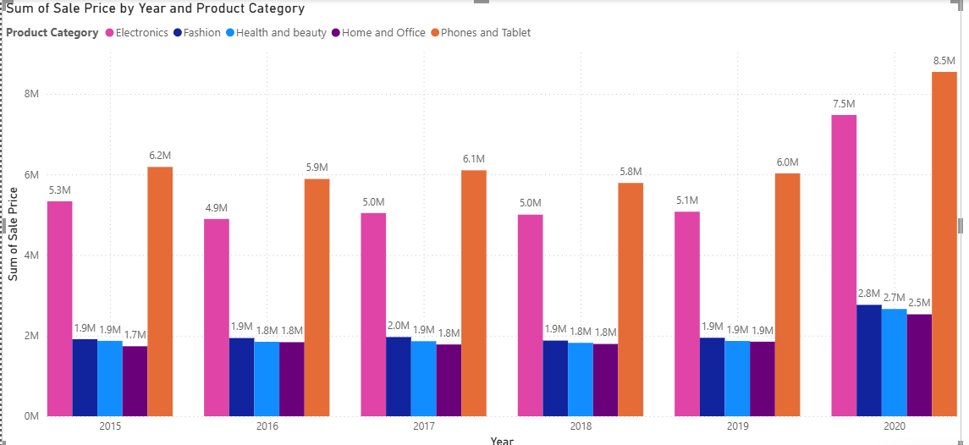
Sales Increase Analysis
Customer ID
Unique identifier for each customer
Customer Age
Age of the customer
Customer Gender
Gender of the customer
Notes:
The customer table consists of three attributes: customer ID, customer age, and customer gender. Each customer has a unique ID, their age is recorded, and their gender is noted. Original Content: Which products have seen an increase or decrease in sales over the year? Ans There are total 3 attributes in the customer table that is customer id, customer age and customer gender.

Slide 11
Unique Products Count
Determining Unique Products
Identify all products listed in the company's inventory
Filter out duplicate entries to find unique products
Total Number of Attributes in Customer Table
Examine the structure of the customer table
Count all distinct attributes present in the table
Notes:
To determine the total number of unique products, we need to identify all products in the inventory and filter out duplicates. For the customer table, we examine its structure and count the distinct attributes. Original Content: How can we determine the total number of unique products available in the company? What is the total number of attributes in the customer table?

Slide 12
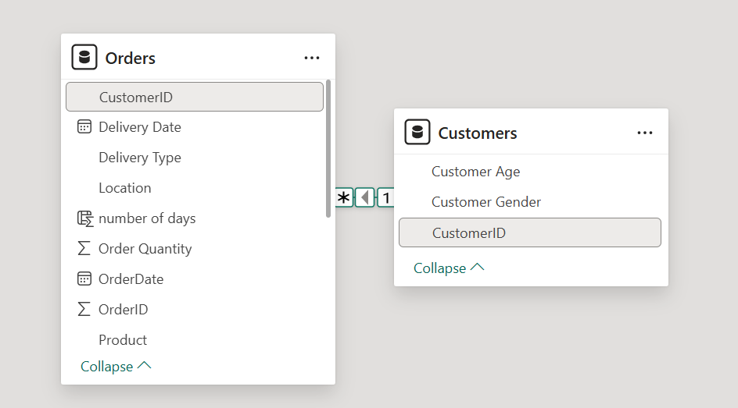
Table Relationships
Type of Relationship between Customer ID in Orders and Customer Tables
Customer ID in Orders table links to Customer table
Establishes a foreign key relationship
Getting Customer's Ages in Order Tables
Use Customer ID to join Orders table with Customer table
Retrieve age data from Customer table
Notes:
In modeling data relationships, the Customer ID in the Orders table links to the Customer table, creating a foreign key relationship. To get customer ages in the Order tables, join the Orders table with the Customer table using Customer ID and retrieve the age data. Original Content: While modeling the data relationships, what will be the type of relationship between the customer ID of Orders and customer tables? How will you get the “Customer’s” ages in the “Order” tables according to customer IDs?

Slide 13
DAX Functions Usage
Approach
Used Data Analysis Expressions (DAX) for calculations
Calculated total sales for 'Fashion' category with 'Shipped from Abroad' delivery type
Other DAX Functions
Calculated total returned products
Identified reasons behind product returns
Insights
Filtered and sorted total sales by product category and delivery type
Total sales for fashion category from overseas deliveries: 4.14 million
Provided insights into performance and distribution of overseas deliveries
Assisted in strategic planning and decision-making
Identified areas for optimization and growth in the global market
Notes:
We used DAX functions to calculate total sales in the fashion category with overseas delivery. This analysis revealed 4.14 million in sales. Additionally, we calculated total returns to understand return reasons, aiding in strategic planning and identifying growth areas. Original Content: Using the DAX functions Calculate and a row iteration DAX function calculate the total sales for the Product Category “Fashion” and delivery type “Shipped from Abroad”. What are the other types of DAX functions you have used in the project? Ans Approach: Used Data Analysis Expressions (DAX) to calculate total sales in the fashion category with overseas delivery. DAX, a formula language for Power BI, consists of functions, operators, and constants for data analysis and calculations. other DAX function I used to find total returned which helped me identify how many products are returning and whats the reason behind returning. Insights: The use of this DAX function proved beneficial in filtering and sorting total sales according to the product category "Fashion" and the delivery type "Shipped from Abroad." Through this analysis, it was determined that the total sales for the fashion category from overseas deliveries amounted to 4.14 million. This comprehensive filtering mechanism provides valuable insights into the performance and distribution of products delivered from abroad, enabling more informed decision-making and strategic planning for future sales initiatives. Furthermore, understanding the sales dynamics specific to overseas shipments assists in identifying potential areas for optimization and growth within the global market.

Slide 14
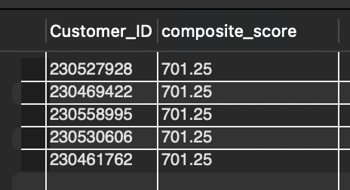
Top Customers Identification
Composite Score Calculation
Total Revenue (50% weight)
Order Frequency (30% weight)
Average Order Value (20% weight)
SQL Query for Composite Score
select Customer_ID, (sum(Sale_Price)*0.5 + Order_Quantity*0.3 + avg(Sale_Price)*0.2) composite_score from orders
group by Customer_ID, Order_Quantity
order by composite_score desc
Modification of Orders Table
Reason column removed due to empty rows
Notes:
To identify the top 5 most valuable customers, we use a composite score combining Total Revenue, Order Frequency, and Average Order Value. The SQL query calculates this score and sorts customers accordingly. Additionally, the reason column was removed from the orders table due to empty rows. Original Content: Identify the top 5 most valuable customers using a composite score that combines three key metrics: (SQL) Total Revenue (50% weight): The total amount of money spent by the customer. Order Frequency (30% weight): The number of orders placed by the customer, indicating their loyalty and engagement. Average Order Value (20% weight): The average value of each order placed by the customer, reflecting the typical transaction size. Ans Sql query to solve the question is select Customer_ID, (sum(Sale_Price)*0.5 + Order_Quantity*0.3 + avg(Sale_Price)*0.2) composite_score from orders group by Customer_ID,Order_Quantity order by composite_score desc Ans In orders table most of the row reason column is empty so I removed reason column from order tables by following steps

Slide 15
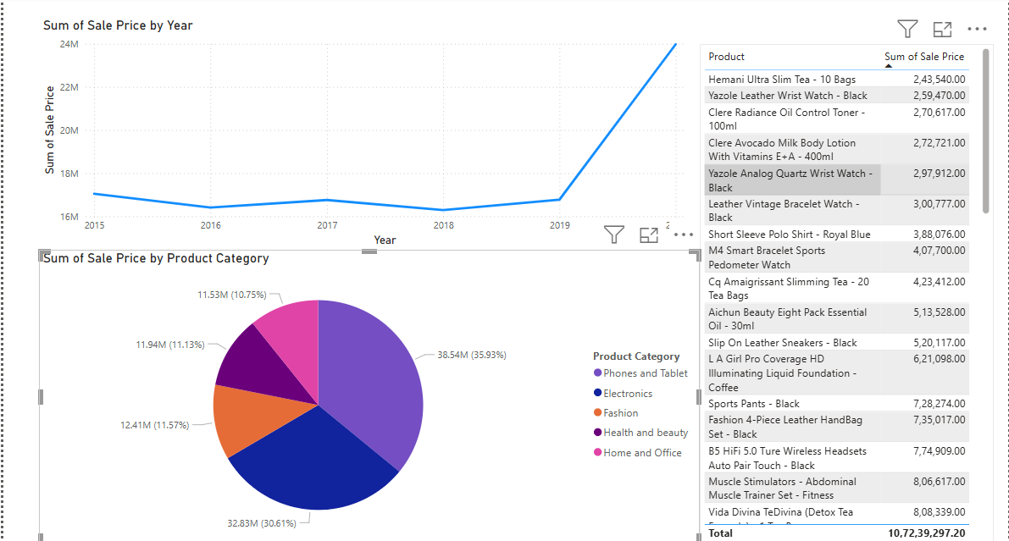
Yearly Revenue Breakdown
Yearly Revenue Breakdown
Minor fluctuations from 2015 to 2019
Significant surge from 2019 to 2020
Product Category Contribution
Phones and tablets: 36%
Electronics: 30.61%
Other categories: 10% to 11%
Suggestions for Increasing Sales
Identify trends in sales increases and decreases
Focus on low-selling items
Notes:
Our analysis shows minor revenue fluctuations from 2015 to 2019, with a significant surge in 2020. Phones and tablets contribute 36% to revenue, followed by electronics at 30.61%. Other categories contribute around 10% to 11%. We suggest focusing on trends and low-selling items to boost sales. Original Content: Subjective Question: Explain the revenue breakdown by year and by-product. Evaluate how different products contribute to annual revenue and come up with suggestions to increase the sales of the low-selling items. Approach: We used a line chart with order date by year and sales price to understand the yearly revenue breakdown. For product revenue breakdown, we analyzed sales by product category and individual products to easily identify trends in sales increases and decreases. Insights: From 2015 to 2019, revenue exhibited minor fluctuations with a slight increase and decrease. However, there was a significant surge in revenue from 2019 to 2020 within a single year. When analyzing product category data, it is evident that phones and tablets contribute the highest share at 36%, followed by the electronics category at 30.61%. Other categories hover around 10% to 11%.

Slide 16
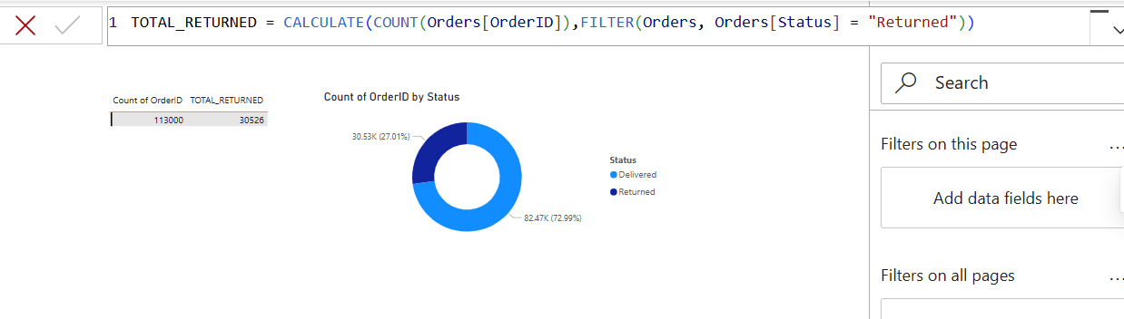
Product Returns Analysis
Metric Calculation Using DAX Function
Formula: TOTAL_RETURNED = CALCULATE(COUNT(Orders[OrderID]), FILTER(Orders, Orders[Status] = 'Returned'))
Insights from Data
Total orders placed: 113,000
Orders returned: 30,526 (27%)
Orders successfully delivered: 73%
Potential Reasons for Returns
Product descriptions
Quality control issues
Improvement Indications
Enhanced product descriptions
Better quality control measures
Notes:
We used a DAX function to calculate the total number of returned orders. The formula is TOTAL_RETURNED = CALCULATE(COUNT(Orders[OrderID]), FILTER(Orders, Orders[Status] = 'Returned')). Insights show that out of 113,000 orders, 30,526 were returned, indicating a need for better product descriptions and quality control. Original Content: How many products were returned? Use a DAX function to get this metric. Examine the possible reasons for returns and consider how this metric could indicate improvements in product descriptions or quality control. Approach: To identify the potential reasons for returns, we used a DAX function to determine the total number of returned orders. The formula is: TOTAL_RETURNED = CALCULATE(COUNT(Orders[OrderID]), FILTER(Orders, Orders[Status] = "Returned")) Insights: The image shows that a total of 113,000 orders were placed, with 30,526 orders (27%) returned and 73% successfully delivered. The gauge chart provides a clear view of the number of orders returned and delivered.

Slide 17
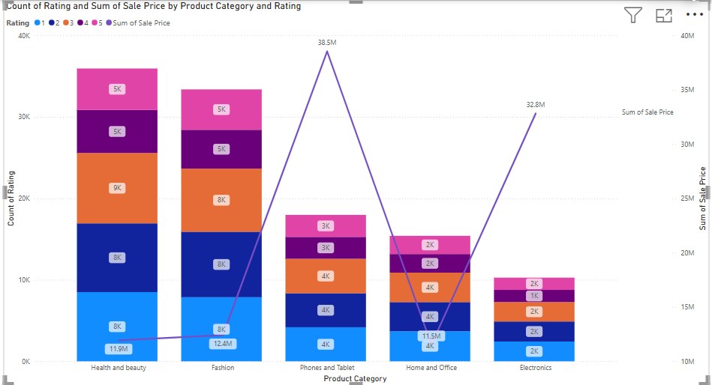
Impact of Product Ratings
Approach to Determine Influence of Ratings on Sales
Used line and stacked graphs for visualization
Parameters: product category, sum of sale prices, count of ratings
X-axis: product category
Column y-axis: count of ratings
Line y-axis: sum of sales prices
Insights from Graph Analysis
Health and Beauty category has highest ratings
Sales revenue is lowest despite high ratings
5,000 customers gave 5-star ratings
8,000 customers gave 1-star ratings
9,000 customers gave 3-star ratings
Notes:
We analyzed whether product ratings impact sales using line and stacked graphs. The Health and Beauty category had the highest ratings but the lowest sales revenue. Despite high ratings, sales did not increase proportionately, indicating no direct correlation. Original Content: Whenever a customer goes to Amazon, they’ll filter the most rated products to buy the better category. Can you verify this using any visualization or table that the ratings of products impact their sales value? Approach: To determine whether product ratings influence sales, we used line and stacked graphs. The parameters are product category, sum of sale prices, and count of ratings. The x-axis represents the product category, the column y-axis represents the count of ratings, and the line y-axis represents the sum of sales prices. Insights: The graph clearly illustrates that the Health and Beauty category has the highest number of ratings, yet its sales revenue is the lowest compared to all other categories. Within this category, only 5,000 customers gave a 5-star rating, while 8,000 customers provided a lower 1-star rating. Approximately 9,000 customers, which constitutes the majority, rated it with 3 stars. This data suggests that there is no direct correlation between ratings and sales; despite an increase in ratings, sales have not increased proportionately.

Slide 18
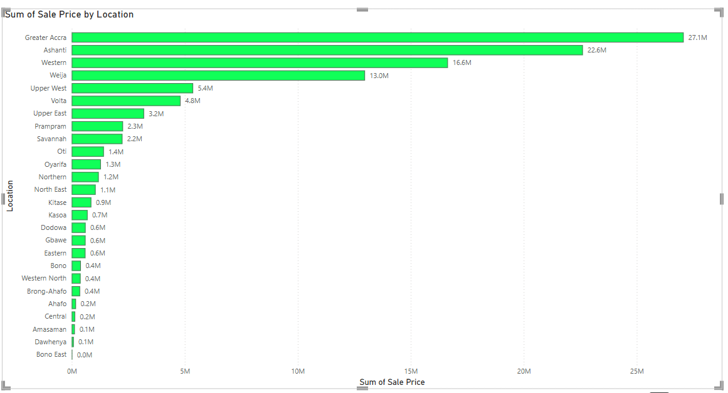
Revenue Distribution by Location
Top Five Locations with Highest Sales
Greater Accra: 27.1M
Ashanti: 22.6M
Western: 16.6M
Weija: 13.0M
Upper West: 5.4M
Remaining Locations
Sales below 5M
Bono East and Dawhenya: No revenue generated
Strategic Implications
Regional marketing efforts
Location-Based Trends
Notes:
We analyzed revenue distribution across various locations using a cluster bar chart. The top five locations with the highest sales are Greater Accra, Ashanti, Western, Weija, and Upper West. Remaining locations have sales below 5M, with Bono East and Dawhenya generating no revenue. These insights can inform regional marketing, distribution strategies, market segmentation, and resource allocation. Original Content: Investigate how revenue distribution varies across different locations. Explore which geographical areas contribute most to sales and consider the strategic implications for regional marketing and distribution efforts. How might location-based trends inform the company's market segmentation and resource allocation approach? Approach: To analyze revenue distributions across various locations, we utilized a cluster bar chart with the sum of sales price on the x-axis and location on the y-axis. Insights: Utilizing the graph, it is evident that among the 27 locations, the top five with the highest sales are Greater Accra with sales of 27.1M, which is the highest, followed by Ashanti with sales of 22.6M, Western with 16.6M, Weija with 13.0M, and Upper West with 5.4M. The remaining locations have sales below the 5M mark. Locations such as Bono East and Dawhenya have not yet begun generating revenue. Suggestion:

Slide 19
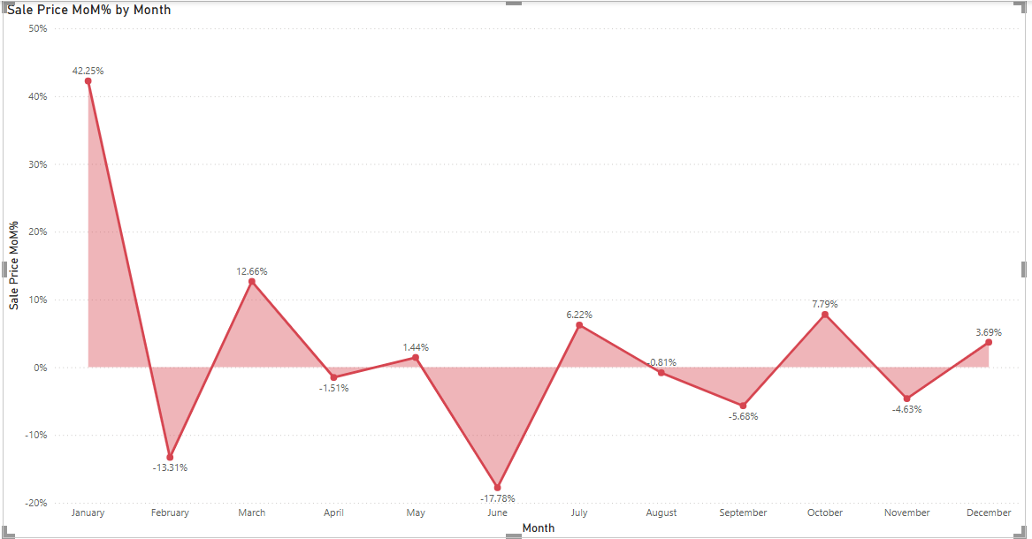
Monthly Sales Analysis
January Sales Performance
Highest sales percentage at approximately 42.25%
February Sales Decline
Sales decrease by 13.1%
June Sales Decline
Significant drop in sales by 17.78%
Other Months
Sales fluctuate between 12% and -5%
Notes:
Our analysis shows January has the highest sales at 42.25%. February and June experience declines of 13.1% and 17.78%, respectively. Other months fluctuate between 12% and -5%. Targeted promotional strategies are needed to boost sales in these months. Original Content: Determine which month could benefit from enhanced promotional offers to boost sales. Can you suggest some targeted marketing strategies here? Approach: To understand the month wise sales in given we use time intelligence function in quick measures that is month on month sales. Than we connected month of month sales to order date indicating only month. We use line chart to understand in which month our sales are going down. Insights: The graph indicates that January has the highest sales percentage at approximately 42.25%. February shows a decline in sales by 13.1%, and June experiences a significant decline of 17.78%. This is a major concern. Sales for other months fluctuate between 12% and -5%. Suggestion:

Slide 20
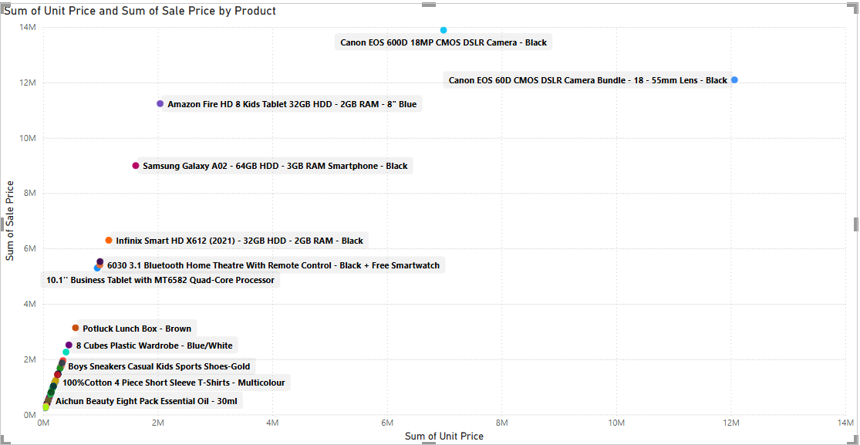
Underperforming Products
Analysis Approach
Used three key parameters: product, unit prices, and sales prices
Integrated these parameters into a scatter plot graph
Visual representation of relationship between product pricing and sales
Identified trends, outliers, and areas for improvement
Insights from Scatter Plot
Most products are priced reasonably
Canon EOS 60D CMOS and Canon EOS 600D 18MP are exceptions
These products have high prices but underperform in sales
Discrepancy suggests lack of demand despite higher price points
Notes:
We analyzed product performance using unit prices and sales prices, visualized in a scatter plot. Most products are priced reasonably, but Canon EOS 60D CMOS and Canon EOS 600D 18MP have high prices yet underperform in sales. This suggests a need for increased marketing efforts. Original Content: Identify which products may require increased marketing efforts. Which items have high prices yet underperform in sales? Approach: To gain a comprehensive understanding of the market performance of our products, we employed a multi-faceted analysis using three key parameters: the product itself, the sum of unit prices, and the sum of sales prices. By integrating these parameters into a scatter plot graph, we were able to visually represent the relationship between product pricing and their respective contributions to overall sales. This approach allowed us to identify trends, outliers, and potential areas for improvement in our pricing strategy and sales performance. Insights: By utilizing a scatter plot, we can observe that the majority of products are priced reasonably. However, there are two notable exceptions: the Canon EOS 60D CMOS and the Canon EOS 600D 18MP. These products are priced significantly higher, yet their sales figures do not reflect a corresponding increase in demand. This discrepancy suggests that despite their higher price points, these products are not performing as well in terms of sales. Suggestion:

Slide 21
Product Discounts Strategy
Identifying Discount Candidates
Analyzed product price and sales performance
Generated scatter plot for visualization
Pinpointed high-priced items with low sales
Insights from Analysis
Most products have appropriate price points
Canon EOS 60D CMOS and 600D 18MP are outliers
Higher prices with lower sales volumes
Discount Suggestions
Implement 15-25% discount on Canon EOS 60D CMOS and 600D 18MP
Reduce price by fixed dollar amount
Run limited-time promotional discounts
Notes:
To boost sales for high-priced cameras, we analyzed product price and sales performance. The Canon EOS 60D CMOS and 600D 18MP were identified as outliers with higher prices and lower sales volumes. We suggest implementing discounts, promotional deals, bundle offers, trade-in programs, extended warranties, and targeted incentives for loyalty members, students, and educators. Original Content: Assess which products should have discounts. How can targeted incentives drive sales and customer loyalty for specific products? Approach: To identify products suitable for discounts, we analyzed the relationship between product price and sales performance. A scatter plot was generated, visualizing the total unit price against total sales price for each product. This allowed us to pinpoint high-priced items with low sales, indicating potential discount candidates. Insights: A scatter plot analysis shows that the majority of products have appropriate price points. However, the Canon EOS 60D CMOS and 600D 18MP stand out as outliers with considerably higher prices. Importantly, their sales volumes do not match these elevated prices, suggesting weaker market performance. Suggestion: Implement a substantial percentage discount (e.g., 15-25%) on both the Canon EOS 60D CMOS and 600D 18MP to immediately stimulate sales and bring their prices in line with market demand. Reduce the price of the Canon EOS 60D CMOS and 600D 18MP by a fixed dollar amount, calculated to make them more competitive within their product category. Run a limited-time promotional discount (e.g., a 'flash sale' or 'weekend special') on these two models to create a sense of urgency and drive immediate sales. Offer a bundle deal that includes the Canon EOS 60D CMOS or 600D 18MP with complementary accessories (e.g., lenses, memory cards, camera bags) at a discounted package price. Introduce a trade-in program, allowing customers to trade in their old camera equipment for a discount on the Canon EOS 60D CMOS or 600D 18MP. Offer an extended warranty or free camera servicing with the purchase of either of these models to enhance their perceived value. Offer exclusive discounts on these models to existing loyalty program members. Provide special discounts to students or educators to tap into a specific market segment.

Slide 22
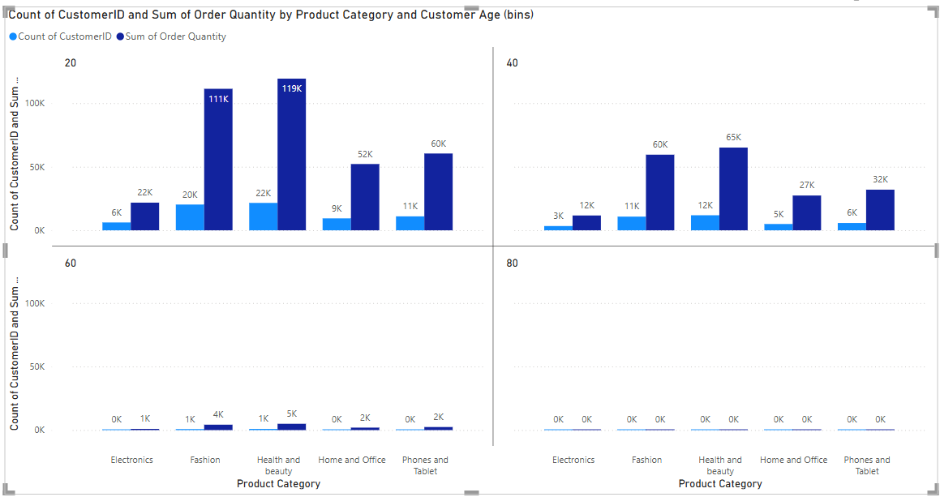
Customer Loyalty Program
Parameters Used for Segmentation
Customer ID Count: Tracks unique customers
Sum of Order Quantity: Measures total quantity purchased
Product Category: Identifies range and type of categories
Customer Age: Groups customers into age brackets
Bucketing Process
Segmented by unique customer IDs and order quantities
Grouped by product categories
Age segmentation in 20-year intervals
Insights by Age Groups
20 Age Group
Suggestions for Loyalty Programs
Notes:
We propose a loyalty program based on customer segmentation. Parameters like Customer ID Count, Order Quantity, Product Category, and Age were used. Insights show high order quantities in Health and Beauty and Fashion categories. Suggestions include tiered benefits, subscription perks, social rewards, and upgrade programs. Original Content: Come up with a loyalty program to benefit the company’s customers. From the available lot of customers come up with strategies to bucket them and provide benefits under different loyalty programs. Approach: Parameters Used: Customer ID Count: To track the number of unique customers. Sum of Order Quantity: To understand the total quantity purchased. Product Category: To identify the range and type of categories customers are purchasing from. Customer Age: To group customers into age brackets for further analysis. Bucketing Process: Customers were segmented based on the count of unique customer IDs and the sum of order quantities, grouped according to the product categories they purchased from. Age segmentation was applied, grouping customers into 20-year intervals (e.g., 0–20 years, 21–40 years, etc.) for a demographic perspective. Insights: As per age groups:- The "Health and beauty" category has the highest "Sum of Order Quantity" at 119K. This suggests that this age group orders the largest number of items in this category. The "Fashion" category has the second-highest "Sum of Order Quantity" at 111K. This indicates a strong interest in fashion items within this age group. The "Electronics" category shows the lowest "Sum of Order Quantity" at 6K. This implies that this age group orders the fewest number of electronic items compared to other categories. Notice that while "Health and beauty" has the highest order quantity (119K), the "Count of CustomerID" (22K) is similar to "Fashion" (20K). This suggests that while a similar number of customers are buying from both categories, those buying "Health and beauty" are likely purchasing a larger quantity of items per order on average. "Home and Office" and "Phones and Tablet" have relatively lower order quantities (52K and 60K respectively) compared to "Health and beauty" and "Fashion". The customer counts for these categories (9K and 11K respectively) are also lower. A similar trend in terms of order quantity is observed in the "40" age group. "Health and beauty" has the highest "Sum of Order Quantity" at 65K. "Fashion" is the second highest at 60K. "Electronics" has the lowest at 3K. Lower Overall Order Quantities: It's important to note that the overall order quantities across all categories appear to be lower in the "40" age group compared to the "20" age group. This could indicate differences in purchasing power, needs, or shopping habits between these age groups. Customer Count Observations: Similar to the "20" age group, the customer counts ("Health and beauty": 12K, "Fashion": 11K) are relatively close despite the difference in order quantities. This again suggests a higher average number of items per order in the "Health and beauty" category. Suggestion: Tiered Beauty/Fashion Insider: Offer points per purchase in these categories, with increasing benefits at higher tiers (e.g., early access to new arrivals, exclusive discounts, free samples, personalized style consultations). Beauty/Fashion Subscription Box Perks: If you offer subscription boxes, provide loyalty points or discounts for subscribers who maintain their subscriptions or refer friends. Social Sharing Rewards: Encourage user-generated content (reviews, photos with purchases) related to beauty and fashion with loyalty points or contest entries. Birthday/Milestone Rewards: Offer special discounts or gifts on birthdays related to beauty or fashion items. Tech/Home Upgrade Program: Offer discounts on future purchases in these categories after a certain number of purchases or a specific spending threshold. Bundle & Save Rewards: Incentivize purchasing related items together (e.g., phone accessories with a phone). Educational Discounts: If applicable, offer discounts for students on tech or home Mature & Home/Tech Interested: Show some engagement in "Home and Office" Loyalty Program Suggestions: Home & Tech Loyalty Tiers: Similar to the Beauty/Fashion tiers, offer increasing benefits for repeat purchases in these categories (e.g., extended warranties, installation discounts, smart home consultations). Trade-In Programs: For electronics, offer discounts for trading in older devices.

Slide 23
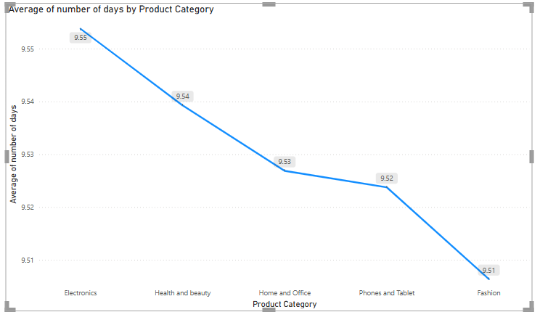
Average Wait Times Analysis
Analysis Objective
Optimize scheduling and staffing
Examine variation in average wait times across product categories
Methodology
Two-parameter approach
Consider average delivery days and product categories
Utilize line graph for visualization
Insights
Average delivery times are similar across product categories
Electronics: 9.55 days
Fashion: 9.51 days
Consistent delivery timeframe around 9.5 days
Notes:
This analysis explores how average wait times vary across different product categories to optimize scheduling and staffing. Using a two-parameter approach, we examined average delivery days and product categories. The line graph shows that delivery times are consistently around 9.5 days across all categories. Original Content: Wait Times Correlated with Demographics and Care: Explore how average wait times vary across different product categories to optimize scheduling and staffing. Approach: This analysis aims to optimize scheduling and staffing by examining the variation in average wait times across different product categories. The methodology involves a two-parameter approach, considering average delivery days and product categories. A line graph was utilized to visualize the average delivery time to end customers for each category, facilitating the identification of correlations between delivery duration and product type. Insights: The line graph reveals that the average delivery times across the five product categories (Electronics, Health and beauty, Home and Office, Phones and Tablet, and Fashion) are remarkably similar, ranging from a high of 9.55 days for Electronics to a low of 9.51 days for Fashion. This suggests that, on average, the delivery timeframe for all product categories is consistently around 9.5 days, with minimal variation between them. Suggestion:

Slide 24
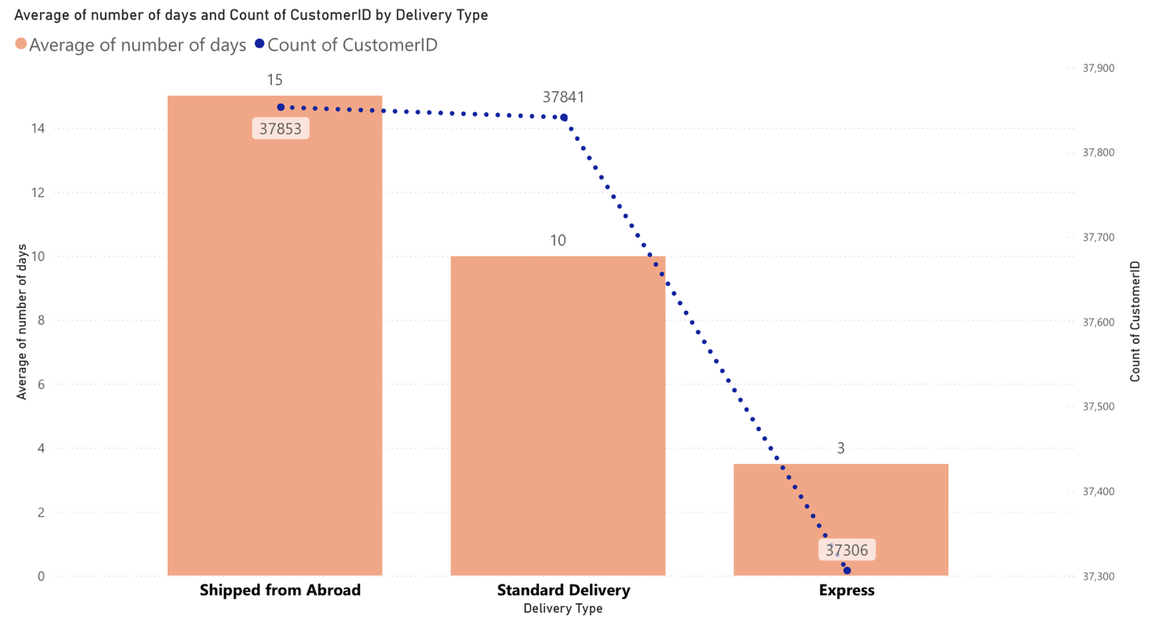
Delivery Type vs Waiting Time
Significant Discrepancy in Delivery Speed
'Shipped from Abroad' averages 15 days
'Express' delivery averages 3 days
'Standard Delivery' averages 10 days
Relationship Between Speed and Volume at the Extremes
'Shipped from Abroad' has the largest customer base
'Express' delivery attracts the fewest customers
Popularity of the Middle Ground
'Standard Delivery' captures a customer volume nearly equivalent to 'Shipped from Abroad'
Relatively Even Customer Distribution Despite Varying Speeds
Overall distribution of customers across delivery types is balanced
Potential Latent Demand or Unmet Need
Notes:
We explored the relationship between delivery type and waiting time. 'Shipped from Abroad' averages 15 days, 'Express' delivery averages 3 days, and 'Standard Delivery' averages 10 days. Despite varying speeds, customer distribution is balanced. 'Express' delivery has low adoption, indicating potential unmet demand. Original Content: Explore if there is any relationship between the Delivery type and waiting time between ordering and receiving an item. Approach: To gain comprehensive insights into the relationship between delivery type and customer experience, a multi-parameter analysis was conducted. The primary parameters under investigation are the delivery type, the average waiting time(quantified as the number of days between order placement and product delivery), and the count of customer IDsassociated with each delivery type (representing the volume of orders). A line and clustered column chart was employed for visualization. The clustered columns represent the average waiting time for each delivery type, allowing for direct comparison. An overlaid line displays the count of customer IDs for each corresponding delivery type, providing insight into the popularity or usage of each method. This analysis aims to identify potential inefficiencies or areas for optimization by simultaneously examining delivery speed and adoption rates across different delivery processes. Insights Significant Discrepancy in Delivery Speed: The data reveals a substantial variation in average delivery times across the different methods. "Shipped from Abroad" stands out with a significantly longer average of 15 days, contrasting sharply with the rapid 3-day average for "Express" delivery. "Standard Delivery" occupies a middle ground at 10 days. This highlights fundamentally different logistical processes and potentially geographical distances involved in each option. Relationship Between Speed and Volume at the Extremes: An intriguing observation is the inverse correlation at the extremes of the delivery speed spectrum. The delivery method with the longest average waiting time ("Shipped from Abroad") commands the largest customer base. Conversely, the method offering the quickest delivery ("Express") attracts the fewest customers. This suggests that factors beyond just the speed of delivery are primary drivers of customer choice for a significant portion of your clientele. Popularity of the Middle Ground: "Standard Delivery" demonstrates a strong appeal, capturing a customer volume nearly equivalent to the most popular (but slowest) option. This indicates that a considerable segment of your customers finds the 10-day delivery timeframe acceptable, potentially representing a balance between cost and speed expectations. Relatively Even Customer Distribution Despite Varying Speeds: While "Express" has a noticeably lower customer count, the overall distribution of customers across the three delivery types is surprisingly balanced. This suggests that different segments of your customer base have distinct needs and priorities when it comes to receiving their orders, leading to a fairly even spread across the available options, even the one with a significantly longer wait. Potential Latent Demand or Unmet Need: The low adoption of "Express" delivery, despite its speed advantage, could indicate a latent demand that isn't being fully met or understood. It raises questions about whether the current pricing, visibility, or perceived value proposition of express aligns with customer needs.

Slide 25
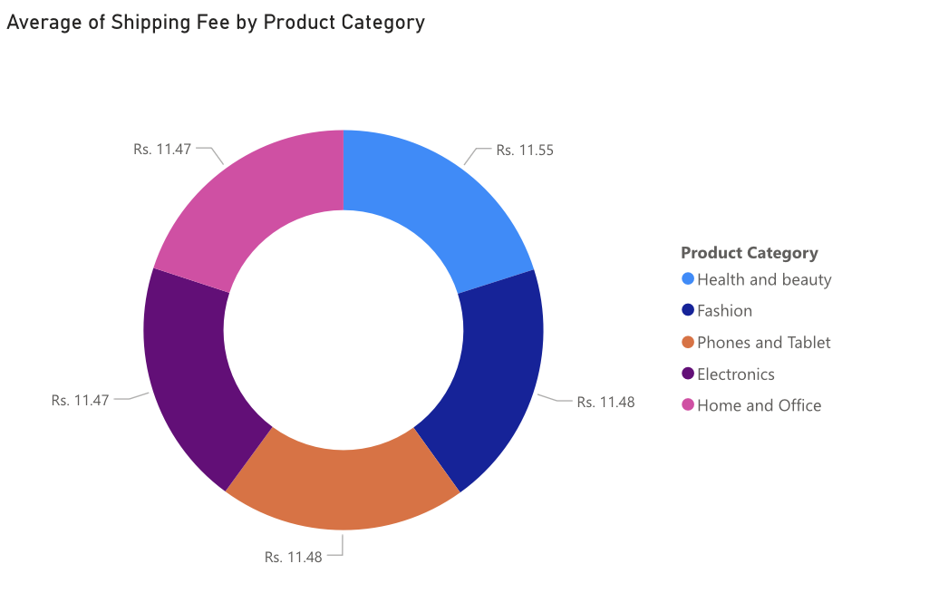
Shipping Charges Analysis
Approach
Two-parameter analysis on product type and average shipping charges
Gauge chart used for visualization
Identifies product categories with higher or lower shipping costs
Insights
Minimal Variation in Average Shipping Fees
Highest average shipping fee: Rs. 11.55 (Health and Beauty)
Lowest average shipping fee: Rs. 11.47 (Electronics and Home and Office)
Negligible difference of Rs. 0.08
Consistent Average Shipping Cost
Uniform cost across all product categories
Lack of Category-Specific Shipping Cost Differences
Notes:
We analyzed the relationship between shipping charges and product type using a gauge chart. The findings show minimal variation in average shipping fees across categories, with the highest fee being Rs. 11.55 and the lowest Rs. 11.47. This suggests consistent shipping costs regardless of product type, with no significant cost drivers influencing the fees. Original Content: Is there any relationship between shipping charges and product type? Approach: To gain insights into how shipping charges vary across different product categories, a two-parameter analysis was conducted focusing on product type and the average shipping charges associated with each category. A gauge chart was selected as the primary visualization tool to effectively represent the average shipping charges for each product type in relation to a predefined scale or target range. This approach aims to identify product categories with notably higher or lower average shipping costs, potentially revealing underlying factors influencing these charges and informing pricing and logistical strategies. Insights: Minimal Variation in Average Shipping Fees: The most striking insight is the extremely small difference in the average shipping fees across all the product categories displayed. The highest average shipping fee is Rs. 11.55 (for Health and Beauty), and the lowest is Rs. 11.47 (for Electronics and Home and Office), resulting in a negligible difference of only Rs. 0.08. Consistent Average Shipping Cost: This near uniformity suggests that, on average, the cost to ship an item is practically the same regardless of whether it falls into the Health and Beauty, Fashion, Phones and Tablet, Electronics, or Home and Office category. Lack of Category-Specific Shipping Cost Differences : The data indicates that, when looking at the average, there are no significant cost drivers related to the product category that are influencing the shipping fee. Factors that typically differentiate shipping costs between product types (like significant differences in weight, size, or special handling needs) appear to be either absent or averaged out across these categories.

Slide 26
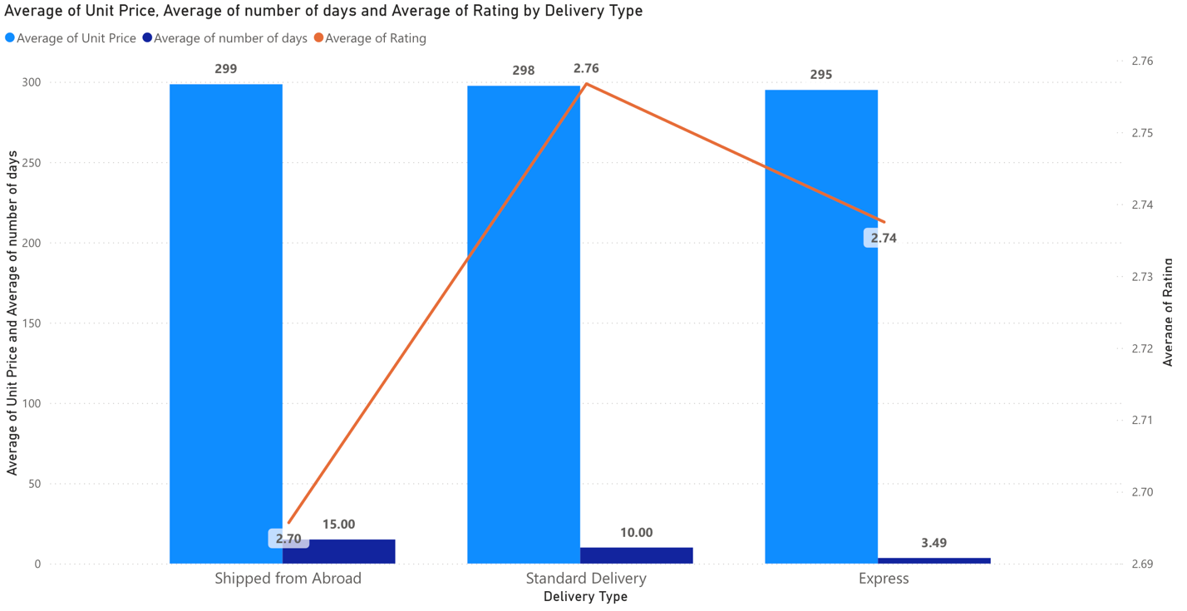
Low Rating Orders Analysis
Key Factors Influencing Low Order Ratings
Waiting time measured in days for order delivery
Shipping type
Unit price
Visualization Approach
Cluster line and column chart used
Clustered columns represent average waiting time and/or unit price
Overlaid line represents proportion or count of low-rated orders
Insights from Analysis
Strong inverse relationship between delivery time and customer rating
Delivery method with longest average transit time has lowest average customer rating
Customer Tolerance Thresholds
Notes:
We analyzed factors like waiting time, shipping type, and unit price to identify strategies for improving low rating orders. Our visualization approach used cluster line and column charts. Key insights show a strong inverse relationship between delivery time and customer ratings, while unit price is not a significant factor. Customer satisfaction drops significantly for 15-day delivery periods, with ratings plateauing for delivery within 3-10 days. Original Content: Come up with strategies to decrease the low rating orders after analyzing different factors like waiting time, shipping type, unit price, etc. Approach: To identify key factors potentially influencing low order ratings, a multi-parameter analysis was conducted. The primary parameters under investigation are waiting time (measured in the number of days for order delivery), shipping type, and unit price. A cluster line and column chart was employed for visualization. The clustered columns are used to represent the average waiting time and/or unit price for orders associated with different shipping types, allowing for direct comparison. An overlaid line is used to represent the proportion or count of low-rated orders within each shipping type category. This approach aims to visually correlate these factors with the occurrence of low order ratings, thereby highlighting potential areas for improvement in service and product offerings. Insights: Strong Inverse Relationship Between Delivery Time and Customer Rating: The most prominent deep insight is the clear negative correlation between the average number of days for delivery and the average customer rating. The delivery method with the longest average transit time ("Shipped from Abroad" at 15 days) corresponds to the lowest average customer rating (approximately 2.70). Conversely, the delivery methods with shorter average transit times ("Standard Delivery" at 10 days and "Express" at 3.49 days) exhibit higher average customer ratings (approximately 2.76 and 2.74, respectively). This strongly suggests that delivery speed is a significant driver of customer satisfaction. Average Unit Price as a Non-Contributing Factor to Rating Variance (in this dataset): The remarkably consistent average unit price across all three delivery types (ranging narrowly from approximately 295 to 299) suggests that the product's average price point is not a primary differentiating factor influencing customer ratings related to the delivery experience in this context. The variability in ratings appears to be more strongly tied to the logistics of the delivery itself. The data subtly hints at customer tolerance thresholds for delivery times. The noticeable drop in average rating for "Shipped from Abroad" suggests that the 15-day waiting period significantly impacts customer satisfaction. The relatively close ratings for "Standard Delivery" and "Express" might indicate that once delivery is within a certain timeframe (around 3-10 days), the impact on average rating plateaus or becomes influenced by other factors more than just the incremental speed difference.

Slide 27
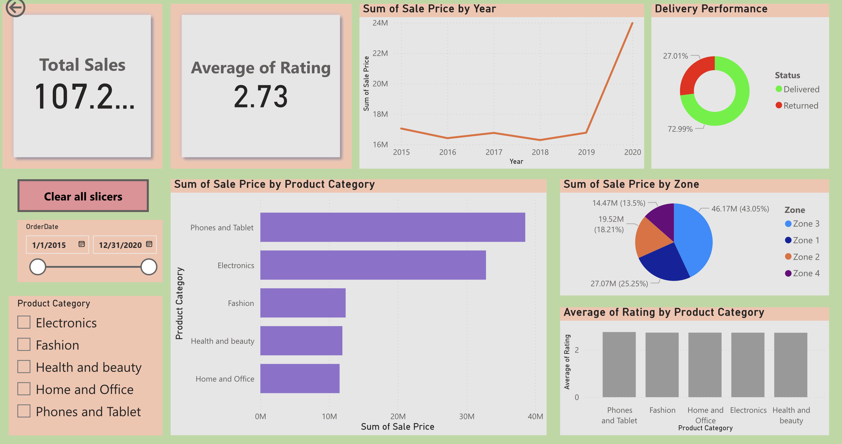
Dashboard main tab

Slide 28
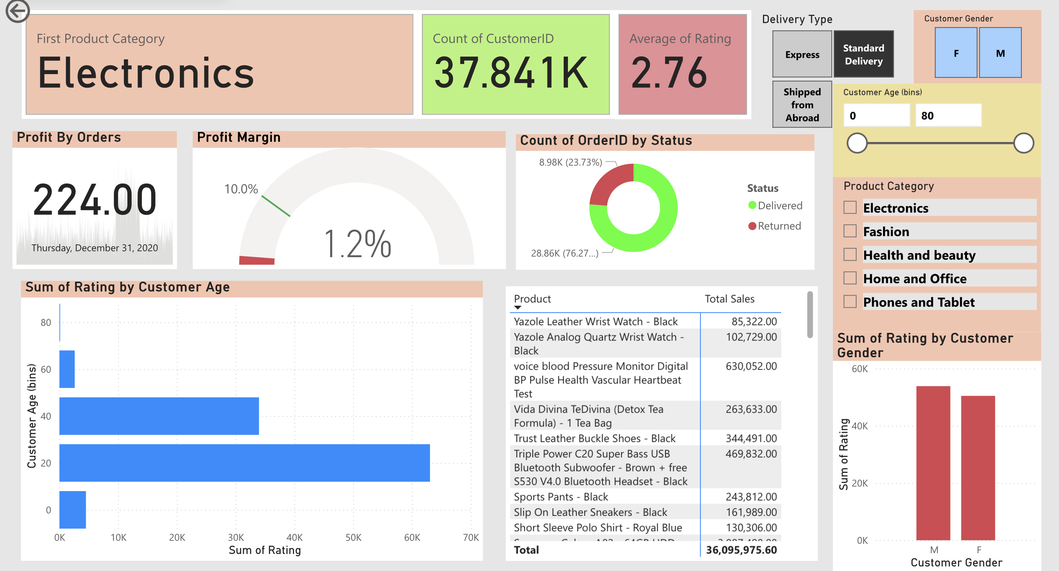
Product tab

Slide 29
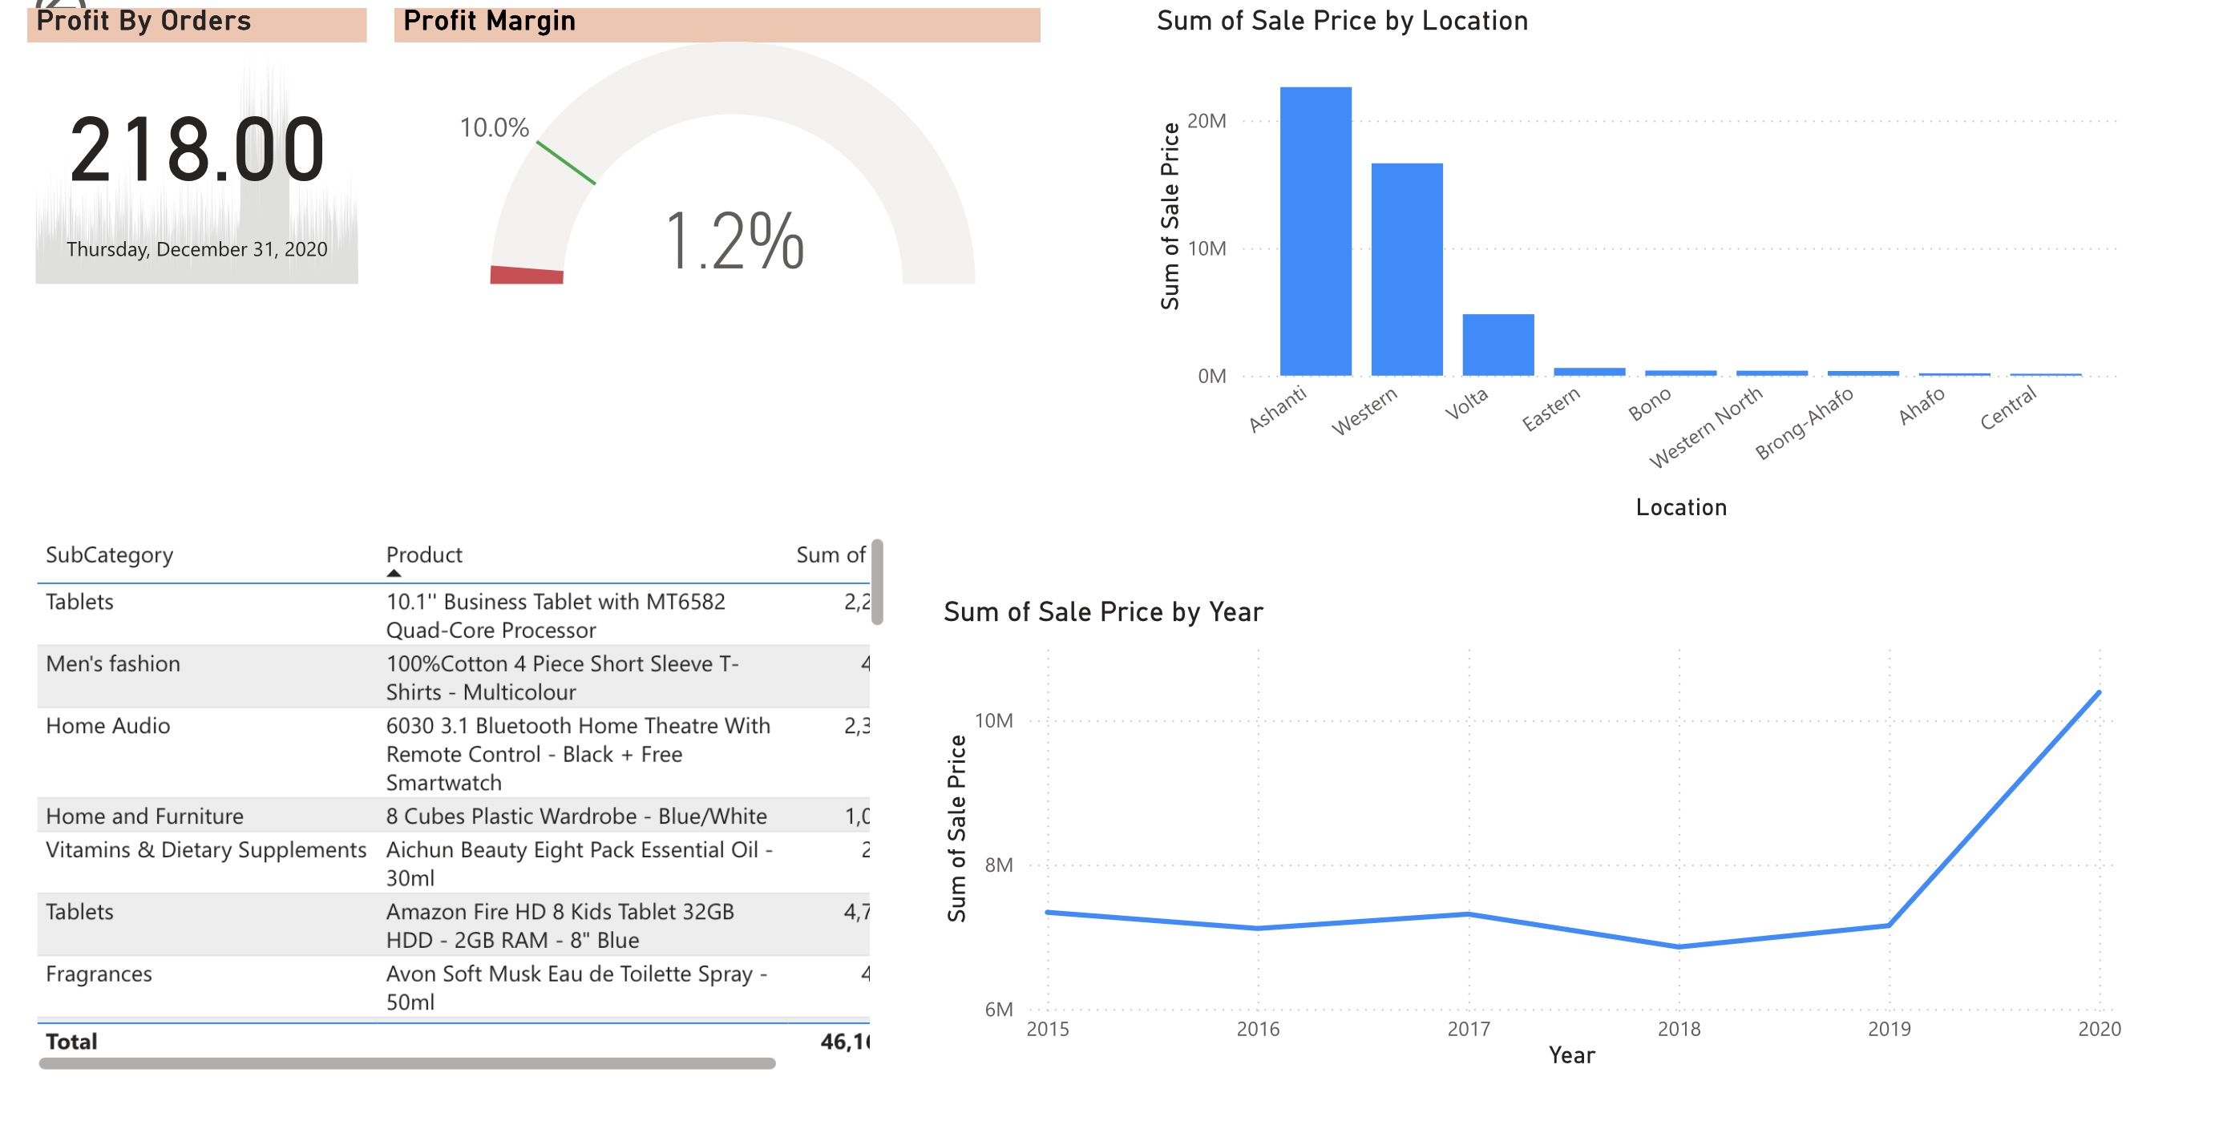
Individual tab

Slide 30

Key Recommendations for Improvement
Implement targeted marketing strategies for underperforming products.
Enhance customer feedback mechanisms to gather insights.
Optimize inventory management to reduce delivery times.
Consider customer age demographics for tailored promotions.
Utilize data analytics to identify sales trends and patterns.
Notes:
The recommendations focus on improving sales and customer satisfaction. By implementing targeted marketing strategies, the company can address the needs of underperforming products. Additionally, enhancing customer feedback will provide valuable insights for future improvements. Data analytics can help in understanding sales trends, which is crucial for inventory management and promotional strategies.

Slide 31

Conclusion
Overall sales performance shows promising growth trends.
Identified key areas for improvement can enhance profitability.
Strategic initiatives will address customer needs effectively.
Continuous monitoring of metrics is essential for success.
Commitment to quality and service will drive future success.
Notes:
In conclusion, the analysis indicates positive growth trends in sales. However, addressing the identified key areas for improvement is vital for maximizing profitability. Strategic initiatives based on customer needs will be crucial in ensuring long-term success. A commitment to quality and service will further enhance the company's market position.

