Slide 1

Zomato restaurant analysis
By Krishna Rathore

Slide 2
About Zomato
Zomato is an Indian multinational platform that specializes in food delivery and restaurant discovery.
It offers users access to a wealth of information, including restaurant menus, user reviews, and ratings.

Slide 3
Zomato working
The platform allows users to search for restaurants based on various criteria such as location and cuisine preferences.
Once a restaurant is selected, users can view detailed information including the menu, pricing, photos, and operating hours.
Zomato also facilitates food orders directly through its app or website, enabling users to customize their selections and choose from multiple payment options.
Additionally, Zomato encourages user feedback through ratings and reviews, enhancing the dining experience for future customers

Slide 4
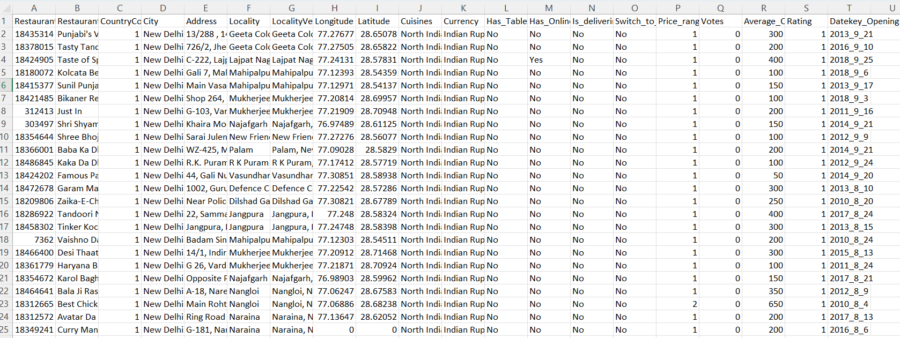
Problem Statement
Zomato is planning for expansion and opening new restaurant.

Slide 5
Summary of dataset
There total 20 attributes present in the dataset.
1
Total number of restaurants are 9551.
2
Coverage of 15 countries and 141 cities.
3
Years of opening of restaurant are from 2010 to 2018.
4
There are more than 1826 types of cuisines serves in different type of restaurant.
5
Function like vlookup is used to match country code with country name and text is used to convert date to year.
6

Slide 6
Methodology for Data Cleaning and Analysis
Data Cleaning Techniques
Find and Replace, Concatenation, and Count Blank Function:
• Utilized find and replace to identify and correct erroneous entries.
• Employed concatenation to merge relevant data fields for a cohesive dataset.
• Applied the count blank function to identify and address missing values, ensuring dataset completeness.
• Implemented VLOOKUP to enrich the dataset by adding country names from a reference table, enhancing geographical context.

Slide 7
Data Summarization & Representation
• Used pivot tables for effective data summarization, enabling the identification of key patterns and trends for quick insights.
• Created dynamic charts and dashboards for visualizing analyzed data, facilitating interactive exploration and enabling users to derive actionable insights.

Slide 8
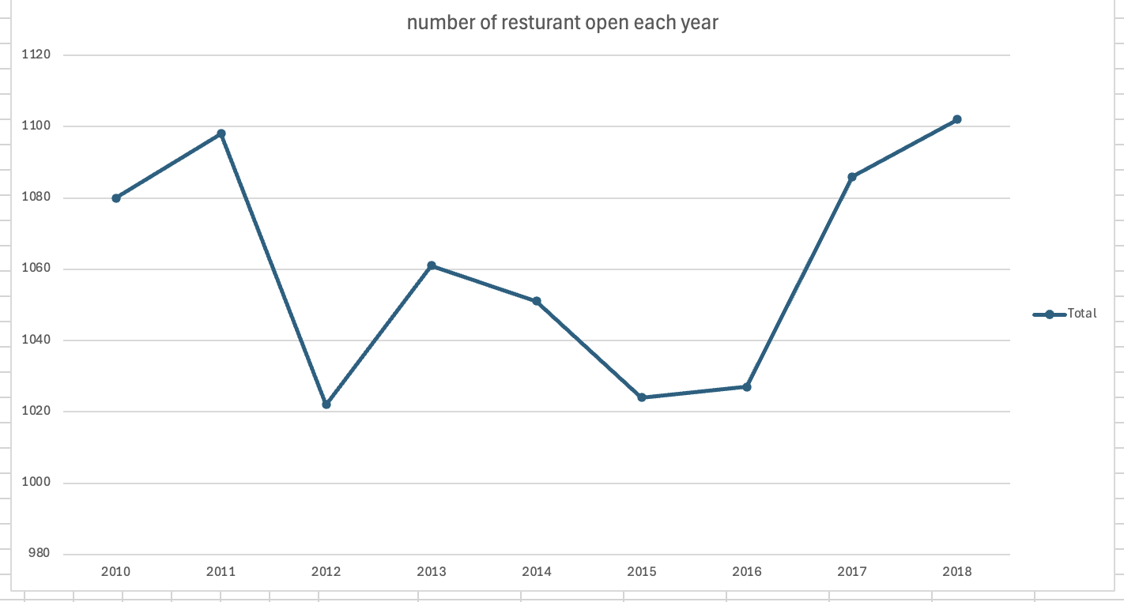
Approaches and Findings
There is surge seen opening of restaurant from 2016 to 2018

Slide 9
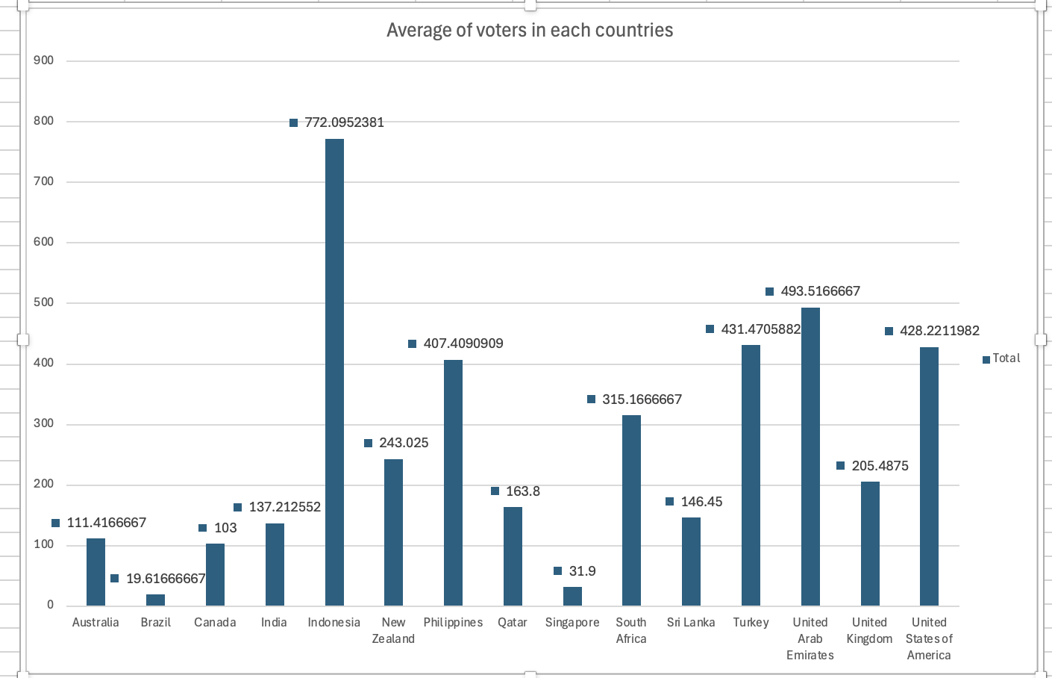
Average voters VS countries
There are highest average voters in Indonesia and least number of voters are in Brazil followed by Singapore

Slide 10
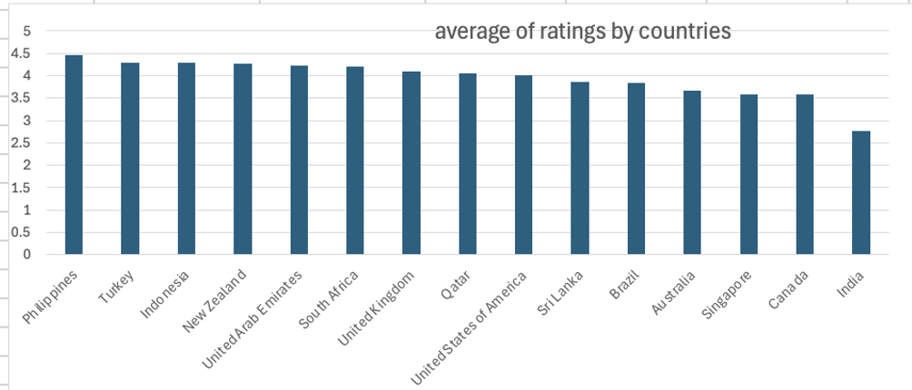
Average of rating VS countries
The average ratings of the countries are ranked as follows:
1. Philippines: Highest average rating
2. Turkey: Second highest average rating
3. Indonesia: Third highest average rating
Countries not listed have lower average ratings compared to these top three.

Slide 11
Average rating VS top countries city
Santa Rosa, Philippines, received the lowest livability score of 3. 8 among nine cities. Quezon City had the highest score of 4. 8. Other cities like Taguig, Tagaytay, Mandaluyong, and Makati scored between 4. 5 and 4. 6.
In Turkey, two cities had scores around 4. 3.
Bogor in Indonesia had the lowest score of 3. 85, while Jakarta had the highest at 4. 35.

Slide 12
Restaurant count city wise
In the Philippines, Mandaluyong and Taguig have four restaurants each, while Quezon and Tagaytay have one. In Turkey, Ankara has 20 restaurants and Istanbul has 14. In Indonesia, Jakarta leads with 16 restaurants, while Bandung has one. Overall, Philippines shows even restaurant distribution, while Indonesia is mainly concentrated in

Slide 13
Average rating of restaurant VS Philippines
The top-rated restaurants include Le Petit Soufflé, Locavore, Sodam Korean Restaurant, and Ooma, each boasting ratings above 4.8. Conversely, Café Arabelle holds the lowest rating at 3.6. Moreover, there are over 11 restaurants that exceed the national average rating of 4.46. Notably, there are no establishments rated within the lower tiers of 1-2 or 2-3.

Slide 14
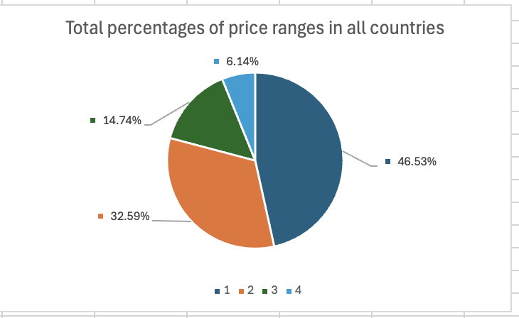
Percentage of price range country wise
We have more customers whose price range are 1 followed by price range of 2 if we include India.
If we exclude india we can see most of the customers likes price range of 3 and 4

Slide 15
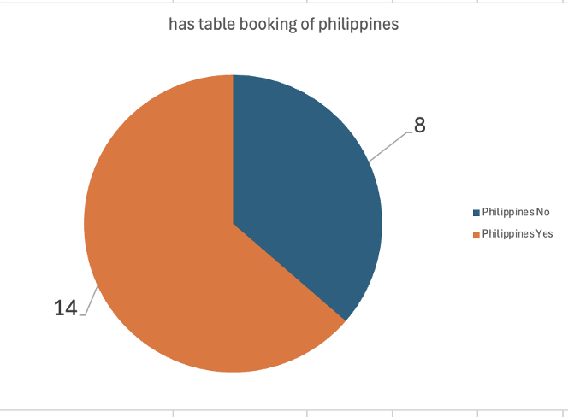
Table booking ratio of Philippines
If we take example of Philippines, we can see that majority of restaurants have table booking.

Slide 16
Corelation between average rating and and average cost of two standard currency
A correlation value of approximately 0.3424 indicates a positive relationship between average ratings and average costs, suggesting that as average ratings increase, average costs tend to rise slightly.
The accompanying graph supports this observation, displaying an upward trend without a significant rise. Therefore, while there is a slight increase in average cost with higher ratings, the correlation does not reflect a strong or definitive connection between these variables.

Slide 17
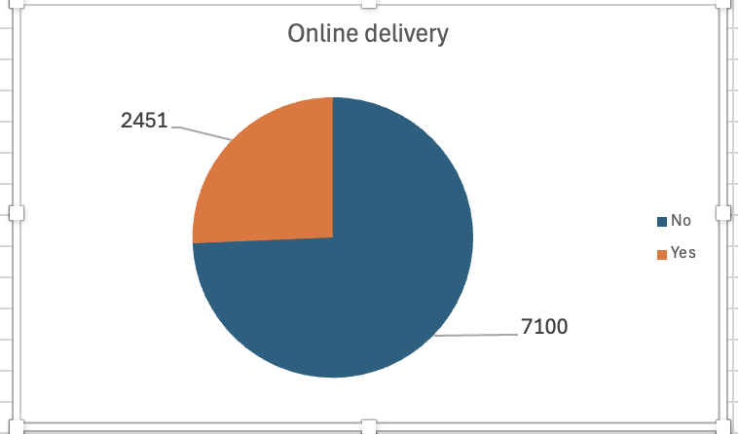
Total online delivery ratio
To communicate customers in their own languages by creating by ads in there own countries or in regional languages.
We should focus on encouraging restaurant to promote online delivery because majority of restaurant not delivering online

Slide 18
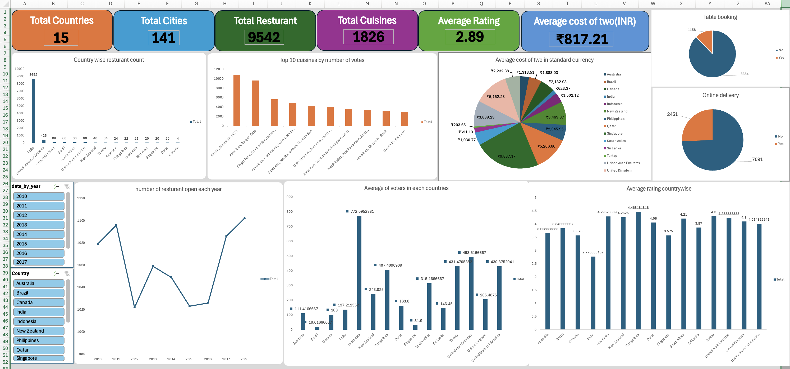
Dashboard

Slide 19

Recommendation
Target Locations
Identify areas with low restaurant counts but high customer ratings.
Cuisine Selection
Prioritize highly rated cuisines.
Focus on options where customers are willing to pay a premium.
Online Delivery Emphasis
Shift focus to online delivery services.
Data shows a higher volume of online orders compared to table bookings.

Slide 20
Conclusion
Company should focus on restaurant who offers cuisines which are like most by customers in different countries.
Company increase the promotion of online delivery by giving cashback offers to customers and attractive restaurant engaging policies.

