Slide 1


SESSION 2026-2027
SMART WEATHER STATION
PRESENTED BY :
PRANJAL PANDEY
2501921520281
PIYUSH MALVIYA
2501921520272
PRASHANT KUMAR
2501921520282
OMKAR RAI
2501921520263
UNDER SUPERVISION OF :
NIDHI KATARIA CHAWLA
YEAR COORDINATOR
CSAI, GLBITM
Department of Computer Science & Engineering – Artificial Intelligence
1

Slide 2
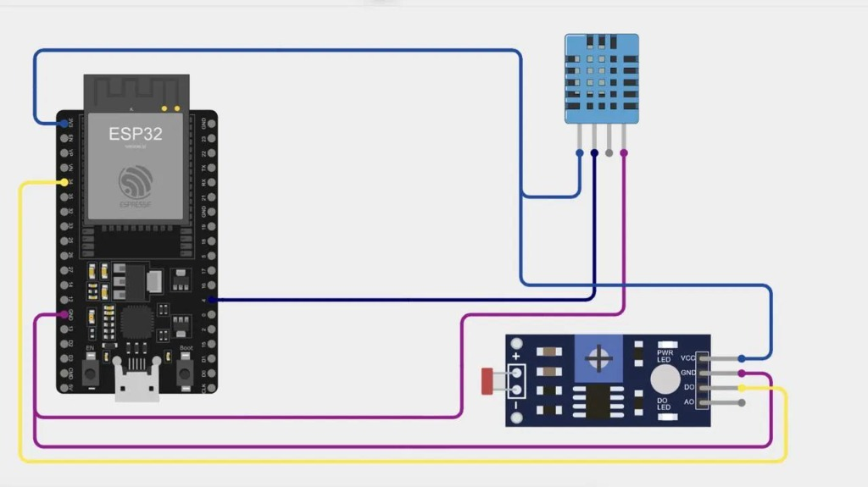
INTRODUCTION OF THE PROJECT
• Real-time monitoring of atmospheric temperature, relative humidity, and ambient light is essential for indoor comfort, smart homes, and precision agriculture.
• Traditional analog weather meters require manual observation, lack data logging, and cannot transmit real-time alerts or analytics.
• The Smart Weather Station is an IoT-enabled embedded system engineered for automated, continuous, and localized environmental telemetry.
• The station utilizes an ESP32 microcontroller paired with DHT11 and LDR sensors to capture live physical parameters with high reliability.
• An optical LDR sensor dynamically monitors ambient illumination to intelligently classify environmental lighting as bright daylight or low-light conditions.
• The proposed system delivers a compact, cost-effective, energy-efficient, and user-friendly IoT solution with zero cloud subscription fees.
Key Hardware Interconnections:
• ESP32 NodeMCU: Dual-core 240MHz MCU & Wi-Fi Web Server
• DHT11 Sensor: Calibrated digital temperature & humidity sensing
• LDR Module: Ambient optical detection via digital GPIO pin
• Embedded Web Server: Real-time telemetry broadcasted at 192.168.1.18
Department of Computer Science & Engineering – Artificial Intelligence
2

Slide 3
OBJECTIVES
• To develop a compact, IoT-based Smart Environmental Weather Station using the ESP32 microcontroller.
• To accurately and continuously acquire ambient temperature and relative humidity measurements using the DHT11 sensor.
• To detect ambient light levels and classify illumination thresholds (Daylight / Low-Light / Dark) using an LDR sensor module.
• To host an embedded, asynchronous HTTP web server on the ESP32 for high-speed local data broadcasting.
• To design an intuitive, modern, dark-themed responsive web dashboard accessible across smartphones, tablets, and PCs without app installation.
• To compute automated real-time environmental comfort analytics (evaluating thermal and moisture conditions for human living spaces).
• To record and plot live 30-point historical telemetry trends (temperature history and humidity history) directly in the browser.
• To engineer a low-cost, energy-efficient, robust, and zero-subscription weather monitoring prototype suitable for smart homes and classrooms.
Department of Computer Science & Engineering – Artificial Intelligence
3

Slide 4
HARDWARE & SOFTWARE REQUIREMENTS
Hardware Requirements:
• ESP32 Development Board – 32-bit dual-core microcontroller with integrated Wi-Fi & Bluetooth for data acquisition and web hosting
• DHT11 Sensor – Calibrated digital composite sensor measuring temperature (-20°C to 50°C) and relative humidity (20% to 90% RH)
• LDR Sensor Module – Photoresistor sensor module detecting ambient light intensity and day/night transitions
• Micro-USB Cable – Supplies stable 5V DC power to the ESP32 and provides serial interface for programming
• Breadboard & Jumper Wires – Solderless prototyping platform and interconnect cables for circuit assembly
• Local Wi-Fi Network / Hotspot – Wireless communication medium to host and access the live web dashboard
• Client Device (PC / Smartphone) – Web browser client to access and monitor real-time environmental data
Software Requirements:
• Arduino IDE – Used to write, compile, and upload firmware to the ESP32 microcontroller
• Embedded C/C++ – Used to program the ESP32, manage sensor communication protocols, and host network sockets
• HTML5, CSS3 & JavaScript – Used to craft the modern, responsive, dark-mode real-time dashboard UI
• Chart.js / Canvas Engine – Used to render dynamic live temperature and humidity historical trend graphs
Department of Computer Science & Engineering – Artificial Intelligence
4

Slide 5
EXISTING SYSTEM/RELATED WORK
• Traditional meteorological systems rely on manual analog thermometers, hygrometers, and barometers, which require periodic physical reading and manual logging.
• Conventional automated weather stations are bulky, expensive, and engineered primarily for industrial, agricultural, or government research installations.
• Commercial smart home climate monitors frequently utilize proprietary closed ecosystems, requiring mandatory cloud accounts and recurring subscriptions.
• Many open-source hobbyist weather stations depend completely on third-party cloud platforms (e.g., ThingSpeak, Adafruit IO), causing latency and failing during internet dropouts.
• Basic microcontrollers like the Arduino Uno lack built-in wireless connectivity, requiring external Wi-Fi shields (e.g., ESP8266) that complicate circuitry and increase power drain.
• Existing low-cost DIY systems typically output raw numbers without evaluating thermal comfort indices or offering historical trend visualization.
• Our project integrates local multi-sensing (DHT11 & LDR) with an onboard high-performance ESP32 web server, delivering standalone real-time telemetry, automated comfort analysis, and zero-subscription data visualization.
Department of Computer Science & Engineering – Artificial Intelligence
5

Slide 6
LITERATURE SURVEY (Example Shown Below)
S. No | Date | Year | Author | Title | Paper Published in (Journal Name..) | Conceptual Framework | Methodology | Conclusion | Future research
1. | May 2023 | 2023 | S. R. Rao; K. V. Sharma; A. P. Patel | Title: IoT Based Real-Time Environmental Weather Monitoring Station using ESP32 | IEEE ICCCA 2023 | Conceptual Framework: ESP32-centric wireless node monitoring temperature, humidity, and light for micro-climates. | ESP32 + DHT11 + LDR sensor + Asynchronous HTTP Web Server + Wi-Fi telemetry. | Provides accurate, real-time localized weather data with refresh rates under 2 seconds. | Future Research: Incorporate solar power harvesting, particulate matter (PM2.5) sensing, and LoRa transmission.
Department of Computer Science & Engineering – Artificial Intelligence
6

Slide 7
LITERATURE SURVEY (Example Shown Below)
S. No | Date | Year | Author | Title | Paper Published in (Journal Name..) | Conceptual Framework | Methodology | Conclusion | Future research
2. | Aug 2024 | 2024 | M. Al-Khafaji; D. Kumar; R. B. Thorne | Title: Low-Cost Smart Environmental Monitoring System with Embedded Web Server Architecture | Internet of Things, Elsevier 2024 | Conceptual Framework: Standalone edge-based IoT architecture avoiding third-party cloud latency for localized climates. | Dual-core ESP32 RTOS + DHT11 + LDR module + Local JSON API + HTML5 dashboard. | Demonstrated 99.4% uptime and zero-latency local alert delivery without external cloud dependencies. | Future Research: Implement local non-volatile flash data logging and edge anomaly detection algorithms.
Department of Computer Science & Engineering – Artificial Intelligence
6

Slide 8
LITERATURE SURVEY (Example Shown Below)
S. No | Date | Year | Author | Title | Paper Published in (Journal Name..) | Conceptual Framework | Methodology | Conclusion | Future research
3. | Nov 2023 | 2023 | P. G. Hernandez; J. M. Rossi; T. Takahashi | Title: Design and Implementation of an Energy-Efficient Micro Weather Station for Smart Agriculture | IEEE Sensors Journal 2023 | Conceptual Framework: Precision micro-climate sensing combining thermal, moisture, and optical metrics. | ESP32 + DHT11 + LDR module + Sleep cycles + Mobile-responsive web interface. | Proved highly effective for real-time greenhouse decision-making and automated environmental comfort profiling. | Future Research: Add AI-driven predictive weather forecasting and multi-node mesh networking.
Department of Computer Science & Engineering – Artificial Intelligence
6

Slide 9
MOTIVATION/PROBLEM STATEMENT
• Regional weather forecasts provided by commercial and government meteorological stations cover wide geographical zones, failing to capture hyperlocal micro-climates in homes, classrooms, and greenhouses.
• Manual collection and logging of temperature and humidity is labor-intensive, inconsistent, and incapable of providing real-time comfort warnings or trend detection.
• Commercial smart monitoring systems are expensive, rely on closed proprietary software, and often lock data access behind recurring cloud subscription paywalls.
• IoT devices that depend entirely on active internet connections stop serving data during network outages and pose privacy risks by uploading local environmental metrics to remote servers.
• Existing basic DIY weather stations typically display only raw sensor numbers without providing intelligent environmental comfort analysis or historical trend curves.
• Therefore, our project aims to engineer an affordable, self-contained Smart Weather Station combining temperature, humidity, and ambient light monitoring.
• The proposed Smart Weather Station delivers a convenient, low-cost, and real-time environmental monitoring aid while promoting healthy living conditions and energy efficiency.
Department of Computer Science & Engineering – Artificial Intelligence
7

Slide 10
DESCRIPTION OF PROJECT (In Form Of Diagram)
Traditional environmental logging reliant on manual analog meters and regional forecasts.
Multi-sensor data acquisition: DHT11 (temp & humidity) and LDR (ambient light intensity).
ESP32 dual-core processing, real-time comfort calculation, and Wi-Fi web serving.
A smarter, safer, and real-time environmental dashboard providing live trends and comfort alerts.
Department of Computer Science & Engineering – Artificial Intelligence
8

Slide 11
PROJECT DETAILS (Description Of Various Modules)
MODULE 1: SENSOR ACQUISITION & CALIBRATION MODULE
• DHT11 sensor detects temperature (-20°C to 50°C) and relative humidity (20% to 90% RH).
• LDR sensor module detects ambient illumination levels using light-dependent resistance.
• ESP32 reads digital pulses from DHT11 and threshold/analog signals from LDR accurately.
MODULE 2: PROCESSING & COMFORT EVALUATION ENGINE
• ESP32 dual-core processor executes continuous sampling every 2 seconds.
• Calculates thermal comfort index and categorizes environmental condition (e.g., 'Generally Comfortable').
• Determines day/night or low-light environmental status from optical sensor signals.
MODULE 3: EMBEDDED WEB SERVER & DATA VISUALIZATION
• ESP32 hosts a lightweight asynchronous HTTP web server on local IP (192.168.1.18).
• Serves responsive, dark-mode modern dashboard to any connected smartphone or laptop.
• Renders live gauges, real-time trend charts, and real-world application metrics.
Department of Computer Science & Engineering – Artificial Intelligence
9

Slide 12
PROJECT DETAILS (Description Of Various Modules)
MODULE 1: SENSOR ACQUISITION & CALIBRATION MODULE
• DHT11 continuously reads ambient temperature and humidity through a calibrated single-bus digital signal.
• LDR photoresistor module monitors ambient light flux, distinguishing bright daylight from low-light/dark conditions.
• ESP32 GPIO pins sample sensor inputs reliably with internal pull-up and digital debounce filtering.
• Eliminates false triggers through periodic averaging and software validation of received data packets.
MODULE 2: PROCESSING & COMFORT EVALUATION ENGINE
• ESP32 firmware executes real-time data parsing and algorithmic comfort evaluation.
• Dynamically analyzes thermal-humidity ratios to classify ambient conditions (e.g., Comfortable, Humid, Cold).
• Evaluates light levels to trigger automated daytime/nighttime environmental classification.
• Formats processed parameters into JSON payloads for high-speed transmission across the network.
MODULE 3: EMBEDDED WEB SERVER & DATA VISUALIZATION
• The ESP32 hosts a built-in asynchronous HTTP server accessible via local network IP (192.168.1.18).
• Serves an intuitive, glassmorphic dark-themed UI featuring temperature, humidity, and light indicators.
• Live charting engine dynamically plots the last 30 data points for temperature and humidity history.
• Enables seamless, cross-platform remote viewing on laptops, tablets, and smartphones without installing apps.
Department of Computer Science & Engineering – Artificial Intelligence
10

Slide 13
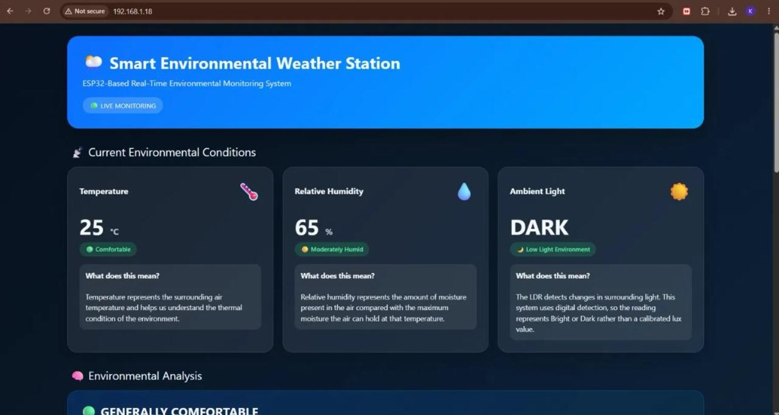
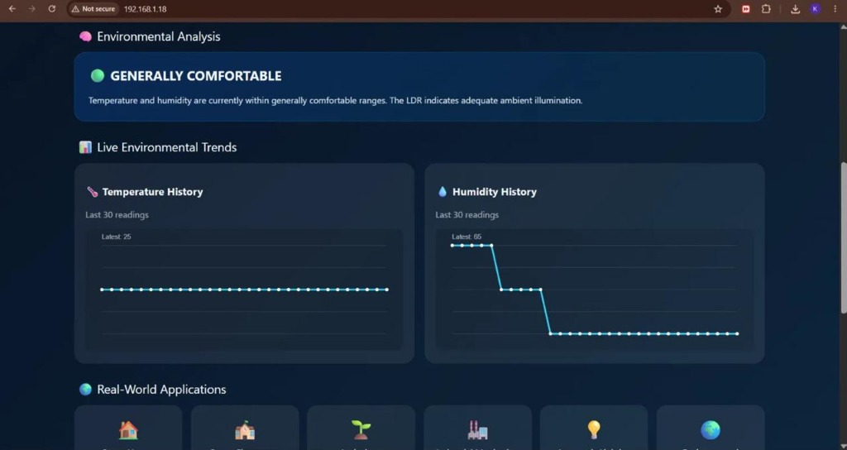
SCREENSHOTS OF RESULT (If Any)
Figure 1: Live Environmental Dashboard & Comfort Evaluation
Figure 2: Historical Telemetry Trends & Real-World Use Cases
• Live Temperature Metric: Real-time 25°C ('Comfortable' badge)
• Relative Humidity Metric: Real-time 65% ('Moderately Humid' badge)
• Ambient Optical Sensor: 'DARK' (Low-Light Environment detected)
• Automated Assessment: 'GENERALLY COMFORTABLE' condition rating
• Standalone Hosting: Embedded HTTP server active at 192.168.1.18
• Temperature Trend Log: Dynamic moving plot of last 30 data points
• Humidity Trend Log: Captures rapid drops/rises with high precision
• Target Scenarios: Smart Homes, Classrooms, Greenhouses, & Labs
• Real-Time Polling: Automatic 2-second background telemetry refresh
• Cross-Platform: Zero apps needed; responsive HTML5/CSS3 layout
Department of Computer Science & Engineering – Artificial Intelligence
11

Slide 14
CONCLUSION & SCOPE OF PROJECT
CONCLUSION
• The Smart Weather Station enhances traditional environmental monitoring by integrating localized electronic sensors and embedded web telemetry.
• DHT11 digital sensing accurately acquires ambient temperature and relative humidity without requiring manual calibration.
• The optical LDR sensor continuously evaluates ambient lighting levels, automatically distinguishing daylight and low-light environments.
• The embedded asynchronous HTTP server delivers immediate, cross-platform telemetry feedback to any browser device without external cloud reliance.
• Real-time comfort indexing and historical trend graphing significantly improve user awareness of micro-climate conditions.
• The project provides an affordable, robust, scalable, and energy-efficient solution for automated climate tracking in smart environments.
FUTURE SCOPE
• Integrate barometric pressure (BMP280/BME280) and rain sensors to provide comprehensive local weather forecasting.
• Implement solar harvesting circuits and rechargeable Li-ion batteries with ESP32 deep-sleep modes for off-grid outdoor autonomy.
• Add MQTT protocol support and cloud telemetry logging (AWS IoT / Google Cloud) for multi-station geographical mapping.
• Introduce AI-based micro-climate prediction to forecast localized temperature fluctuations and heatstroke risks.
• Implement push notifications, audio buzzer warnings, and SMS alerts for critical environmental thresholds.
Department of Computer Science & Engineering – Artificial Intelligence
12

Slide 15
REFERENCES
[1] World Meteorological Organization (WMO). (2022). Guide to Instruments and Methods of Observation (WMO-No. 8). World Meteorological Organization.
[2] Rao, S. R., Sharma, K. V., & Patel, A. P. (2023). IoT based real-time environmental weather monitoring station using ESP32. IEEE International Conference on Computing, Communication and Automation (ICCCA), 412–418.
[3] Al-Khafaji, M., Kumar, D., & Thorne, R. B. (2024). Low-cost smart environmental monitoring system with embedded web server architecture. Internet of Things (Elsevier), 25, 100982.
[4] Hernandez, P. G., Rossi, J. M., & Takahashi, T. (2023). Design and implementation of an energy-efficient micro weather station for smart agriculture. IEEE Sensors Journal, 23(14), 16210–16219.
[5] Espressif Systems. (2024). ESP32 Series Datasheet and Technical Reference Manual (v4.2). Espressif Systems Documentation.
[6] Aosong Electronics. (2023). DHT11 Digital Temperature and Humidity Sensor Technical Specification and Communication Protocol.
[7] Relevant technical research papers, IEEE transactions, and standard documentation on IoT environmental monitoring systems, sensor calibration, and embedded web servers.
Department of Computer Science & Engineering – Artificial Intelligence
13

Slide 16
Thank You
Department of Computer Science & Engineering – Artificial Intelligence
14

