Slide 1
BitFusion Architecture with support for 6 bit quantization
Sreekrishna Ramaswamy
Rohit Gupta

Slide 2
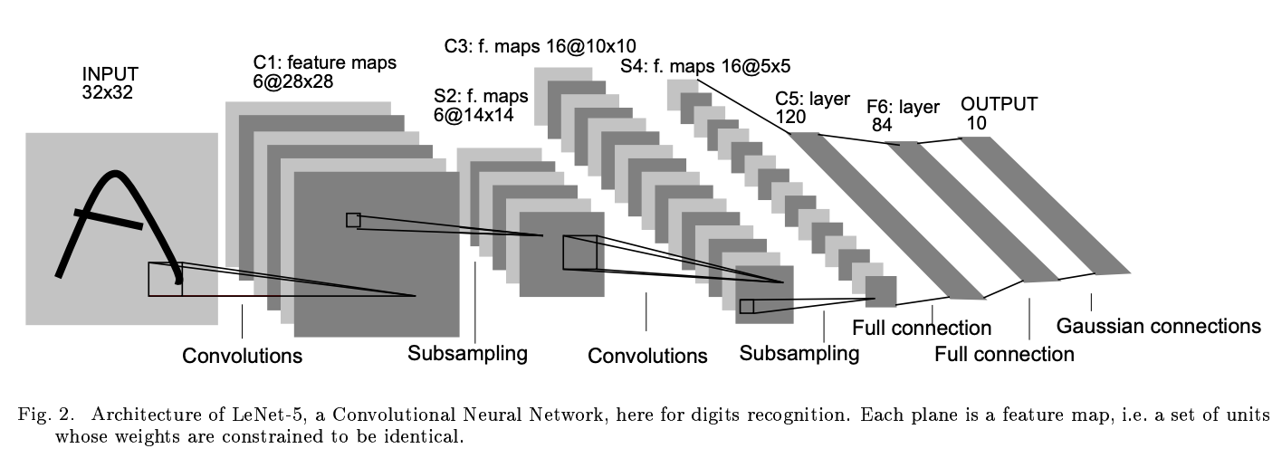
LeNet-5

Slide 3
LeNet-5 details
LeNet-5 comprises of 7 layers which are (in order and after input) -
Convolution layer C1 (6 filters of size 5x5)
Input shape: 32x32x1
Output shape: 28x28x6
Pooling layer S2 (size 2x2)
Input shape: 28x28x6
Output shape: 14x14x6
Convolution layer C3 (16 filters of size 5x5)
Input shape: 14x14x6
Output shape: 10x10x16
Pooling layer S4 (size 2x2)
Input shape: 10x10x16
Output shape: 5x5x16
Convolution layer C5 (120 filters of size 5x5)
Input shape: 5x5x16
Output shape: 1x1x120
Fully connected
Input shape: 1x1x120
Output shape: 1x1x84
Output
Layer to simulate on hardware is parameterizable

Slide 4
Weight Buffer
FROM COMPILER
WBUF
CODE
IBUF
SCHEDULER +
PE
FUSION UNIT COLLECTION
(16 x16)
DRAM

Slide 5
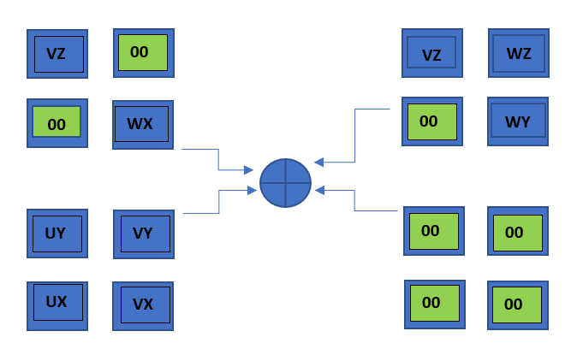
BIT FUSION ARCHITECTURE – 6b x 6b Quantization
Product
UVW x XYZ

Slide 6
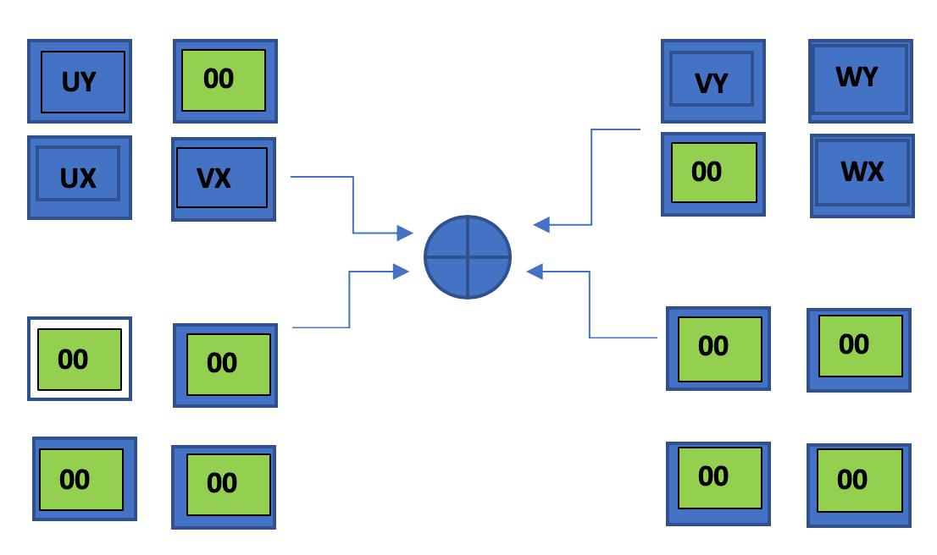
BIT FUSION ARCHITECTURE – 6b x 4b Quantization
Product
UVW x XY

Slide 7
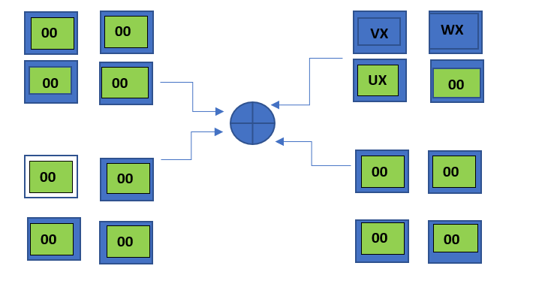
BIT FUSION ARCHITECTURE – 6b x 2b Quantization
Product
UVW x X

Slide 8
Tasks & Status
ISA
Almost done
Micro-architecture
Almost done
Compiler
Currently being implemented
Cycle accurate simulator
WIP
Generate timing data
Pooling and activation unit
Needs input from compiler
Benchmarks
Yet to be started

Slide 9
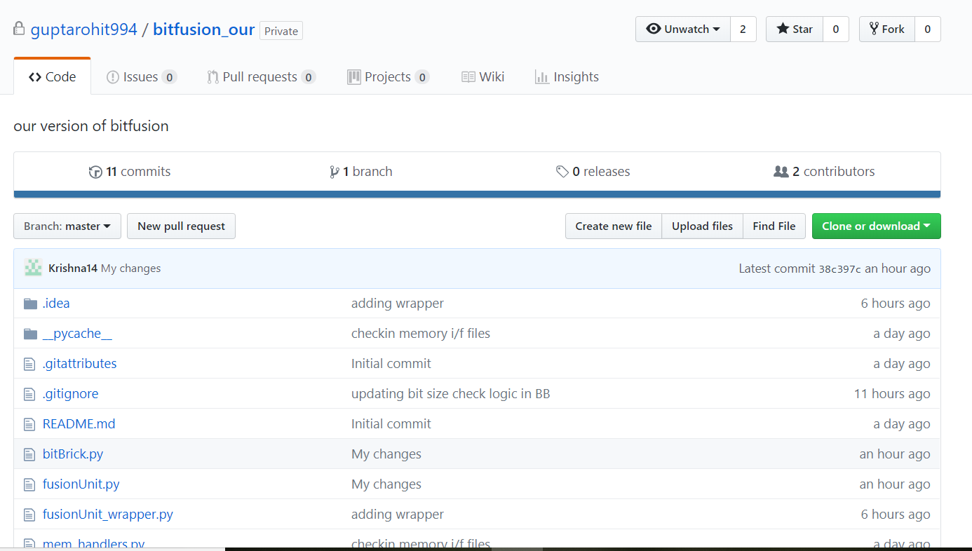
Simulator
https://github.com/guptarohit994/bitfusion_our

Slide 10

Backup slides

Slide 11
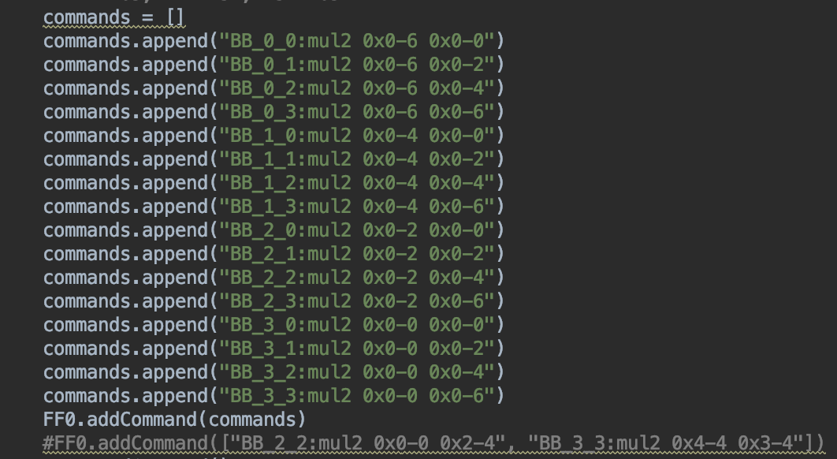
Compiler output and simulator input

