Slide 1
UE24CS352A · MACHINE LEARNING · MINI-PROJECT REVIEW
Gaining a Statistical Edge in
Soccer Prediction using Machine Learning
The role of meta-statistics in match prediction.
Kenche Srujana PES1UG24CS227
Krishna Keerthan Reddy D R PES1UG24CS237
Team 20 · Problem Statement #69 · EPL 2019–2025

Slide 2
01 · THE PROBLEM
Raw match stats are outcomes,
not predictors.
Home win, draw, or away win — a three-way call every pundit makes from gut feel. Naive models average a team's own raw numbers: goals, shots, corners. But those numbers are themselves the result of matches already played — weaker forward-looking signal than they seem to carry.
● Can we beat a baseline built only on a team's own raw match stats?
● Does engineering meta-statistics — strength ratings, form, market odds — give a real, measurable edge?
02 / 12

Slide 3
02 · THE DATASET
Six seasons of the Premier League
Pulled live from football-data.co.uk — no manual download, no Kaggle keys.
2,280
MATCHES
6
SEASONS · 2019/20–2024/25
20
CLUBS PER SEASON
Each row: date, teams, final score, shot counts, and closing bookmaker odds — the raw material for both feature sets.
03 / 12

Slide 4
03 · THE CORE IDEA
Two feature sets, same models,
head-to-head
Baseline — raw statistics
Rolling averages (last 5 games) of a team's own goals scored, goal difference, and shots.
Meta-statistics
Elo rating, recent form, goal-difference trend, rest days, head-to-head history, and de-vigorized market-implied probability.
VS
Same models trained on each set — so any accuracy gap is caused by the features, not the model.
04 / 12

Slide 5
04 · METHODOLOGY
Rule #1: no peeking at the future.
Every feature for a match uses only information available strictly before kickoff. Matches are processed in chronological order; a team's Elo, form, and head-to-head record update only after that match's features are already recorded.
Why it matters
Skip this and the model silently “learns” from information it would never have had before kickoff — inflating accuracy with results that don't hold up on new matches.
05 / 12

Slide 6
05 · PIPELINE
Data to decision, seven steps
1
Download
6 seasons
2
Clean &
de-vig odds
3
EDA
4
Leak-free
features
5
Chronological
split
6
Train &
evaluate
7
Interpret
results
Models: Logistic Regression & Random Forest · notebooks/Soccer_Match_Prediction.ipynb
06 / 12

Slide 7
06 · VALIDATION
Train on the past, test on the future
Chronological split, not random — the only valid approach for time-ordered sports data.
Train — 1,900 matches
First five seasons: 2019/20 through 2023/24.
Test — 380 matches
Held out entirely: the 2024/25 season, never touched during training.
07 / 12

Slide 8
07 · RESULTS
Meta-statistics win, consistently
FEATURE SET | MODEL | ACCURACY | F1 (MACRO) | LOG-LOSS
Majority-class baseline | – | 0.408 | – | –
Baseline (raw stats) | LogReg | 0.505 | 0.378 | 1.022
Baseline (raw stats) | RandForest | 0.500 | 0.372 | 1.049
Meta-statistics | LogReg | 0.545 | 0.409 | 0.977
Meta-statistics | RandForest | 0.542 | 0.409 | 0.966
Combined | LogReg | 0.542 | 0.406 | 0.981
Combined | RandForest | 0.537 | 0.405 | 0.977
08 / 12

Slide 9
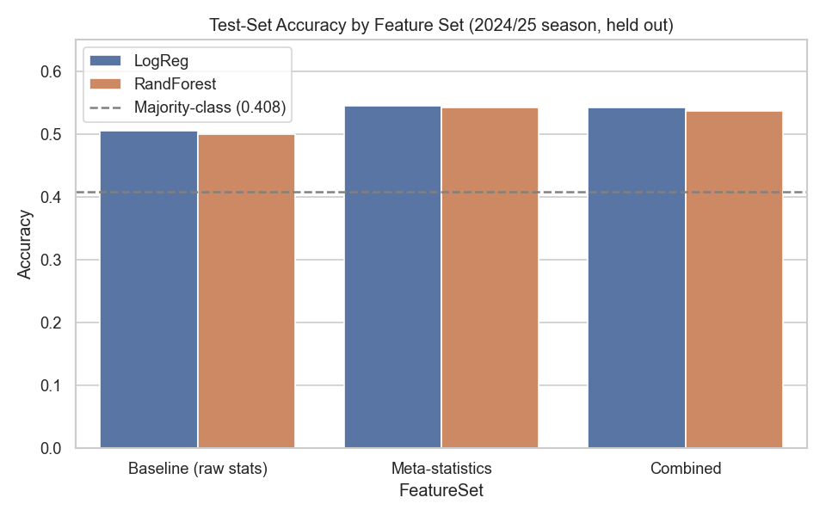
07 · RESULTS, VISUALLY
A clean, repeatable lift over baseline
09 / 12
Test-set accuracy by feature set & model — 2024/25 season, held out.

Slide 10
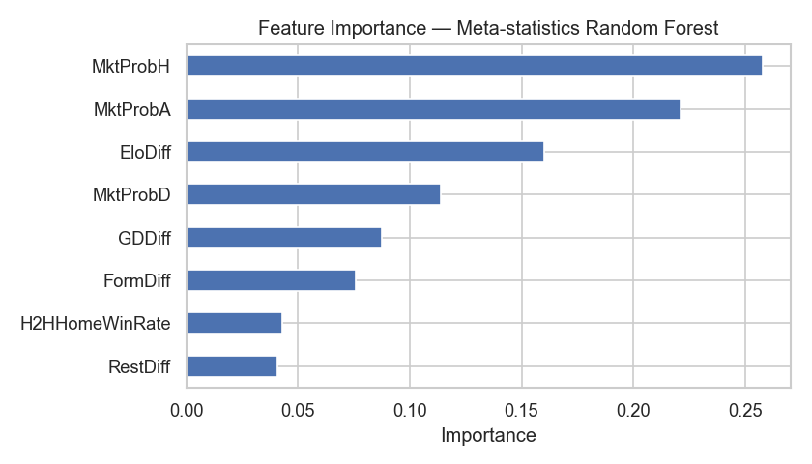
08 · WHAT MATTERED
The market already knows a lot.
Market-implied probability and Elo rating difference are the two strongest single predictors — the “wisdom of the crowd” and a compounding strength rating beat any single raw stat.
Feature importance — meta-statistics Random Forest.
10 / 12

Slide 11
09 · CONCLUSIONS
The statistical edge is real.
● A majority-class guess (“always Home win”) reaches ~41% — the floor to beat.
● Raw per-match stats, rolling-averaged, barely clear that floor (~50%).
● Meta-statistics give a consistent ~4-point accuracy lift and lower log-loss, on both a linear and a tree-based model.
● Combining both sets doesn't beat meta-statistics alone — raw stats add little that Elo, form, and market odds don't already capture.
Limitations: single league, no player-level data. Future work: gradient boosting, multi-league generalization, recency-weighted Elo.
11 / 12

Slide 12
THANK YOU
Questions? We're ready.
Full pipeline, write-up, and results:
notebooks/Soccer_Match_Prediction.ipynb
Kenche Srujana PES1UG24CS227
Krishna Keerthan Reddy D R PES1UG24CS237
12 / 12

