Slide 1
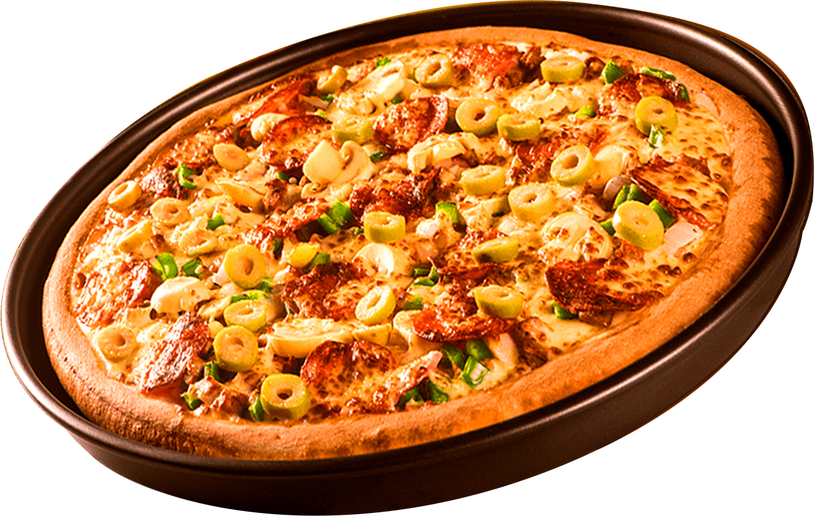
PIZZA
Analytics
Sales

Slide 2
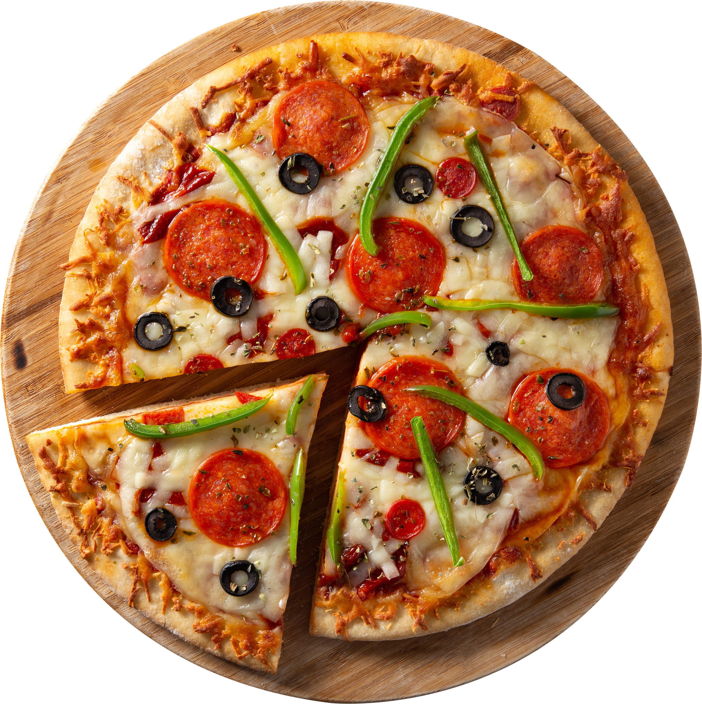
HELLO!
Hello, I am Krishna. In this project, I used SQL to clean and analyze raw pizza sales data to discover key business trends like top-selling pizzas, popular sizes, and busy order hours. I then used Power BI to turn these findings into a clear visual dashboard that makes the data easy to understand and act on.

Slide 3
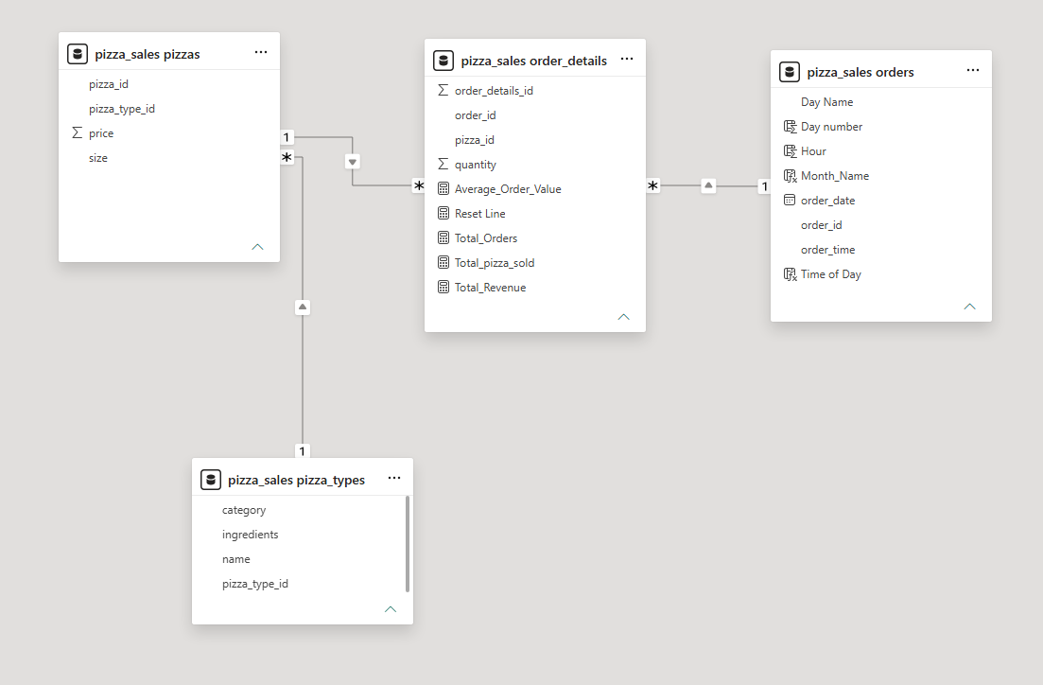

Data Model & Schema Overview
The Project runs on a star-style data model of four tables. The central fact table, order_details, holds each order line with its quantity and all the DAX measures (Total Revenue, Total Orders, Total Pizzas Sold, Average Order Value). It connects through one-to-many relationships to orders (date, time, day and month), pizzas (size and price), and pizza_types (name, category and ingredients, linked via pizzas). Because of these relationships, any slicer filters every KPI and chart on the page, keeping totals accurate and letting users analyze sales by month, hour, size and category.

Slide 4


RETRIEVE THE TOTAL NUMBER OF ORDERS PLACED.

Slide 5
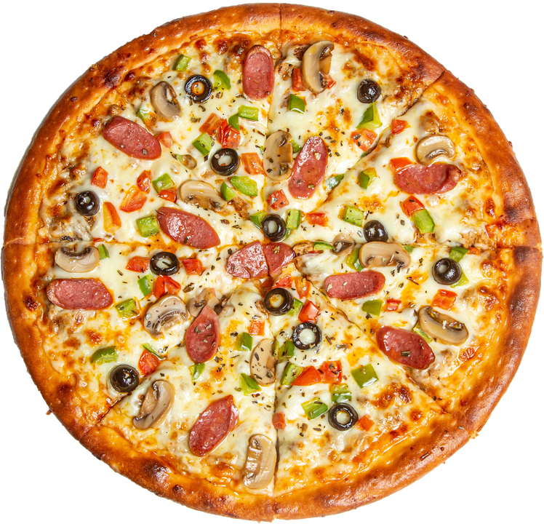
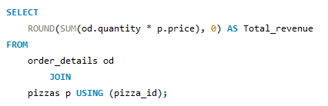

CALCULATE THE TOTAL REVENUE GENERATED FROM PIZZA SALES.

Slide 6
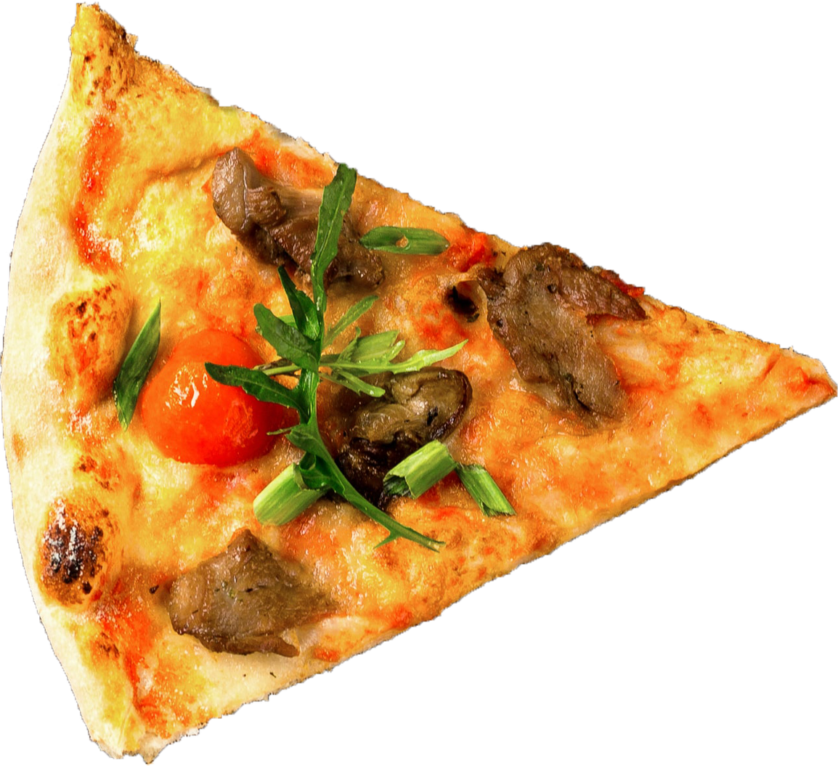
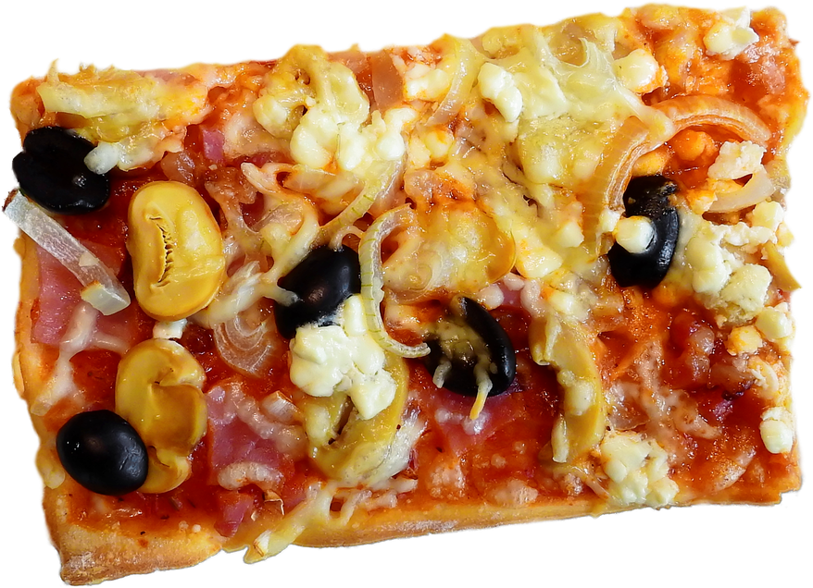
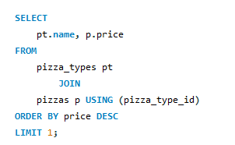

IDENTIFY THE HIGHEST PRICED PIZZA.

Slide 7
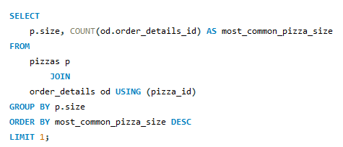

IDENTIFY THE MOST COMMON PIZZA SIZE ORDERED.

Slide 8
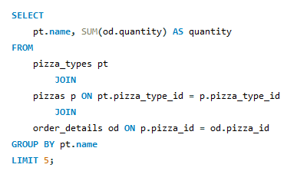
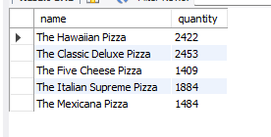
LIST THE TOP 5 MOST ORDERED PIZZA TYPES ALONG WITH THEIR QUANTITIES.

Slide 9
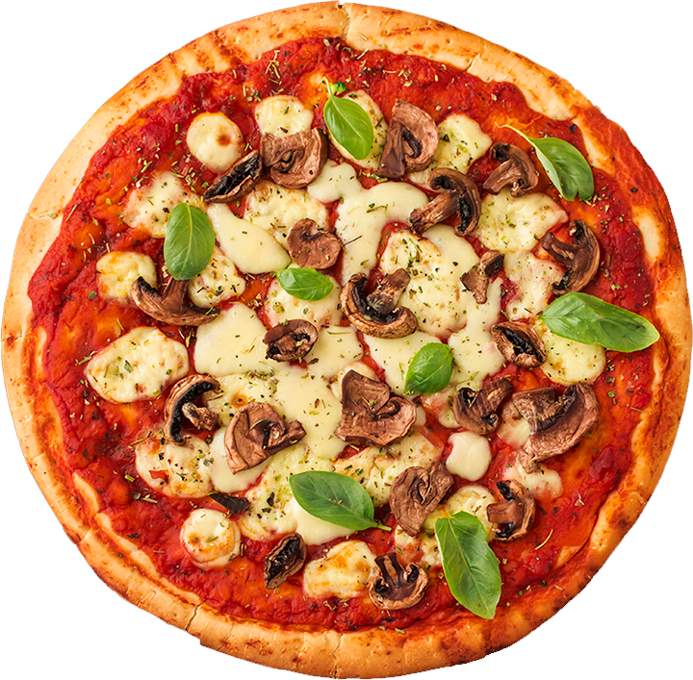
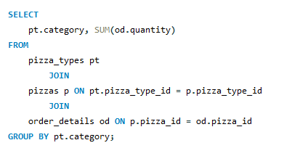
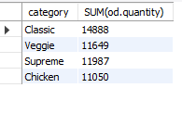
JOIN THE NECESSARY TABLES TO FIND THE TOTAL QUANTITY OF EACH PIZZA CATEGORY ORDERED.

Slide 10

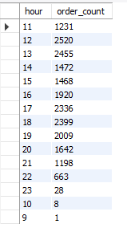
DETERMINE THE DISTRIBUTION OF ORDERS BY HOUR OF THE DAY.

Slide 11
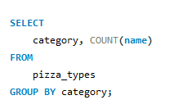
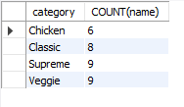
JOIN RELEVANT TABLES TO FIND THE CATEGORY WISE DISTRIBUTION OF PIZZAS.

Slide 12
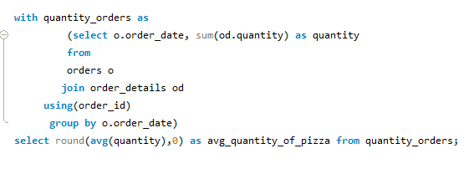

GROUP THE ORDERS BY DATE AND CALCULATE THE AVERAGE NUMBER OF PIZZAS ORDERED PER DAY.

Slide 13
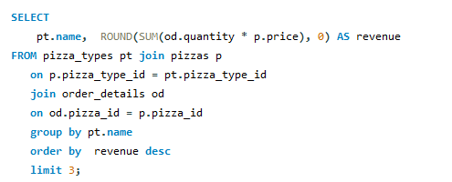
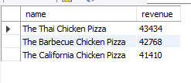
DETERMINE THE TOP 3 MOST ORDERED PIZZA TYPES BASED ON REVENUE.

Slide 14
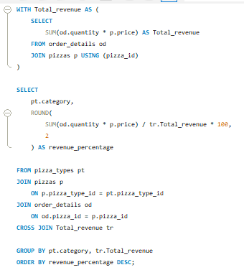
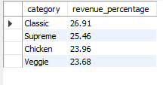
CALCULATE THE PERCENTAGE CONTRIBUTION OF EACH PIZZA TYPE TO TOTAL REVENUE.

Slide 15
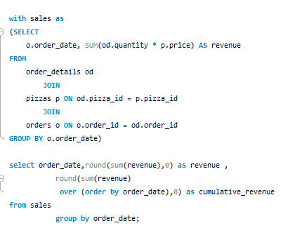
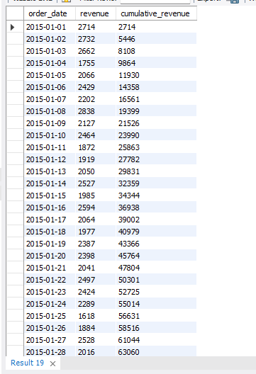
ANALYZE THE CUMULATIVE REVENUE GENERATED OVER TIME.

Slide 16
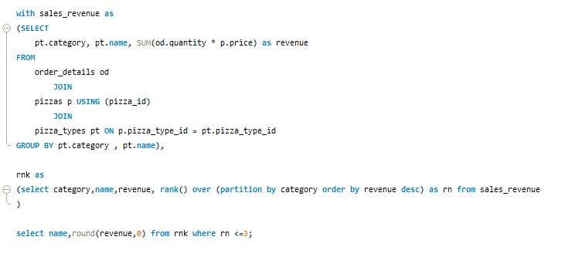
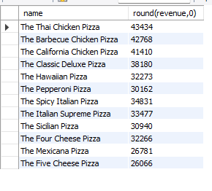
DETERMINE THE TOP 3 MOST ORDERED PIZZA TYPES BASED ON REVENUE FOR EACH PIZZA CATEGORY.

Slide 17


CONNECT WITH ME
https://www.linkedin.com/in/krishna-das-07b3b9244/
https://github.com/Krishna17201
das360497@gmail.com

Slide 18

THANK YOU

