Slide 1
GUVI(HCL)Project
Problem Statement - 1: Student Marks and Grades Summary
Description:
Design a Python program to calculate and summarize student marks and grades using basic
programming concepts.
ExpectedOutput
• Total and average for each student
• Grade assignment
• Class average and topper
Input:
Student Names, Marks in 3 Subjects

Slide 2
Project Description
The purpose of this Python-based project is to gather, process, and evaluate student grades in three different subjects. It determines the class average, determines the class topper, assigns grades according to predetermined standards, and computes the total and average score for each student.

Slide 3
Tools & Libraries Used
Python
Core programming language used to write the entire program
Used for data processing, logic, and user interaction
Matplotlib
A popular Python library used for creating static visualizations
Used in this project to generate a bar chart showing student average marks and class average line
ALL CODE IS IN THE GITHUB

Slide 4
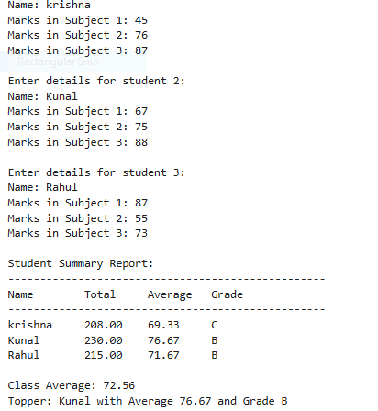
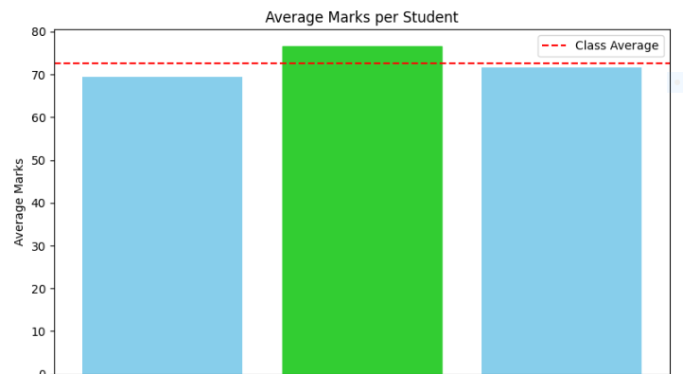
I will implement this code both manually and using a CSV file.
Output :- Manually

Slide 5
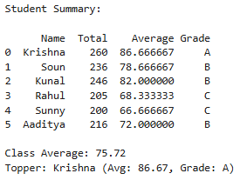
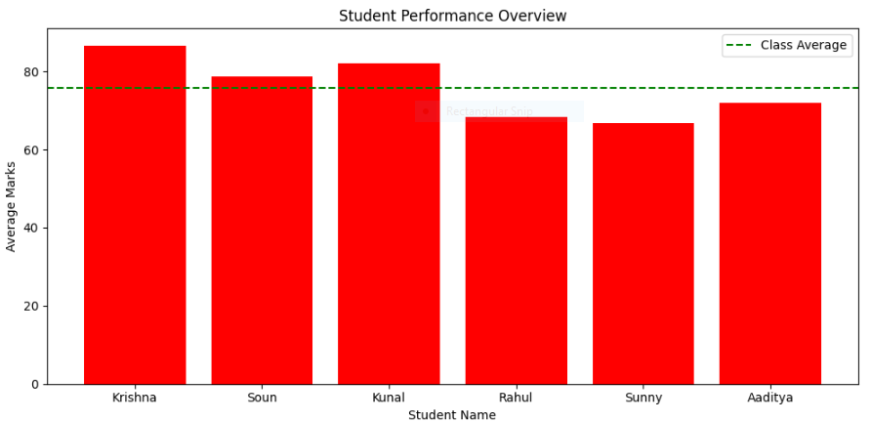
Output :-student(.csv)

Slide 6
Thank You

