Slide 1
Project Title - Heart_Diseases_Prediction
Name: KRISHNA KUNAL
Roll no- 2312res340
Date: 07 September 2025

Slide 2
GUVI(HCL)Project:-3
Heart_Diseases_Prediction
The project's main goal is to use machine learning techniques to predict heart disease.
Preprocessing of the data, feature engineering, and visualisation (confusing matrix, bar plots, and pairplots) were done.
We trained and assessed models such as Random Forest, XGBoost, SVC, and Logistic Regression.
Heatmaps of the accuracy and confusion matrices were used to compare the performance of the models.

Slide 3
It Includes—->
Data Heart Diseases implementation
Training Feature ENGINEERING & MODEL BUILDING AND EVALUATION
Model evaluation with accuracy, LOGISTIC REGRESSION
Visualizations (pairplot, confusion matrix heatmap, Bar Plot)
Saving/loading trained models
Example predictions
XGBOOST,RANDOM FOREST,SVC etc

Slide 4
Tools & Libraries Used
Python
import pandas as pd
import numpy as np
import matplotlib.pyplot as plt
import seaborn as sns
from sklearn.model_selection import train_test_split
ALL CODE IS IN THE GITHUB

Slide 5
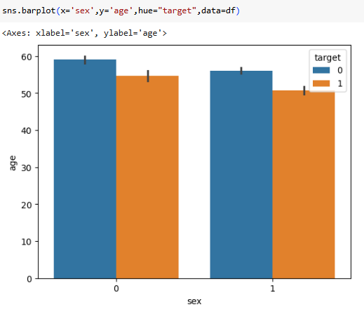
VISUALIZATIONS
Gender is represented by the X-axis (sex), where 0 denotes female and 1 denotes male in medical datasets.
The average age of people is shown on the Y-axis (age).
The heart disease outcome is represented by the hue (target) (0 = no heart disease, 1 = has heart disease).
Bars: Display the average age by target outcome for each sex group.

Slide 6
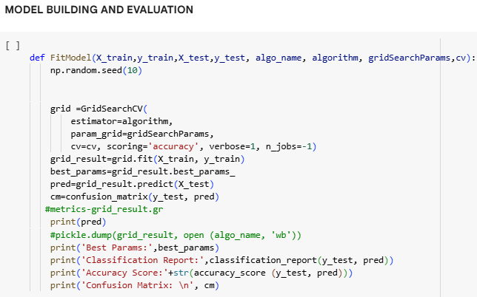

Slide 7
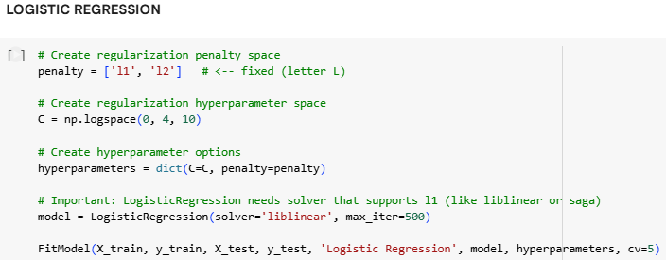

Slide 8
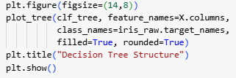
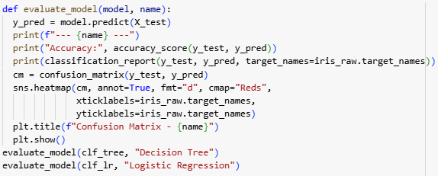
Model Evaluation
• Accuracy: 100% for both models.
• Classification Report: Precision, Recall, F1 all 1.00.
• Confusion Matrix: Perfect classification.

Slide 9
Future Scope
Improved Accuracy – Future work can involve using more advanced machine learning/deep learning models to improve prediction accuracy.
Real-Time Prediction – Integrating the model into mobile or web applications for real-time health monitoring.
Wearable Device Integration – Linking with smartwatches and fitness trackers to continuously analyze heart health.
Larger Dataset – Using bigger and more diverse datasets for better generalization across populations.

Slide 10
Conclusion
The project shows how machine learning can be extremely helpful in accurately predicting heart disease.
It demonstrates how data-driven strategies can help medical practitioners with early diagnosis and treatment planning.
For preliminary screening, the prediction model offers an economical and efficient tool.

Slide 11
Github link:-https://github.com/Krishna18-Kunal/Guvi_project3.git

Slide 12
Thank You

