Slide 1


Accenture Innovation Challenge
Harness Generative AI to develop innovative solutions that boost business and societal growth

Slide 2

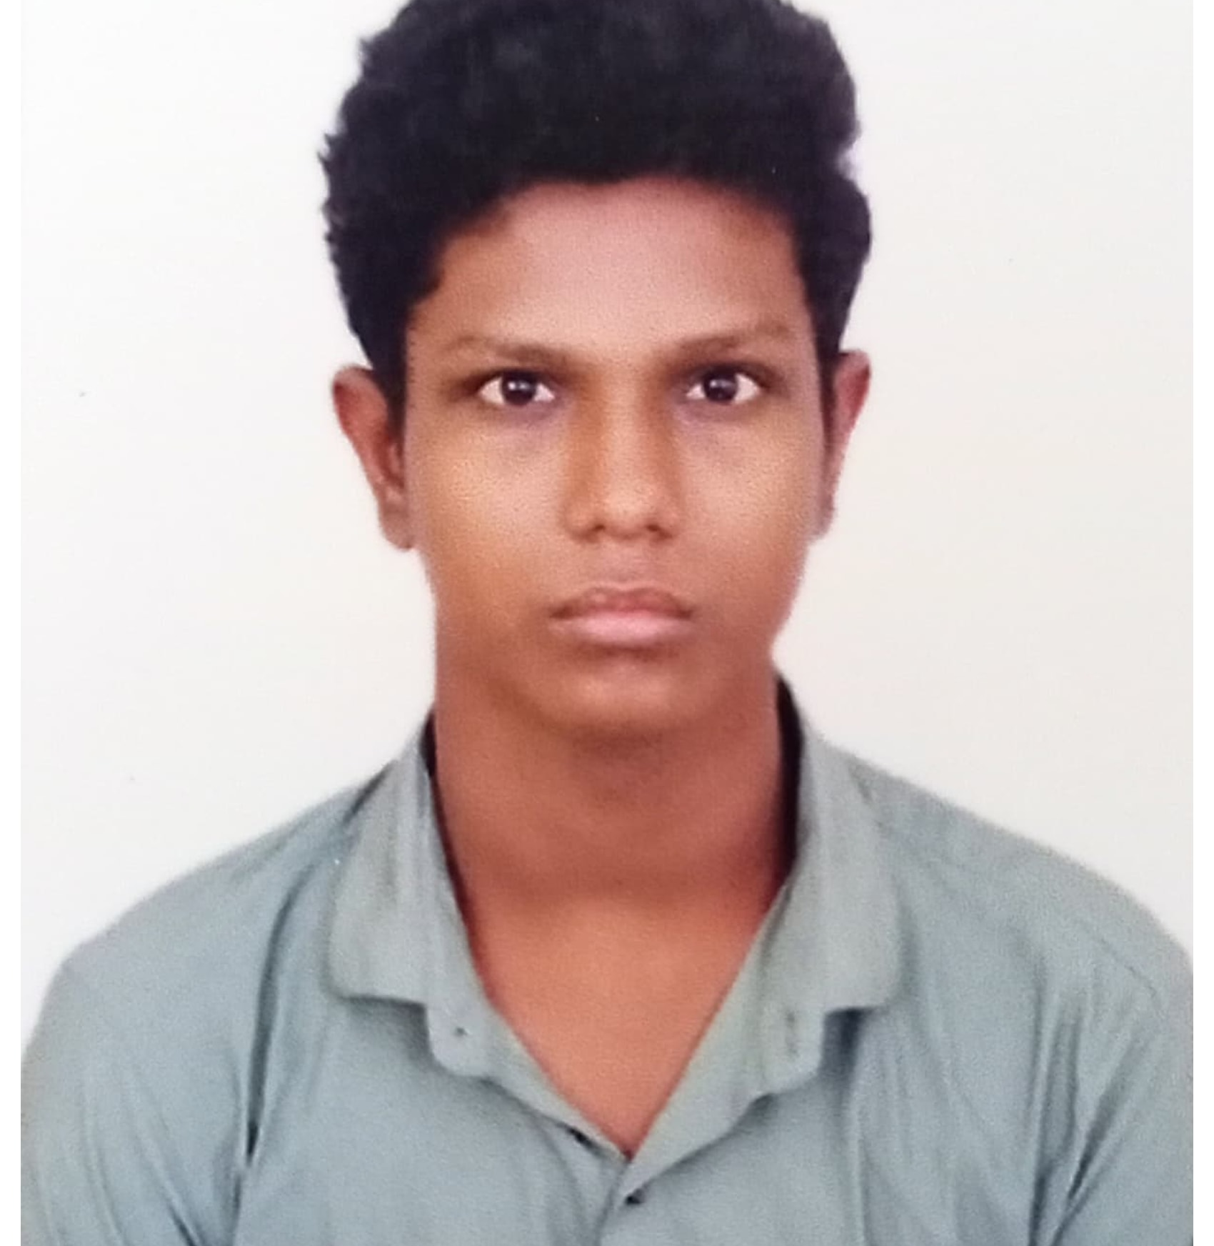
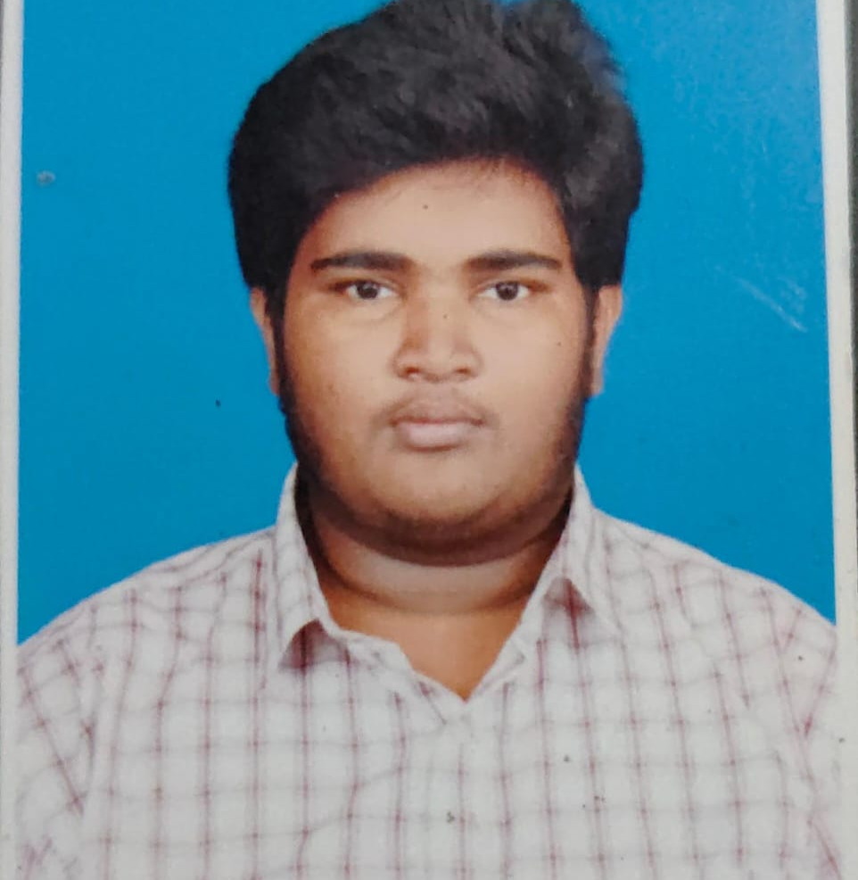
Team details
TEAM NAME: Team White
Krishna K (Team Leader)
Nivasan K
College: K.Ramakrishnan College of Engineering, Tiruchirappalli
Stream: Computer Science and Business Systems
Year of graduation: 2026
College: K.Ramakrishnan College of Engineering, Tiruchirappalli
Stream: Computer Science Engineering
Year of graduation: 2026
Arularasan S
College: K.Ramakrishnan College of Engineering, Tiruchirappalli
Stream: Computer Science Engineering
Year of graduation: 2026

Slide 3
Describe the problem statement (200 words)
Problem Statement:
Farmers face significant challenges in managing their crops and livestock while ensuring their well-being. Traditional methods of monitoring and care are often time-consuming, labor-intensive, and may not provide timely insights into potential issues. This leads to losses in productivity, income, and overall farm sustainability.
Specific challenges include:
Remote monitoring: Farmers often need to be away from their farms for various reasons, making it difficult to monitor the health and well-being of their crops and animals.
Disease prediction: Early detection of diseases is crucial for preventing significant losses. However, traditional methods may not provide timely or accurate diagnoses.
Limited access to expertise: Farmers in remote areas may have limited access to veterinary and agricultural experts, hindering their ability to address issues effectively.
Inefficient communication: Inefficient communication channels between farmers, veterinarians, and agricultural experts can delay responses to critical situations.
These challenges collectively contribute to a significant burden on farmers, impacting their livelihoods and the overall sustainability of agricultural practices.

Slide 4
Proposed solution / your big Idea (200 words)
Proposed Solution: A Federated Model Integrated Disease Prediction System
To address the challenges faced by farmers, we propose a federated model integrated disease prediction system for crops and animals. This system will leverage advanced technologies to provide real-time monitoring, early disease detection, and efficient communication between farmers, veterinarians, and agricultural experts.
Key features and benefits:
Real-time monitoring: Sensors and IoT devices will be deployed on farms to collect data on various parameters such as temperature, humidity, soil moisture, and animal behavior. This data will be processed using federated learning techniques to ensure privacy and security.
Disease prediction: Advanced machine learning algorithms will analyze the collected data to predict potential diseases in crops and animals. Early detection will enable timely intervention, reducing losses and improving overall farm health.
Expert connectivity: The system will facilitate seamless communication between farmers, veterinarians, and agricultural experts. Farmers can seek advice, share information, and access expert recommendations through a centralized platform.
Improved productivity and profitability: By enabling early disease detection, optimizing resource management, and providing timely expert guidance, the system will help farmers increase productivity, reduce costs, and improve their overall profitability.
Enhanced sustainability: The system will promote sustainable farming practices by minimizing the use of pesticides and other harmful chemicals. It will also contribute to the conservation of natural resources.
TECHNOLOGY USED: Example - Machine Learning, Deep Learning,Federated learning Algorithms.

Slide 5
How does your innovation accelerate change with the power of Technology? (200 words)
Our innovation leverages technology to accelerate change in the agricultural sector in several ways:
Real-time Data and Insights: By harnessing IoT devices and sensors, we provide farmers with real-time data on their crops and animals. This enables them to make data-driven decisions and respond promptly to changing conditions.
Predictive Analytics: Advanced machine learning algorithms analyze historical and real-time data to predict potential issues, such as diseases or crop failures. This proactive approach allows farmers to take preventative measures, reducing losses and improving overall efficiency.
Expert Connectivity: Our platform facilitates direct communication between farmers and agricultural experts. This provides access to specialized knowledge and support, accelerating the adoption of best practices and innovative techniques.
Scalability and Accessibility: Our solution is designed to be scalable and accessible to farmers of all sizes. This democratizes access to advanced technology, empowering farmers in both developed and developing regions.
Data-Driven Decision Making: By providing farmers with actionable insights, our innovation fosters a culture of data-driven decision making. This can lead to more efficient resource allocation, reduced waste, and improved profitability.

Slide 6
How is your solution different/unique from other solutions in market? (150 words)
Our proposed solution stands out from existing market solutions due to the following key differentiators:
Federated Learning: The use of federated learning ensures that sensitive farm data remains private and secure. This is particularly important for protecting sensitive information related to animal health and crop yields.
Integrated Disease Prediction: Our system combines real-time monitoring, data analysis, and machine learning to provide comprehensive disease prediction for both crops and animals. This integrated approach offers a more accurate and holistic view of farm health.
Expert Connectivity: The direct connection to agricultural experts and veterinarians provides farmers with personalized guidance and support. This fosters a collaborative approach to problem-solving and knowledge sharing.
Focus on Sustainability: Our solution emphasizes sustainable farming practices by minimizing the use of harmful chemicals and promoting resource conservation. This aligns with the growing demand for environmentally friendly agricultural solutions.
Scalability and Adaptability: The system is designed to be scalable and adaptable to various farm sizes and operating conditions. This ensures its applicability to a wide range of agricultural settings.
PATENT FILED: No
Do you have a working model/prototype: No
If not, will you be able to show working prototype during finale. Yes

Slide 7
Please share a 1-minute video of your idea (embed on this PPT or add a downloadable link)
Video Link : https://github.com/Krishna18062005/AccentureInnovation

Slide 8
Thank you!

