Slide 1
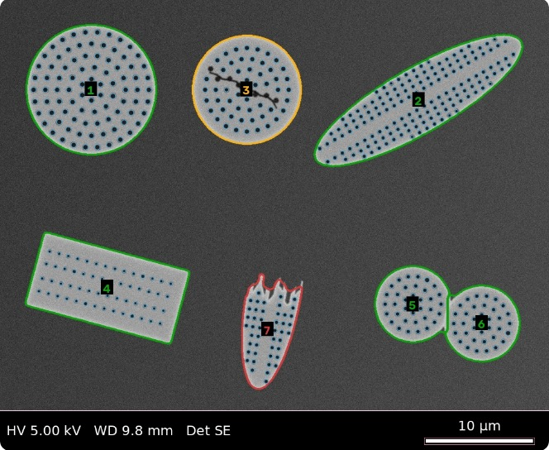
Diatom Analyzer
Drop in SEM images. Get every diatom counted, measured in µm and graded intact, cracked or broken, with every pore, in one Excel file.
Runs on a laptop
Open source
No programming
W&M Nano & Biomaterials Lab · Challenge #1
Notes:
One tool: images in, measurements out. Everything runs on the user's own computer.

Slide 2
What it does
For every diatom in every image, automatically
#
µm
∠
Counts every diatom
Measures it in µm
Reports orientation
Outlined and numbered on the image; touching diatoms are separated
Length, width, area. Scale from the microscope file or scale bar, never assumed
Long-axis angle, and whether it lies face-on or on its side
✓
Sp
•••
Grades its condition
Names its shape
Measures every pore
Intact, cracked or broken, colour-coded on the image
Round or elongated, side view or broken piece; species once taught a few examples
Position and diameter of each pore, plus density and spacing
Notes:
These map one-to-one onto the challenge requirements.

Slide 3
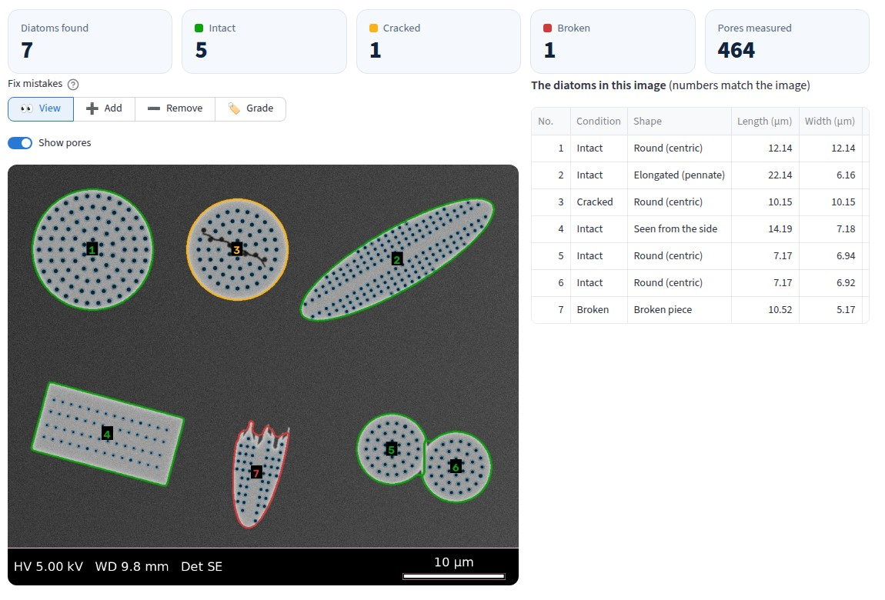
Four steps, no programming
Double-click to start; it opens in the web browser
1
Add images
Drag in SEM images (TIF, JPG, PNG). Hitachi: add the .txt file too.
2
Pick the sample type
Diatoms apart · packed round cells · crowded, I'll mark them myself
3
Check and fix
Add a missed diatom by dragging tip to tip; remove a wrong one; set a condition; undo
4
Download
One Excel file: every diatom, every pore, a summary, and a column guide
Intact
Cracked
Broken
Edge / not assessed
Pore
Notes:
Outline colours follow the condition. Every correction updates the measurements and is recorded in the spreadsheet.

Slide 4
How it works
Classical image analysis: fast, explainable, and runs on any laptop
1
2
3
4
5
6
Scale
Find
Measure
Pores
Condition
Species
Read from the microscope's file, else the scale bar's length and label, else the tick ruler
›
Separate diatoms from background; split touching ones; circle-finding for packed cultures
›
Rotated box for length and width; long-axis angle; face-on or side view
›
Dark spots inside each shell, sized at half their depth
›
Sharp inward corners and bites = broken; long crack lines or chips = cracked
›
Match shape, size, pores and texture against a few examples per species
When it's too hard: the user marks diatoms by dragging tip to tip and the outline is traced for them. Those corrected outlines can train a Cellpose model on the lab's own images (in a test on 8 unseen crowded frames: 96 % found vs 65 % for the classical method).
Notes:
Every stage is a plain rule you can inspect; all thresholds are exported with the results.

Slide 5
How accurate: tested on unseen images
Tuned on 30 generated SEM frames, scored on 30 new frames never used for tuning
142/142
0.8 %
97 %
diatoms found when lying apart, no false detections
mean length error (scale read from the scale bar)
condition correct: intact 85/85, cracked 28/32, broken 25/25
94 → 98 %
1.7 %
71 %
species correct with 1 → 5 reference examples each
mean error in pore count per diatom
found in crowded, overlapping scenes (94 % of outlines correct)
Species: reference examples are separate specimen images; scoring uses the diatoms in the test frames (a true train / test split). Generated images have exact answers but are cleaner than real ones.
Notes:
Held-out reports: reports/heldout and reports/heldout_crowded (seeds 1000-1029). Tuning frames: seeds 0-29.

Slide 6
On the lab's own images
123 SEM images from a Phenom desktop SEM and a Hitachi S-4700
Scale: 123 / 123 read from the microscope's file. Reading the scale bar alone agrees on all 122 images where it can be checked.
✓
Works automatically
!
Needs the user's help
Diatoms on a clean background (Richmond pennates, 1-10 per image)
Packed Thalassiosira cultures: 90-120 valves per image in round-cell mode
Hitachi images at 3,000×: 30-45 valves each, scale from the .txt file
1-20 s per image on a laptop
Debris-heavy diatomite: mineral grains get outlined; remove them or mark diatoms by hand
Dense Didymosphenia fields: mark each cell by dragging tip to tip, then grade it
Close-ups of one or two cells: round-cell mode can add false circles
Real-image counting accuracy not yet measured: needs 10-20 hand-labelled images
Notes:
Figures from running the app's modes over the lab folders. The fix for debris-heavy and dense scenes is a detection model trained on corrected outlines (see How it works).

Slide 7
Try it
1
2
3
Install Python 3.10+
Double-click the launcher
Drag in your SEM images
from python.org (once per computer)
Start Diatom Analyzer (Mac).command or (Windows).bat
and download the Excel file at the end
Everything stays on your computer: no cloud, no GPU, no images uploaded. Built with open-source Python (scikit-image, OpenCV, Streamlit).

