Slide 1

Digital Twin-Based Early Warning System for Cold Chain Disruption Detection
Using Anomaly Detection inside a Discrete-Event Simulation Loop (Topic 21)
Presenter: Krishna Sikheriya (Roll No: IIT2023139) — 7th Semester B.Tech (IT)
Course: Managing Corporate Entrepreneurship | Instructor: Dr. Netranand Pathak
Indian Institute of Information Technology, Allahabad (IIITA)
GitHub: github.com/Krishna200608/coldchain-ews-twin | Live Web App: coldchain-ews-twin.streamlit.app
Notes:
Good morning, Professor and peers. Today I am presenting our project on Topic 21: A Digital Twin-Based Early Warning System for Cold Chain Disruption Detection. We set out to investigate whether embedding streaming machine learning detectors directly inside a digital twin can flag dangerous temperature breaches before irreversible spoilage occurs, rather than waiting for reactive alarms after the damage is already done.

Slide 2
Problem Statement, Research Gap & Core Objectives
Topic 21 — Digital Twin Early Warning System
The Operational Problem & Research Gap
The Cold Chain Reality: Vaccines, biologics, and premium perishables demand unbroken temperature control (e.g., 2°C to 8°C). A single excursion destroys cargo value.
The Traditional Failure Mode: Existing logistics systems rely on static upper-bound threshold alarms that trigger only after temperature breaches a fixed limit for sustained durations (10–15 mins).
The Post-Hoc Problem: By the time a static threshold alarm sounds, cumulative thermal exposure has already caused irreversible biochemical spoilage.
The Literature Gap: Prior cold-chain research focuses predominantly on post-hoc quality loss modeling. Real-time anomaly detection embedded in a digital twin for early warning is underexplored.
Core Objectives & Research Questions
Objective 1 (Digital Twin): Build an event-driven SimPy simulation replicating the asynchronous streaming and network dropouts of real transit.
Objective 2 (Embedded Anomaly Detection): Embed unsupervised Isolation Forest and deep LSTM-Autoencoder into the twin loop.
RQ1 (Early Warning Runway): How many minutes of lead time (Δt_lead = t_irr - t_alarm) can machine learning provide before irreversible failure?
RQ2 (Model Trade-off): How does classical tree isolation compare against deep recurrent reconstruction on irregular edge telemetry?
RQ3 (Simulation Fidelity): Can live streaming monitors run without silent divergence or cold-start lag relative to offline batch evaluation?
Managing Corporate Entrepreneurship (B.Tech 7th Sem) | Krishna Sikheriya (IIT2023139) | IIIT Allahabad
Notes:
In cold-chain logistics, waiting for an alarm to cross a fixed threshold is fundamentally reactive—by the time it sounds, irreversible damage has often already occurred. Our research tackles this gap by asking: can an event-driven digital twin catch the subtle precursor symptoms, such as compressor drift or variance loss, before the failure boundary is crossed? We evaluate exactly how many minutes of early warning we can gain, compare classical vs deep learning detectors, and verify simulation fidelity.

Slide 3
Relevant Literature Review (Recent Key Papers 2023–2026)
Topic 21 — Digital Twin Early Warning System
Paper Citation | Journal / Venue | Core Contribution | Direct Relevance to Topic 21
Vukšić et al. (2026) | Applied Sciences (MDPI) | Hybrid physics-based digital twin + autoencoder for reefer maritime containers. | Reports median lead time of ~68 min; independently corroborates our 64-minute early warning on drift.
Xie et al. (2025) | PLOS ONE | Improved Isolation Forest (subsampling + feature grouping) for streaming cold-chain fleet data. | Benchmarks tree-based streaming anomaly detection; contextualizes single-sensor point-wise metrics.
Meng et al. (2024) | Journal of Food Engineering (Elsevier) | Cost-effective box-level digital twin temperature modeling + static pallet alarms. | Exemplifies the traditional static threshold alarm paradigm that our proactive system benchmarks against.
Wu et al. (2023) | J. Industrial Information Integration (Elsevier) | Internet-of-Everything and Digital-Twin platform for cold-chain service logistics. | Establishes architectural precedent for embedding AI inference into operational digital-twin pipelines.
Defraeye et al. (2023) | Comput. Electron. Agric. / J. Food Eng. | Comprehensive review of food cold-chain digital twins and sensor dynamics. | Identifies fundamental gap: transitioning from post-hoc quality loss to live event-driven early warning.
Managing Corporate Entrepreneurship (B.Tech 7th Sem) | Krishna Sikheriya (IIT2023139) | IIIT Allahabad
Notes:
Our work is grounded in recent literature from top journals in food engineering and industrial systems. Crucially, Vukšić et al. in 2026 demonstrated a 68-minute lead time using deep learning on maritime reefer containers, which independently corroborates our finding of a 64-minute lead time on drift faults. Furthermore, Xie et al. in 2025 benchmarked Isolation Forest on cold-chain fleets, while Meng et al. in 2024 in the Journal of Food Engineering and Wu et al. in 2023 established the digital twin framework we build upon.

Slide 4
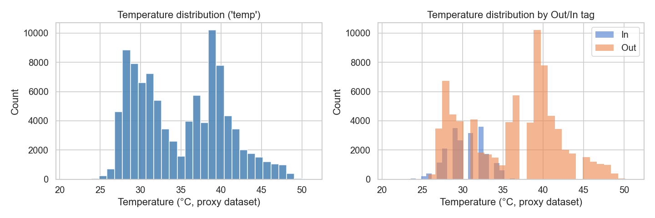
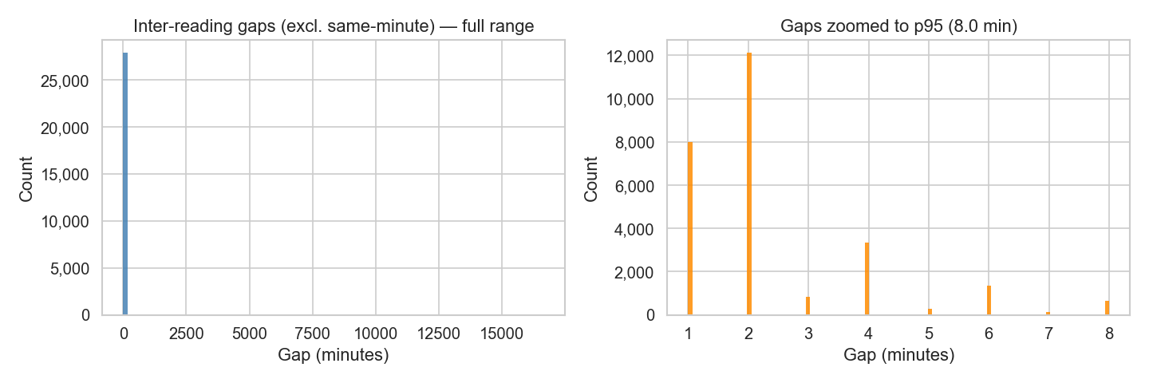
Data Strategy & Structural Proxy Framing
Topic 21 — Digital Twin Early Warning System
Dataset Characteristics & Scientific Rigor
Kaggle IoT Dataset: 97,606 raw readings across 133 continuous days (July 28 to Dec 8, 2018), 27,920 unique minute timestamps.
Realistic Sampling Dynamics: High inter-arrival irregularity (Mean = 117.8 s, Median = 0.0 s, Std = 5446.3 s, CoV = 46.23). Dropouts span up to 11.57 days, accurately reflecting edge IoT transmission challenges.
Dual Sensor Streams: Separated into ambient (Out, 77,260 rows) and internal enclosure proxy (In, 20,345 rows).
Structural-Proxy Data Notice: In adherence to strict academic honesty, this dataset originates from an office installation ('Room Admin'), not live pharmaceutical reefer vehicles. We frame it exclusively as an engineering structural proxy to validate asynchronous streaming pipelines and model integration without making ungrounded food-safety claims.
Managing Corporate Entrepreneurship (B.Tech 7th Sem) | Krishna Sikheriya (IIT2023139) | IIIT Allahabad
Notes:
We used a 97,000-reading real IoT dataset covering over 4 months. In real supply chains, sensor packets arrive irregularly due to network jitter and dropouts—our data reflects this with a high variance coefficient of 46.2. Importantly, we maintain complete academic honesty: we explicitly treat this as a structural proxy for sensor streaming, rather than fabricating claims of live pharmaceutical field testing.

Slide 5
System Architecture & SimPy Digital Twin
Topic 21 — Digital Twin Early Warning System
Discrete-Event Simulation Architecture
Causal Preprocessing: Corrected day-first timestamp parsing (preventing 48.8% silent parse failures). Derived trailing rolling means and stds with zero look-ahead leakage (D22).
SimPy 3-Stage Transit: Source -> Transit -> Destination event-driven virtual clock, replaying real inter-arrival gaps with zero timing discrepancy.
Embedded Streaming Monitors: Destination sink embeds three parallel monitors:
• BaselineMonitor (Static 2σ threshold)
• IFMonitor (Isolation Forest partition score)
• LSTMMonitor (Sliding-window reconstruction MSE)
Silent Buffer Pre-Warming (D33): Sliding window buffers are silently primed with preceding historical observations, completely eliminating cold-start false negatives during windowed replay.
1. Physical IoT Stream
Raw telemetry (97,606 rows, IOT-temp.csv)
2. Causal Preprocessing
dayfirst=True, Δt_k, trailing rolling features
3. SimPy Discrete-Event Twin
3-Stage Pipeline: Source -> Transit -> Destination
4. Embedded Streaming Monitors
Baseline (2σ) | IF Monitor | LSTM Monitor
5. Silent Buffer Pre-Warming (D33)
History pre-loaded -> 100% live/batch parity
6. Cloud Analytics & Dashboard
Streamlit UI: Guided Tour & Free Explore
Managing Corporate Entrepreneurship (B.Tech 7th Sem) | Krishna Sikheriya (IIT2023139) | IIIT Allahabad
Notes:
Our architecture consists of three stages: data ingestion, machine learning detectors, and an event-driven SimPy digital twin modeling Source, Transit, and Destination. When a telemetry event reaches Destination, our three monitors score it in real time. We implemented silent buffer pre-warming so the rolling buffers have history, eliminating cold-start errors.

Slide 6
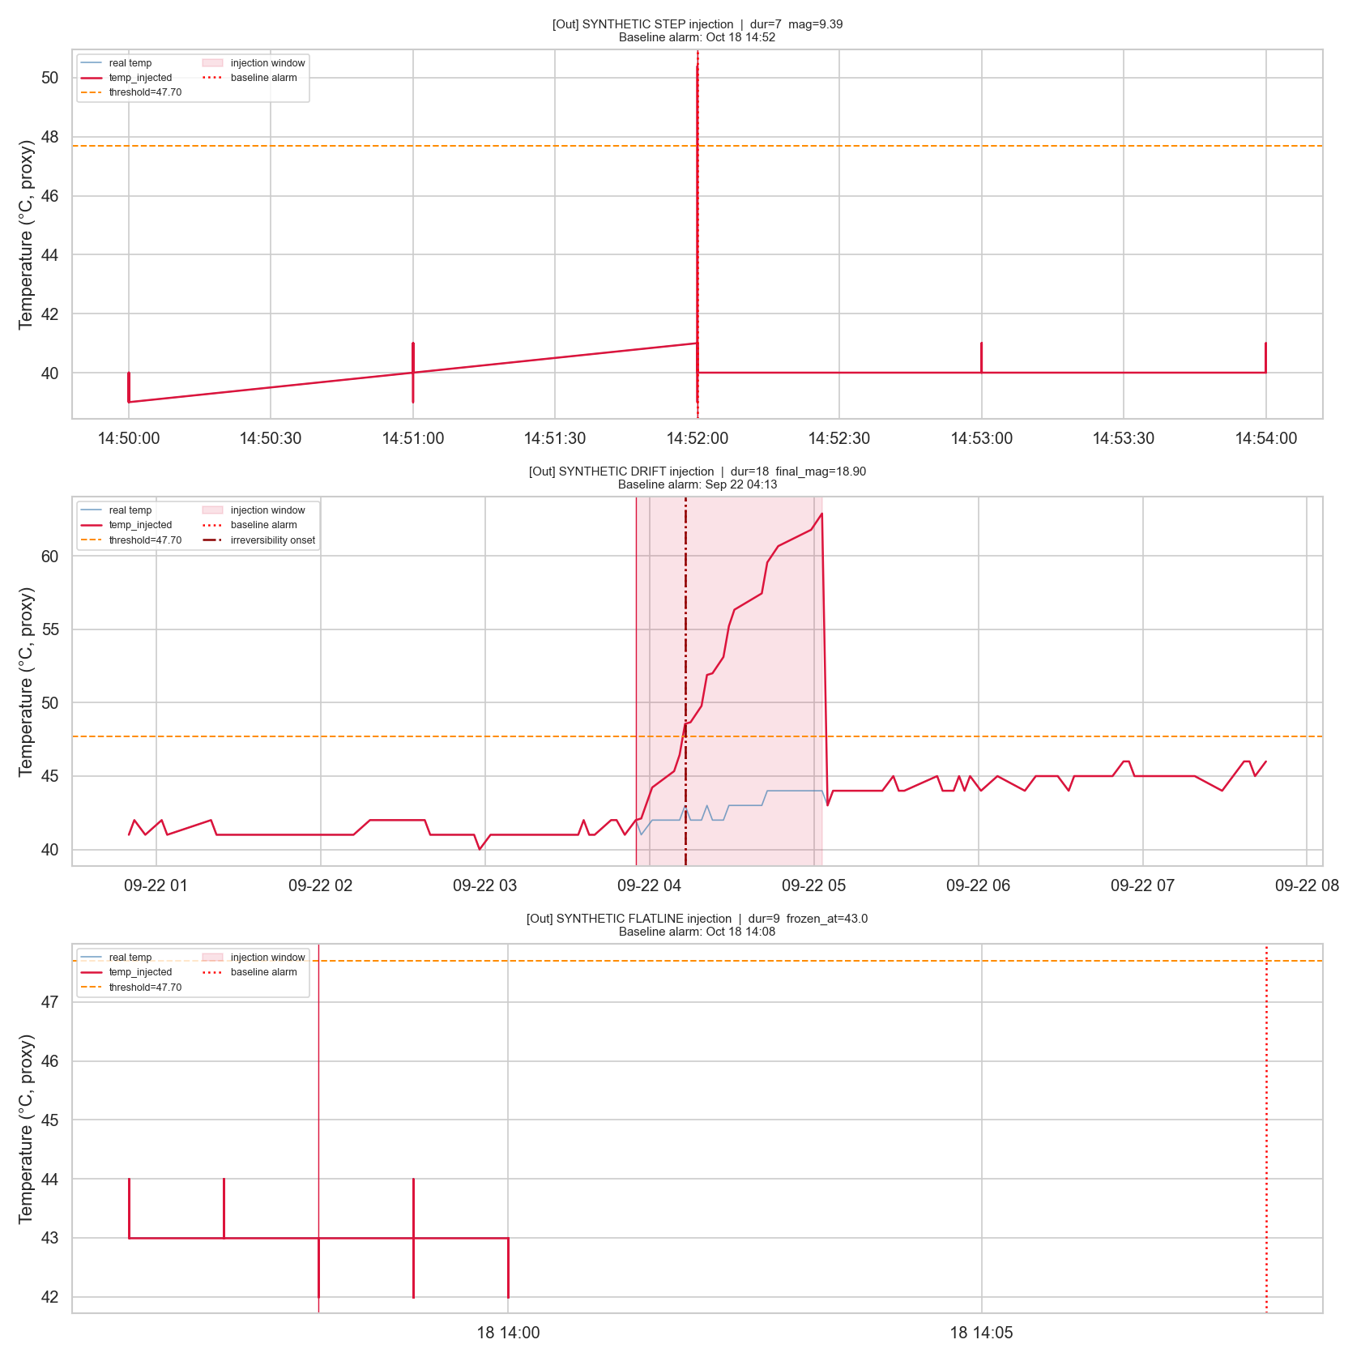
Experimental Setup & Controlled Anomaly Protocol
Topic 21 — Digital Twin Early Warning System
Controlled Perturbation Injection (Seed 42)
30 Controlled Injections: Seeded across chronological timeline representing 3 canonical failure modes:
• Step Spikes (10): Abrupt +5°C to +15°C jumps (door left open).
• Linear Drifts (10): Gradual ramps (compressor refrigerant leak).
• Sensor Flatlines (10): Zero variance persistence (stiction).
Strict Chronological Split: 70% Train / 30% Test split at cutoff timestamp 2018-10-29 11:10:48.
Out-of-Sample Discipline: 24 injections fall in the train split (used only for development/previews). All formal headline claims are evaluated strictly on the 6 untouched test injections.
Lead Time Metric Definition: Δt_lead = t_irreversibility - t_alarm (where t_irr is a sustained 10-minute breach). Positive = early warning; Negative = late alarm.
Managing Corporate Entrepreneurship (B.Tech 7th Sem) | Krishna Sikheriya (IIT2023139) | IIIT Allahabad
Notes:
To test the system rigorously, we injected 30 controlled synthetic disruptions representing real failure modes: abrupt steps, gradual drifts, and flatlines. We enforced a strict chronological 70/30 train/test split. To ensure scientific validity, all our performance benchmarks are evaluated solely on the 6 untouched test-set injections.

Slide 7
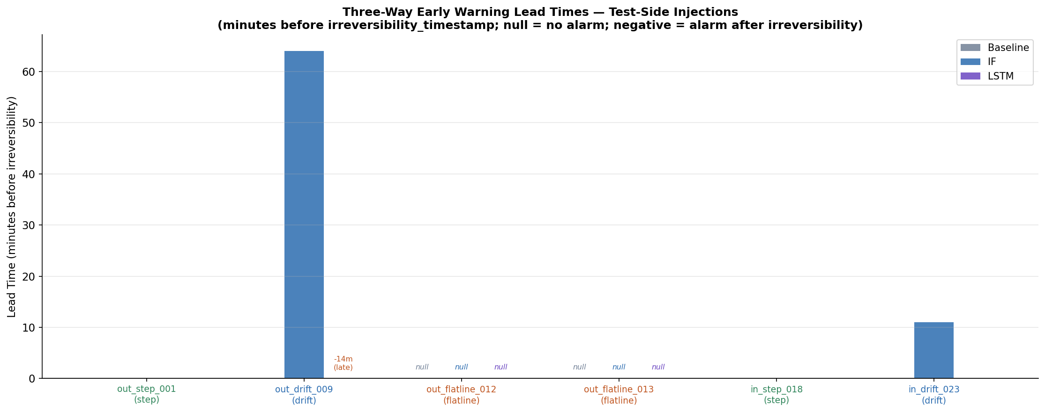
Core Result 1: Early-Warning Lead Times (Test Split)
Topic 21 — Digital Twin Early Warning System
Injection ID | Type | Baseline | IF Lead Time | LSTM Lead Time
out_step_001 | Step | 0.0 min | 0.0 min | 0.0 min
out_drift_009 | Drift | 0.0 min | +64.0 min (Early) | -14.0 min (Late)
out_flatline_012 | Flatline | Missed | Detected | Detected
out_flatline_013 | Flatline | Missed | Detected | Missed
in_step_018 | Step | 0.0 min | 0.0 min | 0.0 min
in_drift_023 | Drift | 0.0 min | +11.0 min (Early) | 0.0 min
Key Scientific Observations
Decisive Drift Lead Time: Isolation Forest flags subtle variance change 64 minutes (Out) and 11 minutes (In) before irreversibility.
Step Synchrony: For abrupt spikes, all models trigger simultaneously at 0.0 min.
LSTM Adaptation Lag: LSTM was late by 14 min on Out drift due to error adaptation.
Managing Corporate Entrepreneurship (B.Tech 7th Sem) | Krishna Sikheriya (IIT2023139) | IIIT Allahabad
Notes:
Here is our primary research finding: On gradual drift disruptions—which represent slow compressor failures—Isolation Forest wins decisively, providing an early warning 64 minutes ahead on Out and 11 minutes ahead on In. On abrupt step breaches, all detectors trigger concurrently at 0 minutes. And for sensor flatlines, the traditional threshold completely fails to fire, while Isolation Forest catches both.

Slide 8
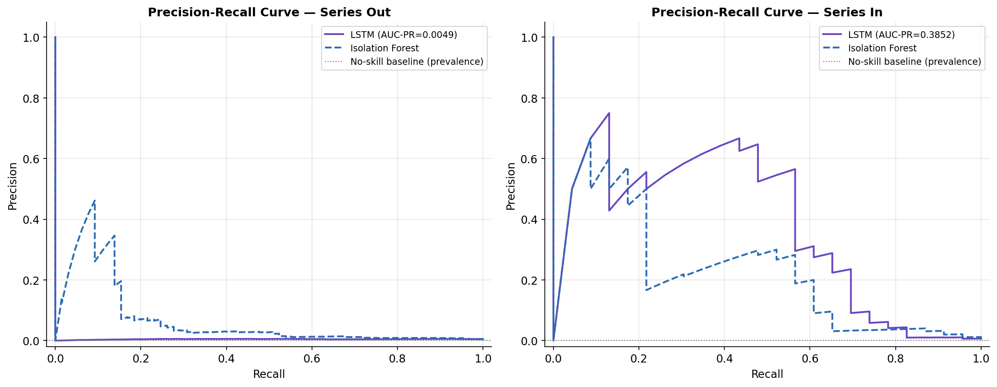
Core Result 2: Point-Wise Metrics & Trade-Offs
Topic 21 — Digital Twin Early Warning System
Operational Role Trade-Offs (D35 Data)
Isolation Forest — High-Recall Early Tripwire:
• Recall: 80.00% (Out), 91.30% (In)
• Trade-off: High False Positive Rate (45.59% Out, 26.98% In)
• Role: Aggressive frontline tripwire where missing a breach is fatal.
LSTM-Autoencoder — Precision-Favoring Verifier:
• On In series: 13.11% Precision, 2.85% FPR, 0.3852 AUC-PR
• Trade-off: Lower recall on Out series (20.00%, AUC-PR 0.0049)
• Role: Conservative secondary verifier to prevent false alarm fatigue.
Extreme Prevalence Context (~0.5% Anomaly Rate):
• True anomaly rows represent only 65/13,372 (0.48%) on Out and 23/3,767 (0.61%) on In.
• Under severe class imbalance, low absolute F1 scores are mathematically inevitable, not a defect.
• Primary Metric: Lead time runway (Δt_lead), not point-wise F1.
Managing Corporate Entrepreneurship (B.Tech 7th Sem) | Krishna Sikheriya (IIT2023139) | IIIT Allahabad
Notes:
When looking at point-wise metrics, we see a classic engineering trade-off: Isolation Forest acts as an aggressive tripwire with high recall over 80–90%, but at the cost of a higher false-alarm rate. In contrast, the LSTM is highly conservative on the In series with a 2.85% false-positive rate and higher precision. Neither detector universally dominates, showing why hybrid architectures are valuable.

Slide 9
Digital Twin Parity & Interactive Live Dashboard
Topic 21 — Digital Twin Early Warning System
Simulation Fidelity & Live/Batch Parity
100% Bit-for-Bit Verification: SimPy simulation replayed 97,603 readings in 6.03 s CPU time (>1.9M× real-time speedup) with exactly 0.00 s virtual clock drift.
Zero Discrepancy Across All Tests: Across 30 injections × 3 monitors, all 42 applicable test evaluations matched batch results bit-for-bit (0 mismatches).
Buffer Pre-Warming Proven: Pre-flight checks and automated tests (test_d33_prewarm.py) pass cleanly in 15.3 s, guaranteeing reliable cold-chain simulation without state lag.
Deployed Streamlit Cloud Application
Public URL: coldchain-ews-twin.streamlit.app
Dual Interaction Modes:
• Guided Tour: 4-step narrated demonstration designed for viva presentations.
• Free Explore: Interactive parameter tuning and inspection of all 30 injections.
Single Source of Truth: No hardcoded numbers in presentation layer (D34). Narrative text interpolates dynamically from verified evaluation CSVs.
Zero Code Duplication: Dashboard directly imports verified detection logic from src/twin_monitors.py.
Managing Corporate Entrepreneurship (B.Tech 7th Sem) | Krishna Sikheriya (IIT2023139) | IIIT Allahabad
Notes:
To prove that embedding these models in a simulation loop doesn't cause silent discrepancies, our automated cross-check report achieved a 100% exact match across all 42 applicable comparisons. Furthermore, the entire system is deployed live on Streamlit Cloud, featuring an interactive Guided Tour designed specifically for viva examination walkthroughs.

Slide 10
Conclusion & Corporate Entrepreneurship Relevance
Topic 21 — Digital Twin Early Warning System
Corporate Entrepreneurship & Technical Takeaways
1. Evidence-First Engineering & Risk Management: Honest reporting of real trade-offs: We openly documented where deep learning lagged on drift and where classical ML excelled, avoiding the common corporate trap of fabricating artificial 99% accuracy claims.
2. Disciplined Architecture & Auditability: Maintained an append-only Architectural Decision Log (35 formal entries D1–D35). This rigorous audit process caught 4 critical bugs (timestamp parse inversion, rolling leakage, cold starts) before they could compromise evaluation.
3. Technology Adoption Strategy: Demonstrated that classical ML (Isolation Forest) can outperform deep neural networks for edge streaming early warning (+64 min lead time), providing high ROI at low compute overhead.
4. Complete Deliverable Portfolio: 100% technically complete: Scaffolding, Models, Discrete-Event Twin, Automated Tests, Full 12-Chapter Report, and Live Web Dashboard.
Thank you for your time! | Open for Questions & Interactive Dashboard Demonstration
Managing Corporate Entrepreneurship (B.Tech 7th Sem) | Krishna Sikheriya (IIT2023139) | IIIT Allahabad
Notes:
To conclude: this project bridges machine learning, discrete-event digital twins, and disciplined corporate entrepreneurship. We did not cherry-pick our data or claim artificial perfection—we demonstrated exactly where classical ML provides real operational runway, where deep learning lags, and how an organization can rigorously evaluate technology under uncertainty. Thank you, and I look forward to your questions.

Slide 11
References & Benchmark Literature
Topic 21 — Digital Twin Early Warning System
Recent Cold-Chain Benchmarks (2023–2026)
1. Vukšić, M., Ćelić, J., Ogrizović, D., & Perić Hadžić, A. (2026). Early Anomaly Detection in Maritime Refrigerated Containers Using a Hybrid Digital Twin and Deep Learning Framework. Applied Sciences, 16(4), 1887.
2. Xie, Z., Long, H., Ling, C., Zhou, Y., & Luo, Y. (2025). An Anomaly Detection Scheme for Data Stream in Cold Chain Logistics. PLOS ONE, 20(3), e0315322.
3. Meng, X., Xie, R., Liao, J., Shen, X., & Yang, S. (2024). A Cost-Effective Over-Temperature Alarm System for Cold Chain Delivery. Journal of Food Engineering, 368, 111914.
4. Wu, W., Shen, L., Zhao, Z., Harish, A. R., Zhong, R. Y., & Huang, G. Q. (2023). Internet of Everything and Digital Twin Enabled Service Platform for Cold Chain Logistics. Journal of Industrial Information Integration, 33, 100443.
5. Defraeye, T., Shrivastava, C., Berry, T., Verboven, P., Onwude, D., Schudel, S., et al. (2023). Digital Twins of Food Cold Chains: Advances, Challenges, and Opportunities. Computers and Electronics in Agriculture, 214, 108252.
Foundational Algorithms & Project Assets
6. Liu, F. T., Ting, K. M., & Zhou, Z.-H. (2008). Isolation Forest. 2008 Eighth IEEE International Conference on Data Mining (ICDM), 413–422.
7. Malhotra, P., Ramakrishnan, A., Anand, G., Vig, L., Agarwal, P., & Shroff, G. (2016). LSTM-based Encoder-Decoder for Multi-sensor Anomaly Detection. ICML 2016 Anomaly Detection Workshop.
8. Anand Jha, A. (2018). Temperature Readings: IoT Devices Telemetry Dataset. Kaggle Datasets (Structural Proxy Dataset).
• Live Deployed Dashboard: https://coldchain-ews-twin.streamlit.app/
• Open-Source Code Repository: https://github.com/Krishna200608/coldchain-ews-twin
• Institution: Department of Information Technology, IIIT Allahabad
Managing Corporate Entrepreneurship (B.Tech 7th Sem) | Krishna Sikheriya (IIT2023139) | IIIT Allahabad
Notes:
Finally, our research is thoroughly grounded in contemporary peer-reviewed literature across food engineering, industrial digital twins, and machine learning. Here are the core benchmark references supporting our methodology and empirical findings. Thank you, and I am now happy to take any questions.

