Slide 1

DEPARTMENT OF COMPUTER SCIENCE AND ENGINEERING BIRLA INSTITUTE OF TECHNOLOGY, MESRA
Comprehensive Prediction of Obesity, Alcoholism, and Smoking using Machine Learning Techniques

Slide 2

Presentation Outline
Abstract
Introduction
Existing System
Proposed System
System Configuration
Methodology
Dataset Details
Algorithms Used
Accuracy Comparison of the models
Results
Outputs
Conclusion

Slide 3
Abstract:
The project focuses on the comprehensive classification of obesity levels, alcohol consumption, and smoking habits in a person utilizing machine learning techniques. I leverage demographic information, lifestyle behaviors, and health indicators to develop predictive models. Through the implementation of algorithms such as Gradient Boosting for obesity classification, Random Forest for alcoholism prediction, and Random Forest for smoking status, the aim is to provide accurate assessments. Challenges including data preprocessing and model selection are meticulously addressed to ensure robust and reliable predictions. The project concludes with insights into algorithm performance and avenues for future research to enhance precision in health behavior prediction and intervention strategies.

Slide 4

Introduction to the project:
The project aims to develop predictive models for estimating obesity level of person and classifying individuals as smokers or non-smokers and alcoholism based on relevant demographic and lifestyle factors.
By leveraging machine learning techniques, we seek to address the challenges associated with accurately predicting obesity level and identifying smoking behavior and alcoholism using available data.
This project encompasses various stages, including data preprocessing, feature selection, model training, and evaluation, with the ultimate goal of providing insights into healthcare obesity level estimation , smoking and alcoholism classification for improved decision-making and policy development.
Utilizing datasets encompassing variables such as age, gender, dietary habits, physical activity, and genetic predispositions, predictive models were developed using algorithms such as Gradient Boosting and Random Forest.

Slide 5
Existing System:
Traditional statistical techniques or simple machine learning models are frequently employed in the current obesity level prediction system to evaluate and forecast obesity levels based on lifestyle, health-related, and demographic data. Usually, these approaches entail modeling and data analysis methods like decision trees, logistic regression, or basic linear regression.
The existing system may suffer from the following disadvantages:
Limited Predictive Power: Traditional statistical techniques and basic machine learning models may fail to capture complex patterns and relationships in the data, resulting in suboptimal prediction performance.
Manual Data Analysis: Manual data analysis methods are labor-intensive, error-prone, and unsuitable for handling large datasets, hindering scalability and accuracy.
Lack of Integration: Existing systems often lack integration across prediction tasks, leading to fragmented approaches and inadequate insights into personal health profiles.
Scalability Issues: Conventional methods struggle with large and diverse datasets, causing scalability problems and performance bottlenecks.

Slide 6
Proposed System:
The proposed models predict the obesity level , Alcoholism ,and smoke consumption habits of a person using demographic information (age, gender), anthropometric measures (height, weight), lifestyle behaviors(physical activity, nutritional habits), smoking status, and alcohol consumption patterns.
The working of the system starts with the collection of data and selecting the important attributes. Then the required data is preprocessed into the required format. The data is then divided into two parts training and testing data. The algorithms are applied and the model is trained using the training data. The accuracy of the system is obtained by testing the system using the testing data.
Gradient Boosting and Random Forest machine learning classification Algorithms were used.

Slide 7
Advantages Of Proposed System:-
Improved Predictive Accuracy: By leveraging advanced machine learning algorithms and automated feature engineering techniques, the proposed system is expected to achieve higher predictive accuracy compared to traditional approaches.
Scalability and Flexibility: The modular architecture of the proposed system allows for scalability and adaptability . As new data becomes available or healthcare needs evolve, the system can easily accommodate updates and modifications, ensuring its relevance and effectiveness over time.
Comprehensive Health Assessment: The proposed system integrates multiple predictive models to offer a holistic assessment of individual health profiles.

Slide 8


Hardware Requirements
System Configuration:
Processor: Any updated processor
Ram: MIN 4GB
Hard Disk: MIN 100 GB.
Accessories: Monitor, Keyboard, Mouse
Software Requirements
Operating System: Windows 11
Browser: Chrome/Edge
Source-Code Editor: Jupyter Notebook
languages used: Python

Slide 9
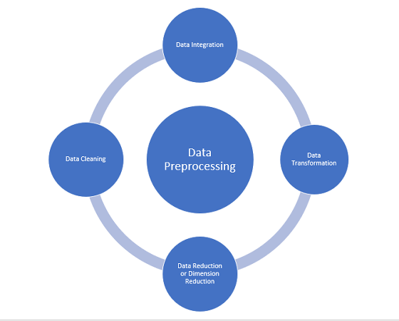
Methodology
Data Pre-Processing:
Data preprocessing is a crucial step in the machine learning that involves transforming raw data into a suitable format for training and building predictive models. It helps to improve the quality and reliability of the data and enhances the performance and accuracy of the machine learning algorithms. Data preprocessing typically includes the following steps:
Data Cleaning:
Handle missing values: Identify and deal with missing data points, either by imputation (filling in missing values) or removing the corresponding rows or columns.
Remove duplicates: Check for and remove duplicate records in the dataset, as they can lead to biased model training.
Data Transformation:
Feature Scaling: Scale numerical features to a common range (e.g., normalization or standardization) to prevent features with larger magnitudes from dominating the model training process.
Encoding Categorical Variables: Convert categorical features into numerical representations (e.g., one-hot encoding or label encoding) that machine learning algorithms can process.

Slide 10
Continued…
Data Reduction:
Dimensionality Reduction: Use techniques like Principal Component Analysis (PCA) or t-distributed Stochastic Neighbor Embedding (t-SNE) to reduce the number of features while retaining the most critical information.
Feature Selection: Select the most relevant features that contribute significantly to the prediction task, thereby simplifying the model and reducing computation time.
Data Splitting:
Divide the dataset into training and testing subsets to evaluate the model's performance accurately. The training set is used for model training and the testing set for final evaluation.
Data Visualization: Data visualization in machine learning involves the use of graphs, charts, and other visual representations to gain insights, explore patterns, and communicate findings in the dataset. It plays a vital role in understanding the data's characteristics, identifying relationships between variables, and making informed decisions during the model-building process. Here are some key aspects of data visualization in machine learning:

Slide 11
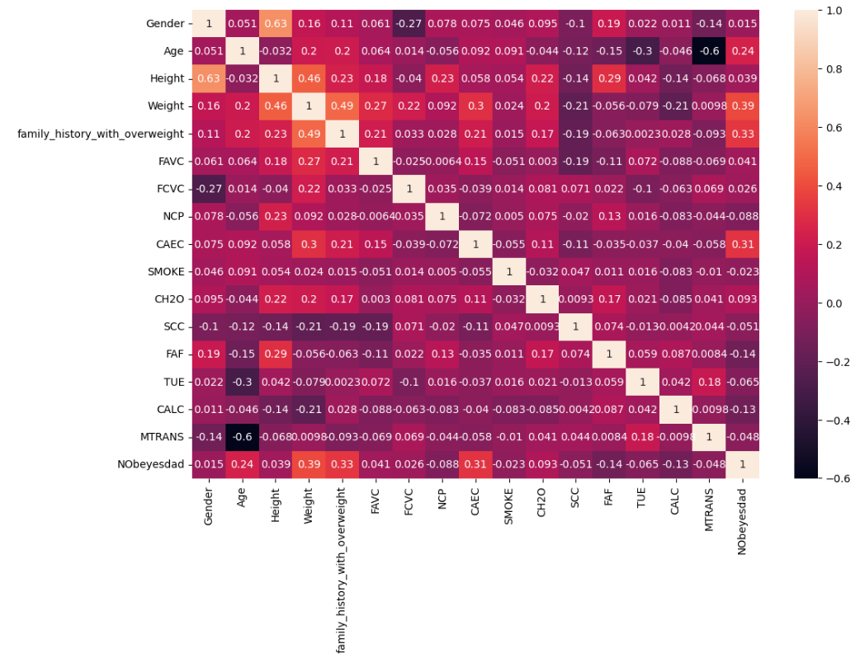
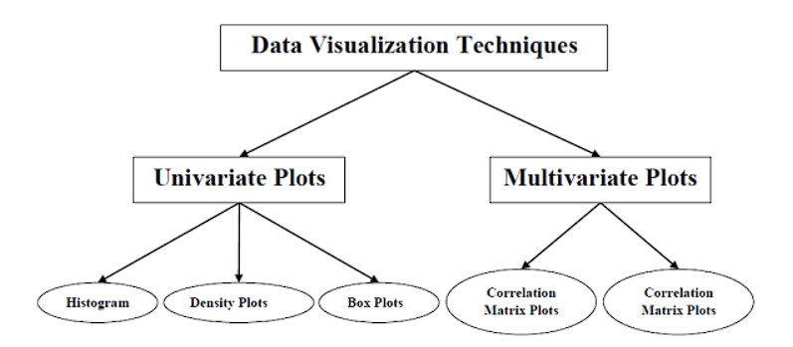
Continued…
Correlation Heatmap

Slide 12
Continued…
Cross Validation: Cross-validation is a resampling technique used in machine learning to evaluate the performance of a model and assess its generalization ability on unseen data. It helps to overcome issues like overfitting or underfitting by providing a more reliable estimate of the model's performance. Cross-validation involves splitting the dataset into multiple subsets, training the model on different combinations of these subsets, and then evaluating its performance on the remaining data.
The process includes :
Data Splitting:
The original dataset is divided into "k" equally-sized or nearly equally-sized folds (subsets).
Training and Validation:
The model is trained k(we are taking k as 2) times, each time using different combinations of "k-1" folds as the training data and the remaining fold as the validation (test) data.
For example, in 5-fold cross-validation, the dataset is divided into 5 subsets. The model is trained 5 times, each time using 4 folds for training and 1 fold for validation.
Performance Evaluation:
The performance metrics (e.g., accuracy, precision, recall, F1-score, R2 score) are computed for each fold, providing an average performance metric across all "k" runs.
The average performance metric is a more reliable estimate of the model's performance compared to a single train-test split.

Slide 13
Dataset Details
Source of Data:
The dataset was accessed via theUCI Machine learning repository https://archive.ics.uci.edu/dataset/544/estimation+of+obesity+levels+based+on+eating+habits+and+physical+condition website and downloaded to the local machine for additional analysis as part of the data gathering process.
I have conducted a survey through survey form to collect dataset similar to the dataset that is being used in the main project to check whether the model is providing accurate outputs or not. It has same fields as that of original dataset
Dataset Format:
The dataset is provided in a CSV (Comma Separated Values) format, commonly used for storing tabular data.
Number of Records:
The dataset contains a total of 2758 records.
Features:
The dataset consists of the following features:
Gender, Age, Height, Weight, family_history_with_overweight, FAVC, FCVC, NCP, CAEC, SMOKE, CH2O, SCC, FAF, TUE, CALC, MTRANS, NObeyesdad
5.Data Quality:
The dataset has been preprocessed to handle missing values, outliers, and inconsistencies to ensure data quality.

Slide 14
Dataset Details
6.Data Exploration:
Exploratory Data Analysis (EDA) techniques have been applied to gain insights into the distribution and relationships among the features.
7.Feature Encoding:
Categorical variables such as Gender,CAEC,MTRANS,SMOKE etc may have been encoded using techniques like one-hot encoding for further analysis.

Slide 15
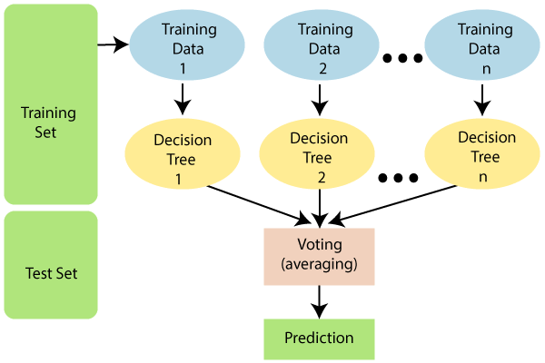
Algorithms Used:-
Random Forest:-
Random Forest is a powerful ensemble learning method widely used in machine learning for both classification and regression tasks.
It is an extension of the decision tree algorithm and operates by creating multiple decision trees during training and combining their predictions to improve accuracy and reduce overfitting.
Random Forest is known for its robustness, high accuracy, and ability to handle large and complex datasets.

Slide 16
Continued..
Random Forest Working:-
Bootstrapping:
Random Forest builds multiple decision trees using a process called bootstrapping or bagging. For each tree, a random subset of the original dataset is sampled with replacement to create a new training set of the same size as the original data.
Feature Randomness:
At each node of the decision tree, only a random subset of features (variables) is considered for splitting. This introduces additional randomness and diversity among the trees, reducing the risk of overfitting.
Tree Building:
Each decision tree in the Random Forest is built using the bootstrapped dataset and a subset of randomly selected features.
The decision trees grow until a stopping criterion is met, such as reaching a maximum depth or having a minimum number of samples per leaf.
Voting (Classification) or Averaging (Regression):
For classification tasks, the Random Forest combines the predictions of all the individual decision trees through majority voting to determine the final class label.
For regression tasks, the predictions of all trees are averaged to obtain the final output.

Slide 17
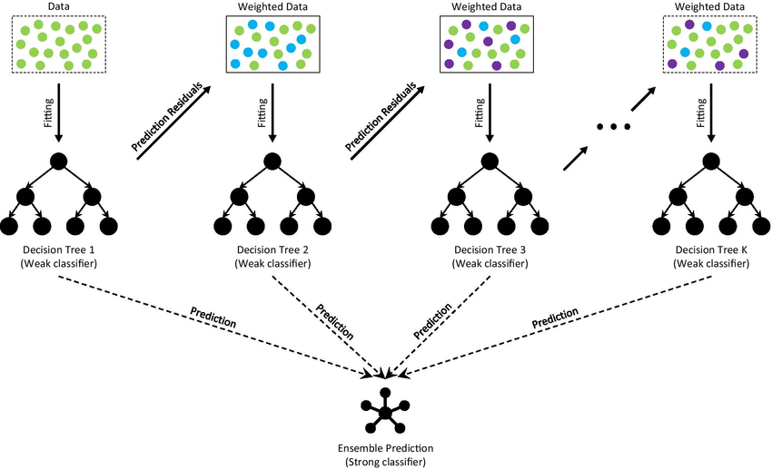
Gradient Boosting:-
Gradient Boosting is a powerful boosting algorithm that combines several weak learners into strong learners, in which each new model is trained to minimize the loss function such as mean squared error or cross-entropy of the previous model using gradient descent. In each iteration, the algorithm computes the gradient of the loss function with respect to the predictions of the current ensemble and then trains a new weak model to minimize this gradient. The predictions of the new model are then added to the ensemble, and the process is repeated until a stopping criterion is met.

Slide 18
Working of Gradient Boosting:
Initialization: Gradient Boosting starts with an initial model, often a simple one like a Decision Tree with a single node (also called a stump), which predicts the average target value for regression tasks or the most frequent class for classification tasks.
Sequential Training: In each subsequent iteration, a new model is added to the ensemble to correct the errors made by the existing ensemble. This is done by fitting a new model to the residuals (the differences between the actual and predicted values) of the previous models.
Gradient Descent: Gradient Boosting minimizes the loss function of the ensemble by iteratively updating the parameters of the new model in the direction that reduces the error (gradient descent).
Weighted Sum: The predictions from all the models in the ensemble are combined through a weighted sum to make the final prediction. Each model's contribution to the final prediction is determined by its performance on the training data and its weight.
Regularization: Gradient Boosting employs techniques like shrinkage (learning rate) and tree depth constraints to prevent overfitting and improve generalization performance.
Stopping Criterion: The training process continues until a predefined number of models (iterations) are added to the ensemble or until a stopping criterion, such as reaching a minimum loss threshold, is met

Slide 19
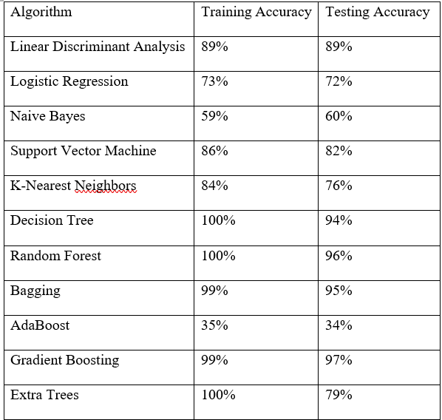
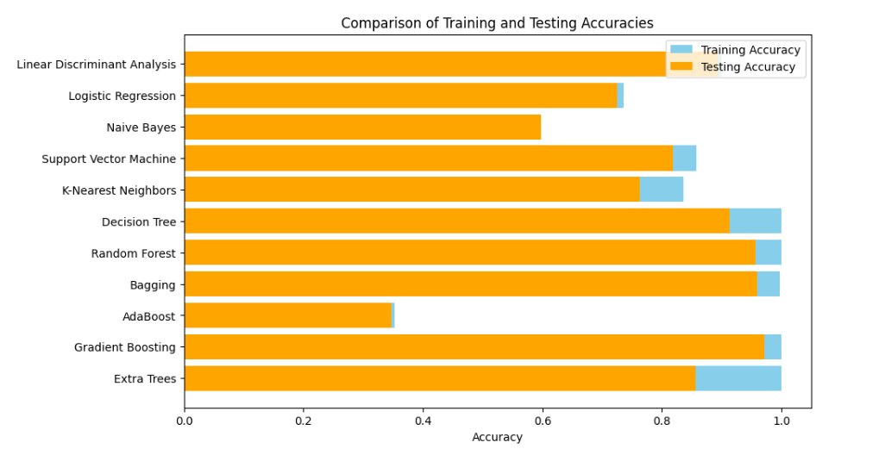
Accuracy Comparison Of the models
For Model 1(The Obesity Level Prediction Model)

Slide 20
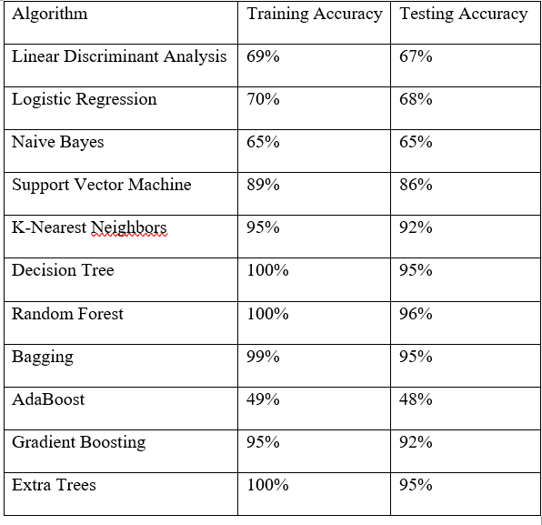
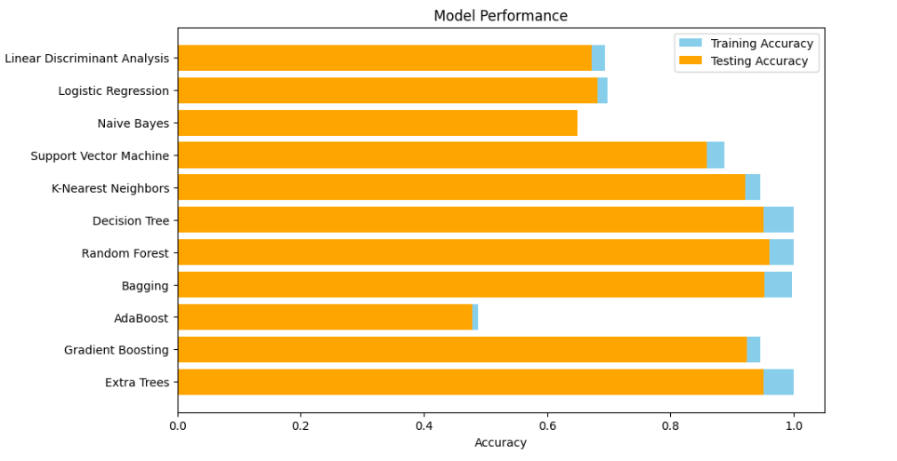
CONTINUED….
For Model 2(The Alcoholism Prediction Model)

Slide 21
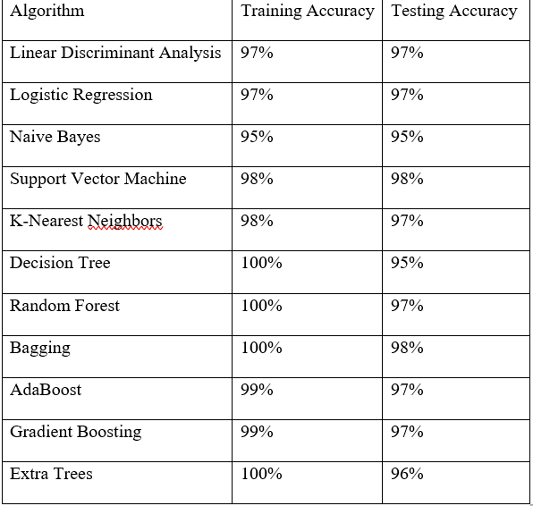
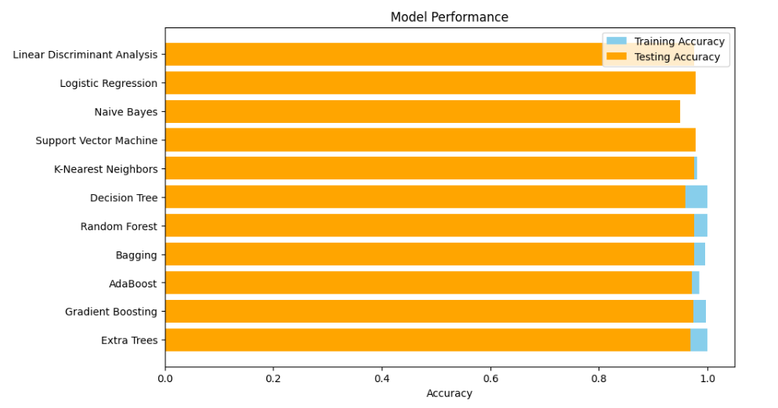
CONTINUED….
For Model 3 (The Smoking status Prediction Model)

Slide 22
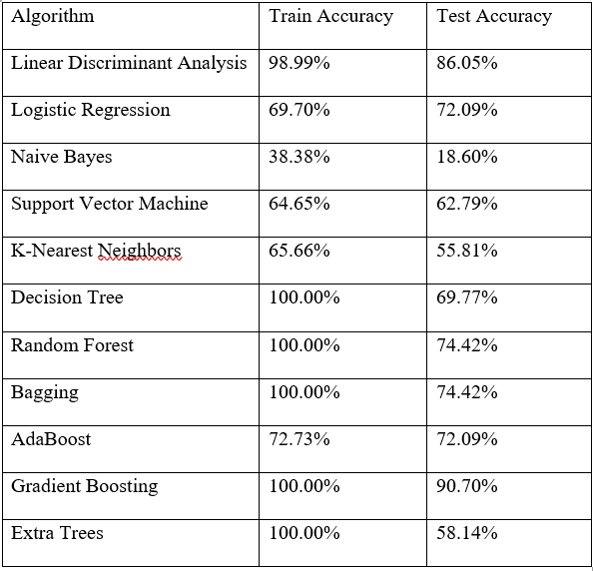
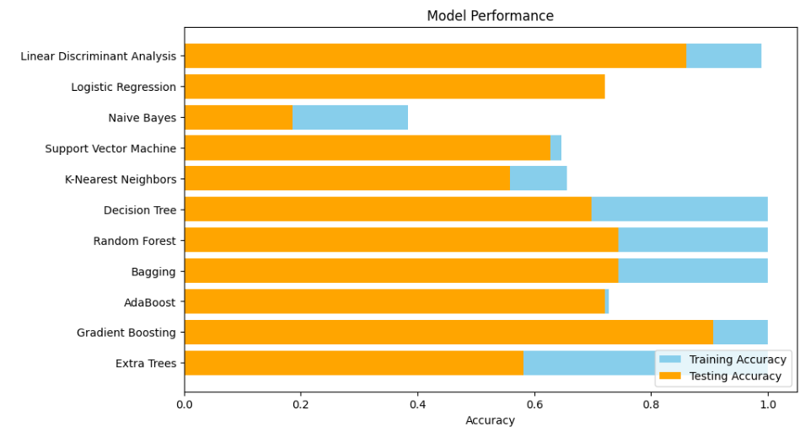
CONTINUED….
For Model with live data (The Obesity Level Prediction Model)

Slide 23
Results:
Model 1 - Obesity Level Prediction:
The best-performing algorithm for predicting obesity levels is the Gradient Boosting Algorithm, achieving a training accuracy of approximately 99% and a testing accuracy of 96%.
Model 2 - Alcoholism Prediction:
The Random Forest Classifier emerged as the most effective algorithm for predicting alcoholism, attaining a remarkable accuracy of 100% on the training data and 96% on the testing data.
Model 3 - Smoking Status Prediction:
The Random Forest Classifier proved to be the optimal choice for predicting smoking status, delivering outstanding results with a training accuracy of 100% and a testing accuracy of 97%.

Slide 24
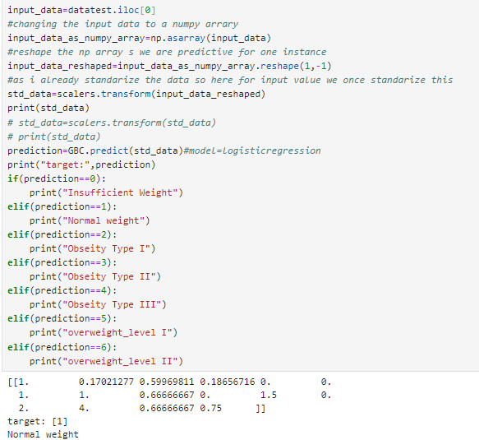
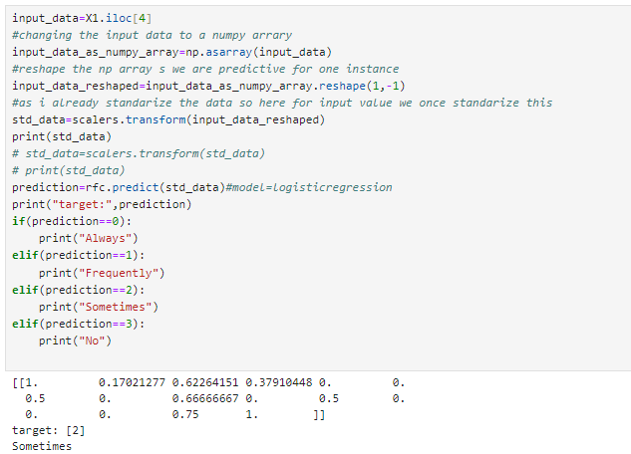
Outputs:
Model no .2 :-The Alcoholism Prediction Model
Model no 1 :- The Obesity Level Prediction Model

Slide 25
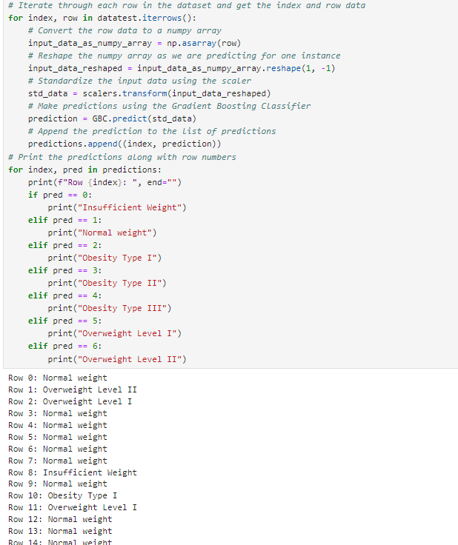
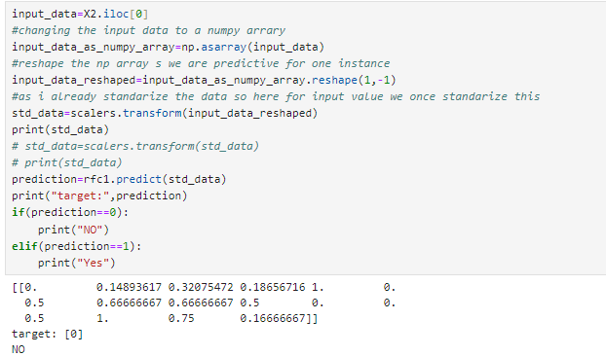
Outputs:
Model no. 3:- The Smoking status Prediction Model
Model no .2 :-The Alcoholism Prediction Model
Output of model number 1 obesity level prediction model against live data collected through survey

Slide 26

Conclusion
In this project, we utilized machine learning algorithms to predict obesity levels, alcoholism, and smoking status based on various demographic and lifestyle factors. The results demonstrate the effectiveness of machine learning in accurately classifying health-related outcomes.
Gradient Boosting emerged as the top-performing algorithm for obesity level prediction, showcasing robust accuracy on both training and testing datasets.
This highlights Gradient Boosting's ability to capture intricate relationships among features and classify individuals into different obesity categories accurately.
The Random Forest Classifier demonstrated superior performance in predicting alcoholism, achieving high accuracy on both training and testing data.
Similarly, the Random Forest Classifier was effective in predicting smoking status, showcasing strong accuracy metrics on both datasets.
These findings suggest that machine learning algorithms can effectively leverage demographic and lifestyle factors for accurate classification.

Slide 27
Thank you!

