Slide 1


Credit Card Fraud Detection Using Machine Learning
Name
Roll no :
Branch :
Guide :

Slide 2

Introduction
Importance of Fraud Detection:
Undetected credit card fraud can lead to significant financial losses for individuals and institutions.
Maintaining user trust in electronic payment systems relies on robust fraud detection mechanisms.
Overview of the Project:
Credit card fraud is a growing concern in the era of digital transactions.
This project focuses on advancing credit card fraud detection through a machine learning approach.

Slide 3

Purpose of the Presentation:
Introduce and discuss key aspects of the credit card fraud detection project.
Highlight the critical role of machine learning in addressing the evolving challenges of fraud detection.

Slide 4
Problem Statement
Key Statistics or Facts:
Every year, billions of dollars are lost to credit card fraud globally.
The frequency and complexity of fraud incidents continue to rise.
Overview of Credit Card Fraud Challenges:
Credit card fraud is a pervasive issue affecting individuals and financial institutions globally.
The digital age has introduced new challenges and sophisticated techniques employed by fraudsters.

Slide 5
Objectives
Specific Goals of the Project:
Develop an advanced credit card fraud detection model using machine learning techniques.
Enhance the accuracy and efficiency of fraud detection to minimize financial losses for individuals and institutions.

Slide 6
Literature Surveys
1.) “Intelligent Fraud Detection in Financial Statements Using Machine Learning and Data Mining: A Systematic Literature Review" by Matin N. Ashtiani and Bijan Raahemi(2022)
Abstract
This survey paper categorizes, compares, and summarizes publications on automated fraud detection within the last ten years. It outlines the professional fraudster, the types and subtypes of known fraud, and the nature of data evidence collected within affected industries. The paper discusses methods and techniques for fraud detection and presents their challenges, highlighting the uniqueness of this survey in covering a broad range of technical articles and proposing alternative data and solutions from related domains.
Methodology
Data Collection and Analysis
Literature Review: The methodology involved an extensive review of academic and industrial research articles on data mining-based fraud detection. This review helped categorize and compare different techniques and methodologies used in the field.
Comparison and Categorization: Various fraud detection techniques and articles were categorized and compared based on their approaches, data used, and effectiveness.
Discussion of Challenges: The paper discusses the main challenges in the field, such as the lack of publicly available real data and the scarcity of well-researched, effective techniques.
Algorithms and Techniques Used
Machine Learning and Data Mining Techniques: The survey covers a wide array of techniques including neural networks, decision trees, support vector machines (SVMs), Bayesian networks, fuzzy logic systems, and genetic algorithms among others.
Hybrid Approaches: It mentions the use of hybrid systems combining multiple algorithms to enhance detection capabilities.
Application of Techniques: The application of these techniques spans various industries and fraud types, utilizing both supervised and unsupervised learning approaches.
Conclusion
The paper concludes that despite significant advancements in fraud detection methods, the field faces ongoing challenges, notably in data availability and methodological robustness. It suggests that leveraging techniques from related fields such as bio-terrorism detection, financial crime analysis, and intrusion detection could be beneficial. The survey advocates for future research to explore unsupervised and semi-supervised methods that could potentially improve the adaptability and effectiveness of fraud detection systems.

Slide 7
Literature Survey continued….
2.) “Credit Card Fraud Detection Using State-of-the-Art Machine Learning and Deep Learning Algorithms" by Fawaz Khaled Alarfaj et al”(2022)
Abstract
The paper investigates the efficacy of various state-of-the-art machine learning (ML) and deep learning (DL) algorithms in detecting credit card fraud. It aims to improve detection accuracy and reduce false alarms by utilizing advanced deep learning techniques on a benchmark European credit card transaction dataset. The study emphasizes overcoming challenges such as class imbalance, evolving fraud techniques, and high rates of false positives inherent in existing models.
Methodology
Data Preparation and Processing
Dataset: The research used the European card benchmark dataset, which comprises credit card transactions with a small proportion of fraudulent transactions, labeled for supervised learning.
Feature Engineering: Key features were selected and engineered to improve the model’s predictive power, using techniques like principal component analysis (PCA) to reduce dimensionality while preserving essential information.
Algorithms and Techniques Used
Initial ML Algorithms: The study first applied traditional machine learning algorithms like Random Forest, Decision Trees, and Logistic Regression to establish a baseline performance.
Advanced DL Models: Later, the focus shifted to more sophisticated deep learning architectures:
Convolutional Neural Networks (CNNs): Multiple architectures were experimented with, adjusting layers, epochs, and hidden units to optimize performance.
Ensemble Techniques: Combined different models to enhance prediction accuracy and reduce the likelihood of overfitting.
Performance Evaluation: Various metrics such as accuracy, precision, recall, F1-score, and AUC were calculated to evaluate and compare the performance of each model.
Conclusion
The study concluded that deep learning models, particularly those involving convolutional neural networks with tailored architectures, significantly outperformed traditional machine learning approaches in detecting credit card fraud. The DL models were better able to handle the class imbalance and capture complex patterns indicative of fraudulent transactions. The paper suggests further exploration of deep learning techniques, particularly those involving more dynamic and adaptive learning processes, to continue improving fraud detection systems.

Slide 8
Literature Survey continued….
3.) “Bibliometric Analysis of Recent Trends in Machine Learning for Online Credit Card Fraud Detection by Dickson Hove*, Oludayo Olugbara, Alveen Singh”(2024)
Abstract
The study conducts a bibliometric analysis to examine the intellectual structure of knowledge in machine learning (ML), deep learning (DL), and ensemble learning (EL) models used for detecting online credit card fraud (OCCF). Utilizing data from 524 publications between 2013 and 2022 extracted from the SCOPUS database, the paper explores the growth and trends in this research domain, highlighting the impact and collaboration patterns across different regions and authors.
Methodology
Data Collection and Analysis
Database and Tools: The research utilized the SCOPUS database and employed tools like Microsoft Excel, VOSViewer, and Biblioshiny for data analysis and visualization.
Bibliometric Analysis: This involved several steps including data retrieval, preprocessing, normalization, mapping, analysis, and visualization to comprehensively understand the publication trends, citation patterns, and collaboration networks in the OCCF detection domain.
Search Strategy: A specific keyword search strategy was designed to gather publications related to ML, DL, and EL in OCCF detection. The inclusion criteria focused on scholarly articles, reviews, and conference proceedings in English.
Algorithms and Techniques Used
Machine Learning Techniques: Including supervised and unsupervised learning approaches with specific mention of logistic regression (LR), support vector machines (SVM), and various data mining techniques for detecting fraudulent transactions.
Deep Learning Models: Employing advanced architectures like convolutional neural networks (CNNs), recurrent neural networks (RNNs), adversarial neural networks, and deep autoencoders, focusing on their application to OCCF detection.
Ensemble Learning: Highlighting the use of bagging, stacking, and boosting methods to combine multiple ML algorithms to enhance detection capabilities and handle large, complex datasets effectively.
Conclusion
The study concludes that there has been significant growth in the number of publications related to ML, DL, and EL for OCCF detection over the past decade. Ensemble learning models, in particular, are identified as a trending area due to their effectiveness in improving performance over individual models. The analysis also emphasizes the need for continued research in this area to address ongoing challenges in fraud detection and suggests that future efforts should focus on innovative approaches that integrate multiple learning models for better accuracy and robustness.

Slide 9
Literature Survey continued….
4.) “A Comparative Study of Using Various Machine Learning and Deep Learning-Based Fraud Detection Models For Universal Health Coverage Schemes by Rohan Yashraj Gupta, Satya Sai Mudigonda , Pallav Kumar Baruah(2021)”
Abstract
This study evaluates various machine learning (ML) and deep learning (DL) models for detecting fraud in Universal Health Coverage schemes, specifically focusing on the Ayushman Bharat (PM-JAY India) program. The paper identifies key challenges in fraud detection such as data imbalance and the selection of appropriate classification models. The research tests a combination of data imbalance techniques and multiple classification models to determine the most effective approach for identifying fraudulent activities within healthcare systems.
Methodology
Data Source: Utilized data from Ayushman Bharat, India's largest health coverage scheme.
Imbalance Handling: Three different techniques were employed to manage data imbalance:
SMOTE (Synthetic Minority Over-sampling Technique), ADASYN (Adaptive Synthetic Sampling Approach), TGANs (Tabular Generative Adversarial Networks)
Model Testing and Evaluation
Classification Models: five classification models were used including: Decision Trees, Random Forest, XGBoost, LightGBM, Gradient Boosting Machines
Neural Network Models: Six variants of neural network models were also tested.
Performance Metrics: Models were evaluated based on accuracy, sensitivity, specificity, and F1-score.
Algorithms Used in Methodology
Tree-based Models: Decision Trees, Random Forest, XGBoost, LightGBM, and Gradient Boosting Machines.
Neural Networks: Variants of neural networks tailored to handle different aspects of the data and its inherent challenges.
Data Imbalance Techniques: SMOTE, ADASYN, and TGANs were used to create balanced datasets for model training to improve the detection of the less frequent fraudulent cases.
Conclusion
The research concludes that neural network models trained on undersampled data provided the best results among the tested models, particularly in terms of F1-score, which balances precision and recall. The study suggests that deep learning models have a significant potential to enhance fraud detection in healthcare systems when combined with effective techniques for handling data imbalance. Future work could explore the application of these models to other types of insurance data or adjust models to further optimize their performance.

Slide 10
Literature Survey continued….
5.) “Cyberattack and Fraud Detection Using Ensemble Stacking” by Raha Soleymanzadeh , Mustafa Aljasim, Muhammad Waseem Qadeer and Rasha Kashef (2022)
Abstract
This study proposes an ensemble stacking method to detect cyberattacks and fraud in IoT systems with high performance. The methodology leverages various machine learning models to improve detection accuracy over individual models. The research highlights the vulnerability of IoT devices to attacks due to increased interconnectivity and discusses the effectiveness of the stacked ensemble approach using three different datasets: credit card, NSL-KDD, and UNSW datasets.
Methodology
Data Collection and Preprocessing
Datasets Used: Credit card, NSL-KDD, and UNSW datasets, each representing different aspects of cyberattacks and fraud.
Preprocessing Steps: Included normalization and handling imbalanced data, especially in the fraud dataset where fraudulent instances were much less frequent than non-fraudulent ones.
Model Development
Ensemble Stacking: Implemented an ensemble stacking model that combines multiple base machine learning models with a meta-learner that integrates the predictions from the base models.
Base Models: Included a variety of machine learning algorithms such as K-Nearest Neighbors (KNNs), Decision Trees, Gaussian Naive Bayes, Support Vector Machines (SVMs), AdaBoost, Gradient Boosting, Random Forest, Extra Trees, Multi-Layer Perceptron (MLP), and XGBoost.
Meta-Learner: Employed different meta-learners and selected the best-performing one based on experimental results to finalize predictions.
Conclusion
The paper concludes that the stacked ensemble model outperforms the individual base models in detecting cyberattacks and fraud, particularly in IoT environments. The ensemble approach effectively harnesses the strengths of various algorithms, thereby improving the robustness and accuracy of fraud detection systems. The study suggests that future research should explore more sophisticated ensemble techniques and incorporate newer machine learning algorithms to continue enhancing the detection capabilities.

Slide 11
Literature Survey continued….
6.) “Transforming Fintech Fraud Detection with Advanced Artificial Intelligence Algorithms" by Philip Olaseni Shoetan and Babajide Tolulope Familoni(2024)
Abstract
The paper explores the transformative potential of advanced AI algorithms in enhancing fintech fraud detection mechanisms. With the rapid evolution and increasing complexity of financial transactions on fintech platforms, there is a growing need for more agile, accurate, and predictive fraud detection solutions. The study leverages cutting-edge AI techniques, including deep learning, machine learning, and natural language processing, to develop a robust framework capable of real-time fraud detection.
Methodology
Data Collection
Datasets: Extensive datasets of genuine and fraudulent financial transactions were used.
Comparative Analysis
AI Algorithms Deployment: Several AI algorithms were deployed and compared for effectiveness in detecting fraudulent transactions in terms of accuracy, efficiency, and scalability.
Algorithms Used
Deep Learning Models: Especially those employing neural networks, were found to be highly effective in detecting nuanced fraudulent activities.
Machine Learning Models: Traditional machine learning models were also used for basic pattern recognition and anomaly detection.
Natural Language Processing (NLP): Employed to analyze and extract information from unstructured data to aid in fraud detection.
Conclusion
The study concludes that advanced AI-based models significantly outperform traditional methods in fintech fraud detection. The AI algorithms provide a dynamic and predictive approach to fraud prevention, essential for the security of fintech platforms. The research contributes to both academic discourse and practical applications for fintech companies aiming to enhance their fraud detection capabilities.

Slide 12
Literature Survey continued….
7.) Advanced Fraud Detection in Blockchain Transactions: An Ensemble Learning and Explainable AI Approach by Shimal Sh. Taher, Siddeeq Y. Ameen, and Jihan A. Ahmed (2024)
Abstract
The study addresses the challenges of detecting fraudulent transactions in the realm of cryptocurrencies, specifically within the Ethereum network, by employing advanced machine learning techniques and ensemble methods. The research focuses on achieving high accuracy and precision in fraud detection and underscores the importance of explainable AI (XAI) to enhance transparency and accountability in AI-based systems.
Methodology
Data Collection and Preprocessing
Dataset: Utilizes transaction data from the Ethereum network.
Preprocessing: Includes normalization and handling of imbalanced datasets, employing techniques like SMOTE for balancing the data.
Algorithms and Techniques Used
Machine Learning Models: Multiple machine learning algorithms are evaluated, including:
Decision Trees
Random Forest
AdaBoost
Support Vector Machines (SVM)
K-Nearest Neighbors (KNN)
Ensemble Techniques: Uses ensemble methods such as Hard Voting and Soft Voting to combine the predictions of various models to improve accuracy and robustness.
Explainable AI (XAI): Implements techniques like LIME (Locally Interpretable Model-Agnostic Explanations) to provide insights into the decision-making processes of the models, enhancing the interpretability and trustworthiness of the predictions.
Conclusion
The research demonstrates that ensemble methods, coupled with advanced machine learning techniques, significantly enhance the capability to detect fraudulent transactions within the Ethereum network. The study also highlights the critical role of explainable AI in making the fraud detection process more transparent and understandable, thereby increasing trust in AI-driven systems.

Slide 13
Literature Survey continued….
8.) Credit Card Fraud Detection Using a New Hybrid Machine Learning Architectureby Esraa Faisal Malik, Khai Wah Khaw, Bahari Belaton, Wai Peng Wong, and XinYing Chew(2022)
Abstract
The paper focuses on addressing the significant impacts of financial crimes such as credit card fraud on financial institutions by proposing and testing seven hybrid machine learning models. These models use a real-world dataset to detect fraudulent activities. The study highlights the limitations of previous approaches and introduces new hybrid models aimed at enhancing fraud detection effectiveness.
Methodology
Data Collection
Dataset: Uses a real-world dataset containing credit card transactions, featuring a mix of numeric and categorical data.
Model Development
Phase One: Various state-of-the-art machine learning algorithms were initially used to detect fraud. These included linear regression (LR), support vector machine (SVM), Naïve Bayes (NB), random forest (RF), decision tree (DT), Light Gradient Boosting Machine (LGBM), eXtreme Gradient Boosting (XGBoost), and Adaptive Boosting (AdaBoost).
Phase Two: The best-performing algorithm from the first phase was used to develop hybrid models by combining it with other algorithms to form various hybrid combinations to test against the dataset.
Algorithms Used
Initial Algorithms: Linear regression, SVM, Naïve Bayes, random forest, decision tree, LGBM, XGBoost, AdaBoost.
Hybrid Models: Combinations of the best single algorithm with each of the others to explore the best hybrid configurations.
Conclusion
The research concludes that the hybrid models, particularly the combination of AdaBoost with LGBM, showed superior performance in detecting fraudulent transactions compared to single-algorithm models. The study demonstrates the potential of hybrid machine learning models in improving fraud detection accuracy in credit card transactions.

Slide 14
Literature Survey continued….
9.) Global Fraud Prevention Leveraging Artificial and Machine Learning Technologies" by G. Jaculine Priya and S. Saradha,(2023)
Abstract
The study investigates the application of artificial and machine learning technologies in global fraud prevention. It emphasizes the potential of these technologies to enhance the effectiveness and efficiency of detecting and preventing fraud across various sectors, particularly focusing on the financial industry.
Methodology
Data Collection
Data Sources: Utilized transactional data from multiple international financial institutions.
Model Development and Testing
Machine Learning Techniques: Various techniques were used to model and detect fraudulent activities.
Evaluation and Validation: Models were validated using cross-validation techniques to ensure their robustness and generalizability.
Algorithms and Techniques Used
Decision Trees: For their ability to provide clear decision paths and rules.
Neural Networks: Utilized for their deep learning capabilities in recognizing complex patterns.
Support Vector Machines (SVM): Chosen for their effectiveness in classification tasks involving high-dimensional spaces.
Ensemble Methods: Including Random Forests and Gradient Boosting, to improve prediction accuracy by combining the strengths of multiple learning algorithms.
Anomaly Detection Algorithms: Employed to identify outliers that could indicate fraudulent transactions.
Conclusion
The research concludes that integrating advanced machine learning and artificial intelligence technologies significantly improves fraud detection systems. The use of ensemble methods and anomaly detection algorithms, in particular, showed considerable promise in increasing the accuracy and speed of fraud detection in financial transactions.

Slide 15
Literature Survey continued….
10.) Credit Card Fraud Detection Framework – A Machine Learning Perspective" by Jasmin Parmar, Dr. Achyut C. Patel, and Dr. Mayur Savsani(2020)
Abstract
The study addresses the increase in credit card fraud linked to the growth of the E-Commerce industry, emphasizing the critical need for effective fraud detection mechanisms. Machine learning is utilized to enhance the detection of fraudulent transactions in credit cards by employing various machine learning methodologies.
Methodology
Data Preparation and Analysis
Data Source: The dataset used comprises 284,808 credit card transactions from an EU bank, sourced from Kaggle, with transactions labeled as fraud ("positive class") or genuine ("negative class").
Data Imbalance Handling: The dataset, which shows a significant imbalance with only about 0.172% fraud cases, necessitates particular attention to model training to avoid bias toward the majority class.
Machine Learning Models and Evaluation
Machine Learning Algorithms Used:
K-Nearest Neighbor (KNN)
Decision Trees
Support Vector Machine (SVM)
Logistic Regression
Random Forest
XGBoost
Model Training and Evaluation: Models were built and evaluated based on their accuracy and F1 score using confusion matrix outputs. The process involved feature selection, data splitting, and iterative model training with evaluation.
Conclusion
The study concludes that the use of machine learning models, particularly KNN and XGBoost, provides high accuracy and effectiveness in detecting fraudulent transactions. The models are assessed to ensure robustness against the challenge posed by the imbalanced dataset, with KNN showing the best performance based on accuracy and F1 score.

Slide 16

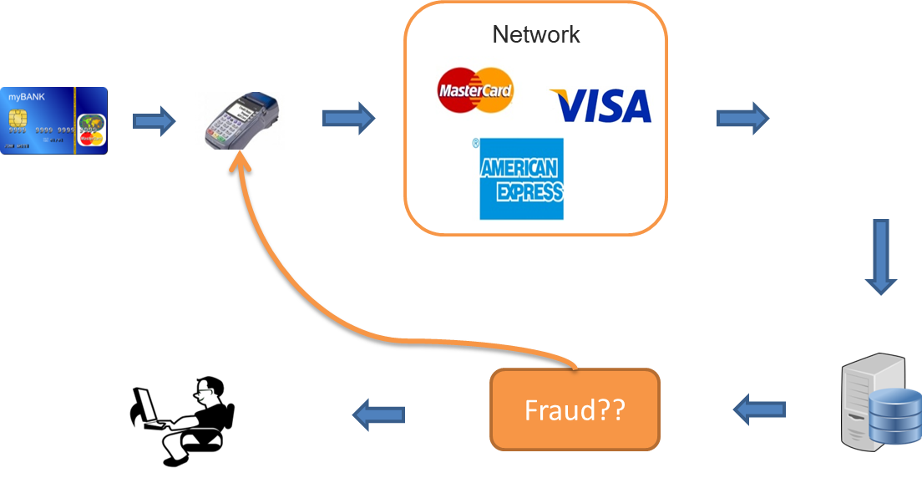

Slide 17
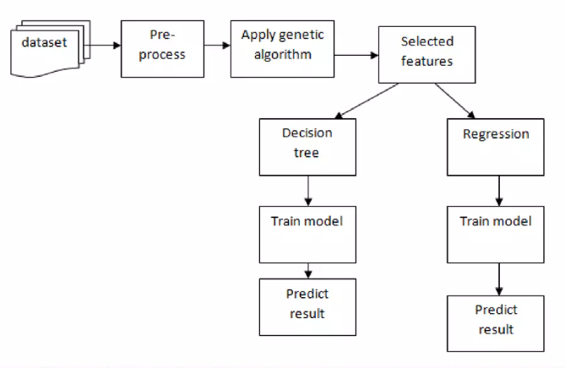
system architecture

Slide 18
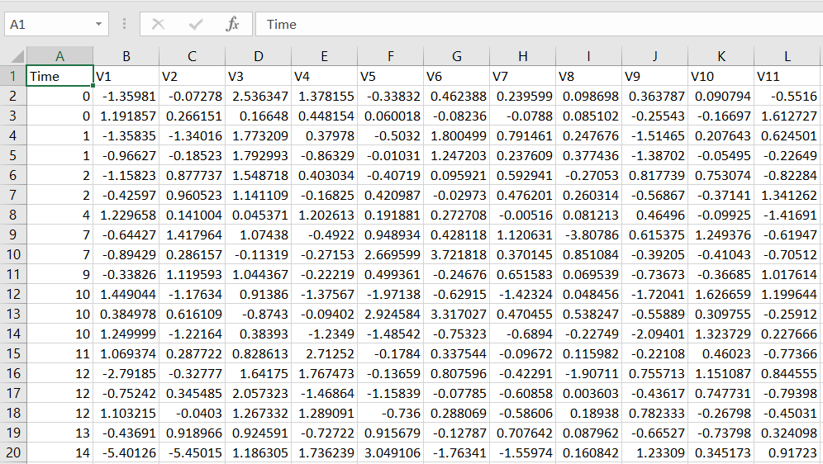
Methodology
Data Collection:
Identify diverse sources, such as financial institutions and online retailers.
Collect transaction data to build a comprehensive dataset.

Slide 19

Correlation Matrix

Slide 20
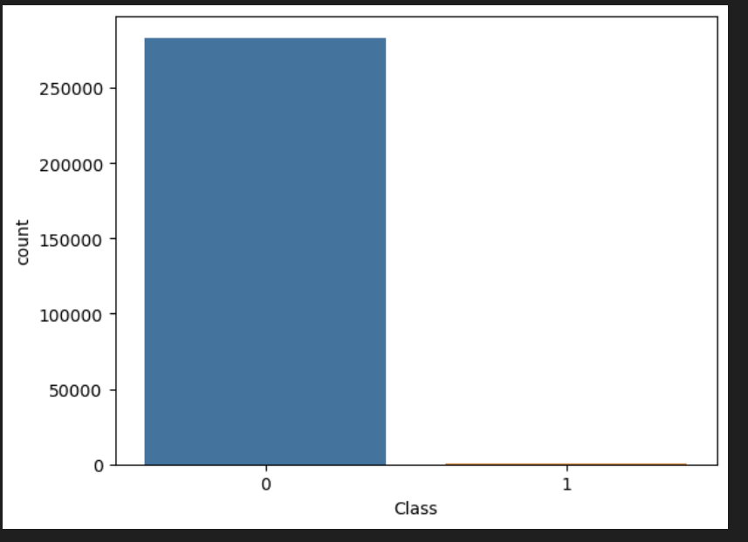
Unbalanced class of legal(0) and Fraudulant(1) transaction

Slide 21
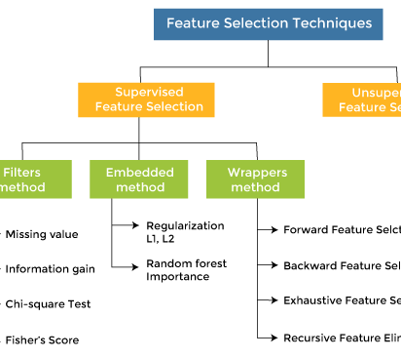
Feature Selection:
Choose relevant features like transaction amount, time, location, user history, and device information.
Rationale: Selected features aim to capture both legitimate and fraudulent transaction patterns.

Slide 22

Model Architecture:
Implement a [insert model type] machine learning model for credit card fraud detection.
Training Strategy: Divide the dataset, optimize hyperparameters, and ensure model convergence.

Slide 23
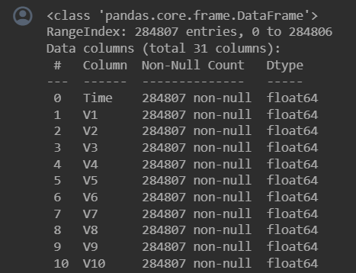
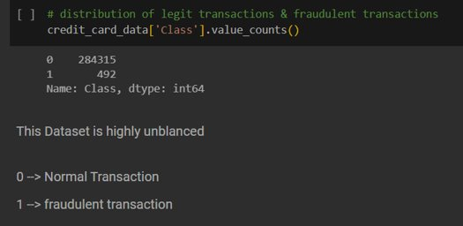
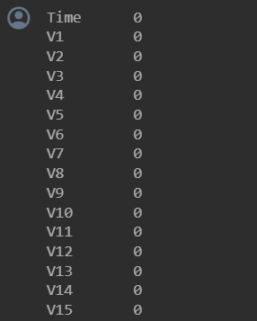


distribution of legit transactions & fraudulent transactions
dataset informations
checking the number of missing values in each column

Slide 24
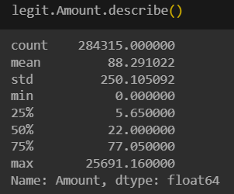
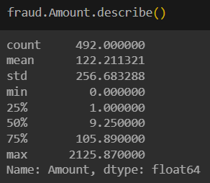
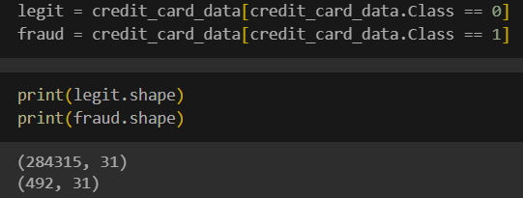

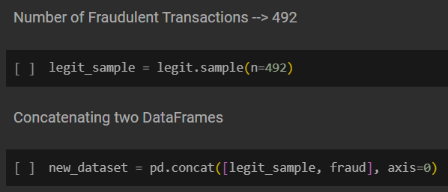
separating the data for analysis
statistical measures of the data
Splitting the data into Features & Targets
Under-Sampling​

Slide 25
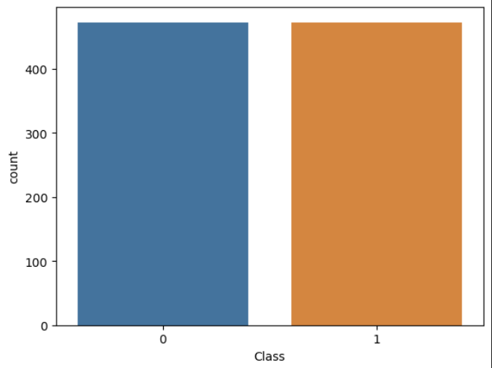
Balanced class of legal(0) and Fraudulant(1) transaction after undersampling

Slide 26
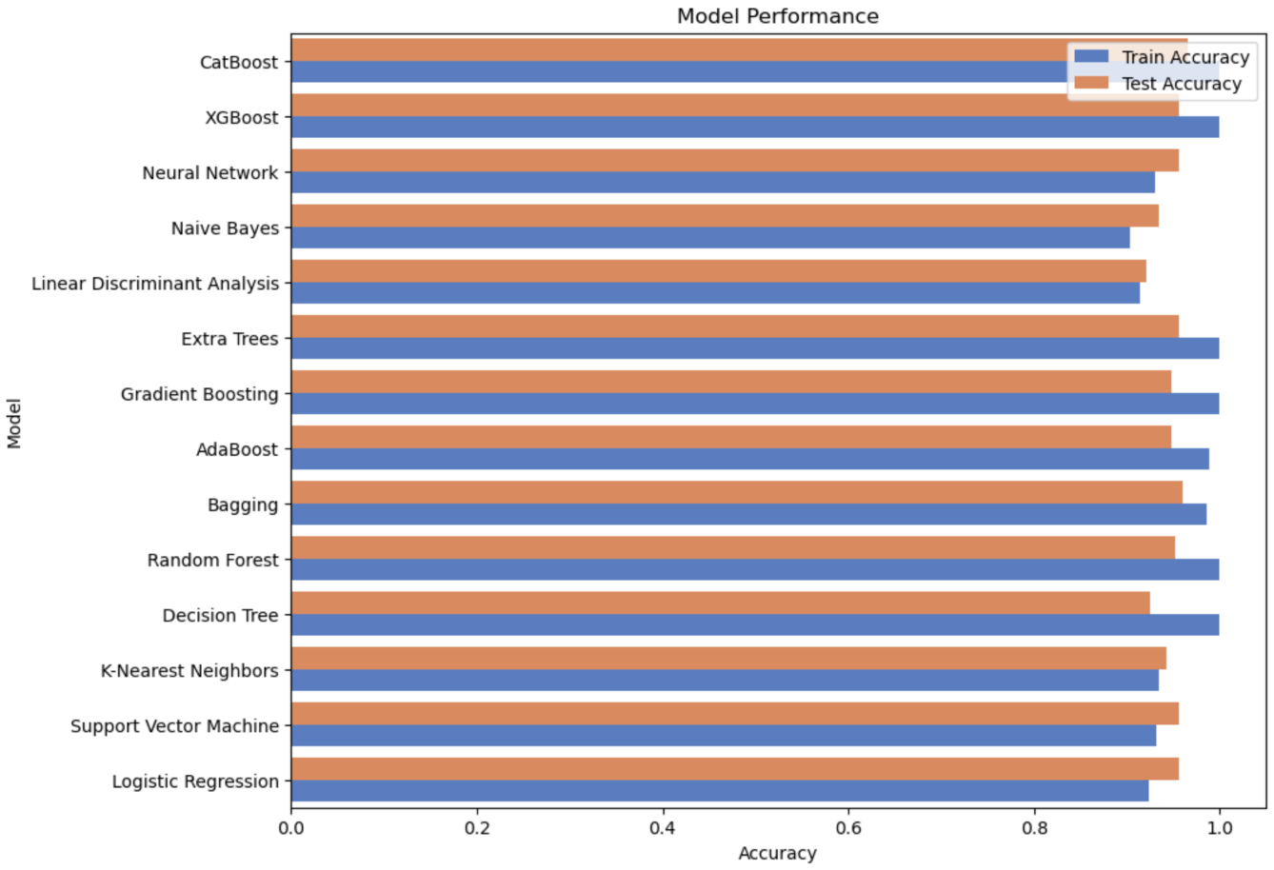
Comparison of Different machine learning algorithms
Algorithms Used | Logistic Regression | Support Vector Machine | K-nearest Neighbors | Decision Tree | Random Forest | Bagging | AdaBoost | Gradient Boosting | Extra Trees | Linear Discriminant Analysis | Naïve Bayes | Neural Network | XGBoost | CatBoost
Training Accuracy | 92% | 93% | 93% | 100% | 100% | 99% | 98% | 100% | 100% | 91% | 92% | 93% | 100% | 100%
Testing Accuracy | 95% | 95% | 95% | 93% | 95% | 96% | 94% | 94% | 94% | 92% | 93% | 95% | 95% | 96%

Slide 27
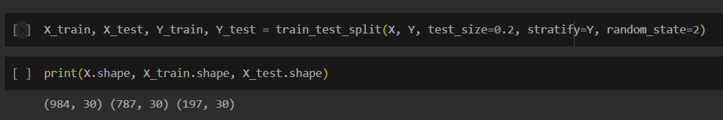
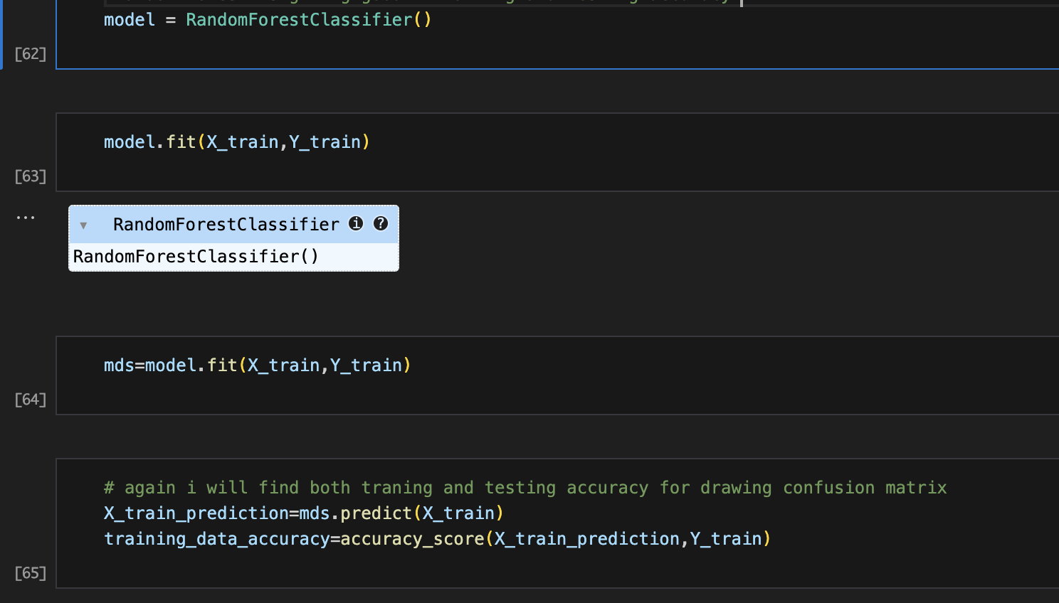
Split the data into Training data & Testing Data​
Model Training

Slide 28
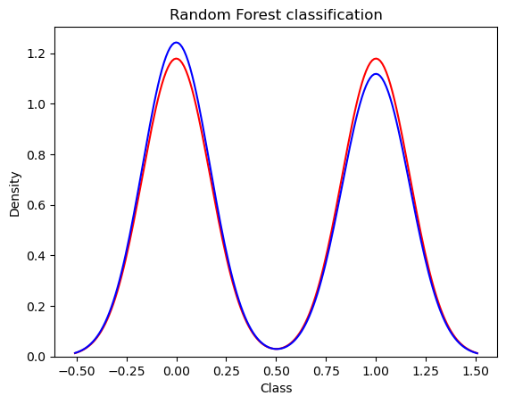
Graph Analysis

Slide 29
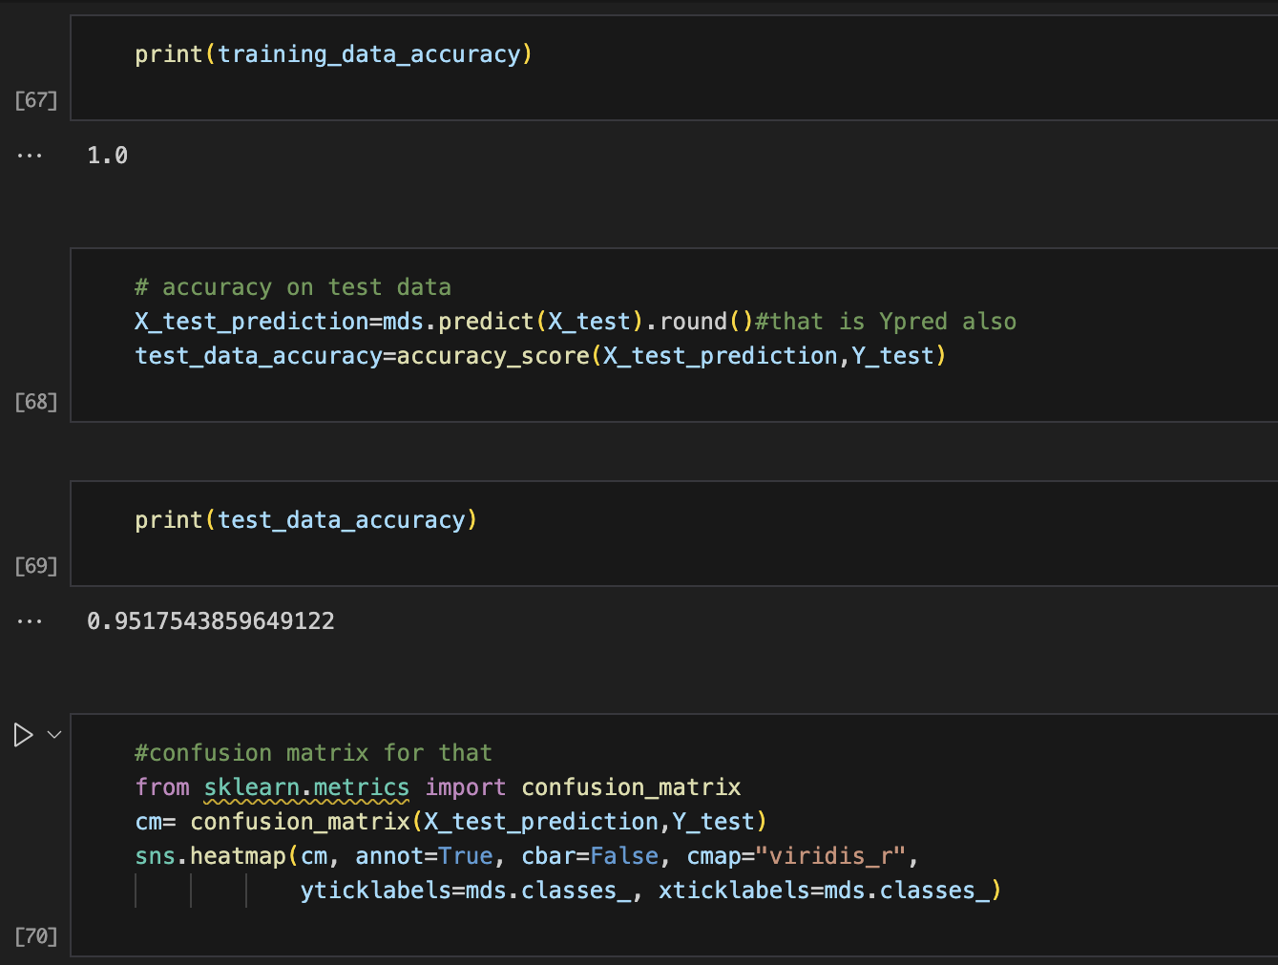
Results
accuracy on training data
accuracy on testing data

Slide 30
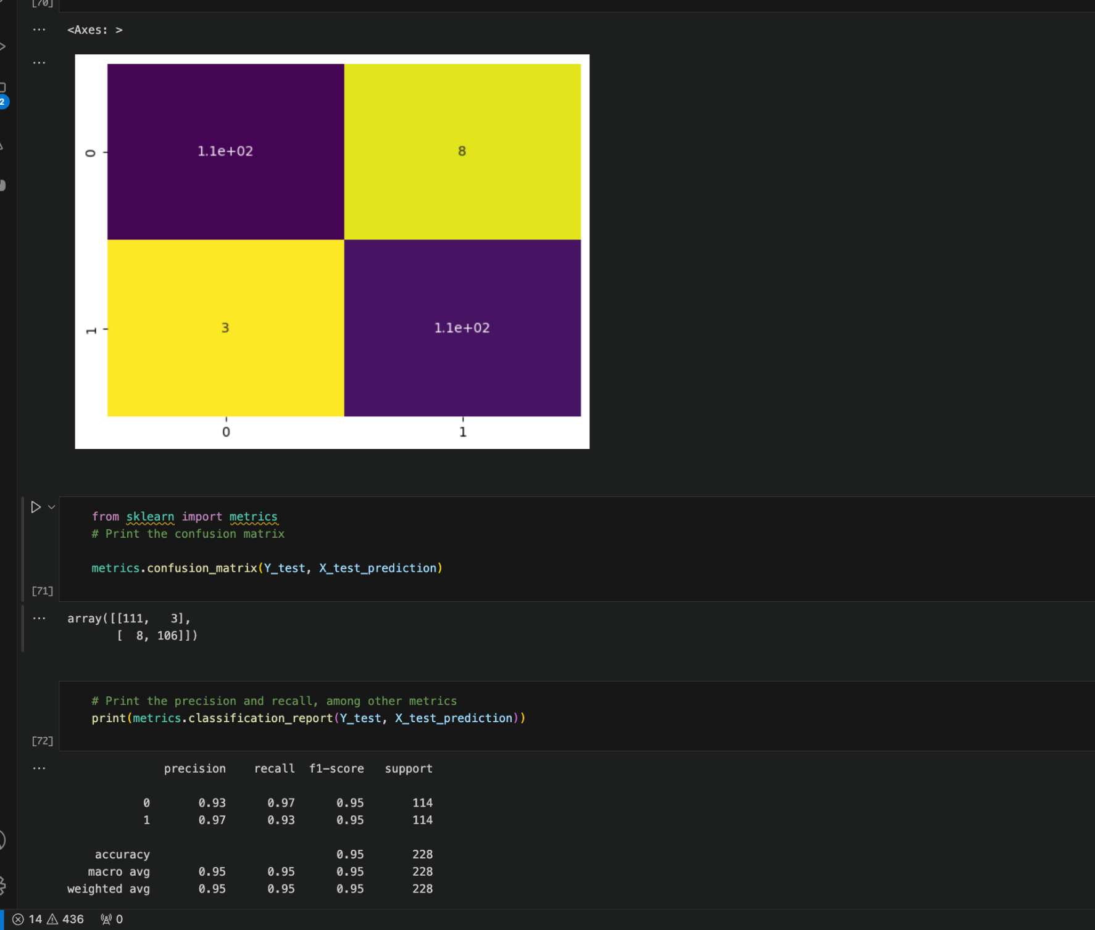
the precision and recall, among other metrics

Slide 31

Oversampling technique used to balance the classes of legal and fraudlant transaction

Slide 32
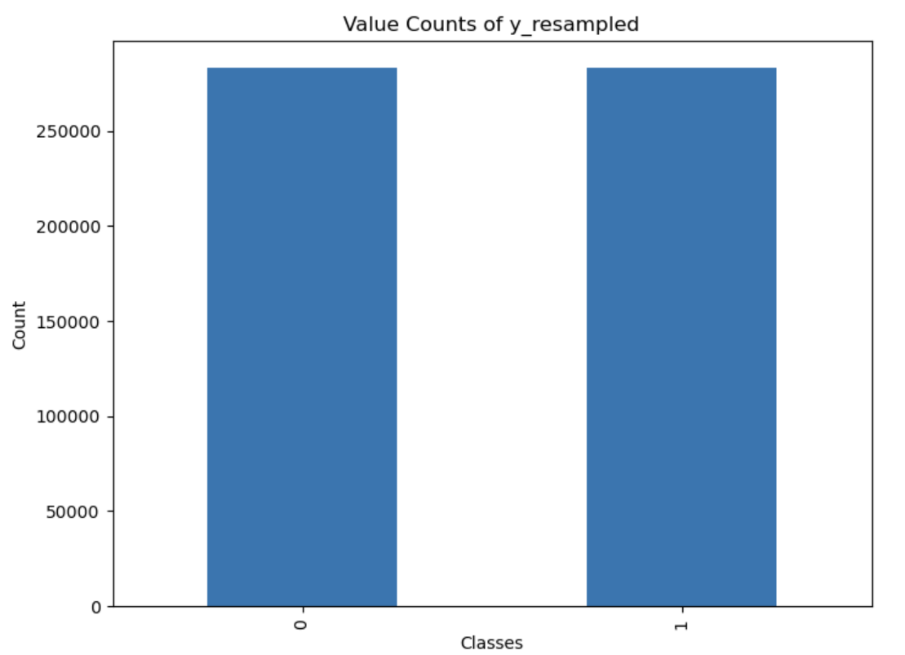
Balanced class of legal(0) and Fraudulant(1) transaction after Oversampling

Slide 33
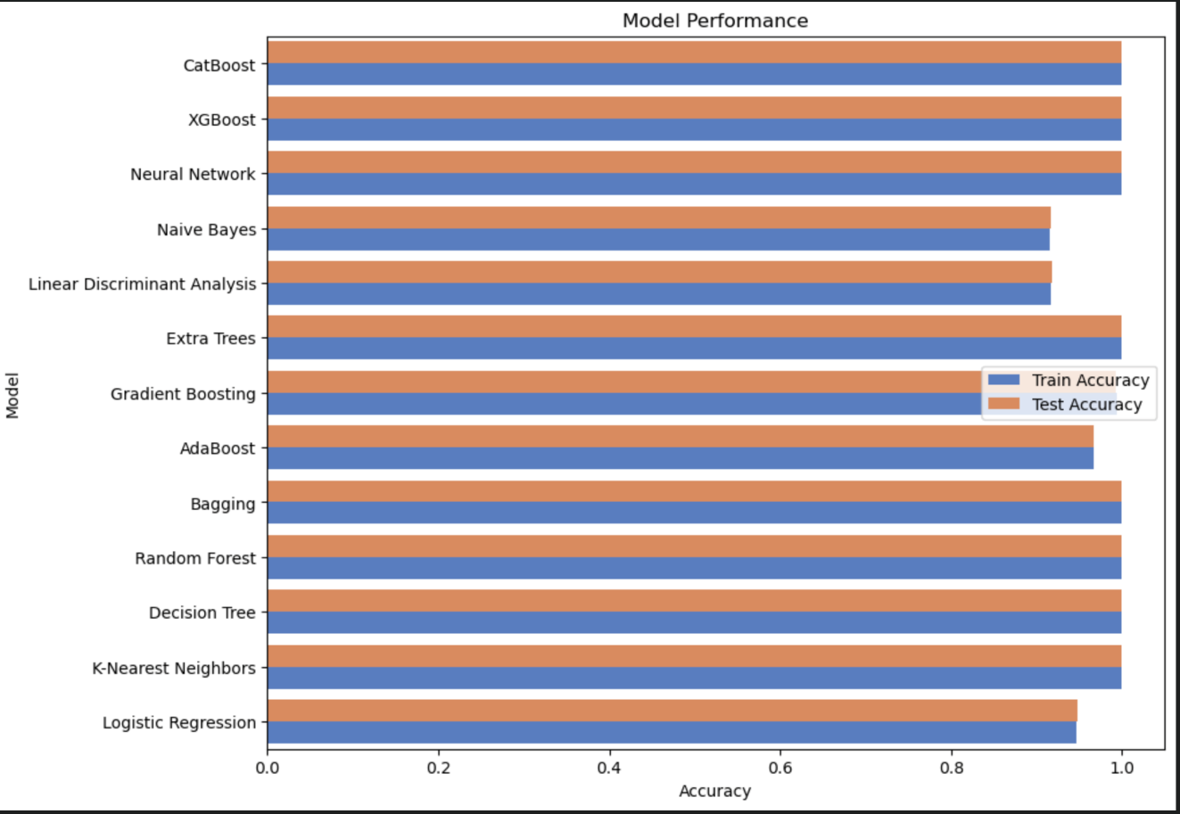
Comparison of Different machine learning algorithms after Oversampling
Algorithms Used | Logistic Regression | K-nearest Neighbors | Decision Tree | Random Forest | Bagging | AdaBoost | Gradient Boosting | Extra Trees | Linear Discriminant Analysis | Naïve Bayes | Neural Network | XGBoost | CatBoost
Training Accuracy | 94% | 99% | 100% | 100% | 100% | 96% | 99% | 100% | 91% | 91% | 100% | 100% | 99%
Testing Accuracy | 94% | 99% | 99% | 99% | 99% | 96% | 99% | 99% | 91% | 91% | 99% | 99% | 99%

Slide 34
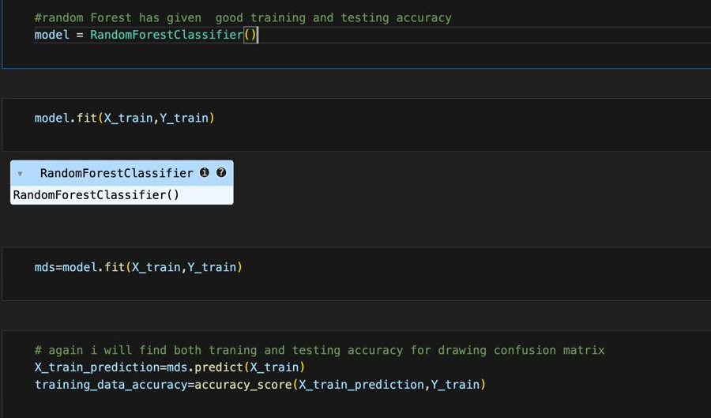
Split the data into Training data & Testing Data​
Model Training

Slide 35
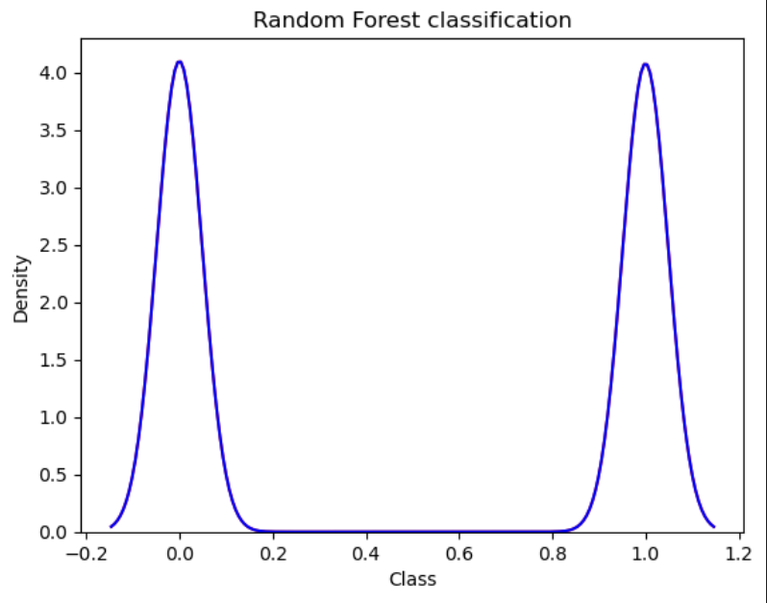
Graph Analysis after Oversampling

Slide 36
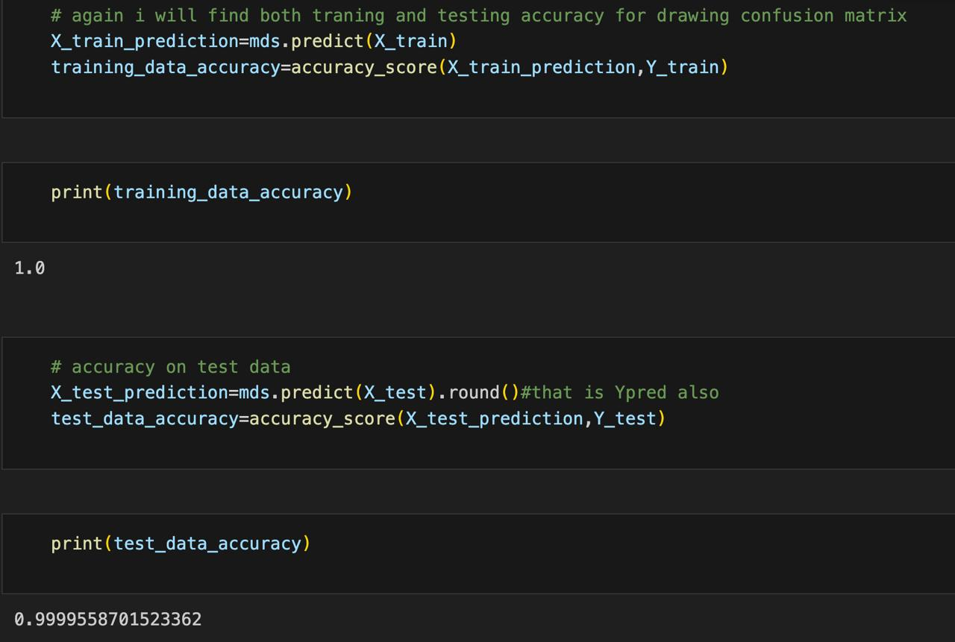
Results
accuracy on training data
accuracy on testing data

Slide 37
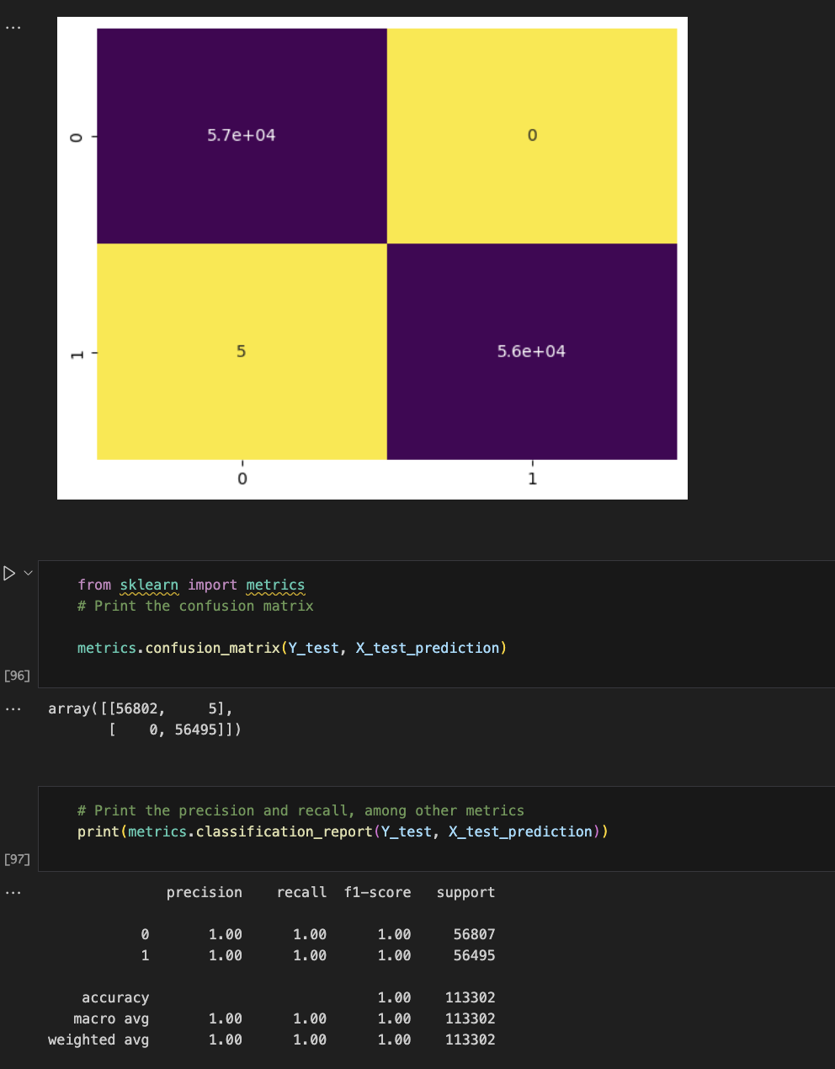
the precision and recall, among other metrics after oversampling

Slide 38
Comparison of results on Random Forest Algorithm upon undersampled and oversampled data
Random Forest Algorithm Used | Undersampled data | Oversampled data
Training Accuracy | 100% | 100%
Testing Accuracy | 95% | 99%
Training accuracy remains the same for both undersampled and oversampled data but testing accuracy is more in oversampled data

Slide 39
Future Work
Recommendations for Future Research:
Exploring Advanced Techniques:
Investigate more advanced machine learning or deep learning techniques to further enhance the model's accuracy and robustness.
Dynamic Adaptation:
Research dynamic adaptation mechanisms to allow the model to evolve and adapt to emerging fraud patterns.
Real-Time Implementation:
Explore the feasibility and benefits of implementing the credit card fraud detection model in real-time processing systems.

Slide 40

Thank You

