Slide 1

Summer Training (MC300) report on “Data Science & Machine Learning internship”
Prediction of Agriculture Crop Production in India using Machine Learning
Birla Institute of Technology, Mesra, Patna campus
Submitted by:
Name: Krishna Kant
Roll: BTECH/15051/20
Branch: Computer Science & Engineering
Guide : Adnan Mahmood, Coordinator : Dr Ayan Kumar Das,
Associate Lecturer Assistant Professor

Slide 2
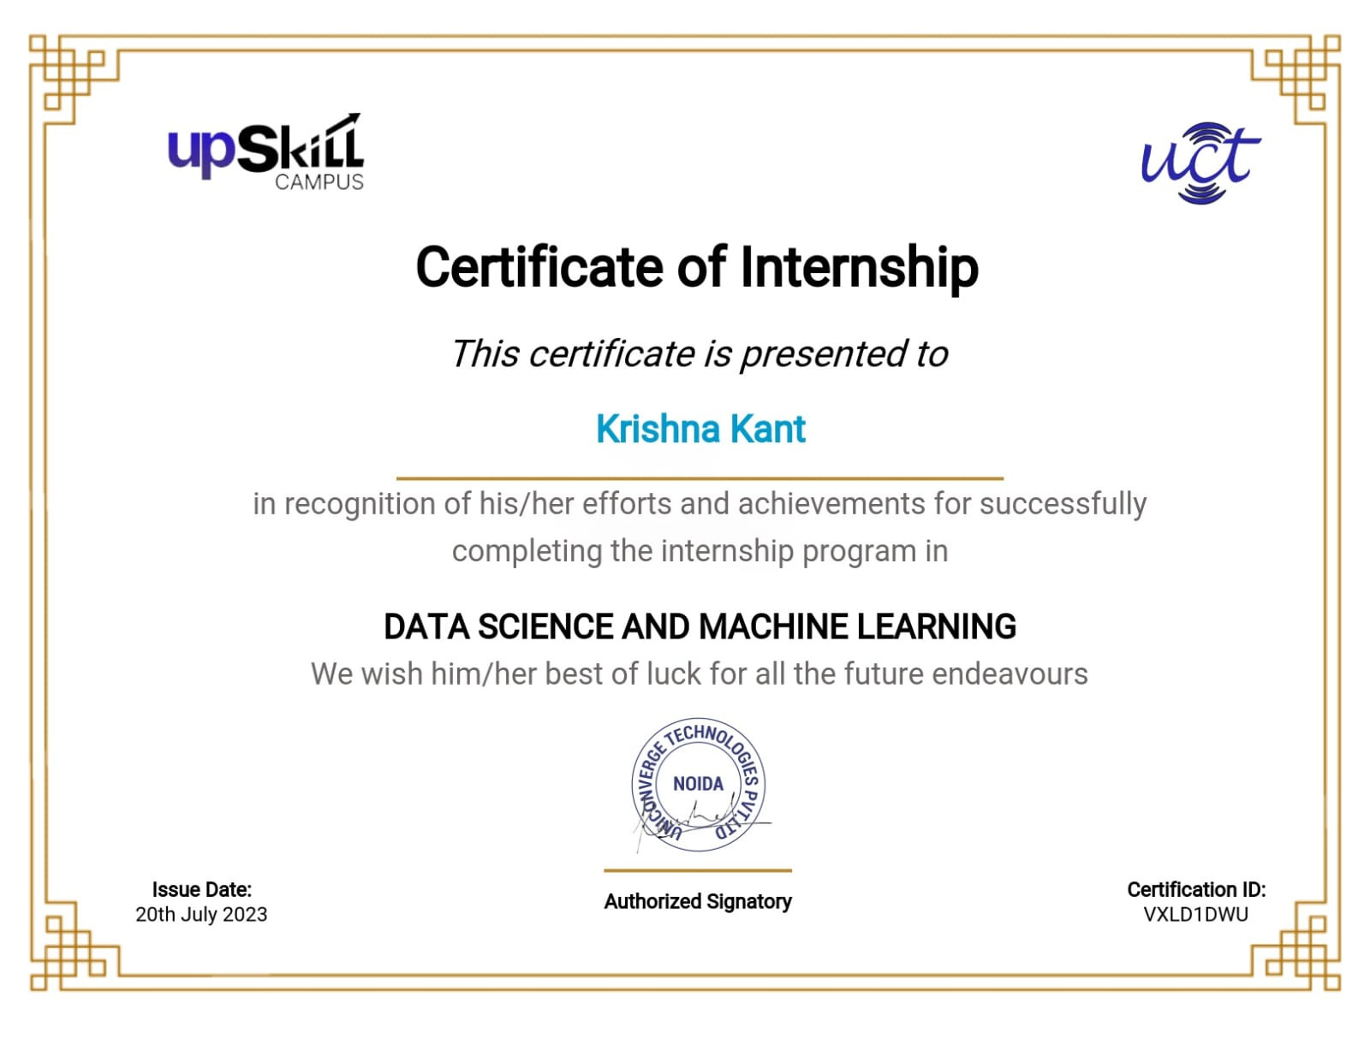

Internship Completion Certificate

Slide 3
Index
Abstract
Introduction
Existing System
Disadvantages of existing system
Proposed System
Advantages of Proposed System
System Configuration
System Architecture
Methodology
Algorithms used
Accuracy Comparison
Output
Conclusion
References

Slide 4
Abstract
This project aims to explore and implement the potential of machine learning techniques to revolutionize agricultural practices in the country. Agriculture plays a crucial role in India's economy, providing livelihoods to millions of people. However, farmers often face challenges such as weather uncertainties, pest attacks, and market unpredictability, which significantly impact crop production and yield.
This project harnesses the power of data and artificial intelligence to predict crop outcomes with greater accuracy, enabling farmers to make informed decisions, and optimized resource utilization.
Machine learning techniques play a crucial role in crop prediction. Various algorithms such as Decision Trees, Random Forests, Support Vector Machines (SVM), Naïve Bayes, Logistic Regression, KNN, AdaBoost, etc., are employed to create predictive models. These algorithms analyze crop yield data, weather patterns, soil health indicators and other relevant agricultural data sources to develop robust machine learning models.
The methods involved in this project are Exploratory Data Analysis(Data Preprocessing and Data Visualization), Cross-Validation, MinMax Scaling, Standardization, Training and Testing and finally the prediction.
The results of this project include the prediction of crop yield and the suitable crop for cultivation based on attributes such as rainfall, temperature, pH value, soil’s NPK level and yield,state name,cost of cultivation,cost of production,etc.

Slide 5
Introduction
Agriculture forms the backbone of India's economy, providing employment to a significant portion of its population and ensuring food security for the nation. With a vast and diverse agricultural landscape, India faces the dual challenge of feeding a growing population while ensuring sustainable and efficient agricultural practices. However, unpredictable weather patterns, changing climatic conditions, and fluctuating market demands make crop planning and management a complex task for farmers.
In recent years, advancements in technology have opened up new avenues to tackle these challenges and optimize agricultural practices. One such promising approach is the utilization of machine learning techniques for predicting crop outcomes. By harnessing the power of data and artificial intelligence, we can revolutionize the way agriculture is practiced in India.
Ultimately, the objective of our project is to provide valuable insights into crop prediction and yield estimation, empowering farmers to make informed decisions and enhance their agricultural practices. By bridging the gap between technology and agriculture, we aspire to contribute to the growth, sustainability, and resilience of India's agricultural sector. Through our research and findings, we hope to play a part in shaping the future of agriculture, benefiting farmers and the nation as a whole.

Slide 6
Existing System
There is a huge diversity in season and rainfall in India, due to which farmers face much difficulty in crops production and management. They are not able to cultivate the right crop based on the weather conditions and soil conditions and moreover, they fail to produce the desired amount of yield without proper information.
Therefore, assessment of suitable crops to be cultivated is necessary.
Farmers or cultivators need proper assistant for crop cultivation and production.

Slide 7
Disadvantages of Existing System
Farmers may lack accurate information about suitable crops for their specific regions and environmental conditions. This can lead to suboptimal crop choices, resulting in reduced crop yields and economic losses.
Climate change and unpredictable weather patterns are becoming more prevalent. Without crop prediction, farmers may face increased vulnerability to extreme weather events, leading to crop failure and food insecurity.
Inaccurate crop planning can lead to excessive input expenses, affecting the overall profitability of farming operations. Farmers may spend more on inputs without corresponding increases in crop yields.
Inadequate crop planning may encourage the cultivation of water-intensive or environmentally harmful crops in regions unsuitable for such practices. This can lead to the depletion of natural resources and long-term ecological damage.
As agricultural conditions evolve, farmers need to adapt their practices accordingly. A predictive system helps them anticipate and adjust to changing circumstances, enhancing their resilience.

Slide 8
Proposed System
The proposed data-driven predictive system for crop selection in Indian agriculture holds the potential to transform traditional farming practices. By harnessing the power of advanced technologies and machine learning, this system aims to improve agricultural productivity, sustainability, and economic outcomes for farmers across India.
The proposed model predict the suitable crop based on state,cost of cultivation,cost of production,rainfall, temperature, pH value, soil’s NPK level and yield .
The second proposed model predict the yield based on the cost of cultivation , cost of production and state name.
The working of the system starts with the collection of data and selecting the important attributes. Then the required data is preprocessed into the required format. The data is then divided into two parts training and testing data. The algorithms are applied and the model is trained using the training data. The accuracy of the system is obtained by testing the system using the testing data.
Support Vector Machine and Decision Tree Algorithms are used.

Slide 9
Advantages of Proposed System
Improved Crop Selection: Farmers will receive data-driven crop recommendations tailored to their specific geographic location and soil conditions, leading to enhanced crop selection and improved yields.
Resilience to Climate Change: The predictive system will help farmers adapt to changing climate patterns by suggesting suitable crops that are more resilient to environmental fluctuations.
Data-Driven Decision-Making: Farmers will have access to valuable data-driven insights, empowering them to make informed decisions and adopt modern agricultural practices.
Market Planning and Profitability: By aligning crop selection with market demand, farmers can plan their agricultural activities better, leading to improved profitability.

Slide 10
System Configuration
Hardware requirements:
Processer : Any Updated Processer
Ram : Min 4GB
Hard Disk : Min 100GB
Software requirements:
Operating System : Macos family
Technology : Python3.7
IDE : Juptyer notebook

Slide 11
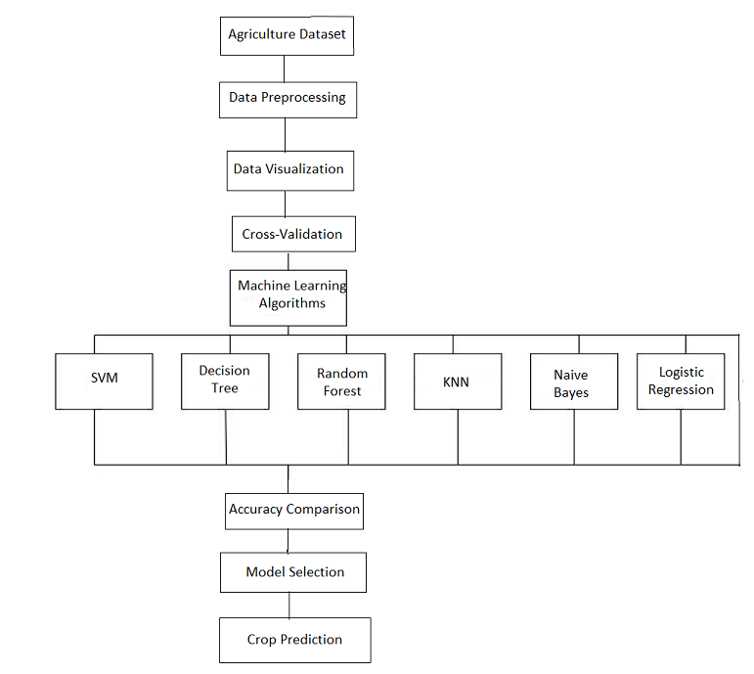
System Architecture

Slide 12
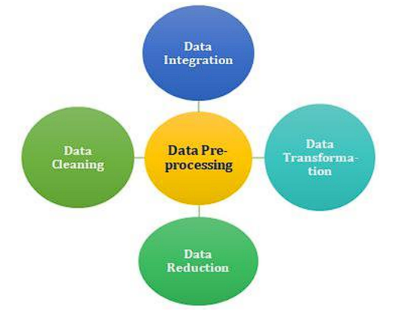
Methodology
Data Preprocessing

Slide 13
Continued..
Data preprocessing is a crucial step in the machine learning pipeline that involves transforming raw data into a suitable format for training and building predictive models. It helps to improve the quality and reliability of the data and enhances the performance and accuracy of the machine learning algorithms. Data preprocessing typically includes the following steps:
Data Cleaning:
Handle missing values: Identify and deal with missing data points, either by imputation (filling in missing values) or removing the corresponding rows or columns.
Remove duplicates: Check for and remove duplicate records in the dataset, as they can lead to biased model training.
Data Transformation:
Feature Scaling: Scale numerical features to a common range (e.g., normalization or standardization) to prevent features with larger magnitudes from dominating the model training process.
Encoding Categorical Variables: Convert categorical features into numerical representations (e.g., one-hot encoding or label encoding) that machine learning algorithms can process.

Slide 14
Continued..
Data Reduction:
Dimensionality Reduction: Use techniques like Principal Component Analysis (PCA) or t-distributed Stochastic Neighbor Embedding (t-SNE) to reduce the number of features while retaining the most critical information.
Feature Selection: Select the most relevant features that contribute significantly to the prediction task, thereby simplifying the model and reducing computation time.
Data Splitting:
Divide the dataset into training and testing subsets to evaluate the model's performance accurately. The training set is used for model training and the testing set for final evaluation.

Slide 15
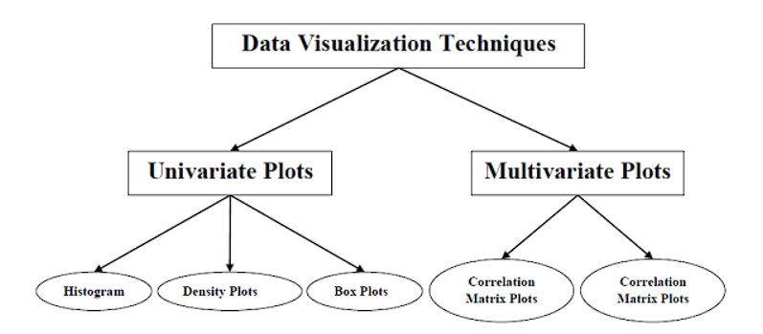
Continued..
Data Visualization

Slide 16
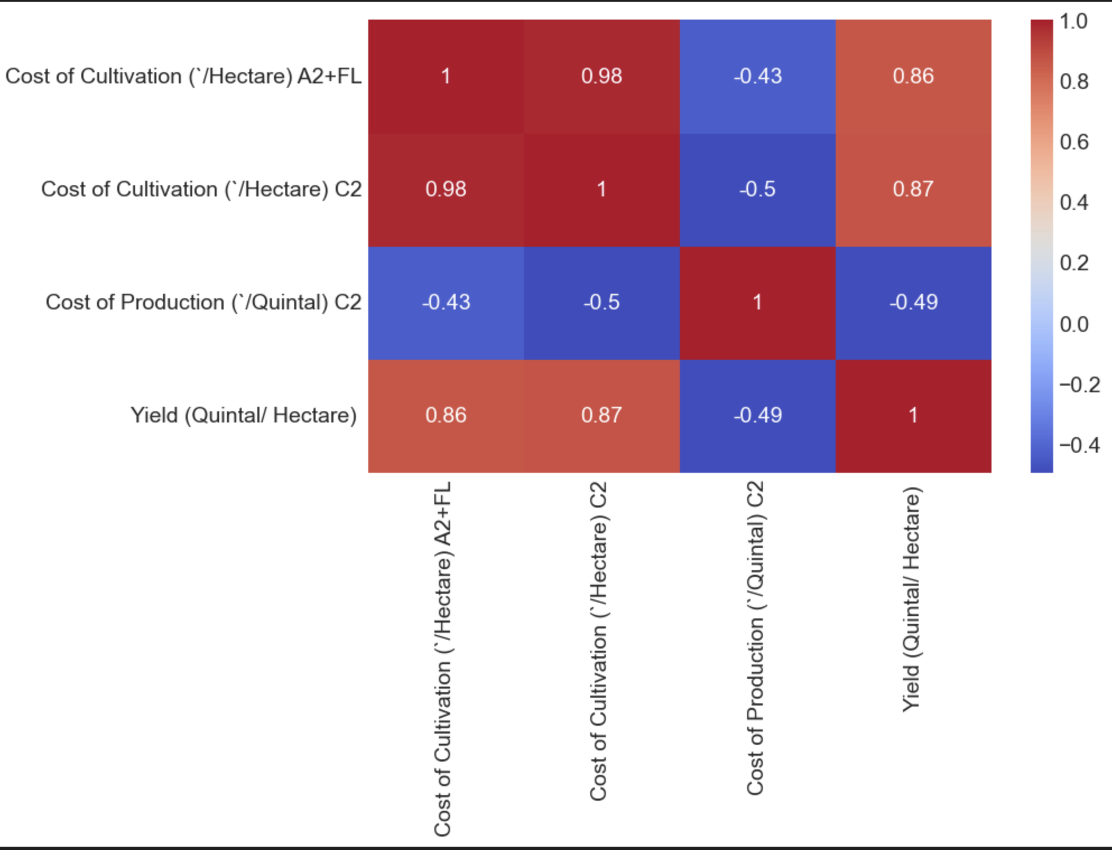
Continued..
Example of a heatmap(correlation matrix)

Slide 17
Continued..
Data visualization in machine learning involves the use of graphs, charts, and other visual representations to gain insights, explore patterns, and communicate findings in the dataset. It plays a vital role in understanding the data's characteristics, identifying relationships between variables, and making informed decisions during the model building process. Here are some key aspects of data visualization in machine learning:
Exploratory Data Analysis (EDA):
Data visualization is an essential step in EDA, which involves visually inspecting the dataset to understand its structure, distributions, and potential patterns.
Histograms, box plots, scatter plots, and density plots are common visualization tools used to examine the distribution and relationships between variables.
Feature Visualization:
Visualizing the features and their relationships can provide insights into which variables might be relevant for the machine learning model.
Correlation matrices or heatmaps can show the pairwise correlations between features, helping to identify highly correlated or redundant variables.

Slide 18
Continued..
Target Variable Analysis:
Visualizing the distribution of the target variable is crucial for understanding the problem's nature and identifying any class imbalances in classification tasks.
In regression tasks, scatter plots or regression lines can help visualize the relationship between the target variable and independent variables.
Model Performance Visualization:
After training the machine learning model, visualizations of model performance metrics (e.g., accuracy, precision, recall, F1-score, R2 score) can aid in assessing the model's effectiveness.

Slide 19
Cross-Validation
Cross-validation is a resampling technique used in machine learning to evaluate the performance of a model and assess its generalization ability on unseen data. It helps to overcome issues like overfitting or underfitting by providing a more reliable estimate of the model's performance. Cross-validation involves splitting the dataset into multiple subsets, training the model on different combinations of these subsets, and then evaluating its performance on the remaining data.
The process includes :
Data Splitting:
The original dataset is divided into "k" equally-sized or nearly equally-sized folds (subsets).
Training and Validation:
The model is trained k(we are taking k as 2) times, each time using different combinations of "k-1" folds as the training data and the remaining fold as the validation (test) data.

Slide 20
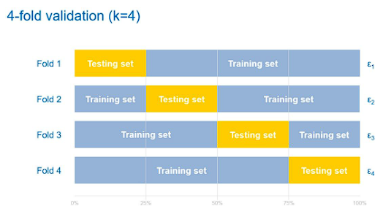
Continued..
For example, in 5-fold cross-validation, the dataset is divided into 5 subsets. The model is trained 5 times, each time using 4 folds for training and 1 fold for validation.
Performance Evaluation:
The performance metrics (e.g., accuracy, precision, recall, F1-score, R2 score) are computed for each fold, providing an average performance metric across all "k" runs.
The average performance metric is a more reliable estimate of the model's performance compared to a single train-test split.

Slide 21
Continued..
Benefits of Cross-Validation:
Provides a more reliable estimate of the model's performance, as it averages the results over multiple folds.
Helps in selecting hyperparameters for the model, as it reduces the risk of hyperparameter tuning based on a specific train-test split.
Offers a better understanding of the model's generalization ability on unseen data.

Slide 22
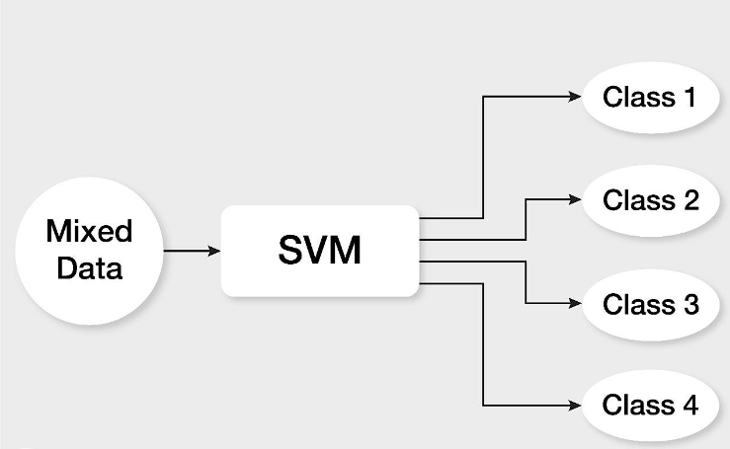
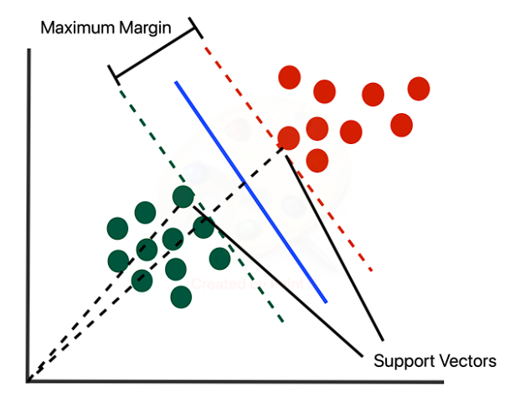
Algorithms used
SVM (Support Vector Machines)

Slide 23
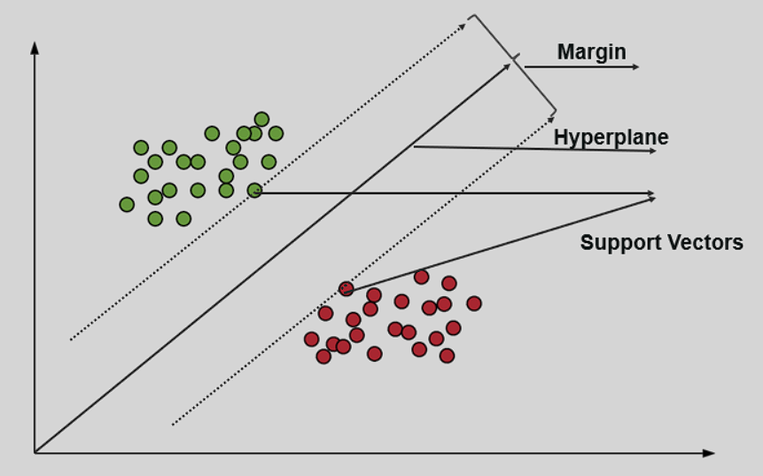
Continued..
Support vector machine (SVM) is a supervised learning algorithm that is used to analyze data. It is used to resolve classification and regression problems.
SVM is known for its effectiveness in handling both linearly separable and non-linearly separable data by finding the optimal hyperplane that best divides the data points into different classes.
The main idea behind SVM is to maximize the margin between the data points of different classes, providing better generalization to unseen data.

Slide 24
Continued..
Key concepts of SVM:
Hyperplane: In a two-dimensional space, a hyperplane is a line that separates the data points of different classes. In higher dimensions, the hyperplane becomes a hyperplane.
Margin: The margin is the distance between the hyperplane and the closest data points of each class. SVM aims to find the hyperplane with the largest margin, which leads to better generalization and robustness.
Support Vectors: Support vectors are the data points that lie closest to the hyperplane and have the most influence on determining the hyperplane's position.
Kernel Trick: SVM can efficiently handle non-linearly separable data by using the kernel trick. The kernel function transforms the original feature space into a higher-dimensional space where the data becomes linearly separable. Common kernel functions include polynomial kernels, radial basis function (RBF) kernels, and sigmoid kernels.

Slide 25
Continued..
Working of SVM:
Linear SVM: In the case of linearly separable data, SVM finds the hyperplane that maximizes the margin between the classes. The hyperplane is represented by the equation wx + b = 0, where "w" is the weight vector perpendicular to the hyperplane, and "b" is the bias term.
Non-linear SVM: When the data is not linearly separable, SVM uses the kernel trick to map the data to a higher-dimensional space where it becomes linearly separable. SVM then finds the hyperplane in the higher-dimensional space and projects it back to the original feature space for classification.

Slide 26
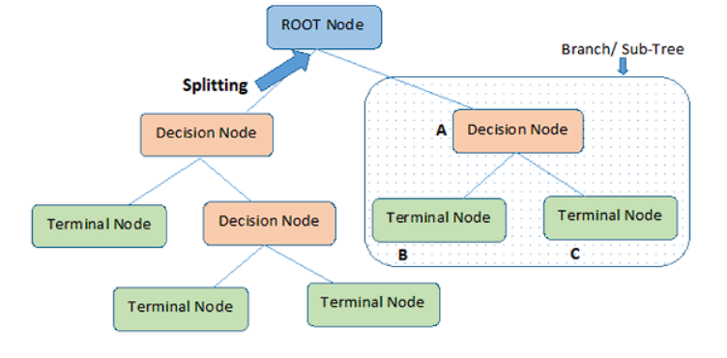
Continued..
Decision Tree

Slide 27
Continued..
A decision tree is a popular supervised machine learning algorithm used for both classification and regression tasks. It works by creating a tree-like model of decisions and their possible consequences based on the features (attributes) of the data.
Each internal node of the tree represents a decision based on a specific feature, and each leaf node represents a class label (in classification) or a numerical value (in regression).
Decision trees are widely used due to their simplicity, interpretability, and ability to handle both categorical and numerical data.
Working of Decision Trees :
Tree Construction:
The algorithm starts with the entire dataset at the root node.
It evaluates different features based on a specific criterion (e.g., Gini impurity for classification or mean squared error for regression) to determine the best feature to split the data at each node.

Slide 28
Continued..
The dataset is partitioned into subsets at each internal node, based on the selected feature's values.
The process continues recursively until a stopping criterion is met, such as reaching a maximum depth or having a minimum number of samples per leaf.
Decision Making:
To make predictions, a new data point traverses the decision tree from the root node to a leaf node, following the decisions made during the training phase.
The predicted class label (for classification) or numerical value (for regression) at the leaf node is the output of the decision tree.

Slide 29
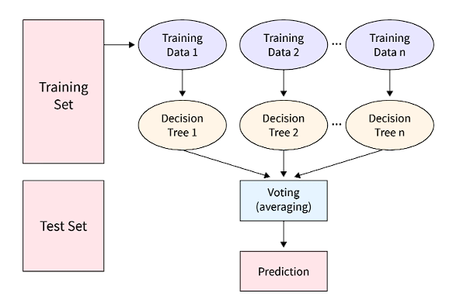
Continued..
Random Forest

Slide 30
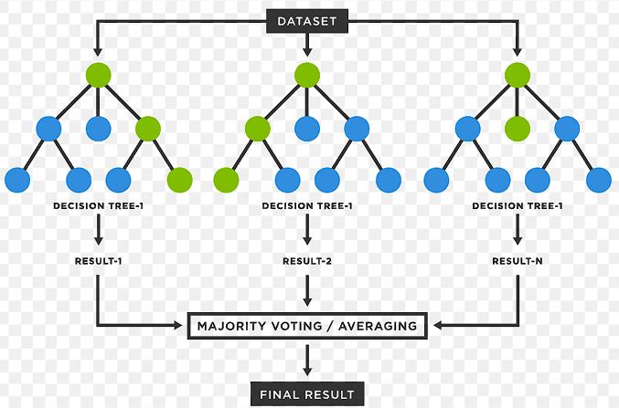
Continued..
Random Forest is a powerful ensemble learning method widely used in machine learning for both classification and regression tasks.
It is an extension of the decision tree algorithm and operates by creating multiple decision trees during training and combining their predictions to improve accuracy and reduce overfitting.
Random Forest is known for its robustness, high accuracy, and ability to handle large and complex datasets.

Slide 31
Continued..
Working of Random Forest :
Bootstrapping:
Random Forest builds multiple decision trees using a process called bootstrapping or bagging. For each tree, a random subset of the original dataset is sampled with replacement to create a new training set of the same size as the original data.
Feature Randomness:
At each node of the decision tree, only a random subset of features (variables) is considered for splitting. This introduces additional randomness and diversity among the trees, reducing the risk of overfitting.
Tree Building:
Each decision tree in the Random Forest is built using the bootstrapped dataset and a subset of randomly selected features.

Slide 32
Continued..
The decision trees grow until a stopping criterion is met, such as reaching a maximum depth or having a minimum number of samples per leaf.
Voting (Classification) or Averaging (Regression):
For classification tasks, the Random Forest combines the predictions of all the individual decision trees through majority voting to determine the final class label.
For regression tasks, the predictions of all trees are averaged to obtain the final output.

Slide 33
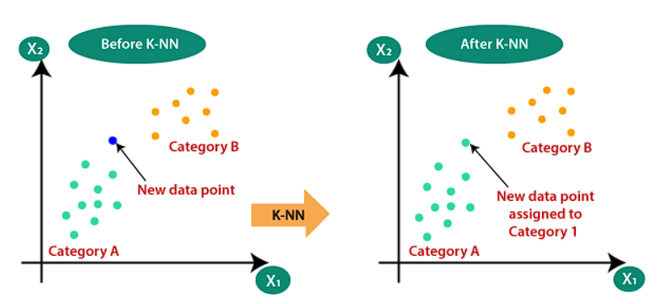
Continued..
K Nearest Neighbors

Slide 34
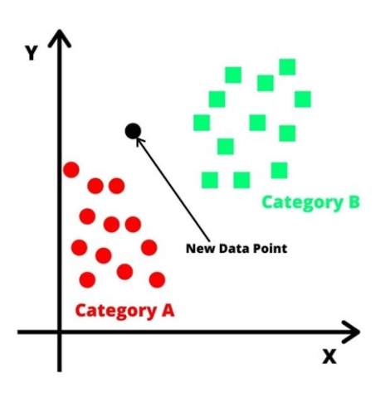
Continued..
K-Nearest Neighbors (KNN) is a simple yet powerful machine learning algorithm used for both classification and regression tasks.
It is a non-parametric and instance-based algorithm, meaning it does not make assumptions about the underlying data distribution and instead relies on the training data itself to make predictions.
KNN is known for its ease of implementation and its ability to handle both linear and non-linear relationships in the data.

Slide 35

Continued..
Working of KNN:
Distance Metric:
KNN measures the distance between data points in the feature space. The most common distance metrics used are Euclidean distance for continuous features and Hamming distance for categorical features.
Choosing the Value of K:
K in KNN represents the number of nearest neighbors to consider for making predictions. It is a hyperparameter that needs to be tuned for the specific problem. A small K value may lead to noisy predictions, while a large K value may result in oversmoothing and loss of local patterns.
Prediction for Classification:
For classification tasks, KNN assigns the majority class label among the K-nearest neighbors to the query data point.

Slide 36
Continued..
Prediction for Regression:
For regression tasks, KNN calculates the average (or weighted average) of the target values of the K-nearest neighbors as the prediction for the query data point.
Voting and Tie-Breaking:
In the case of a tie in the class labels for classification tasks or target values for regression tasks, KNN can use various techniques, such as weighted voting or random selection, to break the tie.

Slide 37
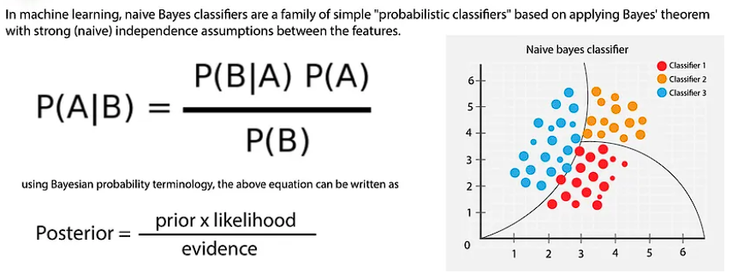
Continued..
Naïve Bayes

Slide 38

Continued..
Naive Bayes is a simple and widely used machine learning algorithm for classification tasks.
It is based on Bayes' theorem and the assumption of independence among features, which makes it computationally efficient and easy to implement.
Despite its simplicity, Naive Bayes can be surprisingly effective in many real-world applications, especially for text classification and spam filtering.
Working of Naïve Bayes:
Bayes' Theorem:
Bayes' theorem describes the probability of an event occurring based on prior knowledge or evidence.
In the context of classification, Bayes' theorem helps calculate the probability of a data point belonging to a particular class given its features.

Slide 39
Continued..
where,
P(A|B) is Posterior probability: Probability of hypothesis A on the observed event B.
P(B|A) is Likelihood probability: Probability of the evidence given that the probability of a hypothesis is true.
P(A) is Prior Probability: Probability of hypothesis before observing the evidence.
P(B) is Marginal Probability: Probability of Evidence.
Assumption of Feature Independence:
Naive Bayes assumes that all features are independent of each other, given the class label. This is a strong assumption and is often not entirely true in real-world scenarios, but it simplifies the calculations significantly.
Calculating Class Probabilities:
To make a prediction, Naive Bayes calculates the posterior probability of each class given the input features using Bayes' theorem.
The class with the highest posterior probability is assigned as the predicted class for the input data point.

Slide 40
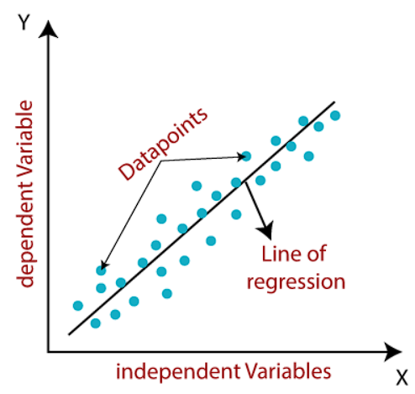
Continued..
Linear Regression

Slide 41
Continued..
Linear Regression is one of the simplest and widely used machine learning algorithms for regression tasks.
It is a linear model that aims to establish a relationship between the independent variables (features) and the dependent variable (target) by fitting a straight line to the data points.
The goal of linear regression is to find the best-fitting line that minimizes the difference between the predicted values and the actual values of the target variable.
Linear Regression Equation: In a simple linear regression with one independent variable (univariate linear regression), the relationship between the independent variable "X" and the dependent variable "y" can be represented by the equation:
y = mx + b
where:
"y" is the target variable (dependent variable).
"X" is the input feature (independent variable).

Slide 42
Continued..
"m" is the slope of the line (coefficient), representing the change in "y" with a one-unit change in "X."
"b" is the y-intercept, representing the value of "y" when "X" is equal to zero.
Working of Linear Regression:
Training the Model:
During the training phase, the linear regression algorithm tries to find the values of "m" and "b" that best fit the data points.
It uses a cost function (e.g., mean squared error) to measure the difference between the predicted values and the actual values of the target variable.
The model adjusts the values of "m" and "b" iteratively using optimization techniques like gradient descent to minimize the cost function and obtain the best-fitting line.
Making Predictions:
Once the linear regression model is trained, it can be used to make predictions on new, unseen data points.
For each input feature "X," the model calculates the corresponding predicted value "y" using the linear regression equation.

Slide 43
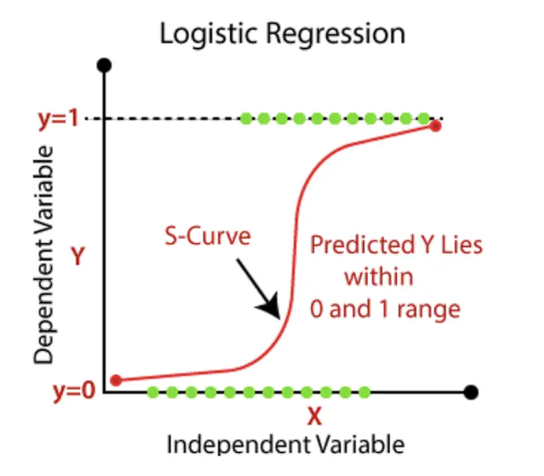
Continued..
Logistic Regression

Slide 44

Continued..
Logistic Regression is a popular and widely used machine learning algorithm primarily used for binary classification tasks.
Despite its name, logistic regression is a classification algorithm, not a regression algorithm.
It models the probability of a binary outcome (e.g., 0 or 1, true or false, yes or no) based on one or more predictor variables (features).
Logistic Regression is well-suited for problems where the dependent variable is categorical and can take one of two classes.
Equation of logistic regression:
Equation of straight line:
In Logistic Regression y can be between 0 and 1 only, so for this let's divide the above equation by (1-y):
But we need range between -[infinity] to +[infinity], then take logarithm of the equation it will become:

Slide 45
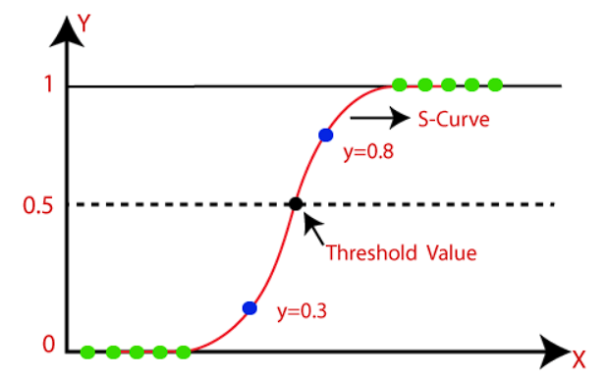
Continued..
Working of Logistic Regression:
Logistic Function (Sigmoid):
Logistic Regression uses the logistic function (sigmoid function) to map any real-valued number to a value between 0 and 1.
The sigmoid function is represented as: f(z) = 1 / (1 + exp(-z)), where "z" is the linear combination of the feature values and their corresponding coefficients.

Slide 46
Continued..
Modeling Probabilities:
In logistic regression, the output is the probability of the target variable belonging to the positive class (class 1).
The probability is calculated as the output of the sigmoid function applied to the linear combination of the feature values and coefficients.
Decision Boundary:
To make predictions, a threshold (typically 0.5) is used. If the predicted probability is greater than the threshold, the data point is classified as class 1; otherwise, it is classified as class 0.
Training the Model:
The coefficients (weights) of the logistic regression model are determined during the training phase using optimization techniques like maximum likelihood estimation or gradient descent.
The objective is to find the optimal coefficients that maximize the likelihood of the observed data given the model.

Slide 47
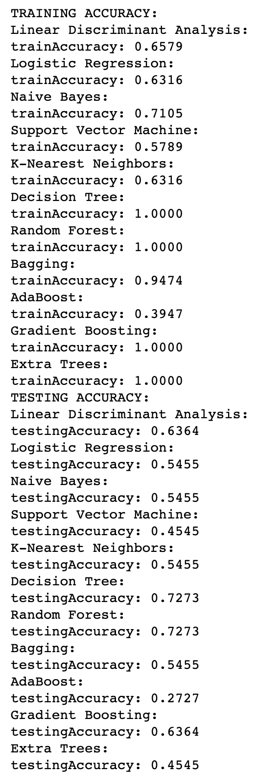
Accuracy Comparison for crop name prediction

Slide 48
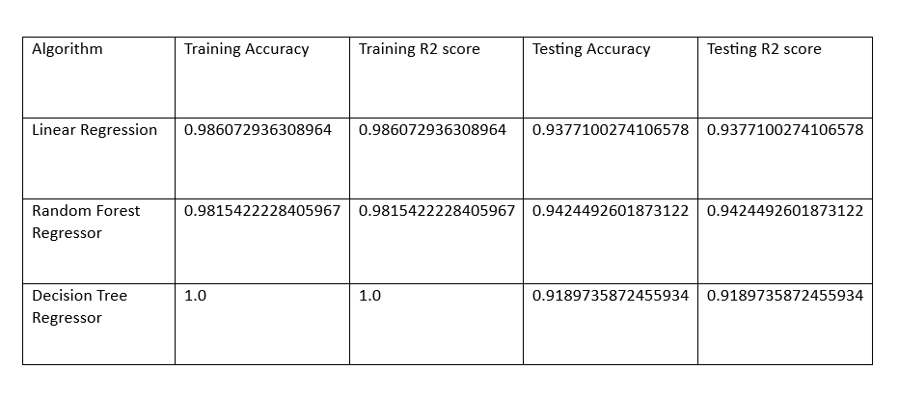
Accuracy Comparison for yield prediction

Slide 49
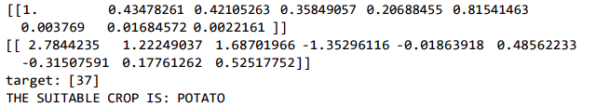
Output for crop name prediction
Model - SVM
Input attributes are soil’s NPK levels, pH, rainfall, temperature, yield
input_data=(180,60,90,4.96,689.88,29.04,21.72)
Output is the suitable crop

Slide 50
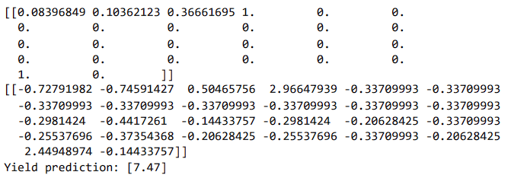
Output for yield prediction
Model – Decision Tree
Input attributes are Cost of cultivation, Cost of Production, crop name, state name
input_data=(10593.15,16528.68,2172.46,1,0,0,0,0,0,0,0,0,0,0,0,0,0,0,0,0,0,0,0,0,1,0)
Output is the yield :

Slide 51
Conclusion
This project aimed to predict agricultural crop and yields in India using machine learning techniques. The significance of this project lies in its potential to contribute to sustainable agriculture practices, enhance food security, and assist policymakers and farmers in making informed decisions.
The dataset for crop prediction consisted of several features, out of which I selected the required feature for the model , then performed Exploratory Data Analysis (Data Preprocessing and Data Visualization) and did the feature scaling on the training data. Further, I applied several algorithms for training and testing and based on their accuracy, I selected SVM for the crop prediction which gave 96% accuracy and Decision Tree for yield prediction which gave 91% accuracy.
The results demonstrated that our model could make reasonably accurate predictions of crops and yields for various regions in India.
The journey of predicting agriculture crop and yields in India using machine learning has been both challenging and rewarding.

Slide 52
References
1.(2018). Singh, R., Sajwan, S., and Aggarwal. A Review of Machine Learning Methods for Crop Yield Prediction. 181(34), 16–20, International Journal of Computer Applications.
2.A. Jaiswal and V. Deora (2019). Crop Yield Prediction Under Climate Change: Simulation-Based Methods and Machine Learning Models. IEEE Access, 7(3), 33615–33625.
3.S. Sharma and G. Bhatia (2019). A Review of Machine Learning Methods for Predicting Crop Yield. Computer Science: An International Journal of Emerging Trends & Technology, 8(4), 352-355.
4.(2017) Agarwal, A., and Saxena, A. A comparative study of crop yield prediction using machine learning. 168(8), 18–22, International Journal of Computer Applications.
5Government of India, Ministry of Agriculture and Farmers Welfare (2021). Agriculture, Cooperation, and Farmers Welfare Department. from https://agricoop.nic.in/ retrieved.
6.A. Gupta, P. N. Reddy, and others (2020). A Comprehensive Review of Machine Learning for Crop Yield Prediction. (Pp. 140–145) in 2020 International Conference on Sustainable Energy and Green Technology (SEGT). IEEE.

