Slide 1

Project Title – Seasonal Agriculture Perfomance Analysis
Student Name – Nathbava Krishna
College Name – Centre For Professional Courses , Gujarat University ]
AICTE STU ID : STU6a661b61590b01785076577

Slide 2

PROBLEM STATEMENT
Agricultural activities are influenced by seasonal variations in environmental conditions, farming practices, resource availability and market conditions. As a result, agricultural performance may differ from one season to another. However, raw agricultural data does not clearly explain how agricultural performance changes across seasons or what patterns can be observed in different seasonal conditions. The problem is to analyze the given agricultural dataset and investigate seasonal differences in agricultural performance by identifying meaningful patterns, trends, relationships and variations within the available data.

Slide 3
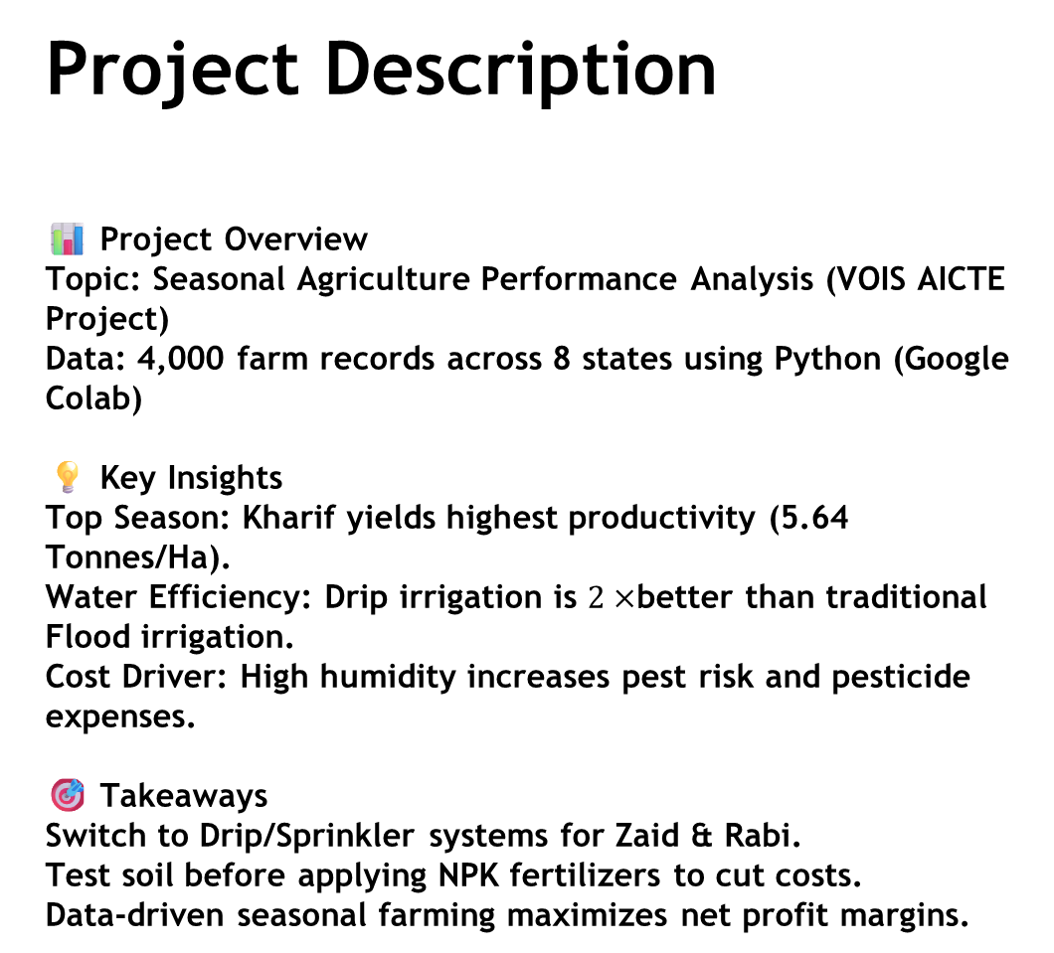
Project Description 📊 Project Overview Topic: Seasonal Agriculture Performance Analysis (VOIS AICTE Project) Data: 4,000 farm records across 8 states using Python (Google Colab) 💡 Key Insights Top Season: Kharif yields highest productivity (5.64 Tonnes/Ha). Water Efficiency: Drip irrigation is $2×$better than traditional Flood irrigation. Cost Driver: High humidity increases pest risk and pesticide expenses. 🎯 Takeaways Switch to Drip/Sprinkler systems for Zaid & Rabi. Test soil before applying NPK fertilizers to cut costs. Data-driven seasonal farming maximizes net profit margins.

Slide 4

WHO ARE THE END USERS?
Farmers & Agri-Producers: Optimizes crop selection, reduces fertilizer costs, and improves irrigation efficiency.
Government & Policy Makers: Guides seasonal subsidies, water conservation schemes, and regional crop planning.
Agri-Tech & Input Suppliers: Helps align inventory (seeds, micro-irrigation, IPM) with regional soil and climate demands.
Agri-Researchers & Analysts: Serves as a benchmark dataset for crop yield modeling and data-driven farming studies.

Slide 5

Technology Used
Language: Python 3
Environment: Google Colab / Jupyter Notebook
Data Processing: Pandas, NumPy
Data Visualization: Matplotlib, Seaborn
Data Format: Microsoft Excel (.xlsx) / CSV

Slide 6
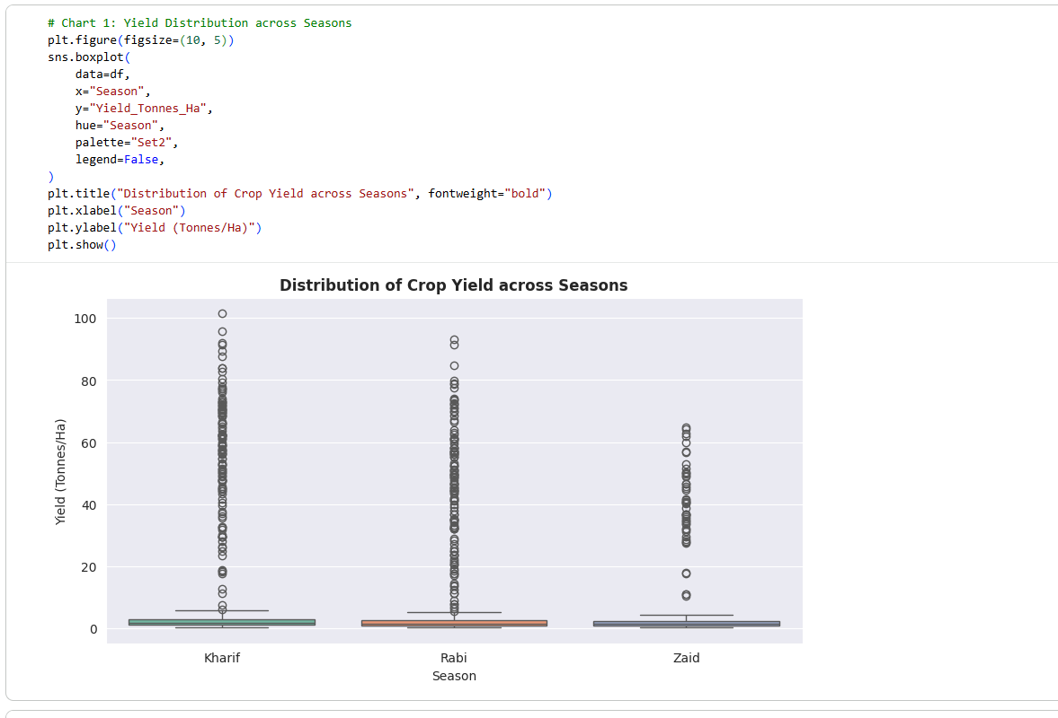
RESULTS

Slide 7
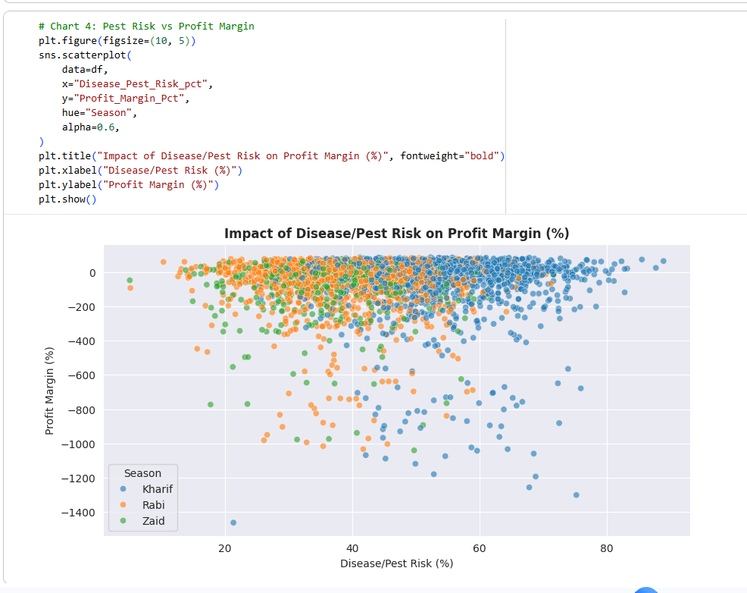
RESULTS

Slide 8
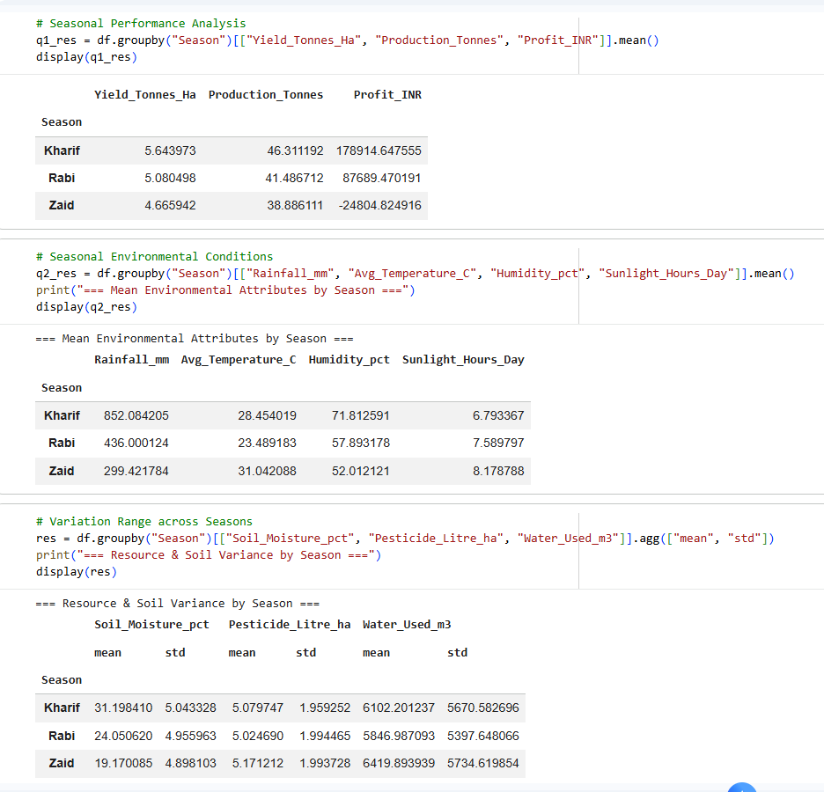
RESULTS

Slide 9
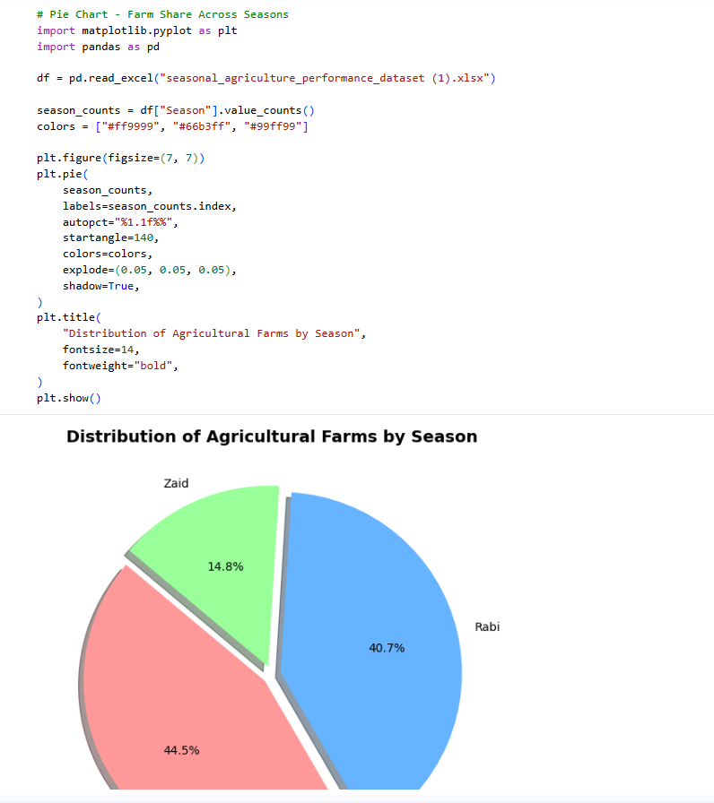
RESULTS

Slide 10
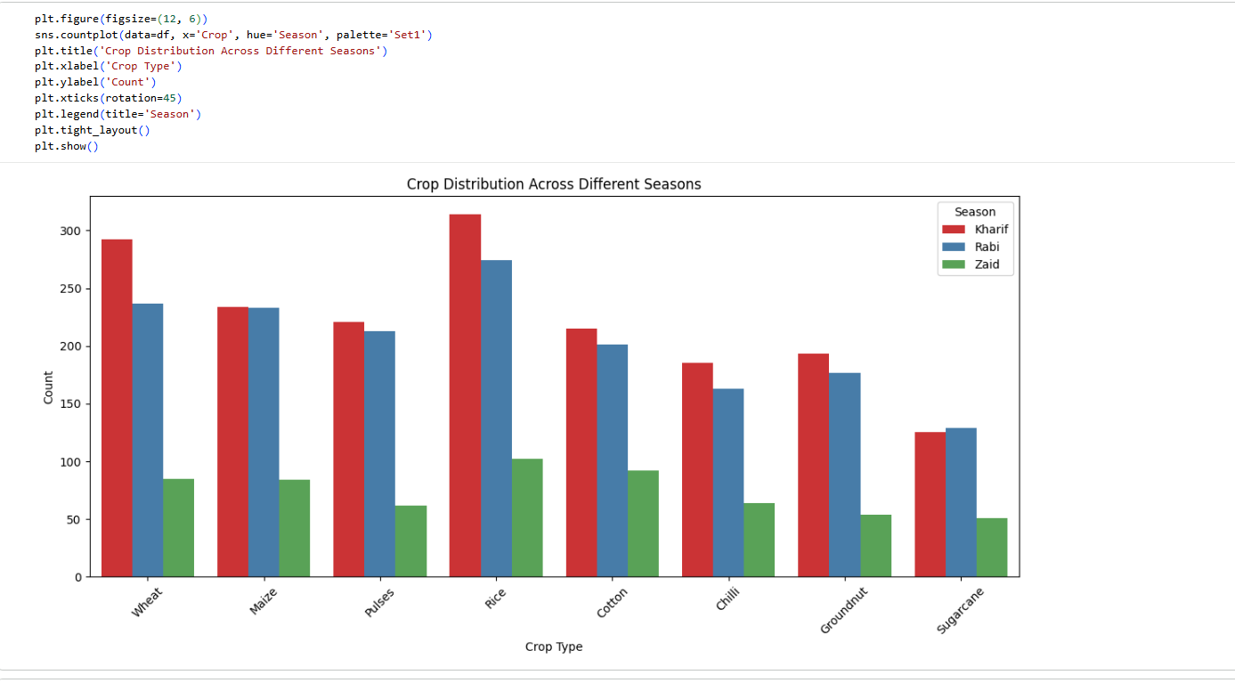
RESULTS

Slide 11
Future scope
Machine Learning & Predictive Modeling: Implement ML models (e.g., Random Forest, XGBoost) for automated yield and profit prediction.
IoT & Real-Time Data Integration: Connect live IoT sensor data for real-time soil moisture, temperature, and weather tracking.
Interactive Dashboard: Build a Web / Streamlit dashboard for real-time visual analytics and scenario simulation.
GIS & Satellite Mapping: Integrate spatial mapping to analyze groundwater levels and regional crop health visually.

Slide 12
GitHub Link
https://github.com/Krishna24187/Seasonal-Agriculture-Perfomance-Analysis

Slide 13
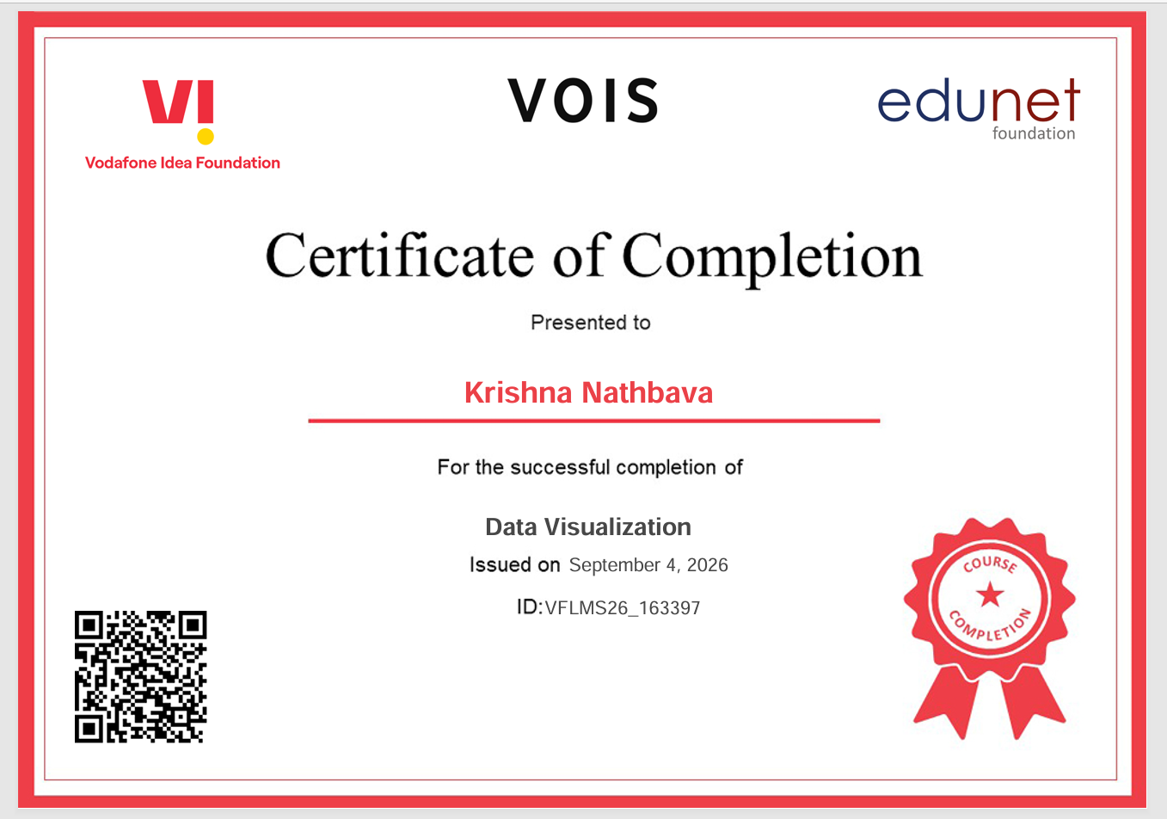
VOIS Course completion certificate - Course name- Data Visualization

Slide 14
Thank you
.
.

