Slide 1
Third International Conference on Intelligent Computing, Instrumentation and Control Technologies (ICICICT) - 2022 SECURE AND LIGHTWEIGHT DATA SHARING MECHANISM FOR MEDICAL IoT
Paper ID : 518
Authors: Presented By:
Tarun Sai Yakkala Sri Krishna Kumar Modekurty
Sri Krishna Kumar Modekurty
Neeraj Boggarapu
Amit Kumar Mandal

Slide 2
Introduction
The integration of IoT and medical sciences has enhanced patient care in the healthcare sector by facilitating monitoring, telemonitoring, and a widespread utilization telemedicine.
IoT in the healthcare sector has a numerous advantages, including lower costs, better illness management, the ability to receive prompt assistance when needed, and more.
A few examples in IoT in healthcare sector are Blood Pressure Monitors, Glucose Level Monitors, Electrocardiogram (ECG) Monitors, and so on.
In a medical-IoT network, the most critical considerations are security and privacy where users authenticate themselves by transmitting messages to sensors and Fog devices.
In medical IoT, the data that is being captured can be of a variety of formats like streams, high-resolution images, graphs, charts, tables, etc.

Slide 3
Motivation
The healthcare sector has engaged in substantial research in terms of technological advancement in an effort to provide the patients with efficient and secure services.
Sensitive information such as heartbeat readings, pulse readings, electrocardiogram (ECG) readings, and so on would be captured and transmitted in an IoT-based healthcare system.
Given that data sharing over the internet entails the patients’ privacy, therefore, it is necessary to ensure that data is transmitted securely so that an adversary cannot tamper with it.
With limited power, processing power, and memory it is very difficult for IoT devices to transmit a large chunk of data over a network by ensuring its security and privacy.

Slide 4
Proposed Model
The proposed scheme is intended towards establishing and maintaining a secure and lightweight communication channel among the communicating entities, namely: Smart healthcare devices and Edge/FoG Devices.
There are three phases in the devised mechanism, namely: Registration, Authentication, Data Compression.

Slide 5
Contd.
The proposed methodology is implemented on the concept of modified Chebyshev Polynomial.
From the literature that has been studied, it exemplifies the fact that Chebyshev polynomial is lightweight and hard to break.
Tp(x) = (2xTp−1(x) − Tp−2(x))%K
where T₀(x)=1%K and T₁(x)=x%K. The value of p is a large prime number, K is a large integer and x∈ [−∞, ∞].

Slide 6
Contd.
The establishment of session key happens at the Authentication Phase of the proposed methodology.
The session would be established at both the Smart Healthcare device end and Edge/Fog device end.
SessionKey = H(N ∥ Krs)
where N represents a Nonce and the value of Krs is computed using the modified Chebyshev Polynomial.

Slide 7
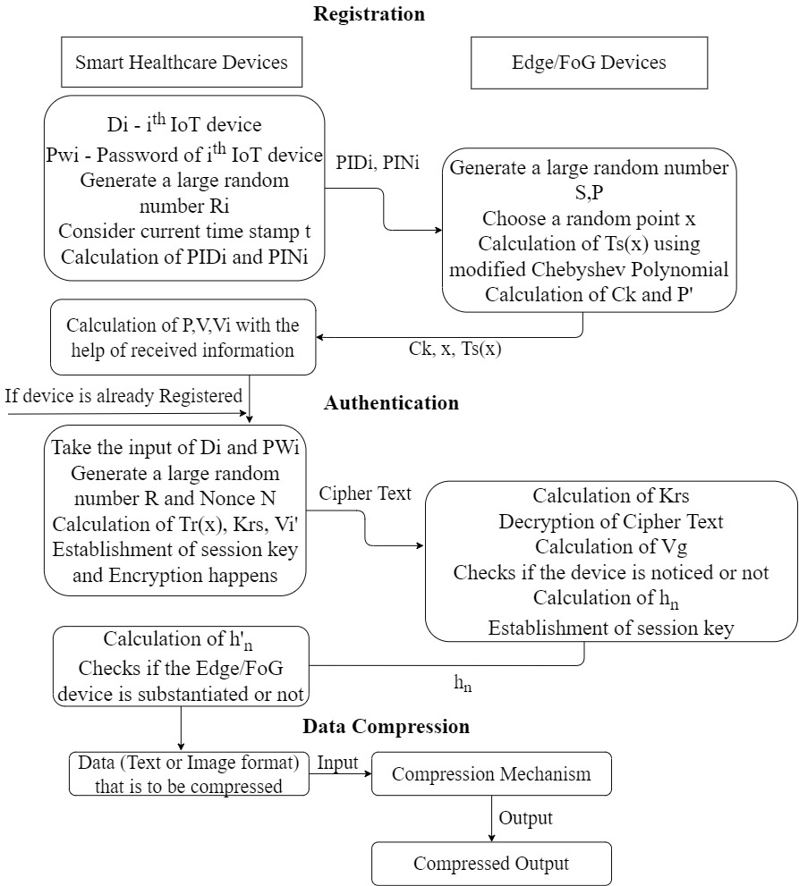
Contd.

Slide 8
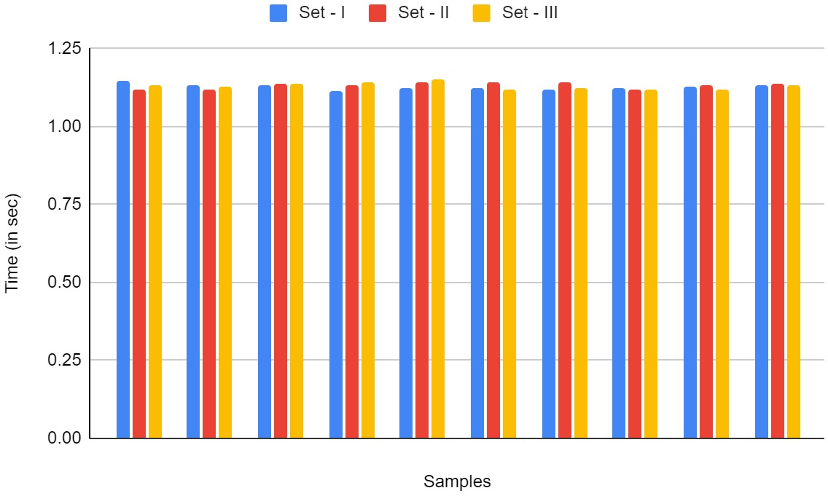
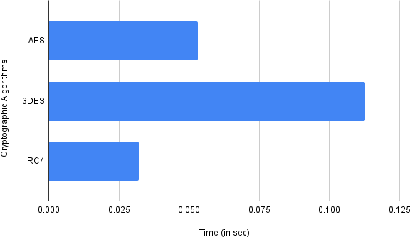
Experimental Results
HandShake Duration
Cryptographic Algorithms

Slide 9
Contd.
Text Compression:
Compression Mechanism | Dataset Name | Original Size | Observed Results | Time Complexity
Pure Huffman Coding | Arrhythmia | 404KB | 1.19MB | O(nlogn)
 | Cancer | 52KB | 272KB
 | Diabetes | 24KB | 79KB
Pure LZW | Arrhythmia | 404KB | 330KB | O(n)
 | Cancer | 52KB | 52KB
 | Diabetes | 24KB | 34KB
LZ77 + Huffman Coding | Arrhythmia | 404KB | 127KB | O(n)
 | Cancer | 52KB | 14KB
 | Diabetes | 24KB | 12KB

Slide 10
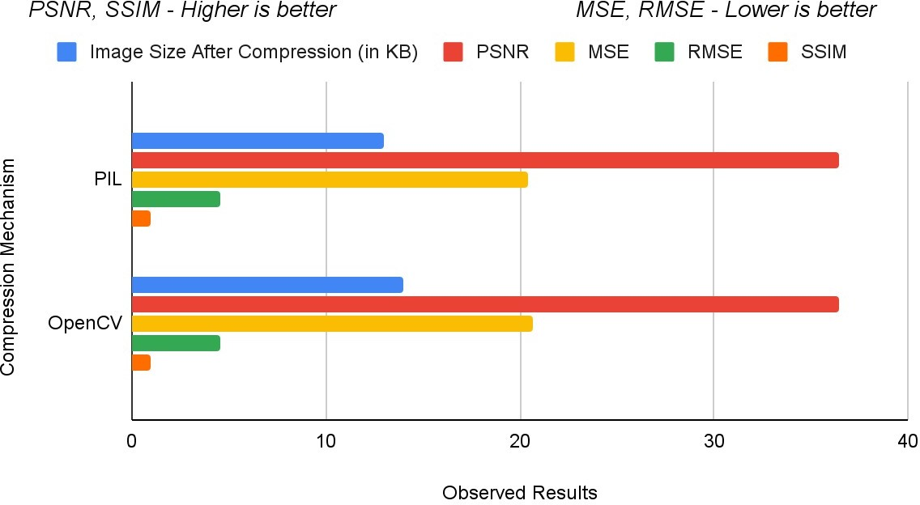
Contd.
Image Compression and Image Quality Metrics:
Image considered size – 26 KB
S.No | Compression Mechanism | Results Observed
1. | PIL Compression | 13 KB
2. | OpenCV Compression | 14 KB
Compression Mechanism | Image Quality Metrics
 | PSNR | MSE | RMSE | SSIM
PIL | 36.46071705 | 20.43225826 | 4.520205555 | 0.9494908679
OpenCV | 36.4106395 | 20.65387187 | 4.544653108 | 0.949293001

Slide 11
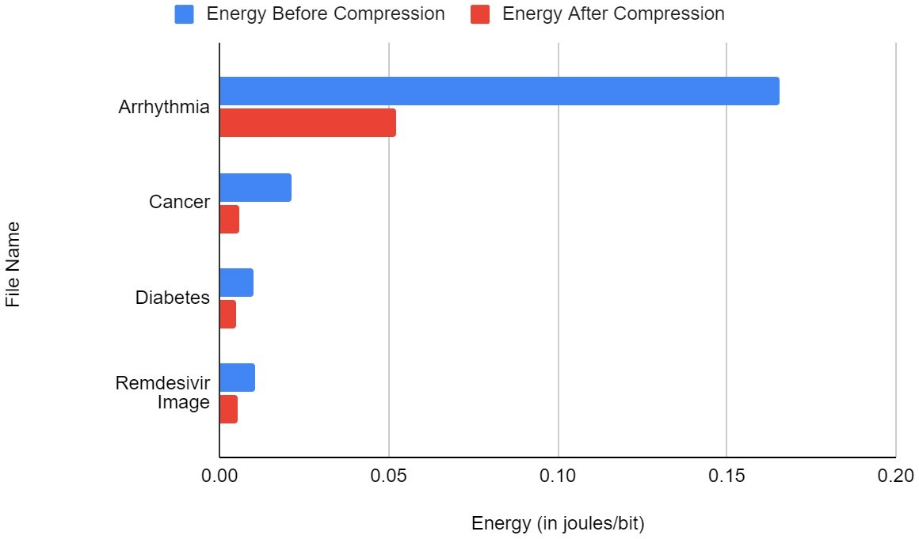
Contd.
Energy Consumption During File Transmission
File Name | Before Compression | After Compression
Arrhythmia[20] | 0.1658093568 J\bit | 0.0520767456 J\bit
Cancer[21] | 0.0213417684 J\bit | 0.0056641056 J\bit
Diabetes[22] | 0.0098500608 J\bit | 0.0046749312 J\bit
Remdesivir Image | 0.0103594776 J\bit | 0.005166312 J\bit

Slide 12
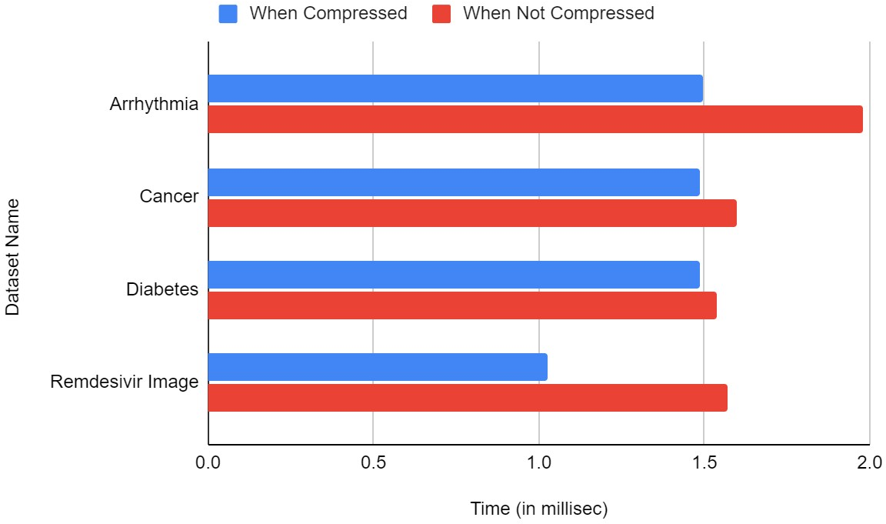
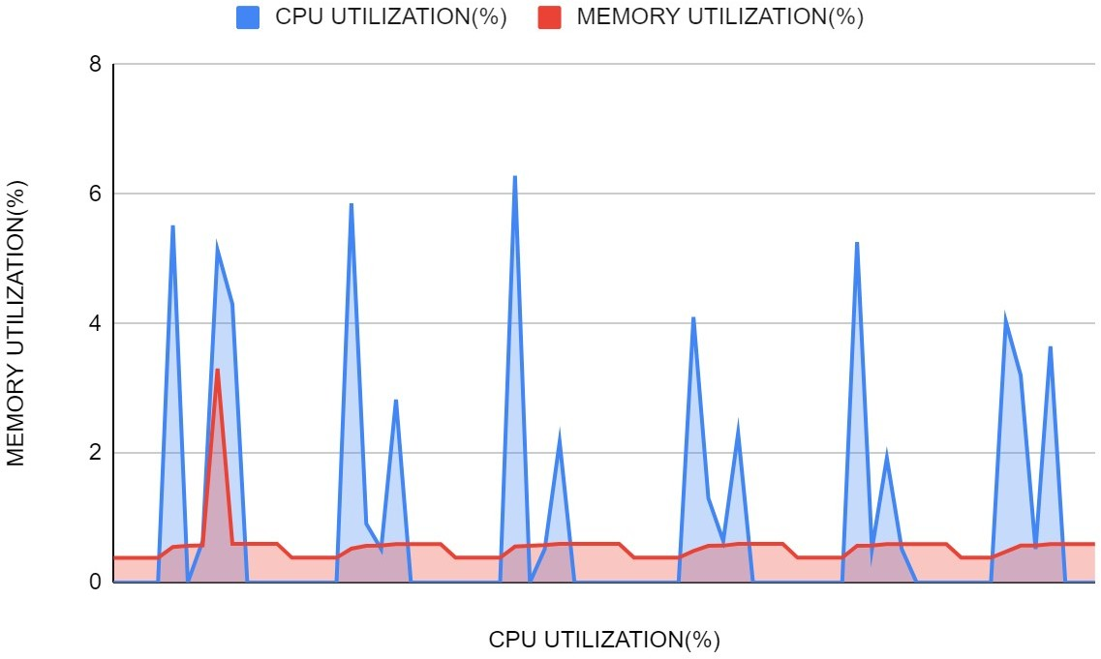
Contd.
File Transmission Time CPU Utilization vs Memory Utilization

Slide 13
Conclusion
An attempt has been made to give the reader an insight into a methodology for data communication among the resource-constrained IoT devices which is secure and lightweight.
To achieve the goal of secure communication among the communicating devices, two phases, namely: registration and authentication were performed in the devised mechanism. The implementation of both the phases was primarily based on the semi-grouping nature of the modified Chebyshev Polynomial.
A diversified data compression mechanism had been performed to find an optimal mechanism to ease the computation on the IoT devices.

Slide 14
Future Works
Formal verification of the proposed methodology using the BAN Logic.
Simulating the protocol in tools such as AVIPSA.
Understanding the behavior of the proposed model on large scale IoT Systems.

Slide 15
References
[1] Nandy T, Idris MYIB, Md Noor R, et al. Review on security of internet of things authentication mechanism. IEEE Access. 2019;7:151054- 151089.
[2] Akhbarifar, S., Javadi, H.H.S., Rahmani, A.M. et al. A secure remote health monitoring model for early disease diagnosis in cloud-based IoT environment. Pers Ubiquit Comput (2020).
[3] Jacob Ziv, The universal LZ77 compression algorithm is essentially optimal for individual finite-length N-blocks. IEEE Transaction Inf. Theory, 55, 5 (May 2009), 1941–1944.
[4] El-hajj, M.; Fadlallah, A.; Chamoun, M.; Serhrouchni, A. A Survey of Internet of Things (IoT) Authentication Schemes. Sensors 2019, 19, 1141.
[5] H. M. Al-Kadhim and H. S. Al-Raweshidy, ”Energy Efficient Data Compression in Cloud Based IoT,” in IEEE Sensors Journal, vol. 21, no. 10, pp. 12212-12219, 15 May15, 2021.
[6] C. J. Deepu, C. -H. Heng and Y. Lian, ”A Hybrid Data Compression Scheme for Power Reduction in Wireless Sensors for IoT,” in IEEE Transactions on Biomedical Circuits and Systems, vol. 11, no. 2, pp. 245-254, April 2017.
[7] R. R. K. Chaudhary and K. Chatterjee, ”An Efficient Lightweight Cryptographic Technique For IoT based E-healthcare System,” 2020 7th International Conference on Signal Processing and Integrated Networks (SPIN), 2020, pp. 991-995.
[8] Saraiva DAF, Leithardt VRQ, de Paula D, Sales Mendes A, Gonzalez ´ GV, Crocker P. PRISEC: Comparison of Symmetric Key Algorithms for IoT Devices. Sensors (Basel). 2019;19(19):4312. Published 2019 Oct 5.
[9] Hamza, R., Yan, Z., Muhammad, K., Bellavista, P., Titouna, F. (2020, July). A privacy-preserving cryptosystem for IoT E-healthcare. Information Sciences, 527, 493-510.

Slide 16
THANK YOU

