Slide 1
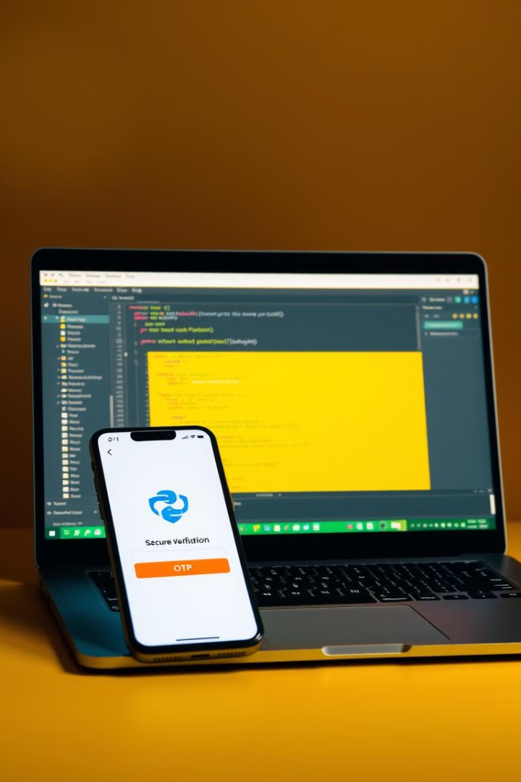
Building an OTP Verification System
This presentation outlines the development of a secure OTP verification system using Python and the SMTP library. We'll explore the process of generating, sending, and verifying OTPs, ensuring robust security measures throughout.
Presented by Sai Krishna, S9951

Slide 2
Prerequisites and Libraries Needed
Python Installation
SMTP Library
Random Module
Ensure Python is installed on your local system. Or use Google Colab for installation free code development.
Import the smtplib library for email communication. You'll also need the email library to construct emails.
Utilize the random module to generate random OTPs. This ensures unique codes for each user.

Slide 3
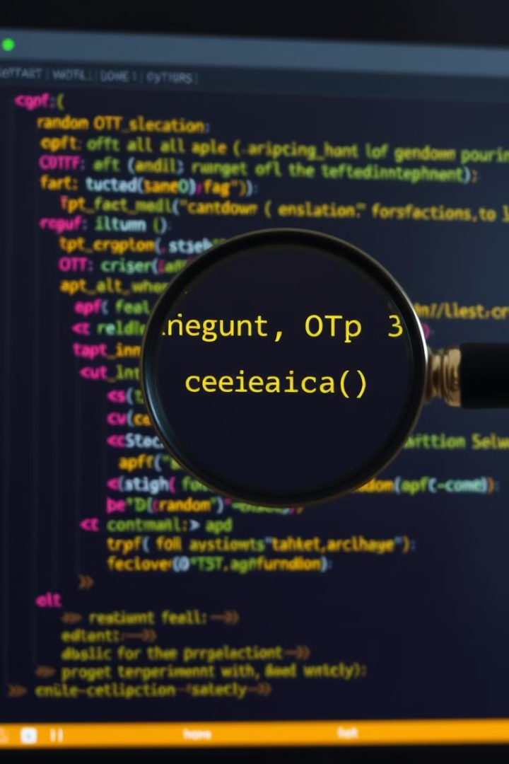
Generating the OTP
from random import randint
def generate_otp(length):
"""Generates a random OTP of specified length.
Args: length - The desired length of the OTP.
Returns: The OTP number."""
lower_limit = 10 ** (length - 1)
upper_limit = 10 ** length - 1
otp = randint(lower_limit, upper_limit)
return otp

Slide 4
Generating App Password
Security
1
App passwords provide a secure way to access your account programmatically.
2
How To
Navigate to the account settings of your email to generate a new app password, usually a 16 character length string.
Utilization
3
Provide the app password while logging in using the methods in SMTP library.

Slide 5
Sending the OTP via SMTP
from smtplib import SMTP
from email.mime.multipart import MIMEMultipart
from email.mime.text import MIMEText
def send_otp(email, otp, sender_email, app_password):
"""Sends an OTP to the specified email address
Args: email - The recipient's email address,
otp - The generated OTP code, sender_email - The sender's email address,
app_password - The app password for the sender's email"""
message = MIMEMultipart()
message['Subject'] = 'OTP Verification'
message['From'] = sender_email
message['To'] = email
message.attach(MIMEText(f'Your OTP is: {otp}', 'plain'))
server = SMTP('smtp.gmail.com', 587) # Server settings
server.starttls() # Secure the connection
server.login(sender_email, app_password)
server.send_message(message)
server.quit() # Close the connection

Slide 6
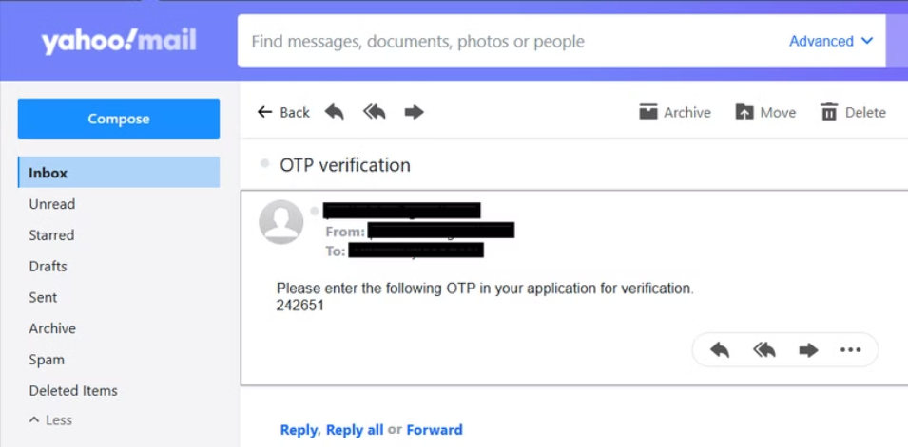
Sample email output
Here is the OTP email I sent to my yahoo account from my Gmail account.
In the image, I have censored my mail addresses for safety purposes.

Slide 7
Verifying the OTP
def validate_otp(otp, n_retries): """compares user's input with the generated OTP Args: otp - The OTP sent to the email, n_retries - number of retries available Prints the authentication status (pass or fail)""" for i in range(n_retries): value = input('\n Enter the 6 digit OTP.\n') if not value.isdigit() and i < n_retries-1: print('Incorrect OTP. Please retry.') elif value.isdigit() and int(value) == otp: print('Authentication passed.') break elif i < n_retries - 1: print('Incorrect OTP. Please retry.') else: print('\n Zero retries left.\n Authentication failed.')

Slide 8
Handling Exceptions and Errors
Incorrect OTP
Other Errors
Provide clear feedback to the user if the entered OTP does not match the generated one.
Handle cases such as invalid email addresses or any unforeseen errors through error handling mechanisms.

Slide 9

Secure Verification
We've successfully created a robust OTP system for user authentication.
The End
Sai Krishna, S9951

