Slide 1
PowerPulse: Household Energy Usage Forecast
Exploratory Data Analysis & Machine Learning Models
Presented by: Krishna Raj S

Slide 2
Problem Statement
Predicting household energy consumption accurately enables better planning, cost reduction, and optimization of resources.
The goal of this project is to develop a machine learning model that can predict household energy consumption based on historical data.
DATASET OVERVIEW:
Total rows: 20,75,259
Time period: 2006 - 2010
Key features: Voltage, Global Active Power, Sub-Metering, etc.

Slide 3
Data Pre-processing:
Extracted data from the link provided.
Converted object data types in float data type.
Handled missing values(1.25% missing, dropped them)
Checked and removed duplicates (None found).
Extracted/Parsed Year,Month,Day and Hour from DateTime feature
Created 3 new additional features such as daily averages, peak hours, and rolling averages.

Slide 4
Exploratory Data Analysis(EDA):
Heatmap of Feature Correlation-Pearson Correlation
Key insights:
Global_active_power & Sub_metering_3 are strongly correlated (0.64).
Voltage has a negative correlation (-0.40) with power
consumption.(Voltage decreases power consumption increases)

Slide 5
Machine Learning Models Used:
Regression Models for power consumption predictions:
Linear Regression
Lasso Regression(for feature selection)
Decision Trees Regressor
Random Forest Regressor
Gradient Booster Regressor

Slide 6
Model Performance Comparision
Model | R2 Score | RMSE | MAE
Linear Regression | 1.0 | 0.04 | 0.0325
Lasso Regression | 0.9979 | 0.0479 | 0.0325
Decision Tree | 0.9982 | 0.0452 | 0.0270
Random Forest | 0.9960 | 0.0665 | 0.0387
Gradient Boosting | 0.9989 | 0.0357 | 0.0230
Key Insight: Gradient Boosting performed the best!

Slide 7
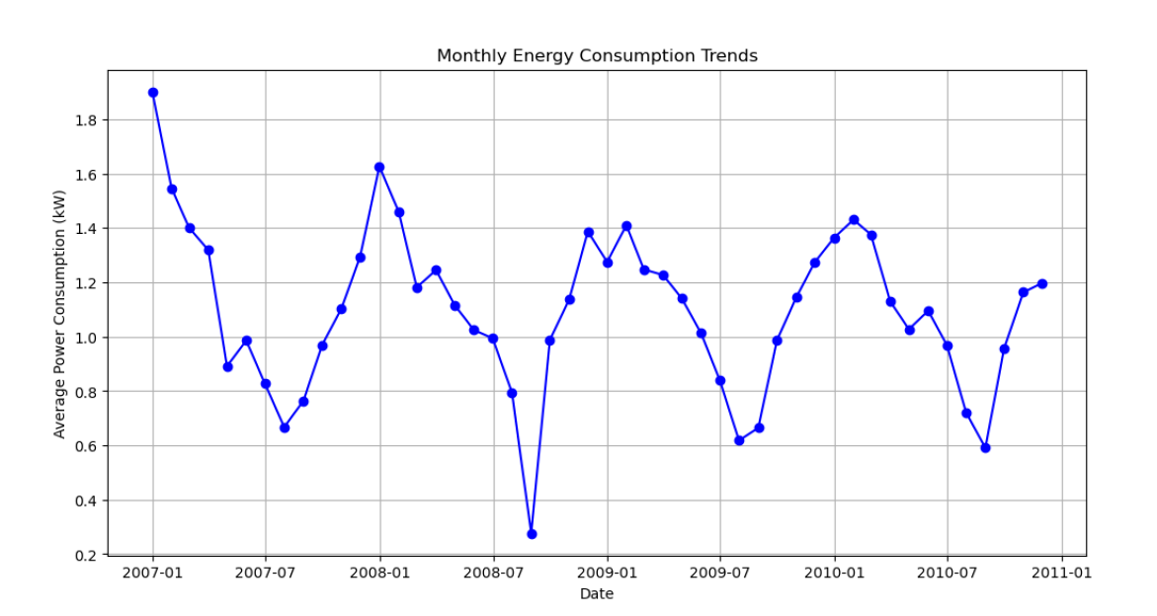
Visualization:
The visualization represents average power consumption over the years.
There are noticeable fluctuations in power consumption over time, indicating possible seasonal effects.
The energy consumption starts at a high level in early 2007 but gradually declines through mid-2008.This could be due to factors like increased energy efficiency, changes in household behavior, or external factors affecting energy demand.
From 2009 onward, the energy consumption fluctuates but remains relatively stable compared to the earlier years.

Slide 8
Challenges faced:
Initially detected outliers for both input features and target variables using box-plots and density plots. And also found out the distributions using histograms.
And removed the outliers using IQR method and z-score method. Then after training the model it R2 score is of exactly 1.0 which is perfectly fit.
Then with the help of mentor’s advise(as this is real world data, no need to detect and remove outliers as without detecting itself the performance will be same) treated as same way.
Tried Lasso Regression also which is used to select the features automatically that are related to the target variable.

Slide 9
Technologies and Tools Used:
Programming Language:
Python (Jupyter Notebook)
Data Processing and Analysis:
Pandas(Data Manipulation)
Numpy(Numerical Computation)
Datetime(Handling Date Features)

Slide 10
Contd:
3) Machine Learning Models:
Scikit-learn(Regressions,Decisions Trees,Random Forest,Gradient Boosting)
Hyper Parameter Tuning(RandomizedSearch CV)
4) Data Visualization Tools:
Matplotlib
Seaborn

Slide 11
Conclusion and Future Works:
Summary and Findings:
Power Consumptions trends over the years.
Voltage has a inverse relationship with power usage.
Gradient Boosting was the most accurate predictive model.
Future Improvements:
Deployment over Web App for real time predictions.
Future testing for Deep Learning Models.

Slide 12
Thank You 🎯
Questions?

