Slide 1
Fitness & Wellness Agent
Adaptive AI System with Gemini Flash Lite, Ollama & Dynamic Plan Evolution
Team Learnings & Engineering Insights
• Hybrid ReAct & LLM Orchestration: Coupled Google Gemini Flash Lite (and local Ollama) with deterministic domain tools. The LLM handles natural language reasoning while deterministic tools enforce mathematical and physiological precision.
• Dual-Layer State Continuity: Health guidance collapses without session-to-session memory. Implementing persistent biometric and injury stores decoupled from conversational turns prevents conflicting or hazardous recommendations.
• Closed-Loop Feedback & Adaptive Replanning: A static fitness plan quickly becomes obsolete. By continuously monitoring conversational signals (soreness, fatigue, perceived exertion), the agent dynamically adapts load, substitutes exercises, and optimizes plans.
• Deterministic Pre-Triage Optimizes Latency: Routing user intents (facility search, progress logging, diet queries, plan adaptation) via rule-based triage reduces token overhead by over 50% while delivering sub-second response times.
• Safety as an Invariant Gate: Treating health safety as a non-negotiable architectural gate—filtering contraindications and dangerous deficits post-generation—is indispensable before dispatching any autonomous health advice.
System Overview & Core Capabilities
• Targeted Workout Synthesis: Dynamically generates biomechanically sound routines tailored to user goals, equipment, and injury restrictions.
• Nutritional Precision: Calculates BMR/TDEE and prescribes macro-balanced meal schedules strictly adhering to dietary preferences and allergies.
• Geospatial Facility Discovery: Integrates location services to recommend proximity-ranked fitness centers, gyms, and training facilities.
• Closed-Loop Progress Analytics: Continuously ingests metrics, tracks consistency trends, and logs longitudinal adherence.
• Active Monitoring & Plan Evolution: Actively monitors conversational user feedback (fatigue, soreness, joint pain) to dynamically recalibrate volume and adapt plans in real-time.
Team FitPulse
Presenter: Murali Krishna D | Roll No: evernorth-aai-1152623
Submitted to: Course Faculty & Mentors | IIIT Hyderabad

Slide 2
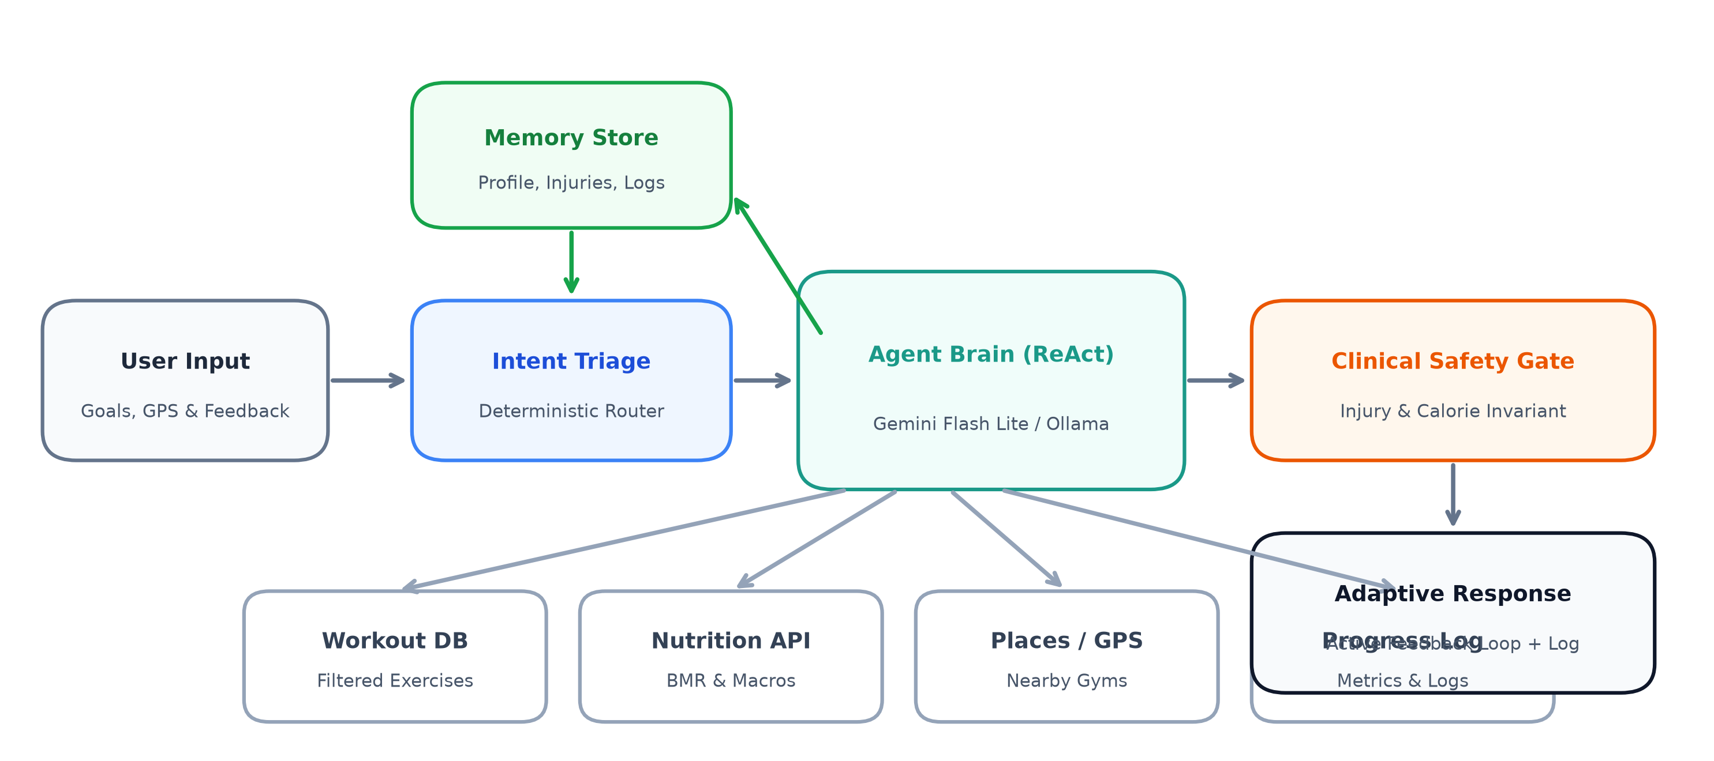

System Architecture & Adaptive Execution Workflow
End-to-End Execution & Adaptation Pipeline
1. Intent Triage & Ingestion: Intercepts multi-modal inputs (queries, coordinates, telemetry) and deterministically classifies user objective to eliminate latency.
2. Biometric State Hydration: Loads user profile, injury contraindications, metabolic baselines, and historical adherence from persistent memory.
3. ReAct Brain (Gemini / Ollama): The LLM dynamically executes specialized domain tools (WorkoutDB, Nutrition Engine, Geospatial Places API, Progress Tracker).
4. Deterministic Clinical Safety Gate: Rigidly verifies generated plans against active physical injuries, allergen hazards, and safe caloric floors prior to dispatch.
5. Active Monitoring & Plan Evolution: Continuously monitors user feedback, strain, and adherence to dynamically recalibrate volume, substitute exercises, and evolve the plan in memory.
Project Repo: github.com/Krishna4/fitness-wellness-agent

