Slide 1
Student Management Portal
Complete and Easy to Access Data.

Slide 2
Table of contents
01
02
03
04
The Project
Why it’s Great
Student Management Portal
Can be embedded to any school/college database.
Our clients
Our team
All over the World!
Team Fantastic Four

Slide 3
EXAM
Problem Statement
Students find it Difficult to track their academic progress and lose the track of various assignment deadlines. A Student Management Portal can resolve all these problems efficiently

Slide 4
About the Project
Student Management Portal Enables Students to efficiently monitor their academic progress including Grades, Assignments, and Quizzes and their Attendance for respective Courses.
Click Here!

Slide 5
What sets us apart?
Complete Metrics
Data Visualisation
Ease of Access
The Databases used have complete data which can be updated in Real-Time
Data Visualization makes it more interesting and less cumbersome to monitor your progress
The Portal can be accessed by students at any time

Slide 6
How do we do it?
Back-end
APIs, JavaScript, Firebase,
Front-end
HTML, CSS, ReactJS, JavaScript, TailwindCSS

Slide 7

Data Visualization
20%
Math
25%
C Programming
25%
Java
30%
Data Structures

Slide 8
Data Visualization is
Awesome!

Slide 9
Course A
Course B
Course C
j
Track Course Progress
.

Slide 10
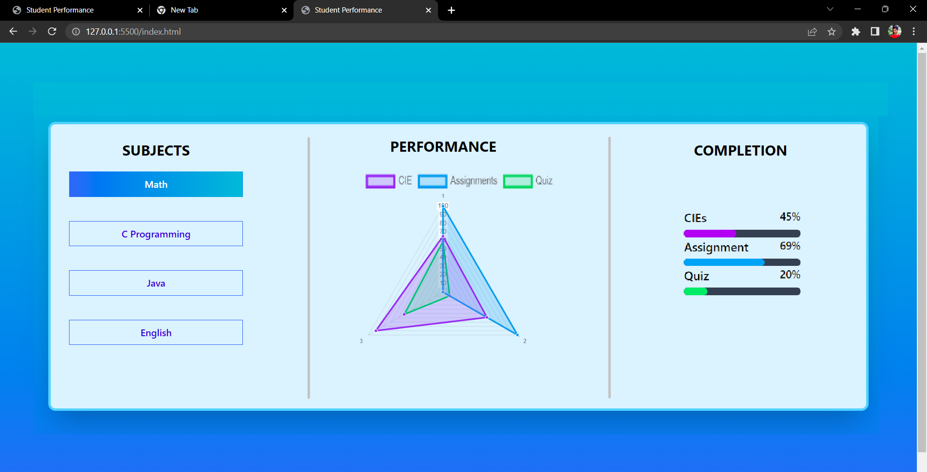
Academics

Slide 11
Thanks!
Does you have any questions?
fantastic4@nhceofficial.net
+91 696 696 696
studentportal.net

