Slide 1

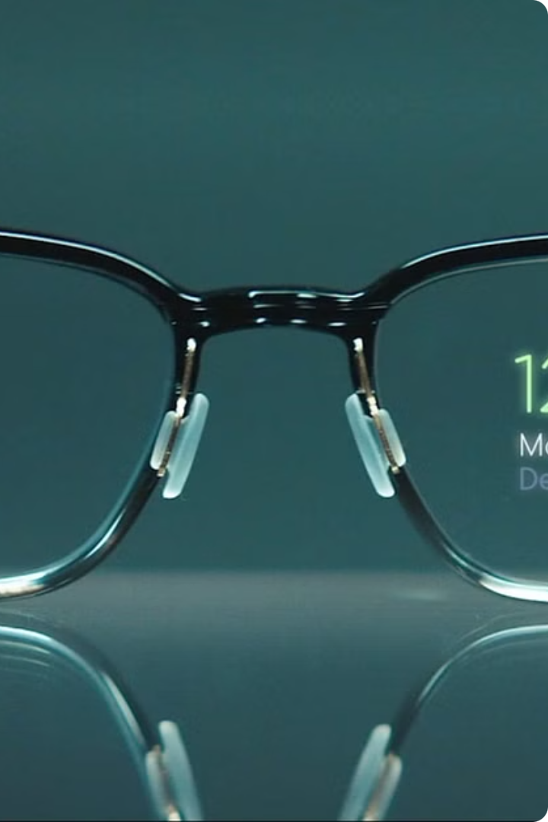
TITLE:-
Auto correcting the power of Spectacles Using Machine Learning (ML)

Slide 2
Introduction to Auto-Correcting Spectacles
Witness the future of vision correction with our revolutionary auto-correcting spectacles. Powered by advanced machine learning algorithms, these smart glasses automatically adjust the lens prescription to provide you with crystal-clear sight tailored to your eyes. Experience the ultimate in personalized vision enhancement.

Slide 3
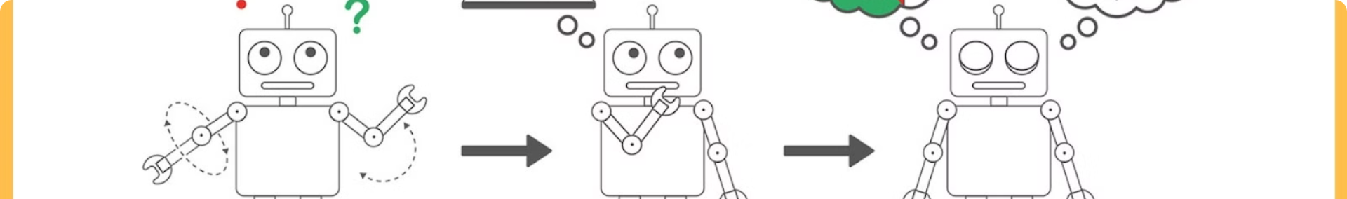



How Machine Learning Powers the Lens Correction
Eye Mapping
Predictive Algorithms
Continuous Refinement
Advanced cameras and sensors map the unique contours and characteristics of the user's eyes, gathering precise data for personalized lens adjustments.
Machine learning models analyze the eye data and predict the optimal lens prescription, adjusting in real-time to account for changes in the user's vision.
The spectacles continuously collect user feedback and eye data, allowing the algorithms to continuously learn and refine the lens adjustments for a truly customized experience.

Slide 4
Advantages of Auto-Correcting Spectacles
Precise Vision
Reduced Eye Strain
The spectacles continuously adjust the lens prescription to your exact vision needs, providing crystal-clear sight customized to your eyes.
By eliminating the need to constantly adjust focus, these smart glasses help reduce eye fatigue and headaches caused by vision issues.
Convenience
Adaptive Technology
No more manually adjusting your glasses or frequently visiting the optometrist. The auto-correction happens seamlessly and automatically.
The spectacles adapt to changes in your vision over time, ensuring you always have the optimal lens prescription.

Slide 5
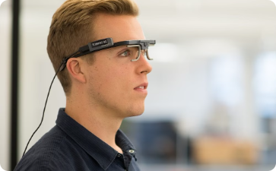
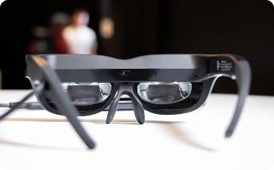
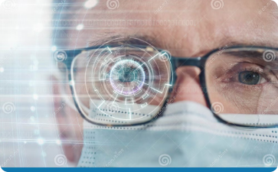
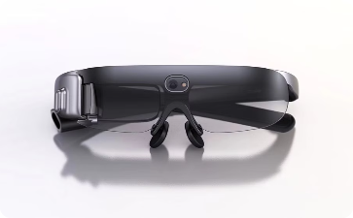
Sensor Technology in the Frames
Advanced Eye Tracking
Proximity Detection
Biometric Identification
Seamless Connectivity
Utilize proximity sensors to monitor the position and distance of the glasses relative to the user's face, enabling accurate lens adjustments.
Precisely track the movement and focus of the user's eyes using high-resolution cameras and infrared sensors embedded in the frames.
Incorporate biometric sensors that can recognize the unique characteristics of the user's eyes and face, ensuring a personalized experience.
Enable wireless communication and power the advanced sensors and processors through a sleek, integrated design in the spectacle frames.

Slide 6



Personalized Lens Adjustment Algorithms
Eye Mapping
1
Precisely analyze the user's unique eye structure and vision needs.
Predictive Modeling
2
Apply machine learning to forecast the optimal lens prescription.
Dynamic Adjustment
3
Continuously refine the lens parameters in real-time for perfect vision.
Our advanced algorithms leverage cutting-edge computer vision and machine learning to provide a truly personalized vision correction experience. By meticulously mapping the user's eyes and applying predictive models, the spectacles can dynamically adjust the lens prescription to account for changes and ensure crystal-clear sight at all times.

Slide 7
Customization Options for Users
Lens Strength Adjustments
Frame Style Selection
Choose from a diverse range of stylish frame designs, from sleek minimalist to bold and expressive, to complement your personal aesthetic.
Customize the precise diopter power of each lens to match your exact vision needs, whether you require mild correction or stronger prescriptions.
Color Variations
Specialized Features
Personalize the look of your spectacles by selecting from a vibrant palette of frame colors, including classic neutrals and eye-catching hues.
Add optional features like blue light filtering, polarization, or photochromic lenses to suit your specific lifestyle and visual requirements.

Slide 8
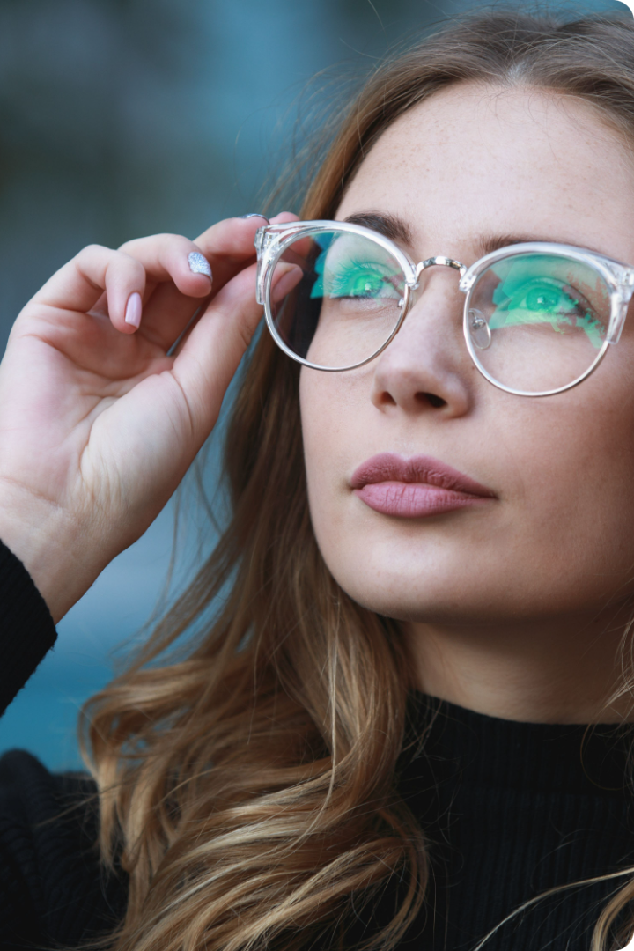
Improving Vision and Reducing Eye Strain
Our auto-correcting spectacles are designed to enhance your visual experience by continuously adapting to your unique eye needs. With precision lens adjustments, you'll enjoy crystal-clear sight and reduced eye fatigue, even during extended wear.

Slide 9
Compatibility with Prescription Lenses
Seamless Integration
Personalized Adjustments
Our auto-correcting spectacles are designed to seamlessly integrate with your existing prescription lenses. The advanced sensors and algorithms can adapt to work in harmony with your custom eye care solution.
The lens correction system dynamically adjusts to complement your prescription, ensuring a perfect balance between the auto-adjustment and your specific vision needs. You get the best of both worlds.

Slide 10



Potential Applications Beyond Vision Correction
Health Monitoring
Augmented Reality
Sports Performance
The advanced sensors in our auto-correcting glasses can track eye health metrics, providing early detection of vision-related conditions and enabling personalized preventative care.
By seamlessly integrating with AR technology, our smart glasses can overlay digital information and interactive experiences directly onto the user's field of vision for enhanced productivity and entertainment.
Athletes can benefit from our auto-correcting lenses, which adapt in real-time to changing lighting conditions and movement, improving visual acuity and reaction times for enhanced sports performance.

Slide 11
Lets see the,
BUSINESS CANVA

Slide 12










Key Partners
Optical Lens Manufacturers: Suppliers of high-quality adjustable lenses.
Electronics Manufacturers: Suppliers of sensors, microcontrollers, and other electronic components.
Medical Professionals and Optometrists: Partners for clinical trials, endorsements, and feedback.
Software Developers and Machine Learning Experts: Partners for developing the software and machine learning algorithms.
Marketing and Distribution Channels: Retailers, e-commerce platforms, and marketing agencies to help sell the product.
B
U
S
I
N
E
S
S
Key Activities
Research and Development: Continuous R&D to improve lens technology, sensors, and machine learning algorithms.
Product Design and Testing: Designing user-friendly and aesthetically pleasing spectacles
Manufacturing and Assembly: Efficient manufacturing and assembly of the spectacles.
Value Propositions
Automatic Vision Correction: Real-time adjustment of lenses for optimal vision clarity.
User Convenience: No need for multiple pairs of glasses or manual adjustments.
Innovative Technology: Cutting-edge machine learning algorithms and sensor technology.
Aesthetically Pleasing Design: Stylish and comfortable spectacles.
Personalization: Customized vision correction for each user.
Customer Relationships
Personalized Support: Dedicated customer service and support for troubleshooting and maintenance.
Engagement through Apps: Mobile app for settings adjustment, feedback, and updates.
Community Building: Building a community of users through social media and user forums.
Customer
Segments
Individuals with Vision Problems: Primary users who need vision correction.
Technology Enthusiasts: Early adopters who are interested in innovative technologies.
Elderly Population: Older adults who need frequent vision adjustments.
Professional Users: Professionals who require precise vision for their work (e.g., surgeons, artists).
Channels
E-commerce Platforms: Online sales through the company website and major e-commerce platforms.
Retail Stores: Partnerships with optical retailers and electronic stores.
Medical Channels: Optometrist offices and eye clinics.
Direct Sales: Direct sales through sales representatives
Key Resources
Technical Expertise: Skilled engineers, optometrists, and machine learning experts.
Manufacturing Facilities: Access to production facilities for lenses and electronic components.
Financial Resources: Capital for R&D, manufacturing, and marketing activities.
Cost Structure
R&D Costs: Expenses related to research and development of the technology.
Manufacturing Costs: Costs of producing lenses, sensors, and other components.
Marketing and Sales Costs: Expenses for advertising, promotions, and sales activities.
Distribution Costs: Costs associated with distributing the product to various channels.
Customer Support Costs: Maintaining a customer service team and support infrastructure.
Revenue Streams
Direct Sales: Revenue from selling the spectacles to end customers.
Subscription Model: Offering subscription services for software updates and additional features.
Service Fees: Charging for maintenance, repairs, and custom adjustments.
Partnerships and Licensing: Licensing the technology to other companies or forming strategic partnerships.
C A N V A

Slide 13
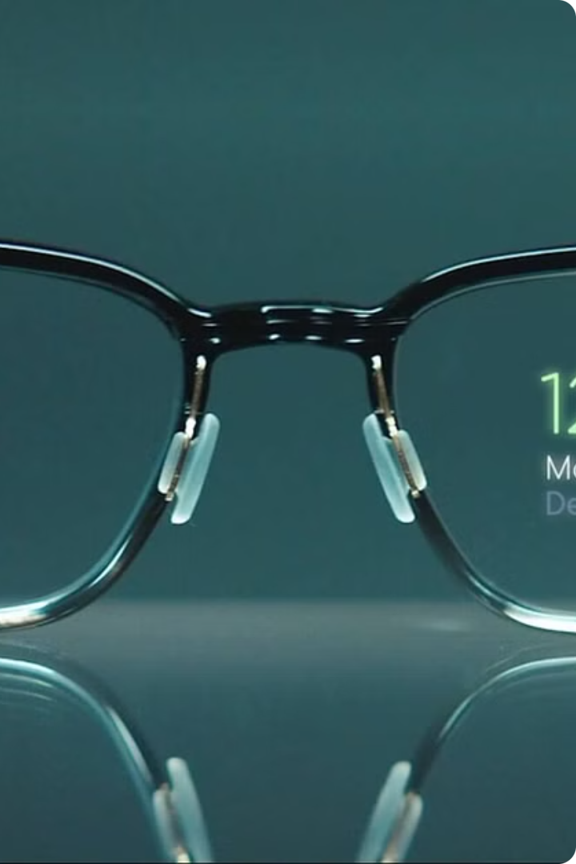
Conclusion and Future Developments
As we look ahead, the future of auto-correcting spectacles holds tremendous promise. With continued advancements in sensor technology, machine learning, and personalized vision algorithms, these smart glasses will become increasingly precise, adaptive, and versatile.

Slide 14
THANK YOU!!

