Slide 1

SMART INDIA HACKATHON 2026
Problem Statement ID - SIH26033
Problem Statement Title - Multiple intermediaries reduce farmers earnings and increase consumer prices.
Theme - Agriculture, Food Tech & Rural Development
PS Category - Software
Team ID -
Team Name (Registered on portal) - Parallax

Slide 2




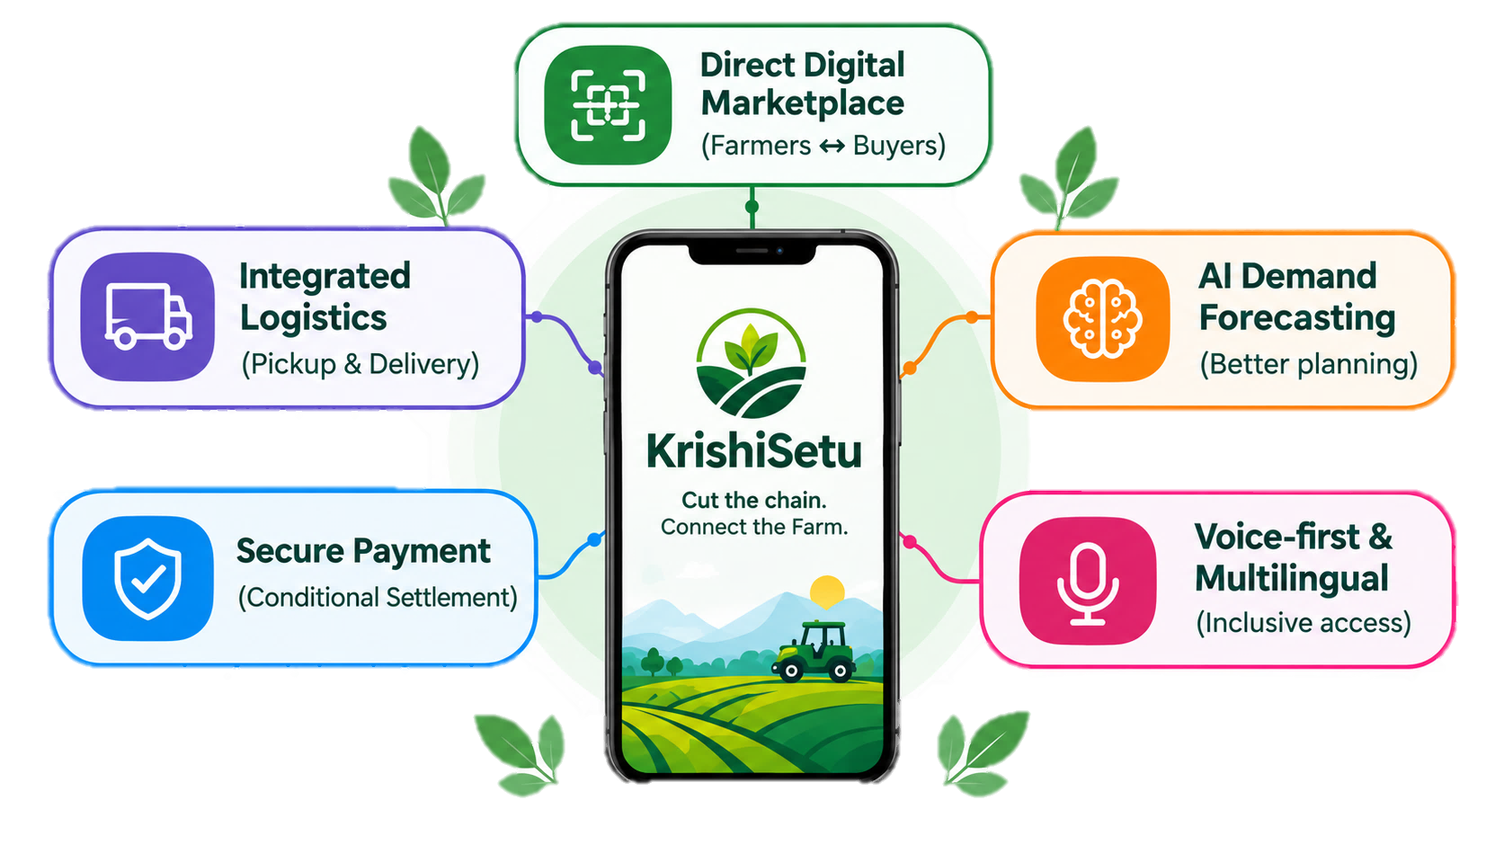












Parallax
KrishiSetu
Cut the chain. Connect the Farm.
The Problem
It addresses the Problem by
Farmer receive
33-37%
of consumer price
Direct market access
Connects farmers/FPOs directly with consumers and buyers.
Consumer pay
2 – 3x
the farm gate price
Better price discovery
Helps farmers access demand and market information.
40% of perishable product wasted before reaching market
Reduce intermediary dependence
Fewer middlemen can improve transparency and farmer earnings.
Multiple intermediaries:
Higher cost, less transparency, more waste.
Lower post-harvest losses
Coordinate logistics helps move produce efficiently and reduce wastage.
Traditional Chain (The Problem)
KrishiSetu Solution
Impact
Higher earnings for farmers.
Fair prices for consumers.
Farmer
Trader
(Arhtiya)
Wholesaler
Retailer
Consumer
Farmer / FPO
Consumer / Bulkbuyer
Reduced waste & efficient supply chain.
KrishiSetu
Stronger rural economy & livelihoods.

Slide 3

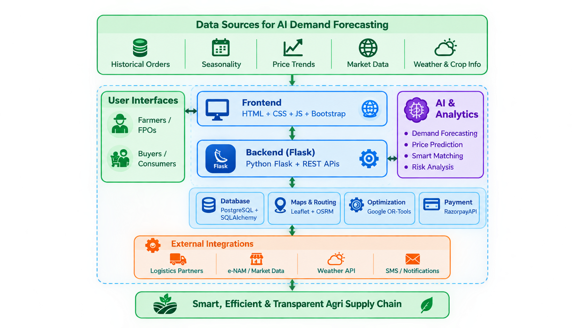


Technical Approach
Parallax
“ Technology that connects every step ”
Tech Stack
Data Sources for AI Demanding Forecasting
System Flow
Frontend
1
Farmers list their produce.
Web: Html5 + CSS3 + Javascript + Bootsrap
2
AI forecasts demand.
HTML
CSS
JS
Bootstrap
3
Smart matching with buyers.
Backend
Buyers orders & pays securely.
Python Flask + REST APIs
4
Python
Flask
REST API
5
Logistics pickup and delivery.
Database
6
Quality confirmed & payment released.
PostgreSQL + SQLAlchemy
PostgreSQL
SQLAlchemy
Key Features
AI / ML
Python + Pandas + NumPy + Scikit-learn
Real time market access & live pricing.
Pandas
NumPy
Scikit-learn
Maps & Routing
AI-based demand forecasting.
Leaflet + OpenStreetMap + OSRM
Smart matching of farmers & buyers.
Leaflet
OpenStreetMap
OSRM
Route optimization for efficient logistics.
Optimization
Google OR-Tools
OR-Tools
Secure digital platforms.
Payment
Security & Reliability
RazorpayAPI
Prototype link & video
Razorpay
Secure Transactions
Data Protection
Scalable Cloud Hosting
24/7
Uptime
No new hardware required.

Slide 4






















Feasibility and Viability
Parallax
2. FEASIBILITY
3. VIABILITY
1. FINANCIALS
Technical + Market + Operational
Why it can sustain and scale
Existing stack:HTML • CSS • JavaScript • Node.js • Express • PostgreSQL • OR-Tools
Revenue Engines:
Logistics Fee | Buyer/FPO Tools | Analytics
Commission
Per-transaction fee
Logistics Fee
Coordination charge
FPO Tools
Premium subscriptions
Maps + OR-Tools: distance, capacity, pickup/delivery, time windows, routing
Public-private partnerships with FPOs & logistics firms enable asset-light scaling.
86.2% of holdings are small & marginal (≤2 ha).
Illustrative Revenue model
Revenue per ₹1,000 order
B2B repeat demand → recurring transactions
398.35M rural internet subscribers; 44.16 per 100 population (FY 2023–24)
Fragmented supply + recurring bulk demand creates a scalable logistics opportunity
Farmer
₹850 (85%)
e-NAM currently links 1,522 markets across 23 states + 4 UTs — evidence of a large digital agricultural market ecosystem.
Scalable by geography, crop and buyer segment
Logistics
₹100 (10%)
Value created: better aggregation, lower friction, more traceability
Buildable with existing technology + real market need + practical partner-based operations.
Scale levers: Orders ↑ GMV ↑ Repeat buyers ↑ Route utilization ↑
Krishi Setu
Platform Fee
₹50 (5%)
4. CHALLENGES & MITIGATION
Digital Literacy
Connectivity
Payment Trust
Logistics Availability
Cold – Chain
Limitation
Key Takeaway
Farmers keep most of the order value,
With a small platform fee keeps Krishi Setu
sustainable
Multiple
Verified
partners
Local language
+ simple UI
Voice interface
Offline /
Low-bandwidth
design
Escrow • Delivery Confirmation • Automated Settlement
Suitable vehicle
+ priority
routing

Slide 5



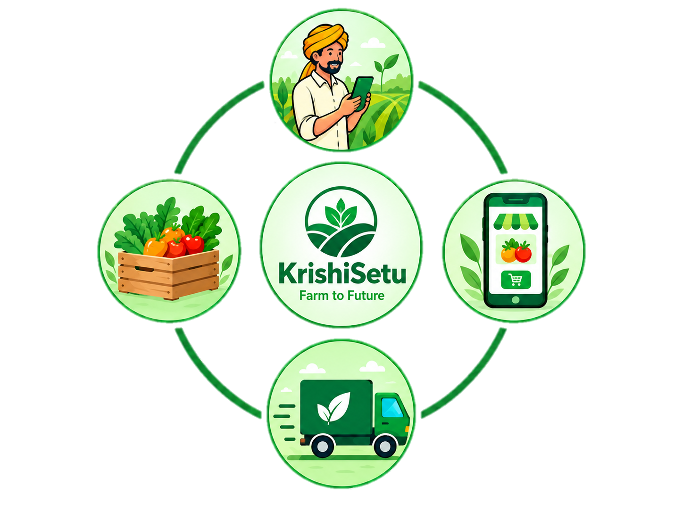






Impact and Benefits
Parallax
“ Better Prices. Less Waste. Greater Impact.”
FARMER BENEFITS
SOCIAL IMPACTS
Market Access
Direct connect to bulk buyers and consumers
Less Farmer Distress
Better price reduce dependency on moneylenders.
Women Empowerment
64% of agri-workforce, FPO model gives direct income.
Less Rural Migration
Stable from income reduces migration to cities.
25-35%
Higher income
Better price no middle man
Reduced Distress
Sell at right time, right place.
Guaranteed Payment
Payment released after delivery.
CONSUMER BENEFITS
ENVIRONMENTAL IMPACTS
Less Food Waste
Efficient logistics reduces 40% pre-market spoilage.
Lower Emissions
Route optimization cuts fuel use & carbon footprints.
  Less Methane
  Less rotting food = less decomposition based methane release.
Lower Prices
No middleman = affordable produce.
Fresher Produce
Direct farm to door delivery.
Price Stability
AI forecasting reduce price shocks.
Full Traceability
Digital record of food origin.
5

Slide 6
RESEARCH AND REFERENCES
Parallax

Slide 7
IMPORTANT INSTRUCTIONS
Please ensure below pointers are met while submitting the Idea PPT:
Kindly keep the maximum slides limit up to six (6). ( Including the title slide)
Try to avoid paragraphs and post your idea in points /diagrams / Infographics /pictures
Keep your explanation precise and easy to understand
Idea should be unique and novel.
You can only use provided template for making the PPT without changing the idea details pointers (mentioned in previous slides).
You need to save the file in PDF and upload the same on portal. No PPT, Word Doc or any other format will be supported.
Note - You can delete this slide (Important Pointers) when you upload the details of your idea on SIH portal.

