Slide 1
REVIEW.
PROCURE.
FULFILL.
SHEET 01 / 07
2'-6"
SMART TAKEOFF FOR WINDOW DEALERS
5
6'-0"
From an architectural drawing set to installed windows, as one continuous, checkable record.
TESTED ON A REAL 31-PAGE DRAWING SET · DEMO v18
5·3 / 30 × 72 IN / CASEMENT
Notes:
WindowBid takes a window dealer from an architectural drawing set to installed windows. Three stages: Review, Procure, Fulfill. The drawing on the right is the record we will follow: window 5·3, a 30 × 72 inch casement.

Slide 2
THE TAKEOFF IS STILL DONE BY HAND.
SHEET 02 / 07
01 / THE PROBLEM
ONE WINDOW, TODAY
30–90
pages in one drawing set, with each window's facts spread across them
A-2.1 · FLOOR PLAN
A-4.1 · WINDOW SCHEDULE
3 3'-0" × 6'-0" CASEMENT 10
5 2'-6" × 6'-0" CASEMENT 15
HOURS
to find the pages, count every opening and type it all in by hand
5
MATCHED
BY HAND
7 3'-0" × 8'-0" PICTURE 6
6-CAR GARAGE
Defined pages away from its tag
4×
retyped after that, and no number can be traced back to the drawing
THEN RETYPED, BY HAND, INTO
RFQ
BID COMPARISON
PROPOSAL
PURCHASE ORDER
Notes:
Today the takeoff starts with a person and a PDF. A floor plan shows tag 5 in a wall; a schedule on another sheet says what 5 means. Someone matches them by hand, types it into a spreadsheet, and then the same numbers are retyped into the RFQ, the bid comparison, the proposal and the purchase order.

Slide 3
READ ONCE. CONFIRM. CARRY IT THROUGH.
SHEET 03 / 07
02 / THE IDEA
01
LIVE · REAL READING
02
PREVIEW · SAMPLE BIDS
03
PREVIEW · SAMPLE DATES
REVIEW
PROCURE
FULFILL
The drawing becomes data.
The data becomes a priced deal.
The deal becomes delivered windows.
UPLOAD → EXTRACT → REVIEW
RFQ → BIDS → PROPOSAL
PO → DELIVERY → INSTALLED
DEALER VERIFIES
CUSTOMER ACCEPTS
MANUFACTURER ACKNOWLEDGES
Window 5·3 on the plan is line 01 on the RFQ, part of the chosen bid, a line on the proposal and a line on the purchase order. Nothing is retyped, and every number traces back to its sheet.
AI READS, A PERSON CONFIRMS
AI READ
VERIFIED BY A PERSON
Notes:
The idea: read the drawings once, let a person confirm what was read, and carry that same record unchanged to installation. Review is real today: uploading, reading, mapping and verification. Procure and Fulfill run on sample manufacturers, prices and dates, and are labelled as a preview.

Slide 4
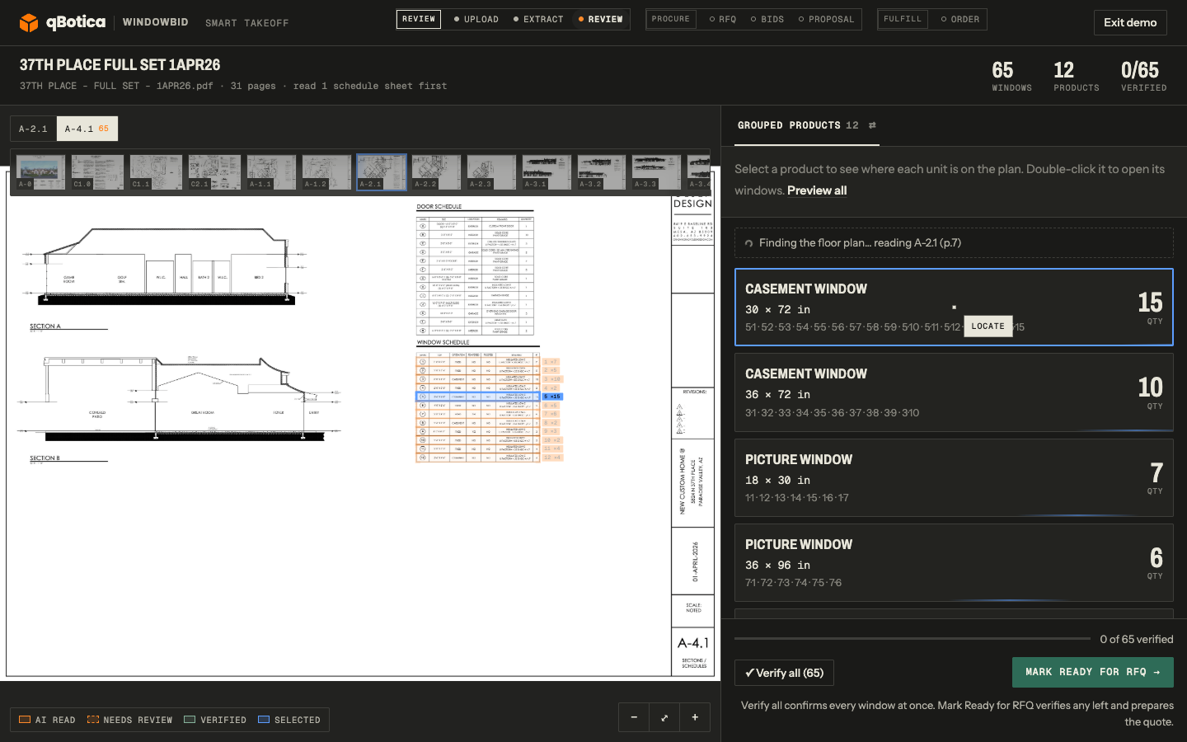
THE SCHEDULE IS READ FIRST.
SHEET 04 / 07
03 / EXTRACT
All 31 pages are sorted in about half a minute. The window schedule on A-4.1 already gives every window a size and a count, so it is the takeoff. Nothing else is read just in case.
2
1
65
12
~1
WINDOWS
PRODUCTS
MINUTE
1 SCHEDULE ROW ON A-4.1 2 THE SAME ROW AS A PRODUCT · 30 × 72 IN · QTY 15
Notes:
Real run on the 37th Place set, 31 pages. Every page gets a quick look first. The schedule is read first, and because it lists every window with a size and a count, that is already the takeoff: 65 windows in 12 products in about a minute. Clicking a product highlights its schedule row.

Slide 5
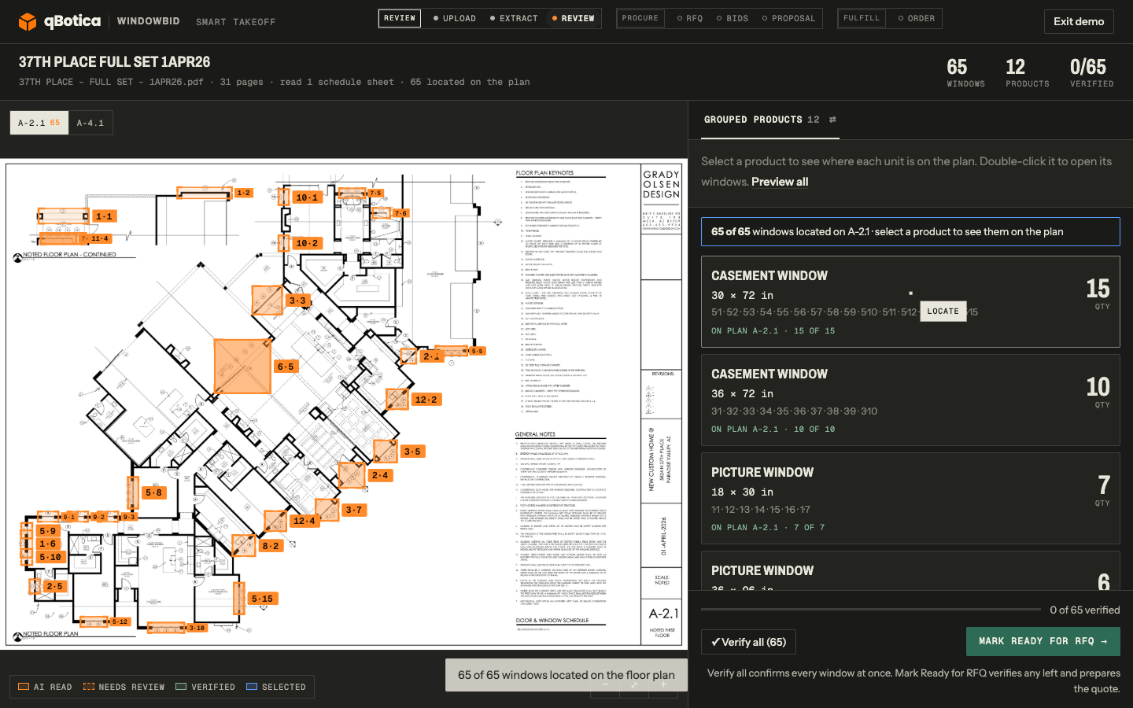
EVERY WINDOW, ON THE PLAN.
SHEET 05 / 07
04 / EXTRACT
While the dealer reviews, WindowBid finds the house plan in the set and places each scheduled window on it. The schedule stays the source of truth for counts; the plan adds where each window is and which room it serves.
2
1
65 / 65
WINDOWS PLACED ON SHEET A-2.1
1 EACH WINDOW BOXED BY ITS TAG 2 ON PLAN A-2.1 · 15 OF 15
Notes:
In the background WindowBid finds the floor plan in the PDF and places every scheduled window on it. Here all 65 of 65 land on sheet A-2.1. Counts still come from the schedule; the plan only adds location and room. Orange means read by the machine and not yet confirmed.

Slide 6
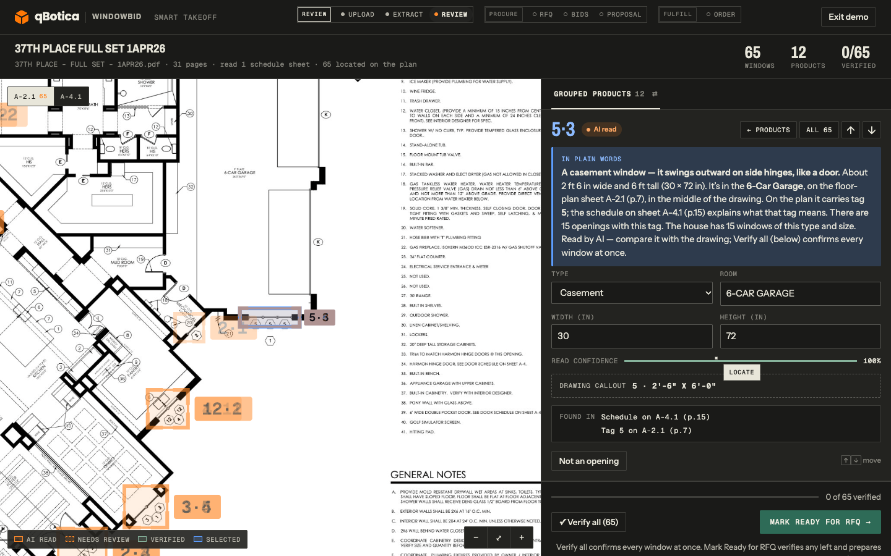
EVERY WINDOW EXPLAINS ITSELF.
SHEET 06 / 07
05 / REVIEW
1
IN PLAIN WORDS
1
A casement window, 2 ft 6 in × 6 ft, in the 6-Car Garage.
2
THE CALLOUT, AS WRITTEN
5 · 2'-6" × 6'-0", copied exactly from the drawing.
2
3
FOUND IN
3
The schedule on A-4.1 (p.15) and tag 5 on A-2.1 (p.7).
AI READ
VERIFIED
SELECTED
WINDOW 5·3 SELECTED · VERIFY ALL → MARK READY FOR RFQ
Notes:
Each window card explains itself in plain words, shows the callout exactly as it is written on the drawing, and lists where every fact came from. Nothing uncertain is hidden. One Verify all confirms the windows, and Mark Ready for RFQ hands the same record to procurement.

Slide 7
TESTED ON REAL DRAWING SETS.
SHEET 07 / 07
06 / RESULTS
37TH PLACE · 31 PAGES
8887-25 · 30 PAGES
RC-MAHESH · 1 SHEET
65/65
78
24/25
WINDOWS · 12 PRODUCTS
WINDOWS · 15 PRODUCTS
WINDOW SIZES EXACT
Read from the schedule in about a minute, matching it exactly. All 65 then placed on plan A-2.1.
Two copies of the schedule, counted once, not doubled. 70 of 78 then placed on the plans.
No schedule at all: sizes read from plan notes like "2650 SH", and untagged openings explained.
WHAT'S NEXT
01
02
03
04
Client, dealer and manufacturer accounts
Real manufacturer bids
Signature and PO acknowledgement
Always-on hosting
Notes:
Results on real sets. 37th Place: 65 of 65 windows from the schedule in about a minute, all placed on the plan. 8887-25: two copies of the schedule counted once, 78 windows, 70 placed. RC-Mahesh: a single plan with no schedule, 24 of 25 window sizes read exactly. Next: three accounts, real bids, signatures and permanent hosting.

