Slide 1
Group 3
Ramakrishna Reddy Kovvuri
Shravyasri Chelkala
Aravind Siddhanthi
Niharika Madhadi
DTSC5082.020

Slide 2
Enhancing Fake News Detection with Retrieval Augmented Generation (RAG) for Fact Verification in U.S. Political News

Slide 3
Contents
Title
Introduction
Background
Problem Statement
Literature Review
Objectives of the Study
Data Sources & Collection Strategy
Data Processing
Workflow
Model Description
Results
Conclusion
References

Slide 4
Introduction
Misinformation spreads 6x faster than factual information on social media
Average person encounters 50-100 potentially misleading news claims daily
Traditional fact-checking methods are labor-intensive and time-consuming
Need for automated, AI-powered tools to help users verify information quickly
Empowering users to make informed decisions based on reliable news sources

Slide 5
Background
Political misinformation poses a major threat to democratic discourse and public opinion
Fact-checking political claims requires timely, source-grounded, and context-aware verification
Most fake news detection tools lack real-time data integration or transparency in how claims are verified
RAG-based systems enhance fact verification by retrieving evidence from trusted sources before generating responses
Our project focuses on using RAG + semantic search to create a chatbot that verifies U.S. political claims with real-time, explainable outputs

Slide 6
Problem Statement
This project addresses the challenge of information verification in an era of overwhelming news content.
Traditional search engines rely on keyword matching and popularity metrics, often failing to provide context-specific factual information.
The News RAG Chatbot enables users to:
Query a custom database of fact-checked news articles
Retrieve semantically relevant information rather than keyword matches
Receive contextually appropriate responses grounded in verified sources
Trace answers back to original sources for verification
Create and maintain their own knowledge base of trusted information

Slide 7
Literature Review
Lewis et al. (2020) introduced the Retrieval-Augmented Generation (RAG) framework that integrates neural retrievers with generative models. This served as the core architectural foundation for our chatbot system.
Gao et al. (2023) demonstrated a 23% increase in accuracy when using RAG compared to standard large language models (LLMs). This validated our decision to adopt a RAG-based approach for fact verification.
Izacard and Grave (2021) showed the effectiveness of vector embeddings in enhancing semantic search, guiding our implementation using Sentence-BERT and FAISS for meaningful query-document matching.
Ngo et al. (2023) emphasized that LLMs integrated with source retrieval can reduce hallucination by up to 42%. This directly supports our goal of generating accurate, grounded, and trustworthy responses.

Slide 8
Objectives of the Study
Develop a customizable chatbot system leveraging RAG architecture for news fact-checking
Create an efficient retrieval mechanism using vector similarity search
Design a user-friendly interface for both system training and querying
Implement context-aware response generation using LLM integration
Evaluate system performance against baseline approaches
Enable source attribution for response verification

Slide 9
Data Sources & Collection Strategy
Data Sources: Our chatbot relies on high-quality, trusted fact-checking platforms to ensure the accuracy and credibility of information:
PolitiFact – Provides detailed verdicts on political claims using their "Truth-O-Meter."
FactCheck.org – A nonpartisan, nonprofit project that monitors the factual accuracy of political statements.
We built a dedicated web scraping pipeline using Beautiful Soup and requests to extract structured data from fact-checking articles.
Extracted Fields:
Article Title – The main claim being verified (e.g., “Biden said the economy is booming”)
Detailed Description – Full fact-check content including analysis, reasoning, and ruling
Publication Date – For assessing recency and relevance of the claim
Source URL – Direct link to the original article for transparency and traceability

Slide 10
Data Processing
Text Normalization & Cleaning: Standardizes raw text by lowercasing, removing noise like HTML, punctuation, and boilerplate. This ensures uniform input for embeddings and improves retrieval accuracy.
Embedding Generation using Sentence-BERT: Converts cleaned text into dense semantic vectors using pre-trained Sentence-BERT models. These embeddings capture context and meaning beyond simple keyword overlap.
Vector Indexing with FAISS: This enables fast similarity search by organizing embeddings into efficient index structures. It allows real-time matching between user queries and stored fact-checks.
Metadata Storage for Source Attribution: Stores article titles, URLs, and publication dates alongside embeddings. This enables transparency and traceability in chatbot responses.

Slide 11
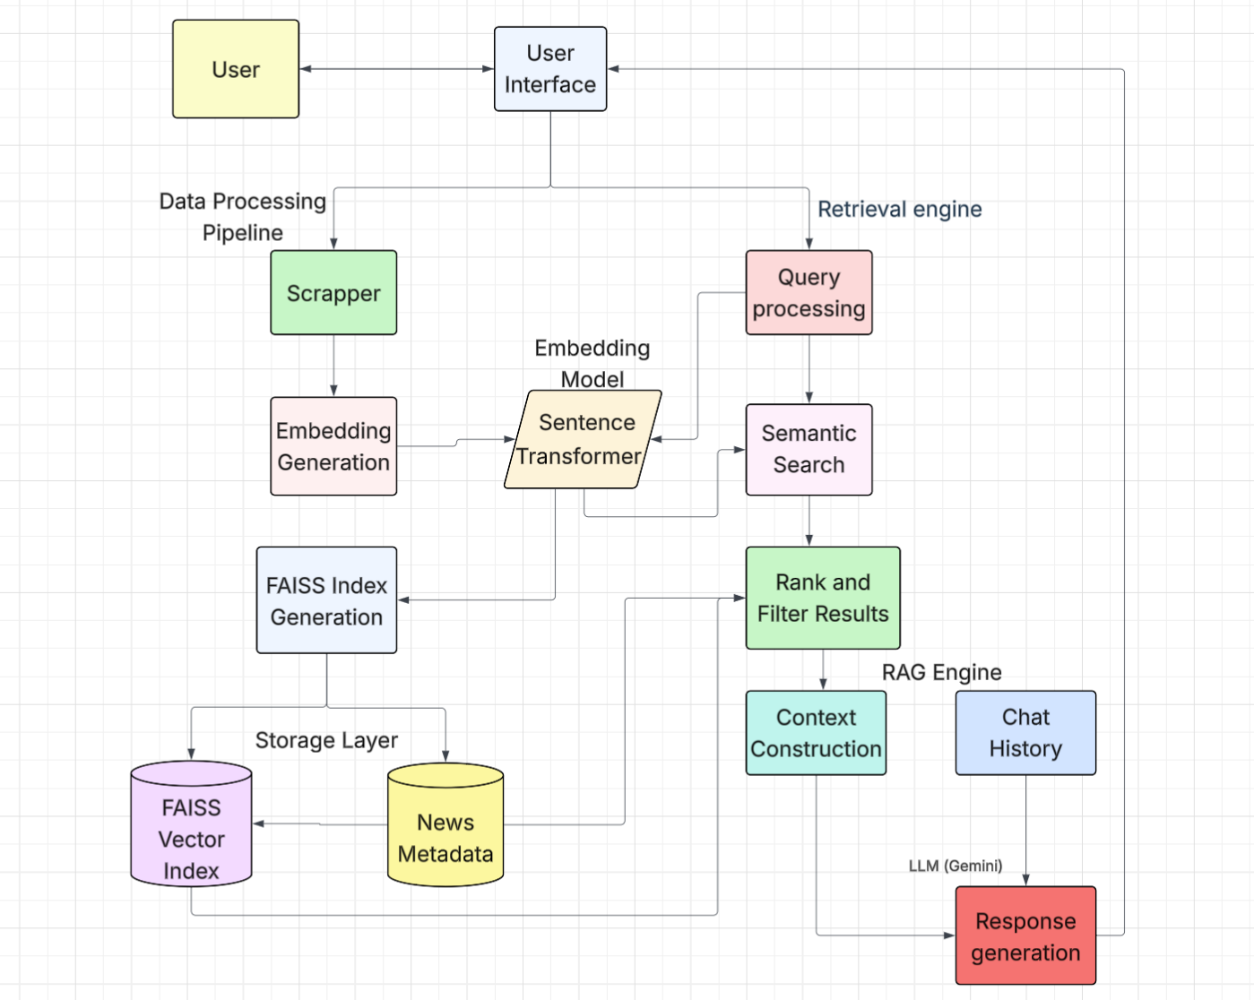
Workflow

Slide 12
Model Description
Embedding Model: Sentence-BERT (all-MiniLM-L6-v2)
Model Architecture: Based on a distilled BERT model with a Siamese network structure. Fine-tuned specifically for semantic textual similarity, paraphrase detection, and retrieval tasks.
Vector Dimension: 384-D: Each input sentence is transformed into a 384-dimensional dense vector. Lower dimensionality ensures fast computations without major accuracy loss.
Training Dataset: Trained on 1+ billion sentence pairs from datasets like SNLI, STS, NLI, and more. Captures deep semantic relationships across a wide variety of topics.
Performance: Optimized for semantic search, question answering, and RAG tasks. Lightweight (~65MB) and fast, ideal for real-time applications with minimal latency.

Slide 13
Model Description
Vector Database: FAISS (Facebook AI Similarity Search)
Technology Overview: FAISS is an open-source library developed by Facebook AI Research. It supports high-speed vector similarity search over large-scale datasets.
Index Type: FlatIP (Inner Product): Uses brute-force search over all vectors, best for maximum accuracy in smaller-to-medium datasets. Inner Product + L2 normalization mimics cosine similarity effectively.
Search Method: Cosine Similarity with L2 Normalization: All vectors are L2-normalized to ensure cosine similarity-based comparisons. Ensures that semantically similar embeddings are ranked closer.
Performance: Achieves O(log n) retrieval time for large-scale indexes (with optimized indexes like HNSW or IVF). In our case, FlatIP provides precise matching with sub-second query latency.

Slide 14
Model Description
Large Language Model: Google Gemini 1.5 Flash
Model Overview: Gemini 1.5 Flash is a lightweight, high-speed variant of Google's Gemini family. Designed for real-time applications, it balances speed, efficiency, and quality.
Parameters & Context Window: Supports up to 32,000 tokens of context — ideal for grounding answers in long fact-checking passages. Enables multi-turn conversations, long document reasoning, and citation tracking in responses.
Response Control: We use a temperature of 0.2 to encourage factual, deterministic outputs. This minimizes hallucination and ensures responses are grounded in retrieved evidence.
API-Based Integration: Gemini is accessed via Google AI Studio API with easy integration into our RAG pipeline. Parameters such as temperature, top-p, max tokens, and safety settings are fully configurable.

Slide 15
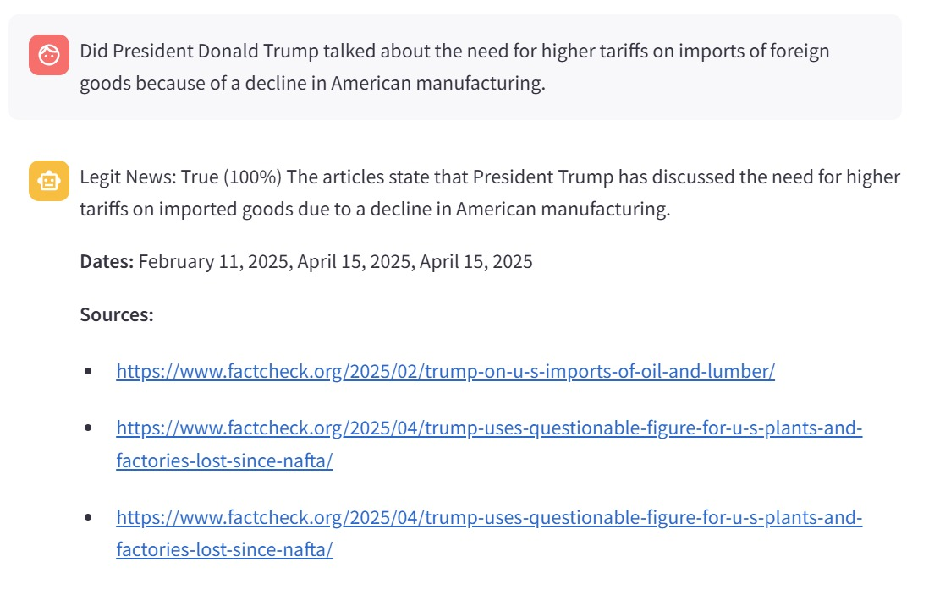
Results
User Query: Did President Donald Trump talk about the need for higher tariffs on imports of foreign goods because of a decline in American manufacturing?
RAG Chatbot retrieved accurate context from trusted sources (factcheck)
Verdict-Legit News: True (100%)
Explanation includes rephrased fact-check, dates, and source links
Demonstrates chatbot’s ability to verify claims with traceable evidence

Slide 16
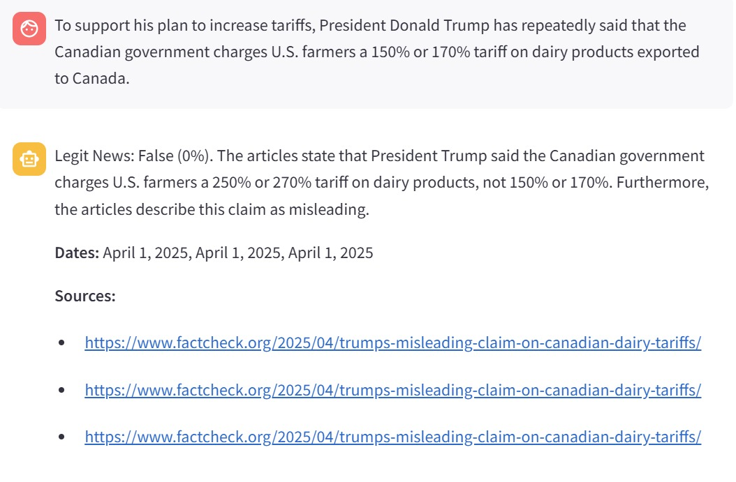
Results
User Query: To support his plan to increase tariffs, President Donald Trump has repeatedly said that the Canadian government charges U.S. farmers a 150% or 170% tariff on dairy products exported to Canada.
RAG Chatbot retrieved accurate context from trusted sources (factcheck)
Verdict-Legit News: False (0%)
Explanation includes corrected fact-check with accurate percentages, dates, and source links.

Slide 17
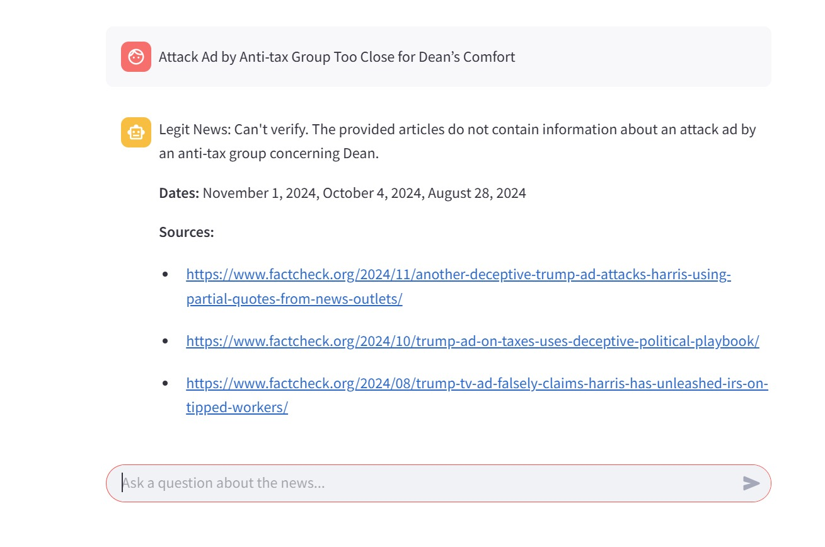
Results
User Query: Attack Ad by Anti-tax Group Too Close for Dean's Comfort.
RAG Chatbot tried retrieved accurate context from trusted sources (factcheck), but this data is backed from 2003 and is not present in our vector database.
Verdict-Legit News: Can’t verify
It gives that it does not contain the complete information about the claim and also give any related articles from recent times based on semantic search.

Slide 18
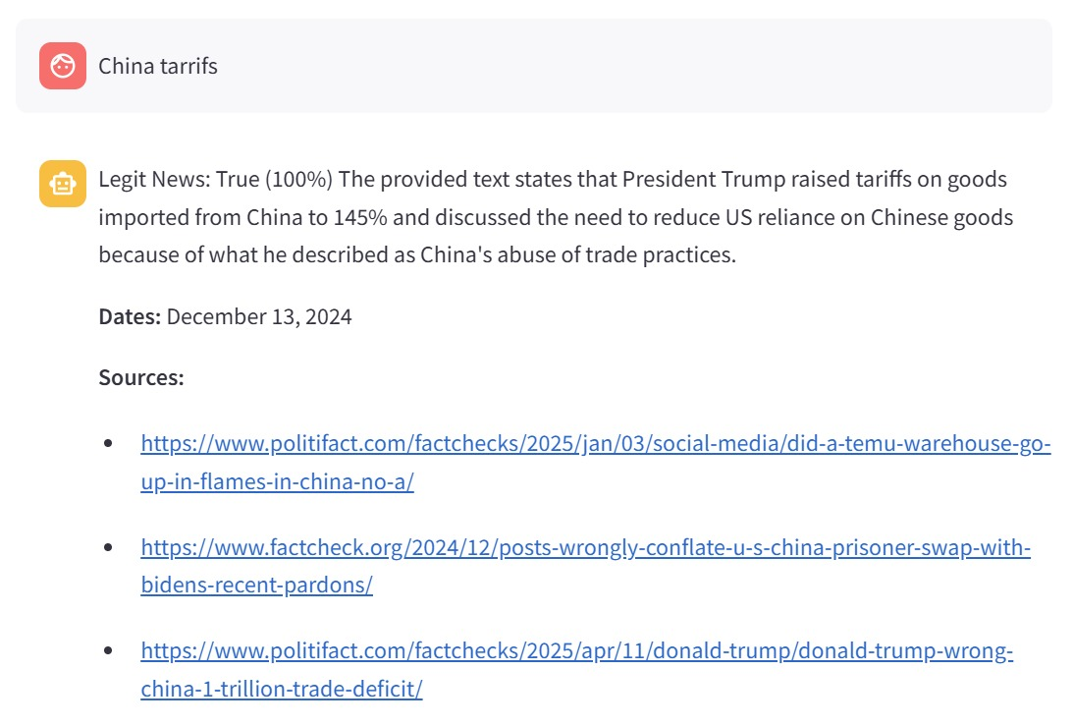
Results
User Query: China tariffs
RAG Chatbot retrieved accurate context from trusted sources (factcheck and politifact)
Verdict-Legit News: True (100%)
Even though user input is incomplete, it gives current fact-check, dates, and source links about it.
Demonstrates chatbot’s ability to verify claims with traceable evidence

Slide 19
Conclusion
The News RAG Chatbot showcases a cutting-edge approach to information verification by integrating vector search for semantic understanding, LLMs for natural interaction, and source attribution for transparency.
By combining semantic search, generative AI, and source attribution, it delivers responses that are both accurate and transparent.
The project bridges the gap between retrieval-based grounding and natural language generation, setting a new standard for trust in AI communication.
With a flexible architecture and user-driven design, it’s well-suited for custom domains, continuous scaling, and real-world deployment.
As we look ahead, ongoing innovations like multilingual support, real-time updates, and user feedback loops will further enhance its impact.

Slide 20
References
Lewis, P., et al. (2020). "Retrieval-Augmented Generation for Knowledge-Intensive NLP Tasks." NeurIPS 2020.
Gao, J., et al. (2023). "Retrieval-Augmented Generation for Large Language Models: A Survey." arXiv:2312.10997.
Izacard, G., & Grave, E. (2021). "Leveraging Passage Retrieval with Generative Models for Open Domain Question Answering." EACL 2021.
Ngo, T., et al. (2023). "Fact-Checking with LLMs: An Analysis of Truth Verification." ACL 2023.
Reimers, N., & Gurevych, I. (2019). "Sentence-BERT: Sentence Embeddings using Siamese BERT-Networks." EMNLP 2019.
Johnson, J., et al. (2021). "Billion-Scale Similarity Search with GPUs." IEEE Transactions on Big Data.

Slide 21
Thank You

