Slide 1
MedXpert: A Multimodal AI Chatbot for Symptom Recognition, Medicine Recommendations, Multilingual Care, and Personalized User Manuals
Authors:
Krishna Annavaram
VighnaSree Vara

Slide 2
Introduction
Many patients struggle to find quick, accurate, and understandable medicine recommendations based on their symptoms.
Existing platforms are overloaded with clinical jargon, inconsistent data, and lack of regional language support.
There’s a critical gap between natural symptom descriptions and structured medical guidance that patients can easily understand.
MedXpert bridges this gap using a conversational AI assistant that routes queries to SQL or vector databases and summarizes results using GPT-4.
It also enables users to generate multilingual, patient-friendly medicine manuals — making healthcare more accessible and personalized.

Slide 3
Literature Survey
Base Paper 1 - Wang, Y., et al. (2024). ProbGate at EHRSQL: Enhancing SQL Query Generation. arXiv.
Problem: Existing SQL generation models in healthcare struggle with accuracy and error handling due to complex queries and ambiguous language.
Methodology: Developed a transformer-based model with probabilistic gating and an abstention mechanism to improve SQL reliability.
Limitations: Tailored for professional EMR systems, not user-facing applications with informal symptom inputs.
Reference Aspects: The fallback strategy for uncertain outputs inspired our multi-agent design, especially the use of a web-search agent when SQL generation fails.
Base Paper 2 - Jadhav, A., et al. (2023). Healthcare Chatbot Using NLP. IJCSIT.
Problem: Users lack a quick and accessible way to assess symptoms and receive relevant medical suggestions.
Methodology: Built a rule-based NLP chatbot using decision trees to classify user symptoms and suggest potential diseases.
Limitations: Lacks adaptability, multilingual output, and connection to real-time databases.
Reference Aspects: The logic of symptom categorization influenced our frontend chatbot flow and initial input classification module.

Slide 4
Literature Survey(Cont.)
Base Paper 3 - Patel, K. (2023). Automated Medical Chatbot. EasyChair Preprints.
Problem: Traditional chatbots without database querying capabilities offer limited support for patient health questions.
Methodology: Used static rule-based systems connected to MS Access to provide response to user-entered health queries.
Limitations: Limited scalability, lacks modern NLP techniques, and no use of advanced AI or LLMs.
Reference Aspects: This paper gave the foundational idea of linking chatbot input to SQL logic; our project modernizes this by automating SQL generation using GPT-4 and enabling live medicine recommendations.
Base Paper 4 - Robofy Inc. (2024). Symptom Checker Chatbot for Healthcare. Robofy.ai.
Problem: Many symptom checkers use predefined templates that do not adapt to individual users or retrieve structured information.
Methodology: Provided a fixed rule-based chatbot interface using symptom-condition mappings without real database interaction.
Limitations: No data backend, no personalization, and no support for medicine-specific recommendations.
Reference Aspects: Helped us design the initial chatbot interface and inspired our approach to conversational design and patient question flow.

Slide 5
Proposed Methodology
Our project aims to propose a medical chatbot system capable of suggesting relevant medicines based on user-described symptoms or health concerns.
The system provides personalized, patient-friendly medicine explanations to improve understanding and accessibility.
It supports generating multilingual user manuals, helping users access medicine information in their preferred language.
The chatbot is designed to enhance healthcare literacy by delivering fast, reliable, and easy-to-understand medicine guidance without needing technical knowledge.

Slide 6
Objectives of the Study
To develop a conversational AI chatbot that understands user-described symptoms and general health-related queries using natural language processing.
To design a dynamic routing system (RoutingAgent) that intelligently directs user queries to structured SQL searches, semantic vector searches, or LLM-based responses based on input type.
To implement structured and semantic information retrieval by integrating both a traditional PostgreSQL database and a modern vector database (Qdrant) for medicine data.
To utilize large language models (GPT-4) for summarizing medicine information into patient-friendly, easy-to-understand explanations.
To build a multilingual user manual generator, enabling users to generate downloadable medicine manuals in their preferred language.
To enhance healthcare accessibility and literacy by providing clear, personalized medicine recommendations without requiring technical expertise.

Slide 7
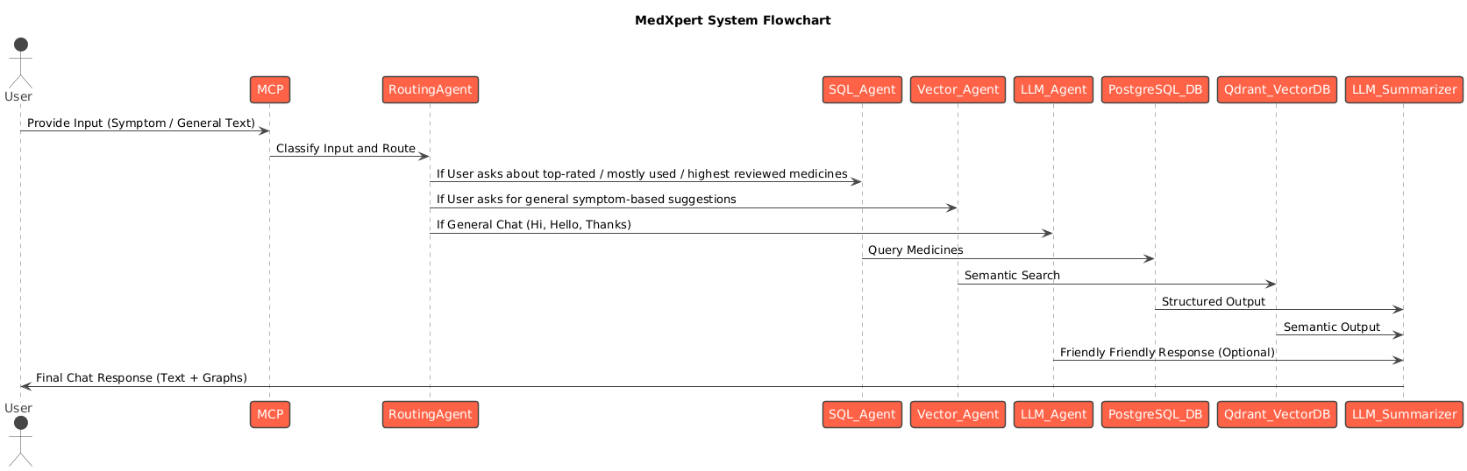
MedXpert Flow Chart

Slide 8
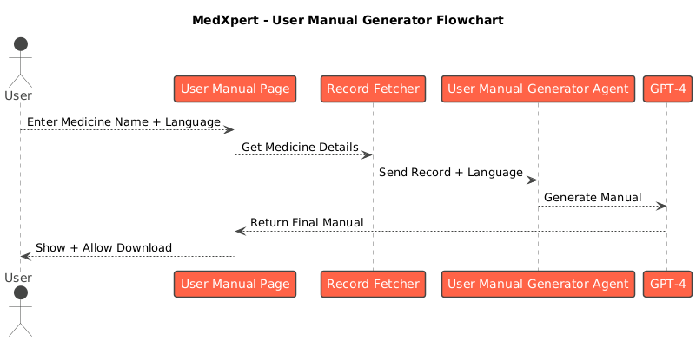
MedXpert User Manual Flow Chart

Slide 9
Data Sources and Description
Dataset 1: DailyMed SPL XML Archives (Primary Dataset)
Source: HealthData.gov – DailyMed SPL Monthly Updates
Format: ZIP files containing structured XML data and corresponding drug label images.
Duration Covered: August 2024 to February 2025
Extracted Features: Medicine Name, Composition, Uses, Side Effects, Manufacturer Details, Image URLs.
Dataset 2: Kaggle Medicine Dataset – 11,000+ Records
Source: Kaggle: 11,000+ Medicine Details Dataset
Records: Over 11,000 structured entries
Fields: Medicine Name, Composition, Uses, Side Effects, Manufacturer Details, Image URLs
Usage: Used for initial exploration, cross-referencing, and validation alongside the SPL XML dataset.
Dataset 3: DrugBank (Fallback External Source)
Source: go.drugbank.com
Status: Access to DrugBank data has been officially requested.
Use Case: To serve as a fallback resource for symptom queries not covered by the local datasets.
Note: Although access is pending, the current two datasets are sufficient to support the full scope of this project.
Table 1:Monthly Breakdown of SPL XML Archive Files
Month | Number of Labels | File Size
Aug-24 | 4,887 | 1.67 GB
Sep-24 | 4,493 | 1.39 GB
Oct-24 | 9,801 | 256.25 MB
Nov-24 | 8,038 | 2.67 GB
Dec-24 | 10,396 | 3.58 GB
Jan-25 | 7,670 | 2.58 GB
Feb-25 | 4,031 | 1.56 GB
Total | 49,316 Labels | ~13.13 GB
The datasets summarized in Table 1 form the core data foundation for this medicine recommendation system (HealthData.gov, 2024; Singh, 2023).

Slide 10
Tools and Techniques
Streamlit — for building the web-based chatbot and user manual application.
PostgreSQL — for structured storage of medicine information (SQL search).
Qdrant Vector Database — for semantic similarity search (vector search).
Sentence Transformers (MiniLM-L6-v2) — for generating dense vector embeddings from text.
OpenAI GPT-3.5 and GPT-4 — for summarization, multilingual user manual generation, and conversation handling.
Tesseract OCR — for extracting text from scanned medicine images.
LangChain (Conceptual Architecture) — inspired the modular design of chaining agents (SQL Agent, Vector Agent, LLM Agent).
Model Context Protocol (MCP) — for classifying user input types.
RoutingAgent — for directing queries to SQL, Vector, or LLM paths.
Python Libraries (Pandas, Matplotlib, dotenv) — for data handling, visualization, and environment management.

Slide 11
Agent-Based System Design
Model Context Protocol (MCP) :
Classifies user inputs into Symptom Queries, Rating-Based Queries, or General Conversations to drive intelligent routing.
RoutingAgent :
Dynamically decides the most suitable agent (SQL Agent, Vector Agent, or LLM Agent) based on the classified intent.
SQL Agent :
Executes structured SQL queries on PostgreSQL to retrieve top-rated or specific medicine records.
Vector Agent :
Conducts semantic search using SentenceTransformer embeddings and Qdrant Vector Database for vague symptom queries.
LLM Agent :
Manages general conversation tasks like greetings, clarifications, and follow-up questions using GPT-3.5/4.
LLM Summarizer :
Refines and transforms database results into concise, patient-friendly language summaries for user readability.

Slide 12
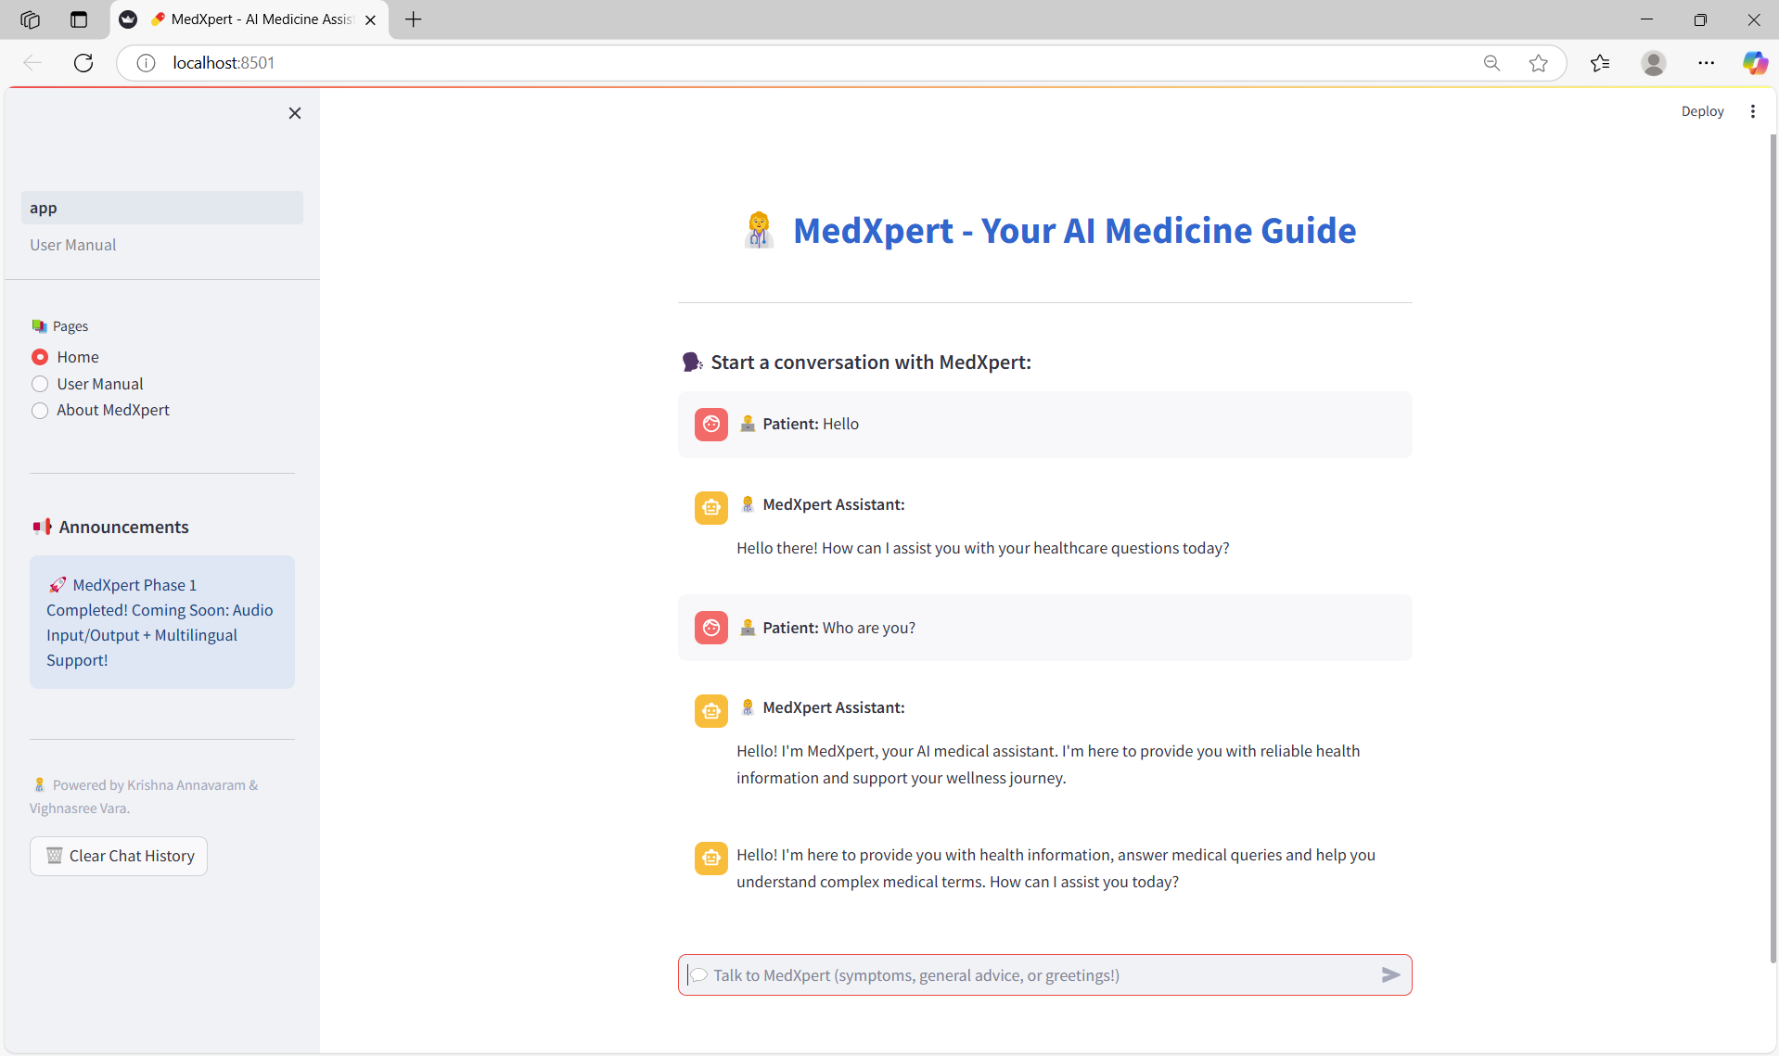
Validation of General Conversation Handling and Session Persistence
The MedXpert chatbot successfully handled open-ended greetings and general inquiries.
It correctly classified user messages like "Hello" and "Who are you?" as General Chat (not symptom-related).
The assistant responded appropriately and politely, introducing itself as a medical assistant.
Chat memory was maintained perfectly — both patient queries and MedXpert replies appeared in order.
No conversation loss was observed even after multiple exchanges.
This demonstrates that the MCP (Model Context Protocol) routing logic and LLM agent are working properly for general conversations.
Observation:
MedXpert behaves like a human-like assistant, maintaining warm interaction and enhancing user engagement during non-medical queries.
Validation:
This proves that MedXpert can handle real-world casual healthcare conversations, not just strict symptom inputs.

Slide 13
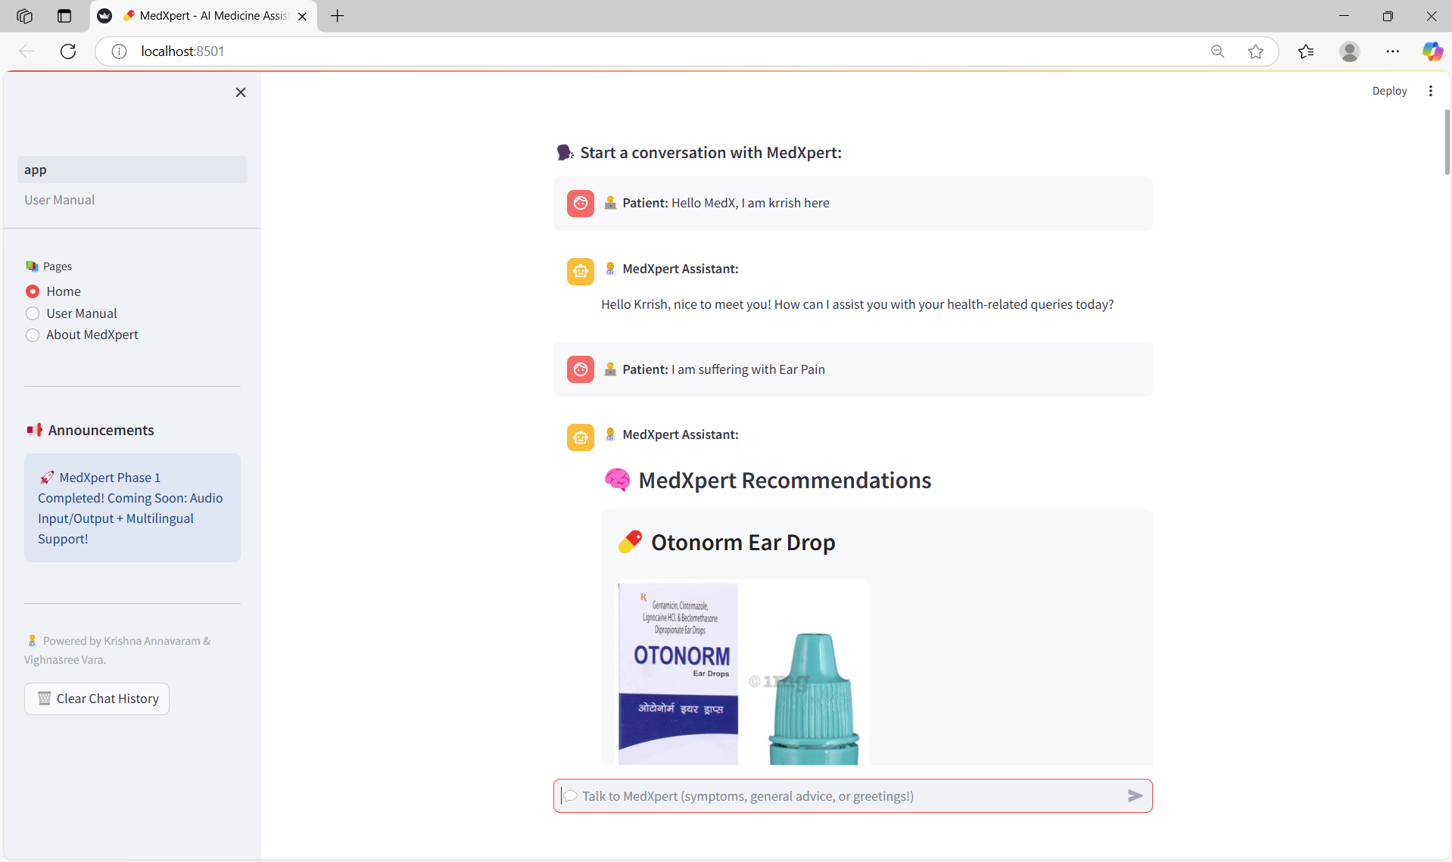
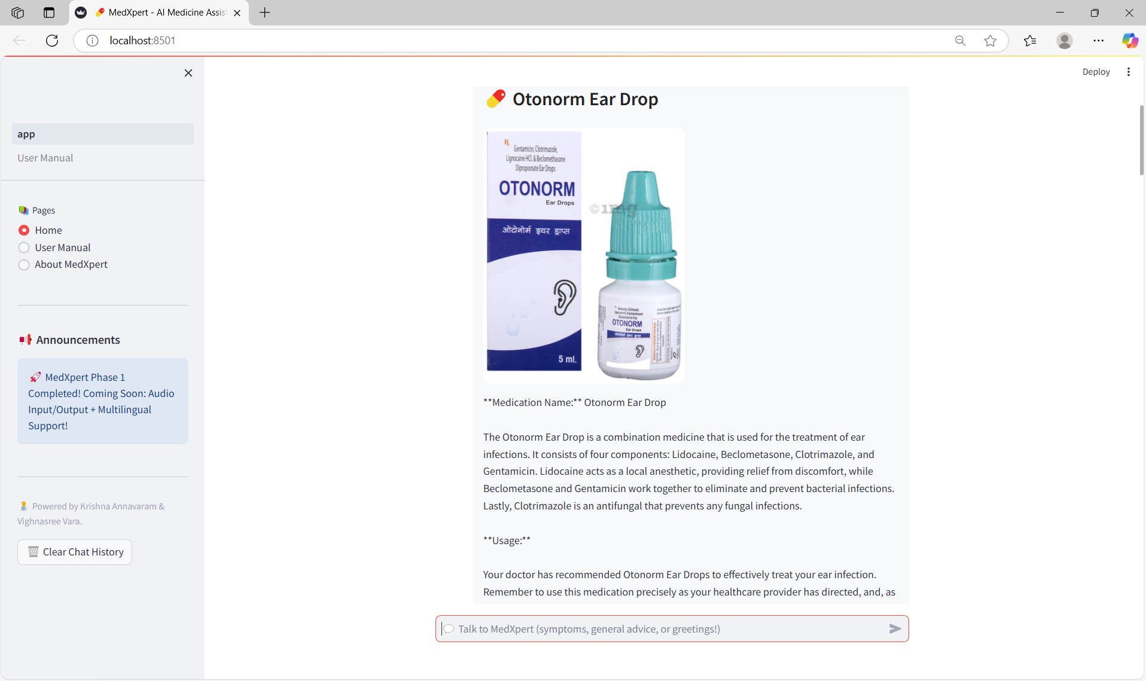
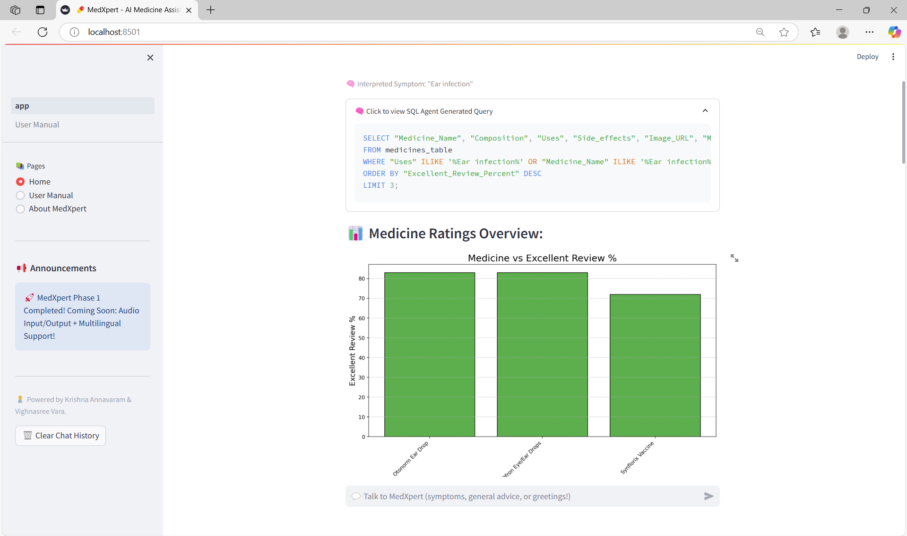
Performance of MedXpert in Symptom-Driven Recommendations

Slide 14
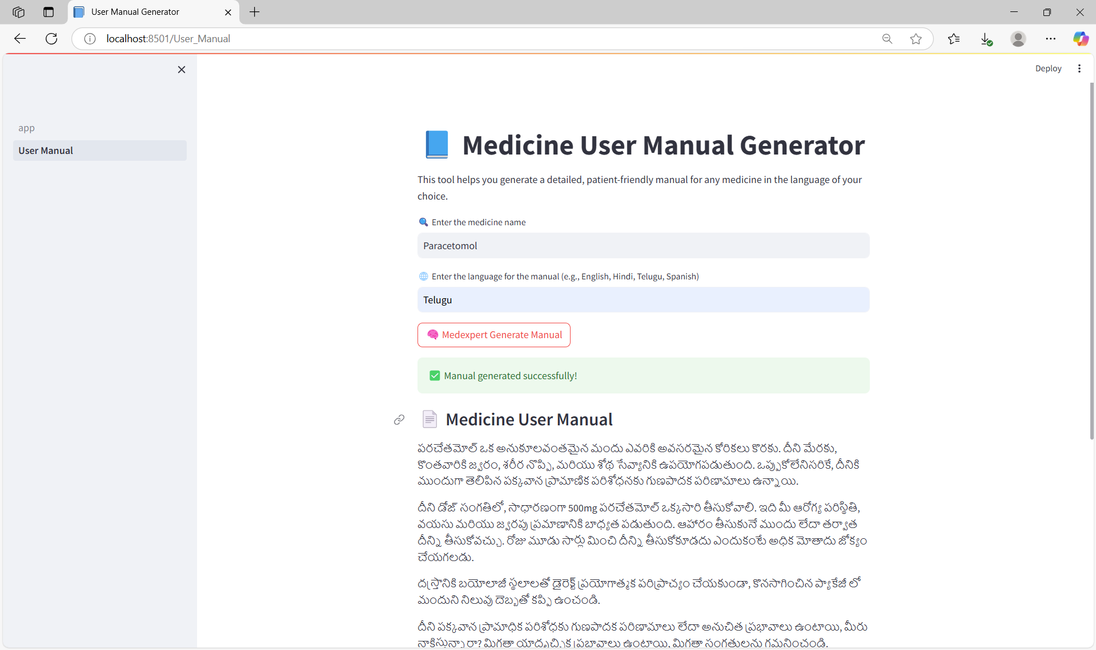
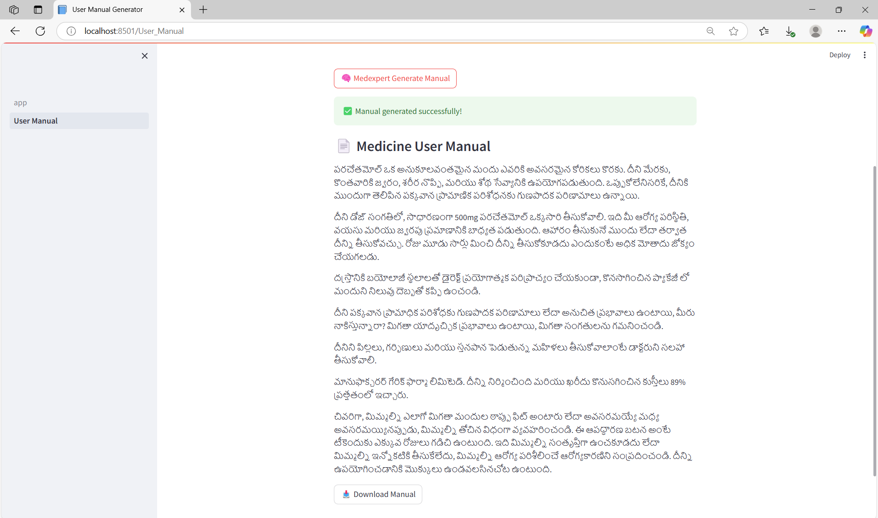
Automated Generation of Patient-Friendly Medicine User Manuals

Slide 15
Conclusion
MedXpert successfully delivers an AI-driven intelligent assistant capable of handling both general conversations and symptom-based medicine queries.
Using a modular agent architecture governed by the Model Context Protocol (MCP), the system dynamically routes user inputs to the SQL Agent, Vector Agent, or LLM Agent based on query type.
For symptom queries, it generates optimized SQL searches, retrieves relevant medicines, and provides summarized, patient-friendly explanations.
For general inquiries, it engages users conversationally through GPT-based dialogue.
The platform also visualizes medicine ratings graphically and generates customized multilingual user manuals to enhance drug information accessibility.
Built with Streamlit for an interactive frontend, MedXpert maintains session memory, supports modular expansion, and ensures a seamless user experience.
The system’s scalable design positions it for future enhancements like multilingual chat, audio input/output, and disease prediction models.

Slide 16
References
HealthData.gov. (2024). DailyMed SPL XML Archive. U.S. Department of Health & Human Services. https://healthdata.gov/dataset/DailyMed/j3hv-i8vg
Singh, N. (2023). 11,000+ Medicine Details Dataset [Data set]. Kaggle. https://www.kaggle.com/datasets/singhnavjot2062001/11000-medicine-details
Wang, Y., et al. (2024). ProbGate at EHRSQL: Enhancing SQL Query Generation. arXiv. https://arxiv.org/abs/2401.00268
Jadhav, A., et al. (2023). Healthcare Chatbot Using NLP. International Journal of Computer Science and Information Technologies (IJCSIT).
Patel, K. (2023). Automated Medical Chatbot. EasyChair Preprints. https://easychair.org/publications/preprint/Gs2C
Robofy Inc. (2024). Symptom Checker Chatbot for Healthcare. https://robofy.ai
Merck & Co. (2024). Using Amazon Bedrock for Healthcare SQL Search. AWS Blog.
Shinde, R., & Gupta, P. (2023). AI-Based Healthcare Chatbot Using NLP. IJNRD.
DrugBank. (2024). Drug Database. https://go.drugbank.com
Zheng, C., et al. (2024). MedT5SQL: A Transformers-Based LLM for Text-to-SQL in EMRs. PubMed Central.

Slide 17
Thank You

